Slide 1




P1413 MANUFACTURING ANALYTICS • PERFORMANCE REVIEW
Production Performance
Overview
An end-to-end data study of production, quality, machine and cost performance, built across Excel, MySQL, Power BI and Tableau.
PRESENTED BY
DATE
Manufacturing Analytics Project Team
Tuesday, 20 October 2026
Excel
MySQL
Power BI
Tableau

Slide 2

WHO WE ARE
Team Introduction
The team behind the Manufacturing Analytics project.
01
Shruti Jitri
02
Pragati Sanjay Pawar
03
M H Prashanth
07
04
Nidhi Vinod Jamgade
TEAM MEMBERS
05
N Pavani
Manufacturing Analytics
Project Team
06
Mrunali Murlidhar Mangutte
Deepak Faujdar Chauhan
07
P1413 MANUFACTURING ANALYTICS
02

Slide 3
TECHNOLOGY STACK
Manufacturing Analytics: Tools Used
Four connected tools carry the analysis from raw data to executive-ready dashboards.
Excel
Power BI
Tableau
MySQL
Data cleaning, PivotTable KPIs, and the KPI card dashboard.
Interactive DAX-driven visual report with cards, treemap, and combo charts.
Linked worksheets combined into one interactive executive dashboard.
Fact and dimension tables in MySQL, with SQL aggregations that validate every KPI.
P1413 MANUFACTURING ANALYTICS
03

Slide 4
PROFESSIONAL & NARRATIVE FLOW
Agenda
1
Introduction & Project Objectives
2
Dataset Overview & Data Schema
Scope, purpose and strategic goals
Tables, fields, and relationships
3
Key Performance Indicators (KPIs)
4
Dashboard Architecture
Excel, SQL, Power BI & Tableau metrics
How the dashboards are structured
5
Conclusions & Strategic Insights
6
Recommendations & Action Items
What the data tells us
Next steps for the project
P1413 MANUFACTURING ANALYTICS
04

Slide 5
OVERVIEW
Introduction
The Manufacturing Analytics Dashboard is an end-to-end Data Analytics project designed to analyze manufacturing operations and generate meaningful business insights using Microsoft Excel, MySQL, Power BI, and Tableau.
The project focuses on production performance, manufacturing efficiency, machine utilization, rejection analysis, manufacturing costs, delivery performance, and department-wise production quality.
By transforming manufacturing data into meaningful KPIs and interactive dashboards, the project supports data-driven decision-making and helps identify opportunities to improve operational performance.
PRODUCTION AT A GLANCE
10,000
TOTAL WORK ORDERS
60,050,621
TOTAL MANUFACTURING QUANTITY
491,023
TOTAL REJECTED QUANTITY
0.82%
REJECTION RATE
P1413 MANUFACTURING ANALYTICS
05

Slide 6



WHY THIS PROJECT
Project Objective
Four objectives guide the analysis of production, quality, operations and cost.
Production Performance
Quality Analysis
Operational Performance
Cost & Efficiency Analysis
Analyze ordered, processed, and manufactured quantities to understand overall production performance.
Evaluate rejected quantities, rejection rates, and wastage to understand manufacturing quality.
Compare employee-wise, machine-wise, operation-wise, and department-wise rejection quantities.
Analyze manufacturing costs, cost per unit, efficiency, machine utilization, and delivery performance.
P1413 MANUFACTURING ANALYTICS
06

Slide 7


THE DATA
Manufacturing Dataset Overview
One fact table and eight dimension tables form the analytical base for every KPI, chart and dashboard.
fact_Production
dim_Buyer
dim_Customer
10,000 valid records
4 rows
9,944 rows
Production quantities, work orders, rejection, costs, and performance metrics.
Buyer information.
Customer information.
dim_Employee
dim_Operation
dim_Machine
899 rows
10 rows
86 rows
Employee information.
Manufacturing operation details.
Machine information.
dim_Department
dim_Item
dim_Date
4 rows
10,000 rows
365 rows
Department information.
Item and product details.
Calendar and date information.
Note: The original production table contained 10,679 rows, including 679 blank placeholder records. These were separated from the 10,000 valid production records used for the main analysis.
P1413 MANUFACTURING ANALYTICS
07

Slide 8
HOW IT CONNECTS
Manufacturing Data Model
fact_Production sits at the centre; each dimension table joins to it through one key column.
dim_Date
Key: Date_FK
dim_Machine
Key: Machine_Code
dim_Buyer
Key: Buyer_ID
dim_Operation
Key: Operation_Code
fact_Production
Central fact table • 10,000 valid records
dim_Customer
Key: Customer_Code
dim_Department
Key: Dept_ID
dim_Employee
Key: Employee_Code
dim_Item
Key: Item_Code
P1413 MANUFACTURING ANALYTICS
08

Slide 9
EXCEL ANALYSIS
Manufacturing KPI Cards
Four headline KPIs were calculated in Excel using PivotTables and summarized into a KPI card panel.
EXCEL KPI CARD PANEL — MANUFACTURING ANALYTICS
TOTAL WORK ORDERS
TOTAL MANUFACTURED QTY
TOTAL REJECTED QTY
REJECTION RATE
10,000
60,050,621
491,023
0.82%
Distinct Doc_Num in fact_Production
Sum of Produced_Qty
Sum of Rejected_Qty
Rejected qty ÷ Produced qty × 100
HOW THE KPIs ARE DEFINED
Rejection Rate % = Total Rejected Qty ÷ Total Manufactured Qty × 100 → 491,023 ÷ 60,050,621 × 100 = 0.82%
Total Work Orders = COUNT(DISTINCT Doc_Num) from fact_Production
EXCEL ANALYSIS
09

Slide 10
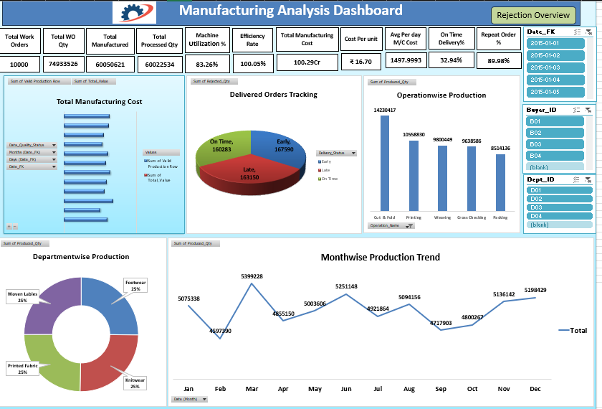
EXCEL ANALYSIS
Manufacturing Excel Dashboard
[INSERT MANUFACTURING EXCEL DASHBOARD SCREENSHOT HERE]
KPI cards, production analysis, rejection analysis and cost analysis
EXCEL ANALYSIS
10

Slide 11
KPI ANALYSIS • I OF III
Production Performance Analysis
Processed 60,022,534 vs produced 60,050,621 (gap of 28,087 units). Ordered (WO_Qty) total: [INSERT FROM POWER BI].
Processed ÷ Ordered × 100 = 80.10%, so 19.90% of ordered quantity is not yet processed.
TAKEAWAY: Produced output closely matches processed quantity (100.05%), while about one-fifth of ordered quantity (19.90%) remains unprocessed. This is the main area for operational review.
KPI ANALYSIS
11

Slide 12
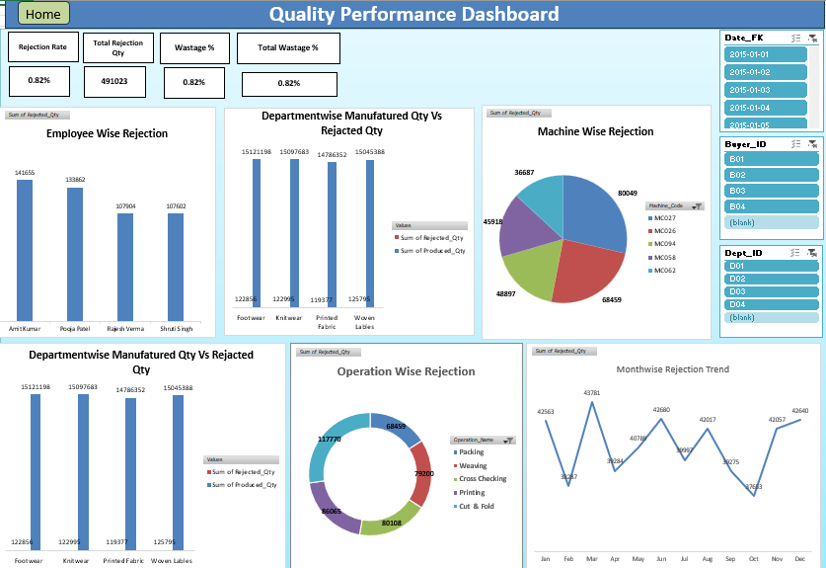
KPI ANALYSIS • II OF III
Quality & Rejection Analysis
Total rejected quantity
Rejection rate
Machine with most rejections
Employee with most rejections
491,023 units
0.82% of manufactured quantity
[INSERT FROM POWER BI]
[INSERT FROM POWER BI]
Takeaway: rejects concentrate by machine, employee and operation. The highest count can reflect production volume, so compare against produced quantity before concluding.
KPI ANALYSIS
12

Slide 13




SQL ANALYSIS
SQL Analysis — Manufacturing Data
KPIs were validated in MySQL against fact_Production and its dimension tables, grouped into six analytical themes.
THEME 01
THEME 02
THEME 03
Production Analysis
Quality Analysis
Employee & Machine Analysis
Work orders, ordered quantities, processed quantities and manufactured quantities.
Total rejected quantity, rejection rates and wastage.
Employee-wise and machine-wise rejection analysis.
THEME 04
THEME 05
THEME 06
Operation & Department Analysis
Cost Analysis
Delivery & Order Analysis
Operation-wise rejection and department-wise production comparisons.
Manufacturing costs, average machine costs and cost per unit.
On-time delivery percentage and repeat-order percentage.
SQL ANALYSIS
14

Slide 14
SQL ANALYSIS
Manufacturing SQL Queries
Three representative queries: total work orders, machine-wise rejections, and department-wise production versus rejects.
Query 1 — Total Work Orders
Query 2 — Rejected Qty by Machine
Query 3 — Produced vs Rejected by Dept
SELECT COUNT(DISTINCT Doc_Num)
AS Total_Work_Orders
FROM fact_Production
WHERE Doc_Num IS NOT NULL;
SELECT
Machine_Code,
SUM(Rejected_Qty) AS Total_Rejected_Qty
FROM fact_Production
WHERE Doc_Num IS NOT NULL
GROUP BY Machine_Code
ORDER BY Total_Rejected_Qty DESC;
SELECT
Dept_ID,
SUM(Produced_Qty) AS Total_Produced_Qty,
SUM(Rejected_Qty) AS Total_Rejected_Qty
FROM fact_Production
WHERE Doc_Num IS NOT NULL
GROUP BY Dept_ID
ORDER BY Dept_ID;
SQL ANALYSIS
15

Slide 15

SQL ANALYSIS
Manufacturing SQL Query Results
Output of the department-wise query (Query 3) from the previous slide.
[INSERT MYSQL WORKBENCH SCREENSHOT HERE]
Capture the Query 3 code and results pane (Dept_ID, Total_Produced_Qty, Total_Rejected_Qty). It demonstrates SUM(), GROUP BY and department comparison.
SQL ANALYSIS
16

Slide 16
SQL ANALYSIS
Manufacturing KPI Validation
KPIs were calculated with SQL aggregation and compared against Excel and Power BI results for consistency.
KPI | Expected Result
Total Work Orders | 10,000
Total Manufactured Qty | 60,050,621
Total Processed Qty | 60,022,534
Total Rejected Qty | 491,023
Efficiency Rate % | 100.05%
Machine Utilization % | 80.10%
Manufacturing KPIs are validated using SQL aggregation and compared against the corresponding Excel and Power BI results to maintain consistency across the analysis.
SQL ANALYSIS
17

Slide 17
POWER BI ANALYSIS
Manufacturing Power BI Dashboard
An interactive manufacturing analytics dashboard developed using Power BI to monitor production performance, quality, rejection quantities, machine utilization, efficiency, manufacturing costs, delivery performance, and department-wise production.
[INSERT MANUFACTURING POWER BI DASHBOARD SCREENSHOT HERE]
KPI cards, charts and slicers
POWER BI ANALYSIS
18

Slide 18
TABLEAU ANALYSIS
Manufacturing Tableau Dashboard
An interactive Tableau dashboard exploring production, quality, machine, department and cost performance.
[INSERT MANUFACTURING TABLEAU DASHBOARD SCREENSHOT HERE]
Interactive worksheets and filters
TABLEAU ANALYSIS
19

Slide 19



SYNTHESIS
Manufacturing Business Insights
Production Performance
Quality Performance
Machine Performance
Produced quantity (60,050,621) is 100.05% of processed quantity (60,022,534). Ordered vs processed comparison: [INSERT FROM POWER BI].
491,023 units were rejected, a 0.82% rejection rate on manufactured quantity.
Compare machines with the highest rejections against their production volume. Top machine: [INSERT FROM POWER BI].
Department Performance
Manufacturing Cost
Data Quality
Manufactured and rejected quantities compared across departments. Department results: [INSERT FROM POWER BI].
Total manufacturing cost and cost per unit: [INSERT FROM POWER BI].
679 blank placeholder rows were separated from the 10,679-row production table, leaving 10,000 valid records.
BUSINESS INSIGHTS
20

Slide 20



WHAT’S NEXT
Manufacturing Recommendations & Future Scope
RECOMMENDATIONS
FUTURE SCOPE
1
Investigate Rejection Patterns
Automated Data Pipeline
Analyze machines and operations with high rejection quantities to identify quality improvement opportunities.
Automate data ingestion, cleaning and transformation to reduce manual processing.
2
Improve Production Efficiency
Predictive Quality Analytics
Compare ordered, processed and produced quantities to identify differences in production performance.
Explore predictive models to identify production conditions linked to higher rejection rates.
3
Monitor Machine Performance
Machine Failure Prediction
Track machine utilization, rejection quantities and operating costs to flag equipment for further investigation.
Investigate machine-level data for patterns that may help anticipate equipment failures.
4
Strengthen Department-Level Monitoring
Real-Time Manufacturing Monitoring
Compare manufactured and rejected quantities across departments to support targeted quality improvement.
Integrate updated production data to monitor manufacturing KPIs more frequently.
RECOMMENDATIONS
21

Slide 21
WRAP-UP
Conclusion
The Manufacturing Analytics Dashboard demonstrates how manufacturing data can be transformed into meaningful business insights using Microsoft Excel, MySQL, Power BI, and Tableau.
The project analyzes production quantities, efficiency, machine utilization, manufacturing costs, delivery performance, and quality indicators to provide a comprehensive view of manufacturing operations.
By comparing rejected quantities across employees, machines, operations, and departments, the analysis supports a better understanding of production quality and identifies areas for further investigation.
The integration of data cleaning, SQL analysis, KPI development, and interactive dashboards demonstrates the practical application of end-to-end data analytics in a manufacturing environment.
10,000
60,050,621
491,023
100.05%
TOTAL WORK ORDERS
TOTAL MANUFACTURED QTY
TOTAL REJECTED QTY
EFFICIENCY RATE
The project demonstrates how data-driven analysis can support manufacturing performance monitoring, quality improvement, and informed operational decision-making.
CONCLUSION
22

Slide 22
Thank You
Questions & discussion are welcome.
PROJECT
Manufacturing Analytics Dashboard

