Slide 1
Where to Explore Food in Hong Kong?

Slide 2
Rundown
Business Problem
Data
Methodology
Results
Conclusion

Slide 3
Business Problem
Hong Kong is famous for its food but tourists may find it difficult to get to decide where to go for exploring food.
Useful to visualise on a map which areas are packed with restaurants/street food.
Restaurants have been serving as shelter for protesters against Hong Kong Police brutality. Protesters may use the map for planning retreat route

Slide 4
Data
3 districts are considered, namely Central, Causeway Bay and Mongkok
10 random pinpoints are selected. The number of amenities within the radius of 500 meters will be gathered from Foursquare.
Keep only restaurants/cafes/eateries
Sum up the number of restaurants/cafes/eateries for each pinpoints and plot on the map.
Colour of the pinpoint depends on the number of restaurants/cafes/eateries

Slide 5
Methodology
Determining the random pinpoints
10 random pinpoints evolving from a pinpoint subjectively chosen which is located at the edge of the district.
2 functions are defined to adjust the latitude and longitude of the chosen pinpoint of each district to generate the remaining 9 pinpoints.
The parameters are adjusted based on trial and error to ensure all pinpoints make sense.
No pinpoint lies in the sea or in the middle of a park, and each pinpoint is reasonable distant from any other pinpoints.

Slide 6
Methodology
Finding the best location to visit
Sum up the total number of restaurants by various groupings.
Total number of restaurants of each pinpoints.
Metrics for restaurant density of a pinpoint
Pinpoints are plotted on a map with the colour of the indicating the number of restaurants
Total Number of restaurants, by food type, in all pinpoints within the district
Metrics for restaurant density of a certain food type for a district
Horizontal bar chart showing the total number of restaurants of each food type from all pinpoints within the district

Slide 7
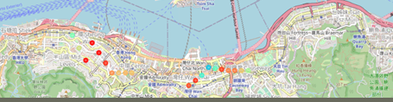
Results
Red pinpoint indicates number of restaurants is the highest, followed by orange, yellow and light blue the lowest.
For Central district (left cluster in the map), restaurants are mainly located in the middle of the cluster, between Central and Sheung Wan area.
For Causeway Bay district (right cluster), restaurants are concentrated around centre of Causeway Bay and Wan Chai (a district next to Causeway Bay).

Slide 8
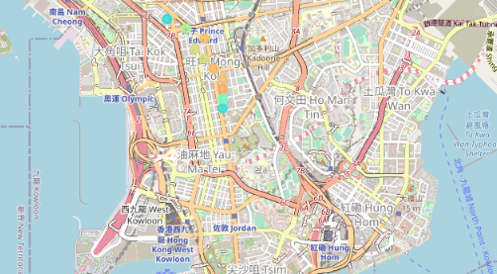
Results
For Mongkok, there is no red pinpoints, meaning that restaurants are less concentrated than the other 2 districts
Orange pinpoints conentrated in centre of the cluster, meaning the restaurants in Mongkok are mostly densely located in centre of Mongkok.

Slide 9
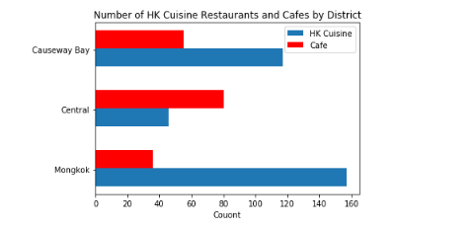
Results
Mongkok has the highest number of Hong Kong cuisine restaurants among the 3 districts, whilst Central has the most choices for a cup of coffee or high tea.
Causeway Bay is in the middle, with a good balance in the choices for cafe and Hong Kong Cuisine restaurants.

Slide 10
Conclusion
Central and Causeway Bay have certain areas where restaurants are highly concentrated and areas where restaurants are less compact. This is different from Mongkok where restaurants are less concentrated and relatively equally distributed.
Tourists may take into consideration of the outcomes of this study and head to the red (orange for Mongkok) pinpoints in the map for exploring the food in Central and Causeway Bay.
In case one has a specific preference, tourists may go to Mongkok for traditional Hong Kong taste and Central for coffee.
Protesters in Central should head towards Sheung Wan while their 'Brothers' in Casueway Bay should head towards Wan Chai and Centre of Causeway Bay during Police crackdown.
Restaurants in Mongkok are relatively less compact, and hence protests should be avoided there.

Slide 11
Conclusion
For future study, rating from reviewers and price could be taken into account and an unsupervised clustering model can be built to cluster each restaurant.

