Slide 1


Slide 2
About Me

Slide 3
Viking Quest VR
Get The Assets:
bit.ly/UnityRSNYC
Dan Miller – danielmi@Unity3d.com

Slide 4
Viking Quest VR
Get The Assets:
bit.ly/UnityRSNYC
Dan Miller – danielmi@Unity3d.com

Slide 5
Viking Quest VR

Slide 6
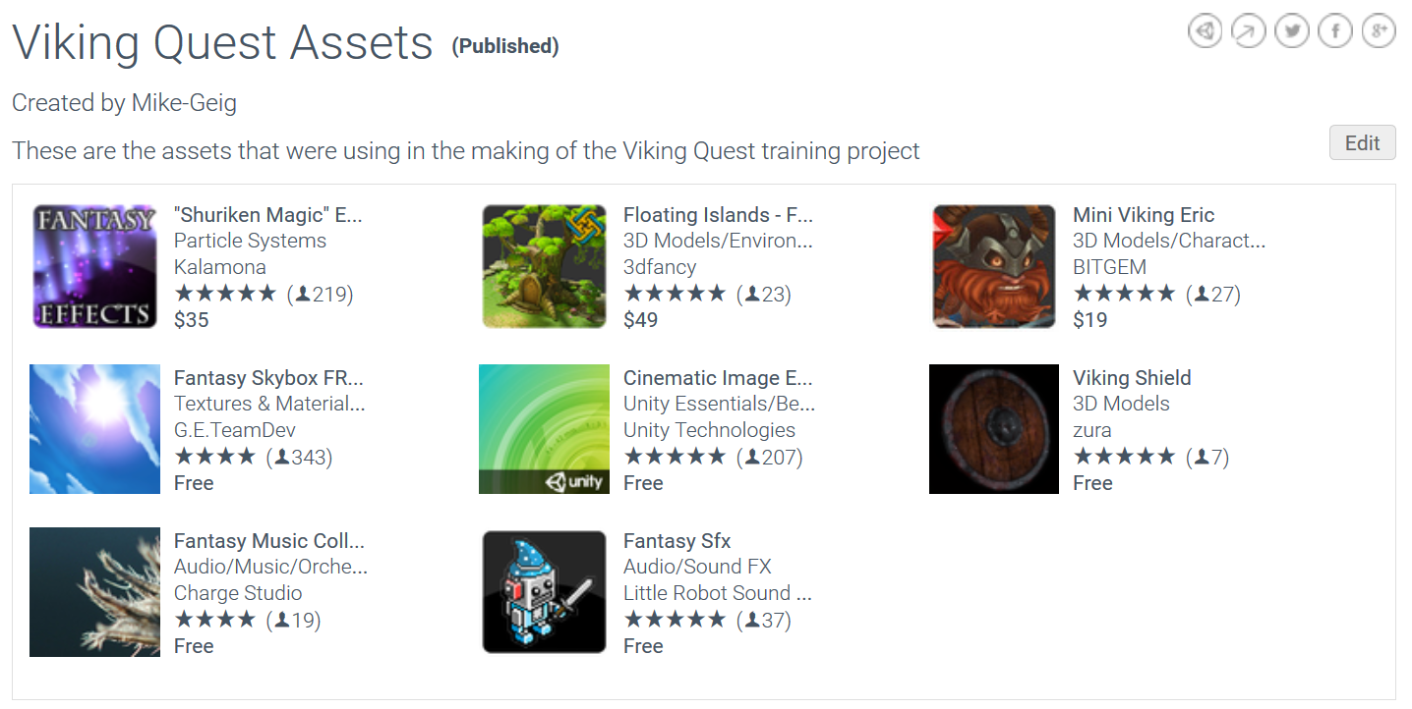
The Assets
http://bit.ly/2gFgIUZ

Slide 7
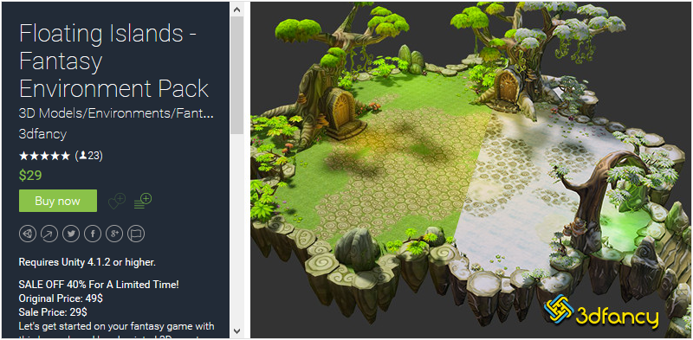
Environment – 3DFancy

Slide 8
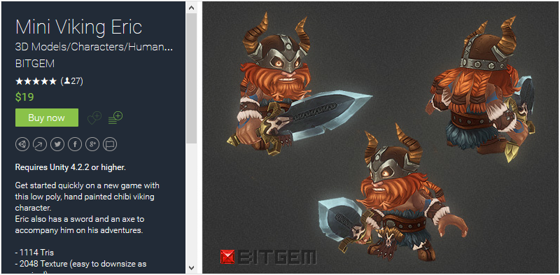
Character - BITGEM

Slide 9

The Game

Slide 10
Objectives
CREATE a game using content from the Asset Store
CONSTRUCT a game with integrated VR
DEMONSTRATE how to use the various tools of the Unity Editor
IDENTIFY good design practices when building for VR

Slide 11
Cycles
The Project
Building a Scene
The Viking
World Boundaries
Integrating VR
Animating a Character
Animation Transitions
Collectables
Spawning Collectables
The Game Manager
Audio
Improving Graphics
Build and Deploy

Slide 12
Step 01: The Project
Open Project
Drag a Ground model into the scene from Prefabs/Environment
Save scene into Scenes folder
Practice navigating the scene
RMB + Drag = Look Around
RMB + WASD = Move Around
RMB + QE = Move Up / Move Down
F = Focus on Select Object

Slide 13
Step 02: Building a Scene
Practice placing objects around the scene
Practice using the scene tools:
Q – Hand tool – used for panning
W – Translate tool – used to move objects
E – Rotate tool – used to rotate objects
R – Scale tool – used to scale objects
T – Rect tool – used to move 2D objects like UI

Slide 14
Step 03: The Viking
Open the scene StartingScene
Drag the Viking model into the scene
Add a Capsule Collider to the Viking - Center.y = 1 Height = 2
Add a Rigidbody to the Viking
Drag the Player_FullControl script onto the Viking

Slide 15
Step 04: World Boundaries
Freeze the X, Y, and Z Rotation Constraints of the Rigidbody component on the Viking
Drag the WorldColliders prefab into the Hierarchy window
Click the Layers button in the upper-right of the editor and click the Eye icon next to the WallColliders layer
On the Camera, uncheck the WallColliders layer on the camera’s Culling Mask
Test the game in Play mode

Slide 16
Step 05: Integrating VR
Create an Empty game object, name it Camera Control Rig
Set Camera Control Rig’s position to X = -2.38, Y = 7, Z = -18
Drag the Main Camera onto Camera Control Rig in the Hierarchy window
Remove any rotation from the Main Camera
Add the Camera Editor Control script to the Main Camera and check Mouse Control if not testing with a VR Headset
Go to VR->Enable VR if testing with a VR Headset

Slide 17
Step 06: Animating a Character
Add CameraFollow script to the Camera Control Rig and set the Viking as the Target and set Speed to 1
Drag the Idle, Run, and Jump animations onto the Viking
Open the Animator window to see the animations on the Viking

Slide 18
Step 07: Animation Transitions – Part 1
In the Animator, create a Float parameter named Speed
Create the transitions between Idle <-> Run
On each transition uncheck Has Exit Time
Set the transition from Idle to Run as “Speed Greater .01”
Set the transition from Run to Idle as “Speed Less .01”

Slide 19
Step 07: Animation Transitions – Part 2
In the Animator create a Trigger named Jump, and a Bool named Grounded
Create the transitions between Idle <-> Jump
On each transition uncheck Has Exit Time
Set the transition from Idle to Jump as “Jump”
Set the transition from Jump to Idle as “Speed Less .01” AND “Grounded = true”
Set the What Is Ground property to Ground on the Viking’s player script

Slide 20
Step 07: Animation Transitions – Part 3
Create the transitions between Run <-> Jump
On each transition uncheck Has Exit Time
Set the transition from Run to Jump as “Jump”
Set the transition from Jump to Run as “Speed Greater .01” AND “Grounded = true”
Adjust the blends on the transitions as needed

Slide 21
Step 08: Collectables
Turn the Viking into a prefab by dragging it from the Hierarchy window into the Prefabs folder
Drag Collectable prefab into scene
Add Collectable script to the Collectable and click Apply in the top right of the Inspector
Tag the Viking as Player

Slide 22
Step 09: Spawning Collectables
Delete Collectable object from scene
Add the CollectableSpawner script to the Spawn Points game object
Add the Collectable prefab to the Collectable Prefab property on the CollectableSpawner script

Slide 23
Step 10: The Game Manager
Drag the Game Manager UI prefab into the scene
Drag the Wall game object onto the Wall property of the Game Manager script
Drag the Collect Panel from the Game Manager onto the Viking
Drag the Timer Panel from the Game Manager onto the Environment
Drag the Win and Loss Panels from the Game Manager onto the Camera Control Rig

Slide 24
Step 11: Audio
Add an Audio Source component to the Main Camera and Wall game objects
On the Camera check Loop and set the Clip to Forrest Spirit
On the Wall uncheck Play on Awake and set the Clip to Spell_02
Add an Audio Source component to the Collectable prefab
On the Collectable uncheck Play on Awake and set the Clip to Inventory_Open_01

Slide 25
Step 12: Improving Graphics
Drag Sunny 03B noSun skybox into scene
Open the Lighting window, uncheck Auto, and then click Bake
Add Post Processing Behavior to the Main Camera (personal preference)
Create Post Processing Profile in Project Hierarchy
Tonemapping
Bloom
Assign Post Processing Profile to Behavior

Slide 26
Step 13: Build and Deploy
Go to File->Build Settings
Click Add Open Scenes to add current scene to the build
Click Build and Run
Save the game file and enjoy!

Slide 27
Optional Steps

Slide 28
Camera Scaling
Drag World Shrinker 3000 prefab into scene
Drag the Camera Control Rig onto the Cam Controller property of the Camera Scaler script
Open the CameraZoomTesting scene to see the difference between zooming a VR camera and scaling it

Slide 29
Motion Controls
Create Empty GameObject
Rename it to Controller
Add MotionController component
Configure VR Node
Create a cube
Remove Collider
Scale to (0.1, 0.1, 0.1)
Make child of Controller
Duplicate Controller
Reconfigure VR Node

Slide 30
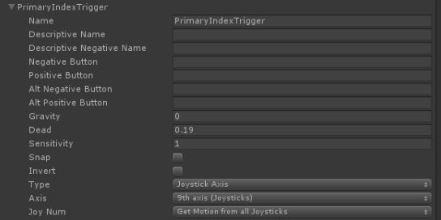
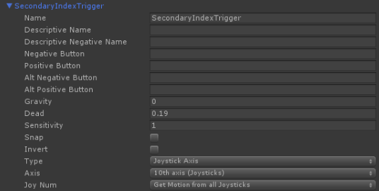
Motion Controllers Input
Open Input Manager
Add PrimaryIndexTrigger and configure
Add SecondaryIndexTrigger and configure

Slide 31
Vacuum Setup
Add ControllerVacuum to Right Controller
Add Empty GameObject to Right Controller as child
Position at (0, 0, 2)
Assing Empty GameObject as LerpPoint

Slide 32
Scene Setup
Disable Camera Follow
Lower Level Boundaries to (0, -2, 0)
Create Dangle Animation On Viking
Add Animation Triggers - Dangle, Idle
Add Dangle State and setup transition from any state
Create transition from any state to Idle state

Slide 33
Thank you bit.ly/rsnyc717

