Slide 1
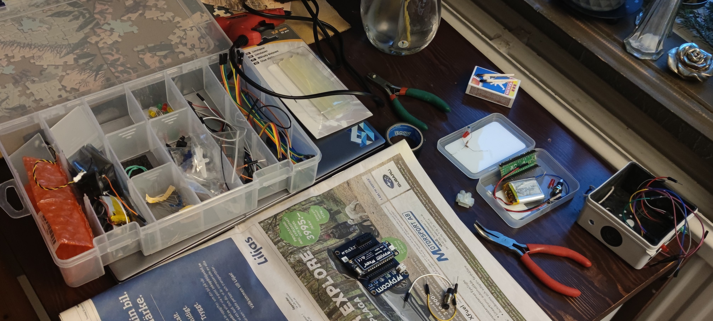
Last week
Changed from Raspberry pi pico to an ESP32 in form of a Pycom Lopy 4

Slide 2
This week
Put different programs in FreeRTOS tasks and run simultaneously

