Slide 1
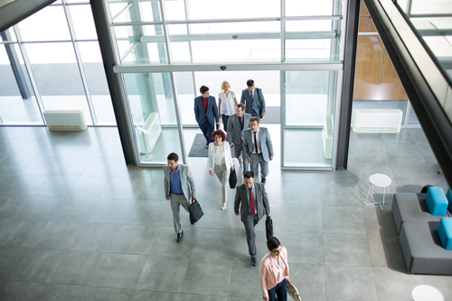
Movement monitoring
Midterm evaluation

Slide 2

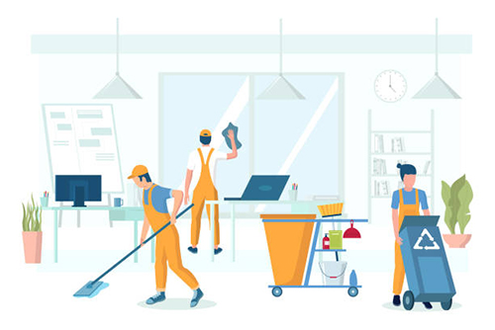
Why collect this data?
Staff planning
investment validation
Cleaning services
Resource planning
Notes:
Staffplanning: How much staff is needed on this youth recreation center?
Investment validation: Do people actually use this facility, when in the day is it used?
Cleaning service: and garbage handling
Resource planning: On this specific week day usually many people go to this place and then we need this many police in the area.

Slide 3
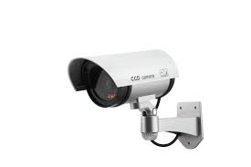
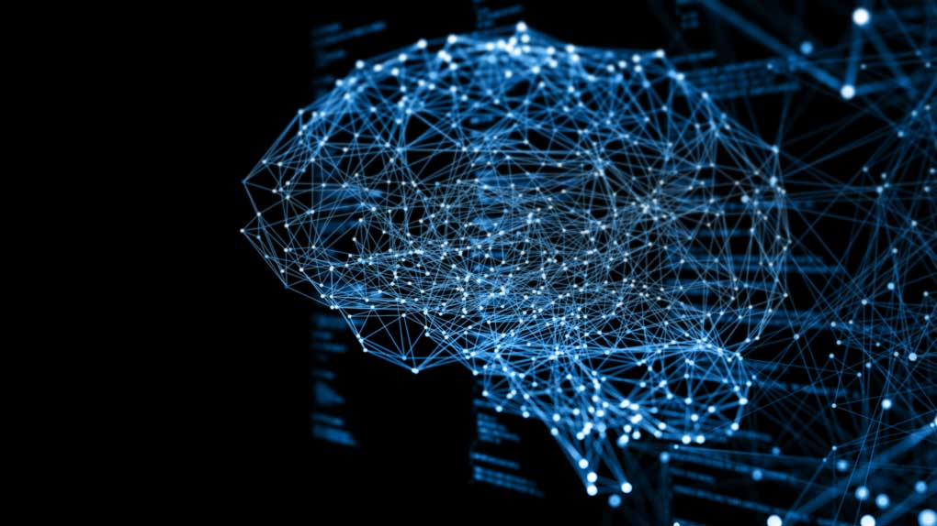
Modern applications
Camera stream connected to computer
Ai scans video and counts
Cons:
Cameras are not allowed everywhere
Feeling of always beeing watched
Requires powerful and expensive hardware
Notes:
Camera connected to computer: both over network or direct
Camera are not allowed in some areas, requires application for permissions

Slide 4
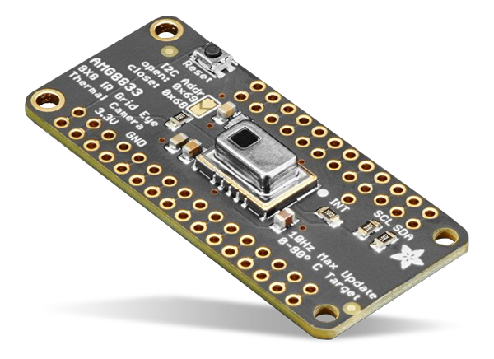
AMG8833 IR Thermal Camera
Returns Array with 64 temperatures
”Can detect a human from a distance of up to 7 meters”

Slide 5
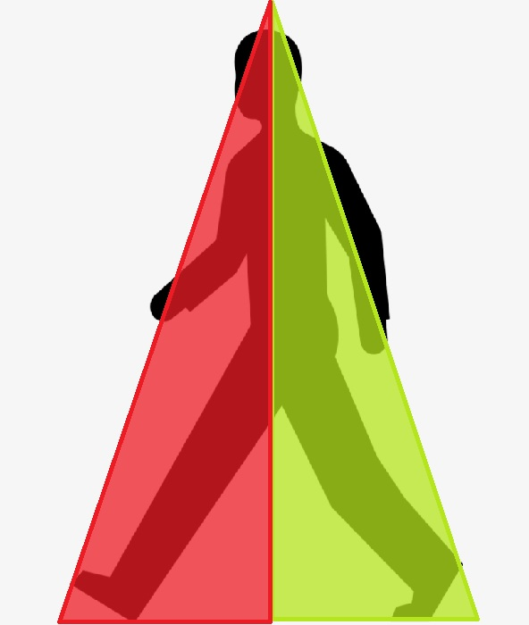
Sence movement
Divided the 64 pixels into two zones
Looks at difference in average temperature
Notes:
Right now i am only using the 32 middle pixels because that turned out to give less background noice.
Looks at diffrence in average temperature between zones and can by that tell in what direction someone is passing the sensor.

Slide 6
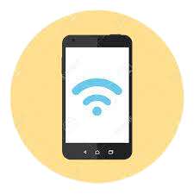
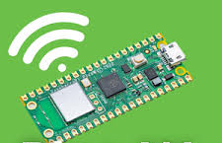
WiFi scanning
Smartphones with wifi turned on
Scans for wifi nodes
estimates how many people are nearby
Notes:
Even if devices are not connected to the same network they can sence eachother.
They perform a handshake and tell eachother their information.
Looks at individual devices by looking at their mac adress.
Currently reading up on the picos support for this.

