Slide 1
Sustainability Presentation
By:
John Bailey
Maria Gonzalez Bocanegra
Camiya Felton
Jamison Golson

Slide 2
Project Introduction
The purpose of this project is to research, design, and fabricate an autonomous drone that will aid firefighters when there is an emergency

Slide 3
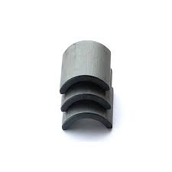
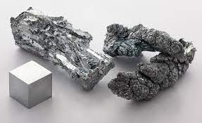
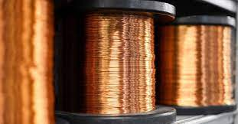
Main Issues Related to Sustainability Identified in our project
Battery
Nonrenewable Materials
Zinc, Copper, Fiberglass, ferrite

Slide 4
Environmental Issues
Material Processing
Zinc (Zn)
Processing impacts water, soil, and crops
Pollution can be hazardous to humans
Copper (Cu)
Easily Recyclable without performance lost
Not generally harmful to the environment
Carbon Fiber Reinforced Composite (CBRC)
Recyclable with chemical, mechanical, and thermal methods
To recover clean fibers and depolymerized matrix in monomers
Commonly disposed of with incineration and landfill

Slide 5
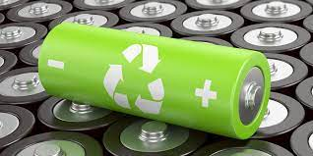
Energy Use Issues
Use of proper propellors
Large propellors draw too much current
Proper disposal of LiPo battery
Make sure to completely discharge battery
Battery charger/discharger
Light bulb

Slide 6
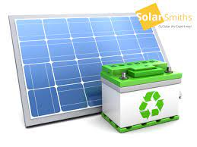
Renewable Energy Use
LiPo battery are rechargeable
Could potentially implement solar energy to recharge batteries

Slide 7
Use of Materials Issues
Fire extinguisher grenade
Drone frame refabricated
Motors Repurposed

Slide 8
Waste of Materials Issues
Balloons:
Latex balloons can take anywhere between six months to four years to biodegrade.
Batteries:
12-18 months for a noticeable drop in performance
100 years to degrade for some components

Slide 9
Pollution Related Issues
Due to the balloon popping, pieces of it could drop off.
Biodegradable balloons can take up to 4 years to degrade but that could be too late.
This liter could be scattered around and/or kill animals
Who will pick up all the pieces?

Slide 10
Social and political
Target audience are Firefighters and victims of a fire
Less Resources are used to prepare firefighters
Injuries are less apparent
Humans not in as much risk fighting fires
Drones focus on fires
Humans focus on victims

Slide 11
Safety Issues
Bystanders may be injured
Autonomous Vehicle
Propellers

Slide 12
Constituencies (People Affected)
Firefighters
Bystanders

Slide 13
Social Impact
Firefighters will be able to focus on other tasks
Less Resources used while extinguishing fires

Slide 14
Health Issues
Preparing the fire extinguishing solution could cause health related issues if not done properly.

Slide 15
Economic impact
Human Capital: A drone Pilot
Manufactured Capital: Factories
Natural Capital: Power source, Frame, motors, sensors.

Slide 16
Experiment cost and earnings
Prototype
Zinc - $3.85 per kg
PLA - $0.05 per g
Fiber glass - $1.2-3 per kg
Wood - $1 per sqft
Product
Copper - $10.25 per kg
Li Ion battery - $5.40 per battery
Profiting
Specialty vehicles and vehicle body manufacturers profit
Oshkosh , E-one, and Kovatch Mobile Equipment Corp

Slide 17
Project Footprint
How much of the Earth’s resources does your project require?
.454 kg of zinc alloy
.35 kg of PLA filament
4 dc motors with 40 g of copper

Slide 18
People, Planet, Profit Relationship
In other words, the triple bottom line of the project:
Planet means factoring the climate change and climate effect the project has.
People means considering employees’ well-being and factoring stakeholders and societal impact into the project's choices.
Profit, means the financial performance that we are looking for, such as to maintain an economic solution.

Slide 19
Questions?

Slide 20
Reference
https://ecochain.com/knowledge/life-cycle-assessment-lca-guide/
https://www.ibisworld.com/united-states/market-research-reports/fire-truck-manufacturing-industry/
https://juggerbot3d.com/pla-filament-review/
https://pubmed.ncbi.nlm.nih.gov/21573711/#:~:text=A%20large%20amount%20of%20lead,is%20hazardous%20to%20human%20health.

