Slide 1
Data 606 Capstone Project Analysis of Telecom Churn Data
Laxmi Prasanna Chennadi
(jg55734)

Slide 2

Recap:
Telecom churn data includes various parameters that effect churn, where churn is number of Customers leaving the current company and moving to another.
Churn analysis is the evaluation usually done by the organization on the customer’s loss rate.
After Data Preprocessing no missing values are found
The rate of churn is 14.49%, which means data is imbalanced.

Slide 3
Exploratory Data Analysis:
Factorts effecting churn are:
Day Charge
Customer Service Calls
International plan Customers
Later, Outliers are detected and clipped for better analysis.

Slide 4

Data Preparation:
Used pd.get_dummies to covert the categorical(yes/no) columns international plan and voicemail plan to numerical(0/1).
Feature Scaling of training data using Min-Max scaling to normalize data.
from sklearn.preprocessing import MinMaxScaler
Data set is split to train set and test set
from sklearn.model_selection import train_test_split

Slide 5
Model Building:
Target variable is either True or False, hence it is a classification problem.
Therefore using classification algorithms like
Logistic Regression
KNearestNeighbors
Random Forest Classifier

Slide 6
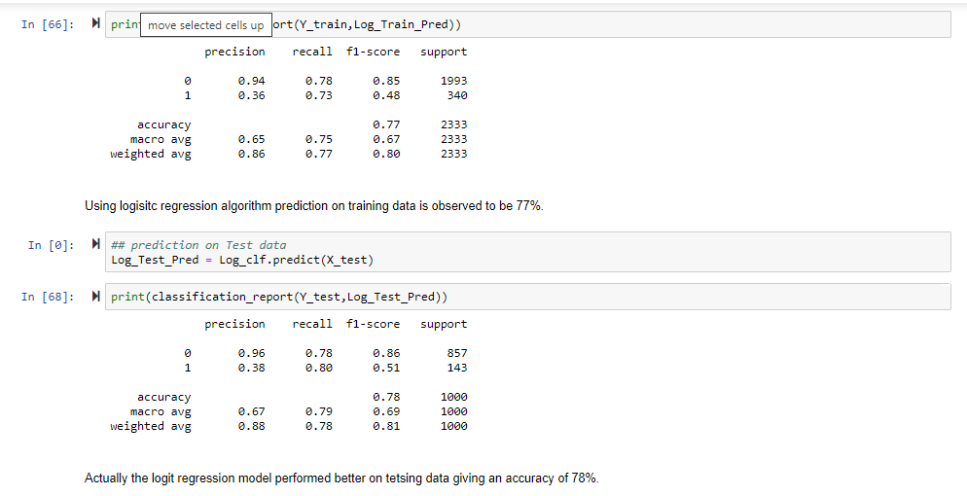
Logistic Regression:
Binomial Logistic regression would give better results.

Slide 7

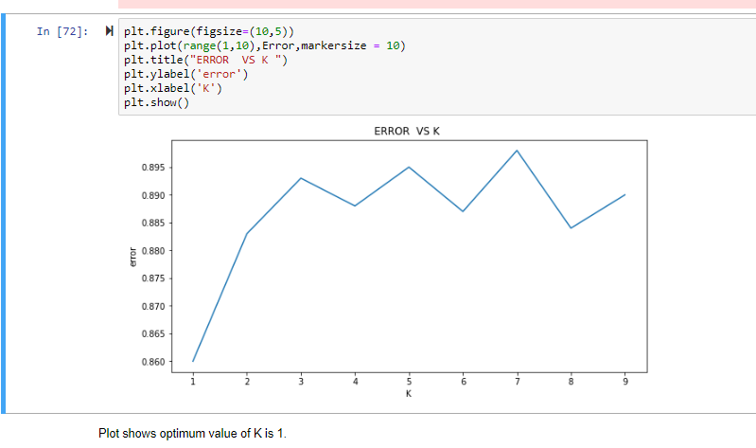
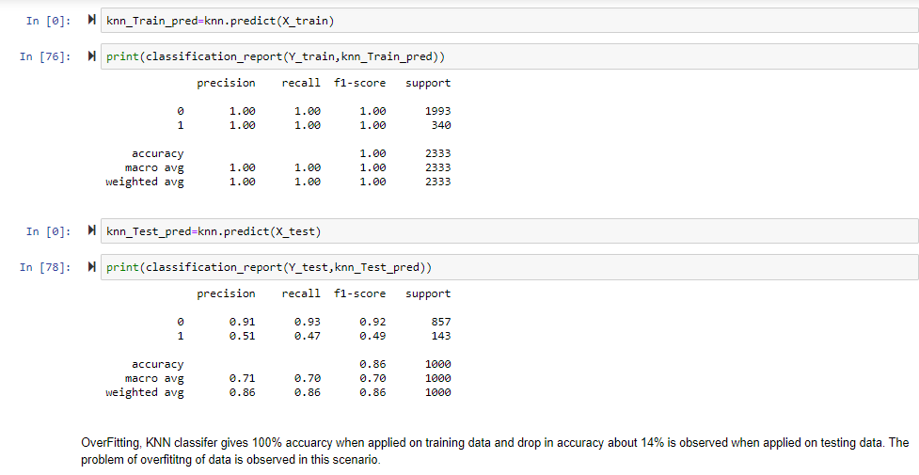
KNearestNeighbors:
iterating k value from 1-10 and plotting the accuracy of each iteration shows 1 as the optimum value of k

Slide 8
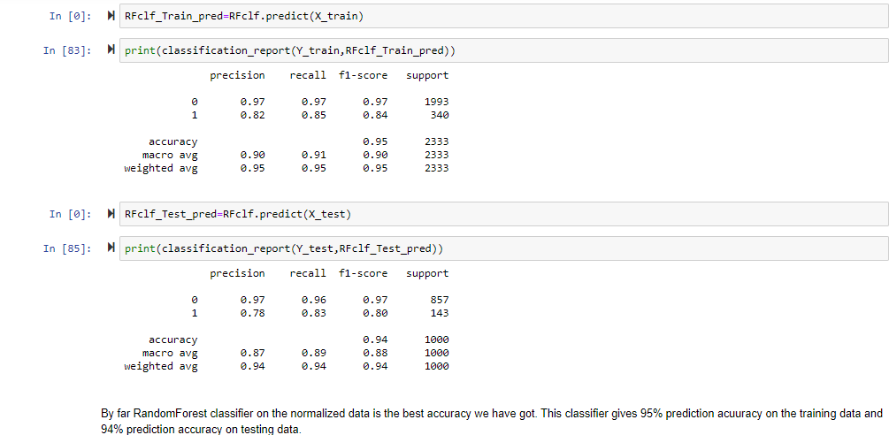
Random Forest Classifier:
Ensemble Method belongs to family of Decision Trees.

Slide 9
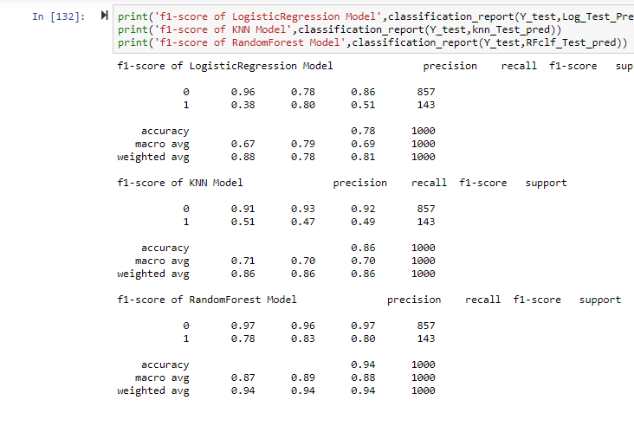
Comparing Accuracy of Models:

Slide 10
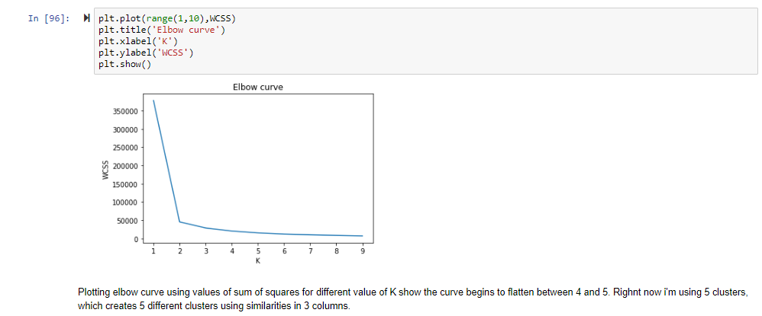
K_Means clustering:
K-Means clustering is used to cluster data points with similar properties.
WCSS(within cluster sum of squares) used to calculate number of clusters to create.
Unique identity columns like state, area code and phone number are clustered.

Slide 11
PCA(Principle Component Analysis):
columns with multicollinearity are removed by applying dimensionality reduction
reduces the computational complexity
created two new components

Slide 12
Kclustering+PCA+ Random forest
New data frame is created with two pca components to churn, international plan, voicemail plan and clusters.
Applied the RandomForest classifier with an expectation of obtaining better results
overfitting problem is observed.

Slide 13
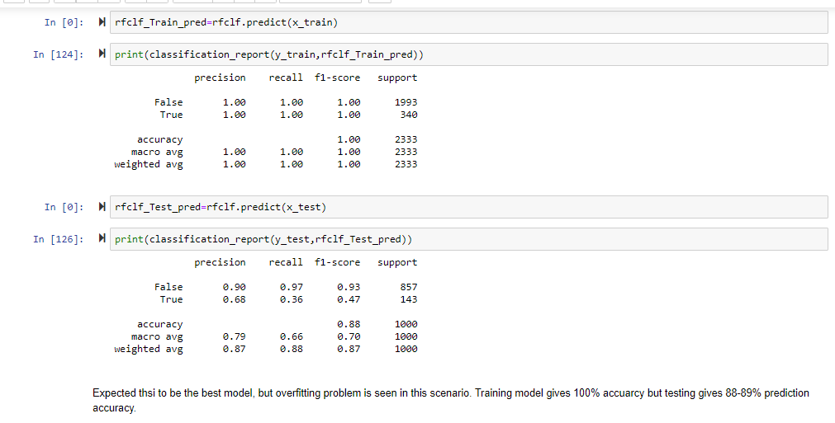

Slide 14
Next Phase:
work on reducing overfitting using Cross validation
Hyperparameter tuning of algorithms using Gridsearch techniques.

Slide 15

Questions??

