Slide 1
The Git Journey
Documentation of the Git workflow for the Module 20 web project
Prepared by: Alejandro de la Osa and Joaquin Gutierrez
Project: European Travel Guide
PS C:\Users\Usuario\Documents\Modulo 20> git init
Initialized empty Git repository
PS C:\Users\Usuario\Documents\Modulo 20> git status
On branch master · working tree checked
Authors: Alejandro de la Osa and Joaquin Gutierrez
GitHub repository: jga0055/Gutierrez_Joaquin_DeLaOsa_Alejandro_Modulo20
Technologies used: HTML5, CSS3 and JavaScript
Final result: a responsive website with linked pages
Live site: GitHub Pages
Module 20 · Git Journey
Alejandro de la Osa · Joaquin Gutierrez

Slide 2
1. Initialization
Creating the local Git repository before starting version control.
Purpose of this stage
PS C:\Users\Usuario\Documents\Modulo 20> git init
Initialized empty Git repository in .git/
PS C:\Users\Usuario\Documents\Modulo 20> git branch
* master
Enable Git inside the project folder.
Prepare the project version history.
Start working from the main master branch.
git init
git branch
Module 20 · Git Journey
Alejandro de la Osa · Joaquin Gutierrez

Slide 3
2. Tracking
Adding files to the repository and checking the working tree status.
Main project files
PS C:\Users\Usuario\Documents\Modulo 20> git status
Untracked files:
index.html
gastronomia.html
contacto.html
styles.css
script.js
PS C:\Users\Usuario\Documents\Modulo 20> git add .
PS C:\Users\Usuario\Documents\Modulo 20> git status
Changes to be committed:
index.html: main destinations page.
gastronomia.html: European food page.
contacto.html: travel contact form.
styles.css and script.js: styling and interactivity.
git add .
git status
Module 20 · Git Journey
Alejandro de la Osa · Joaquin Gutierrez

Slide 4
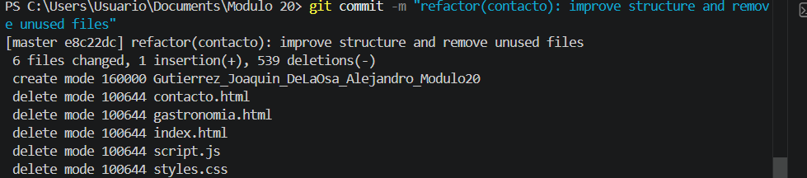
3. Modifying
Evidence of changes, cleanup work and staging control before committing.
Recorded commit
Unused files were removed from the repository.
The project structure was simplified.
The commit records the exact scope of the changes.
git commit -m "refactor(contacto): improve structure and remove unused files"
6 files changed, 1 insertion(+), 539 deletions(-)
delete mode contacto.html
delete mode gastronomia.html
delete mode index.html
delete mode script.js
delete mode styles.css
Module 20 · Git Journey
Alejandro de la Osa · Joaquin Gutierrez

Slide 5
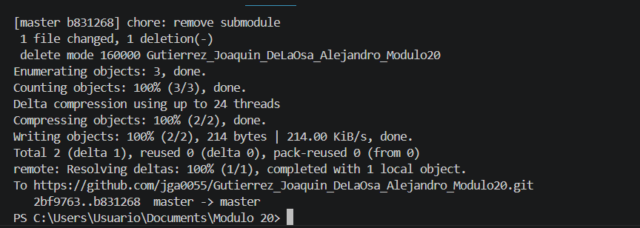
4. Branch Management
Creating a branch, working separately and merging back into the main branch.
PS C:\Users\Usuario\Documents\Modulo 20> git checkout -b contacto
Switched to a new branch 'contacto'
PS C:\Users\Usuario\Documents\Modulo 20> git add contacto.html styles.css script.js
PS C:\Users\Usuario\Documents\Modulo 20> git commit -m "feat(contacto): add form validation"
PS C:\Users\Usuario\Documents\Modulo 20> git checkout master
PS C:\Users\Usuario\Documents\Modulo 20> git merge contacto
Branch workflow
A separate branch was used for focused changes.
A descriptive commit message explains the purpose.
The branch was merged back into master before deployment.
Module 20 · Git Journey
Alejandro de la Osa · Joaquin Gutierrez

Slide 6
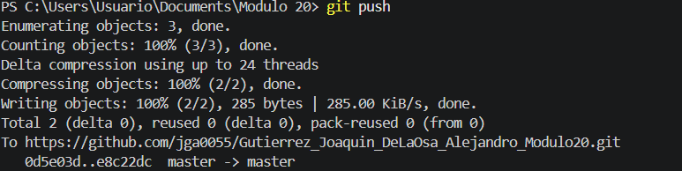
5. Deployment
Pushing the repository to GitHub and publishing the final site with GitHub Pages.
Production link
https://jga0055.github.io/Gutierrez_Joaquin_DeLaOsa_Alejandro_Modulo20/
The remote repository was updated successfully.
GitHub Pages serves the project as a public website.
The submission includes history, screenshots and a live URL.
PS C:\Users\Usuario\Documents\Modulo 20> git push
Enumerating objects: 3, done.
Writing objects: 100% (2/2), done.
To https://github.com/jga0055/Gutierrez_Joaquin_DeLaOsa_Alejandro_Modulo20.git
master -> master
git push
Module 20 · Git Journey
Alejandro de la Osa · Joaquin Gutierrez

Slide 7
Process Summary
Complete workflow used to version, manage and deploy the web project.
01
02
03
04
05
Initialize
Track
Modify
Branch
Deploy
git init
git add · git status
stage management
checkout · merge
git push · GitHub Pages
Final outcome
The web project was delivered with version control, descriptive commits, file cleanup, branch management and deployment through GitHub Pages.
Module 20 · Git Journey
Alejandro de la Osa · Joaquin Gutierrez

