Slide 1


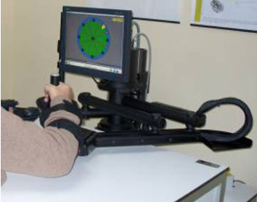
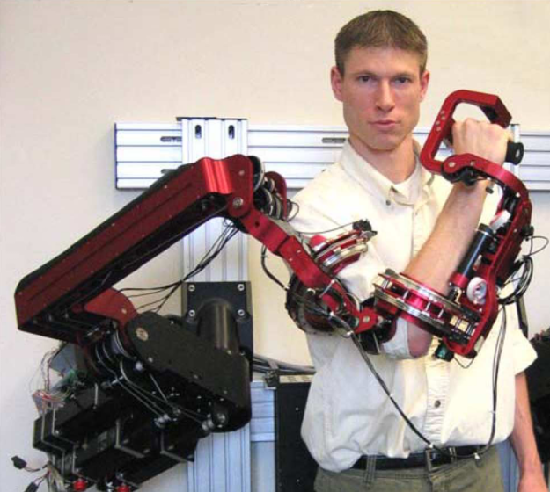
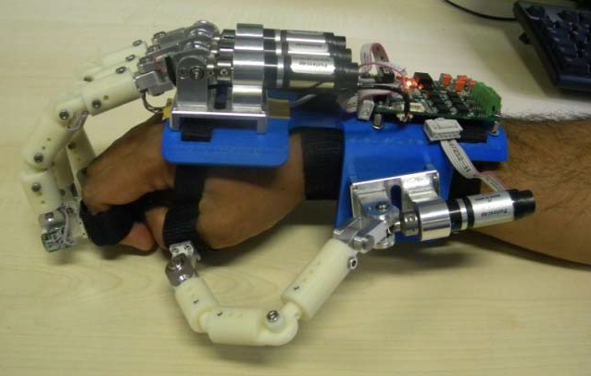
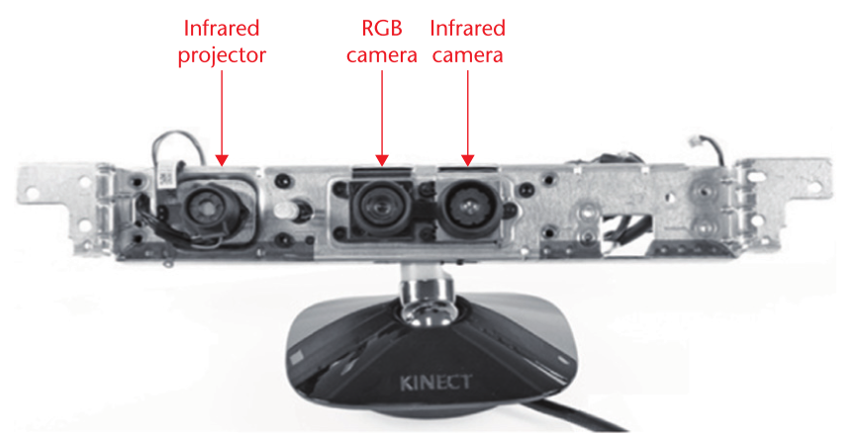
Review of Sensing and Robot Solutions to Stroke Rehabilitation, Focusing on Upper Limbs
John Charlesworth
Supervisor: Dr N. Harris
Introduction
Robots
Strokes can affect the victim differently depending on which part of the brain it happens in:
Left or right hemisphere: paralysis down one side of the body, spatial awareness, language skills and judgement can be impaired
Cerebellum: Balance and co-ordination are affected
Brain stem: up to total paralysis or death
It is possible to recover some functionality after a stroke due to the brain’s ‘plasticity’: its ability to rewire itself after damage [1].
End-effector:
End-effector systems are anchored at one end and free to move at the other, the free to move end is attached to the patient and it’s position monitored as the patient performs a task. The output from the system when the same task is performed at different stages in the patient’s rehabilitation can be used as a metric of recovery [4].
An example of a commercially available end-effector system is the InMotion2 (shown right). This system attaches to the patient at the wrist and forearm an can monitor the position of both in a 2D plane whilst the patient performs tasks shown to him on a screen [10].
Care of stroke victims is broken down into three stages:
Acute care: preventing further strokes, checking vital signs and restoring basic functionality
Rehabilitation care: bringing the patient to a level of functional independence whereby they can be released into community care
Community care: continuing support to the patient
There is potential for robotic and sensing systems to improve the quality of care at each of these stages; particularly the rehabilitation and community stages [2].
[10]
Exoskeleton:
Exoskeletal systems encase the limb. By doing this they are able to monitor the position of the limb over a much greater number of degrees of freedom than end-effector systems [4].
Sensors
An example of an exoskeletal system is the CADEN-7 system (shown right). The 7 in CADEN-7 comes from the fact that the system has 7 degrees of freedom, the same number as the human arm [9].
[9]
Motion Sensors:
Accelerometers are a useful sensor for this purpose as they output the acceleration of the object which can be used to calculate velocity and displacement, or to build up an acceleration profile for a movement allowing it to be recognised [3].
Angle Sensors:
The angle of a joint can most easily be passively measured using a potentiometer, assuming proper hinge alignment [4]. If proper hinge alignment is not possible angle can also be calculated by placing an accelerometer either side of the joint [5].
For measuring the position of an active joint (by measuring the position of the motor driving it) a magnetometer is most common.
An example of an exoskeletal system for the hand is the HEXOSYS-II (shown left) [8].
Force Sensors:
Indicating force can be done using a force sensitive resistor (FSR), to measure applied force quantum tunnelling composite (QTC) material is a better choice as it gives a more reliable change of output with applied force [6,7].
[8]
Conclusions
The effects of a partially paralysing stroke can be mitigated through rehabilitation due to the brain’s plasticity
Robotic and sensor systems have potential as useful tools to the physiotherapist and to the patient
There are two main areas where rehabilitation systems are appropriate:
Large complex systems for use by professionals in a hospital environment; such as the big end-effector or exoskeletal systems
Small simple systems for use by the patient at home to help monitor progress and maintain motivation. Suitable systems for this include those based on a few sensors and vision based systems.
Exoskeletal systems capture more information than end-effector systems but are correspondingly more complex
Linking the system to a game or virtual environment simulating activities of daily living is important in terms of maintaining patient motivation and co-operation. Most systems aimed at rehabilitation include such an interface.
Vision Based
Vision based systems come in three main formats:
Single camera based systems: recognition and tracking of human form in 2D images
Multi-camera systems: using multiple cameras 3D information of a scene can be constructed, this aids significantly in the locating and tracking of objects
Structured light systems: using the deformation of a projected grid a depth map of a scene can be built up [11]
Several systems are being developed using the Microsoft™ Kinect™ sensor for stroke rehabilitation [11]. The Kinect™ includes a camera and a structured light system [12].
[11]
References
Interlink Electronics Inc. (2011). Force Sensorsl [Online]. Available: http://www.interlinkelectronics.com/catalog/Force-Sensors
J. Iqbal, N. G. Tsagarakis, and D. G. Caldwell, A multi-DOF robotic exoskeleton interface for hand motion assistance, 2011 Annual International Conference of the IEEE Engineering in Medicine and Biology Society, pp. 1575-1578, Aug. 2011.
J. Perry and J. Rosen, Upper-limb powered exoskeleton design, Mechatronics, IEEE/ASME, vol. 12, no. 4, pp. 408-417, 2007.
L. Zollo, L. Rossini, M. Bravi, G. Magrone, S. Sterzi, and E. Guglielmelli, Quantitative evaluation of upper-limb motor control in robot-aided rehabilitation., Medical & biological engineering & computing, vol. 49, no. 10, pp. 1131-44, Oct. 2011.
C. Schonauer, T. Pintaric, and H. Kaufmann, Chronic pain rehabilitation with a serious game using multimodal input, International Conference on Virtual Rehabilitation, 2011.
W. Zeng and Z. Zhang, Multimedia at Work Microsoft Kinect Sensor and Its Effect, pp. 4-10, 2012.
National STROKE Association. (2012, April 14). Effects of Stroke [Online]. Available: http://www.stroke.org/site/PageServer?pagename=EFFECT
physiotherapy-treatment.com (2012, April 5). stroke physical therapy [Online]. Available: http://www.physiotherapy-treatment.com/stroke-physical-therapy.html
L. Guo and L. Yu, Upper limb motion recognition for unsupervised stroke rehabilitation based on Support Vector Machine, Bioelectronics and Bioinformatics (ISBB), 2011.
R. C. V. Loureiro, W. S. Harwin, K. Nagai, and M. Johnson, Advances inupper limb stroke rehabilitation: a technology push., Medical & biologicalengineering & computing, vol. 49, no. 10, pp. 1103-18, Oct. 2011.
F. Ghassemi, S. Tafazoli, and P. Lawrence, Design and Calibrationof an Integration-Free Accelerometer-Based Joint-Angle Sensor, IEEE Transactions on Instrumentation and Measurement, vol. 57, no. 1, pp. 150-159, 2008.
Peratech. (2012, May 7). QTC Material [Online]. Available: http://www.peratech.com/qtcmaterial.php

