Slide 1
Histogram of Oriented Gradients
John Charlesworth
Michael Hodgson

Slide 2
Contents
Introduction
Theory
  HOG
Implementation
  HOG
  SVM
Results
Conclusions

Slide 3
Introduction
Histogram of oriented gradients is a feature descriptor
Used in conjunction with a training data set and a classifier

Slide 4
Theory - HOG
Compute Gradients
Compute Orientation of Gradients
Compute a Histogram of these for a “Cell”
Normalise the “Cell” over a “Block”
Collect for Entire Image

Slide 5

Theory - HOG
Block
Cell

Slide 6
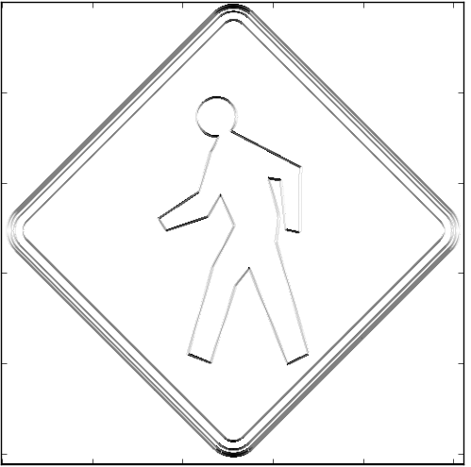
Implementation - HOG
Gradients Calculated by convolution with simple kernels
0 | 0 | 0
-1 | 0 | 1
0 | 0 | 0
0 | -1 | 0
0 | 0 | 0
0 | 1 | 0

Slide 7
Implementation - HOG
The orientation of the gradient at each pixel is calculated
Orientation (in Radians) = arctan (horizontal gradient / vertical gradient)
A histogram is then computed over a cell with 9 bins between 0 and π

