Slide 1
Histogram of Oriented Gradients
John Charlesworth
Michael Hodgson

Slide 2
Contents
Introduction
The Process
Results
Conclusions
References

Slide 3
Introduction
Histogram of oriented gradients is a feature descriptor
Used in conjunction with a training data set and a classifier

Slide 4
The HOG Process
Compute Gradients
Compute Orientation
Histograms
Normalise
Collect over window
Linear SVM
Compute Gradients
Compute Orientation of Gradients
Compute a Histogram of these for a “Cell”
Normalise the “Cell” over a “Block”
Collect for Entire Image

Slide 5

Blocks and Cells
Compute Gradients
Compute Orientation
Histograms
Normalise
Collect over window
Linear SVM
Block
Cell

Slide 6
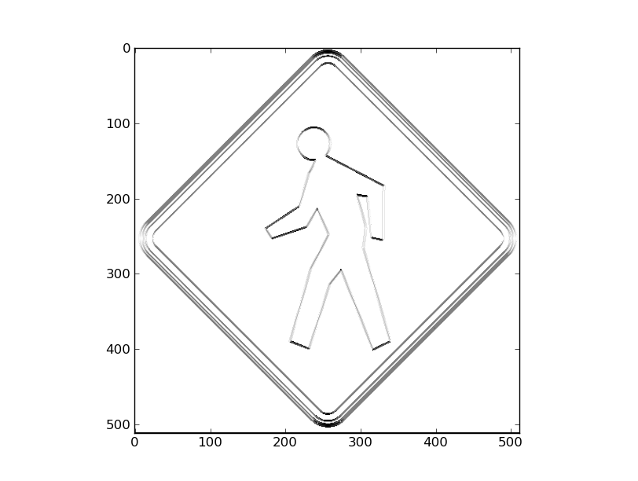
The HOG Process
Compute Gradients
Compute Orientation
Histograms
Normalise
Collect over window
Linear SVM
Gradients Calculated by convolution with simple kernels
0 | 0 | 0
-1 | 0 | 1
0 | 0 | 0
0 | -1 | 0
0 | 0 | 0
0 | 1 | 0

Slide 7
The HOG Process
Compute Gradients
Compute Orientation
Histograms
Normalise
Collect over window
Linear SVM
The orientation of the gradient at each pixel is calculated
Orientation (in Radians) = arctan (horizontal gradient / vertical gradient)

Slide 8
The HOG Process
Compute Gradients
Compute Orientation
Histograms
Normalise
Collect over window
Linear SVM
A histogram is then computed over a cell with 9 bins between 0 and π (unsigned orientation) or – π and π (signed orientation)
Number of bins and signed or unsigned orientations chosen from paper

Slide 9
The HOG Process
Compute Gradients
Compute Orientation
Histograms
Normalise
Collect over window
Linear SVM
Cell

Slide 10
The HOG Process
Compute Gradients
Compute Orientation
Histograms
Normalise
Collect over window
Linear SVM
Cell

Slide 11
The HOG Process
Compute Gradients
Compute Orientation
Histograms
Normalise
Collect over window
Linear SVM
Cell

Slide 12
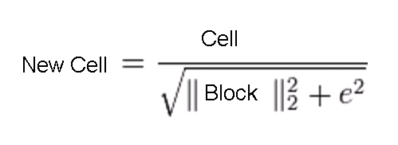
The HOG Process
Compute Gradients
Compute Orientation
Histograms
Normalise
Collect over window
Linear SVM
The histogram of a cell is normalised with respect to a block
The L2-norm of the block is taken
e is a small constant

Slide 13
The HOG Process
Compute Gradients
Compute Orientation
Histograms
Normalise
Collect over window
Linear SVM

Slide 14
The HOG Process
Compute Gradients
Compute Orientation
Histograms
Normalise
Collect over window
Linear SVM

Slide 15
The HOG Process
Compute Gradients
Compute Orientation
Histograms
Normalise
Collect over window
Linear SVM

Slide 16
The HOG Process
Compute Gradients
Compute Orientation
Histograms
Normalise
Collect over window
Linear SVM

Slide 17
The HOG Process
Compute Gradients
Compute Orientation
Histograms
Normalise
Collect over window
Linear SVM

Slide 18
The HOG Process
Compute Gradients
Compute Orientation
Histograms
Normalise
Collect over window
Linear SVM

Slide 19
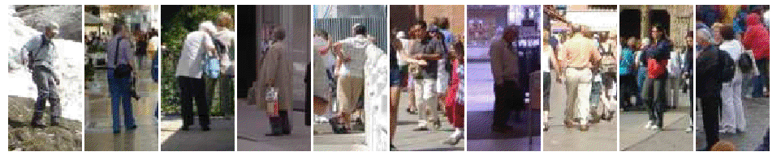
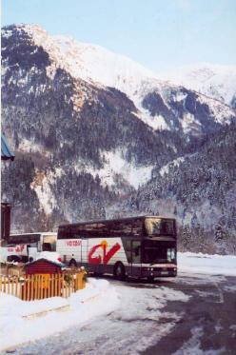

The HOG Process
Compute Gradients
Compute Orientation
Histograms
Normalise
Collect over window
Linear SVM
Trained with large selection of pictures of people
And of not people

Slide 20
The HOG Process
Compute Gradients
Compute Orientation
Histograms
Normalise
Collect over window
Linear SVM
Retrained on false positives
SVM predicts whether a HOG window contains a person
Scale sensitive

Slide 21
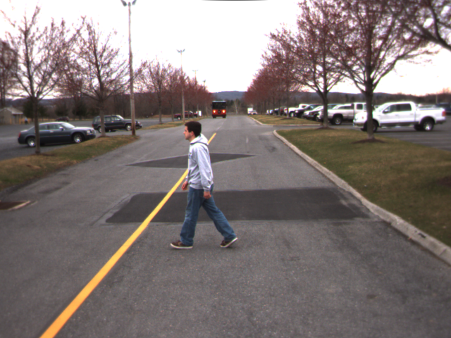
The HOG Process
Compute Gradients
Compute Orientation
Histograms
Normalise
Collect over window
Linear SVM
For location invariance a sliding window is used

Slide 22
The HOG Process
Compute Gradients
Compute Orientation
Histograms
Normalise
Collect over window
Linear SVM
For location invariance a sliding window is used

Slide 23
The HOG Process
Compute Gradients
Compute Orientation
Histograms
Normalise
Collect over window
Linear SVM
Experimented with scale invariance

Slide 24
Results
ROC curve
Location invariance
Scale invariance?
False positives
Computation time
Use awesome Godzilla picture for demo

Slide 25

Demo

Slide 26
Conclusions
Scale Sensitive
Requires careful training

Slide 27
References
Histograms of Oriented Gradients for Human Detection, Naveet Dalal and Bill Triggs, Available: http://ieeexplore.ieee.org/stamp/stamp.jsp?tp=&arnumber=1467360
Object detection using Histograms of Oriented Gradients, Naveet Dalal and Bill Triggs, Available: http://pascallin.ecs.soton.ac.uk/challenges/VOC/voc2006/slides/dalal.pdf

