Slide 1
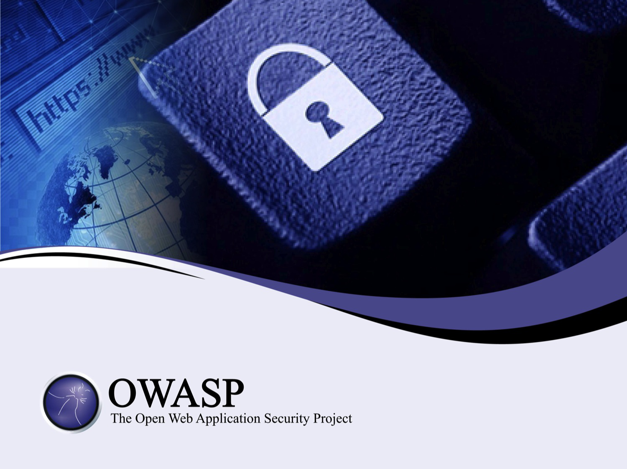

Slide 2
An Introduction to Threat Modeling
as part of a secure software development lifecycle

Slide 3
About Me
Jon Gadsden
Embedded software engineer and security advocate
… product security and secure development lifecycle activities. In his spare time he likes to help organise security conferences and contribute to open source projects - the latest being the OWASP Threat Dragon modeling tool.

Slide 4
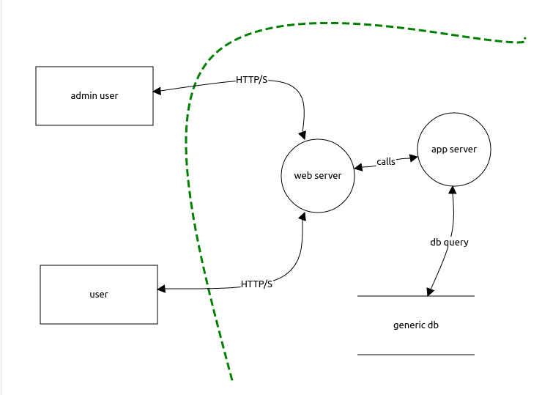
What is a threat model?
Essentially a data flow diagram
Protected assets
Attack vectors
Threat surfaces
… that lists possible threats
Notes:
Show of hands

Slide 5
Who models threats?
So, who already uses threat modeling?
It can be diagrammatic
It can be a spreadsheet
It can be descriptive
Notes:
Show of hands

Slide 6
Who enjoys threat modeling?
… and who thinks it is 'a good thing'?
If not, then you are in good company
If so, then you are also in good company
Notes:
Show of hands
Exercise in futility

Slide 7
Recap on vulnerability, asset, threat
Vulnerability
an exploitable weakness in a system or its design
Asset
anything that is valuable to an organization.
Threat
potential danger to an asset
Vector
method to realise an exploit
Trust boundary
change in level of trust for information or execution

Slide 8
Why model threats
What is the point of threat models?
Security designed in from the start
Determines the threat surface
Starting point of penetration / vulnerability testing
But hard to justify: often no 1:1 benefit

Slide 9
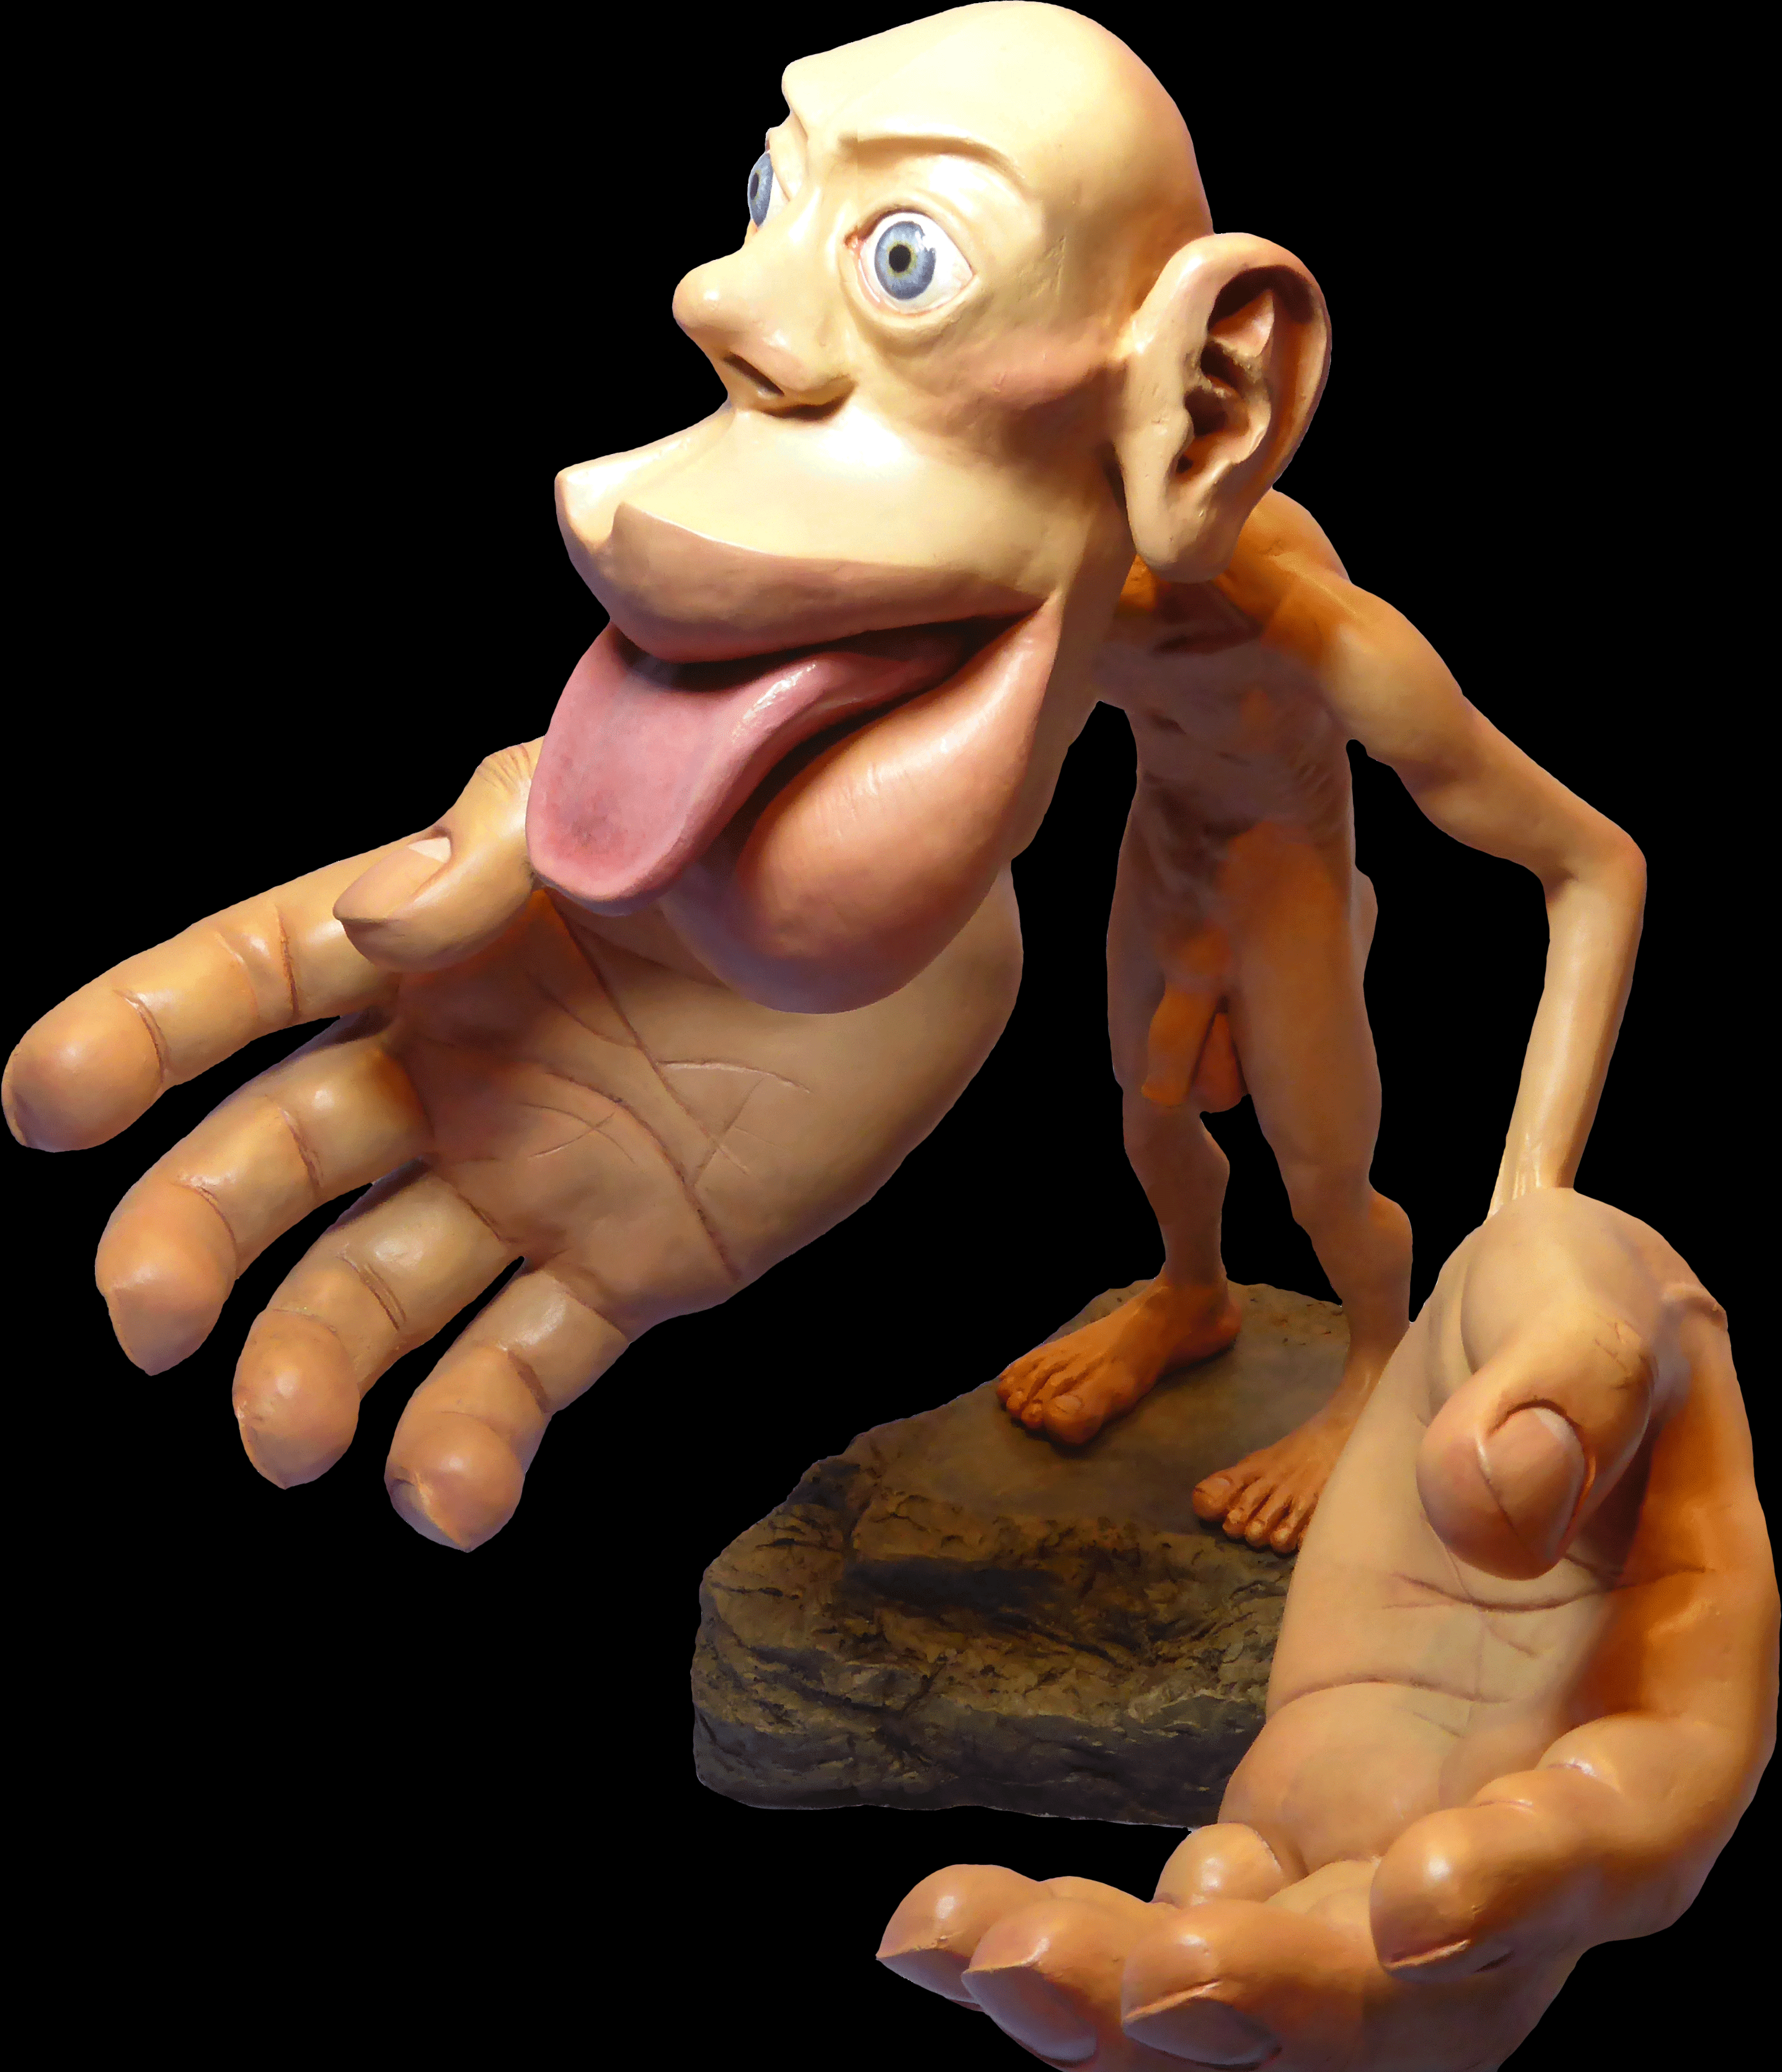
It is not a system diagram #1
It is not a system diagram
Homunculus
…
By Mpj29 - Own work, CC BY-SA 4.0, https://commons.wikimedia.org/w/index.php?curid=54045144

Slide 10
It is not a system diagram #2
It is not a system diagram
Homunculus
Keep it simple
It is not a system diagram

Slide 11
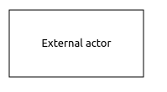
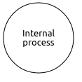



Actors, Processes and Trust Boundaries
Threat Model components
Actor
Process
Storage
Data flow
Trust boundary

Slide 12
STRIDE / DREAD
Originates from Microsoft SDL
Spoofing
Tampering
Repudiation
Information disclosure
Denial of service
Elevation of privilages
Damage
Reproducibility
Exploitability
Affected users
-Discoverability

Slide 13
CWE
Common Weakness Enumeration
Community-developed list of software weakness types
Hosted by Mitre (not for profit, federally funded)
cwe.mitre.org

Slide 14
CAPEC
Common Attack Pattern Enumeration and Classification
Community resource for identifying and understanding attacks
Also hosted by Mitre
capec.mitre.org

Slide 15
OWASP
OWASP top ten threats
OWASP top ten remediations
OWASP threat modeling cheat sheet

Slide 16
Tools, diagrams and spreadsheets
Microsoft Threat Modeling Tool (TMT)
Propietary tools (eg cisco Threat Builder)
OWASP Threat Dragon
Mozilla Sea Sponge
SEI OCTAVE
Trike

Slide 17
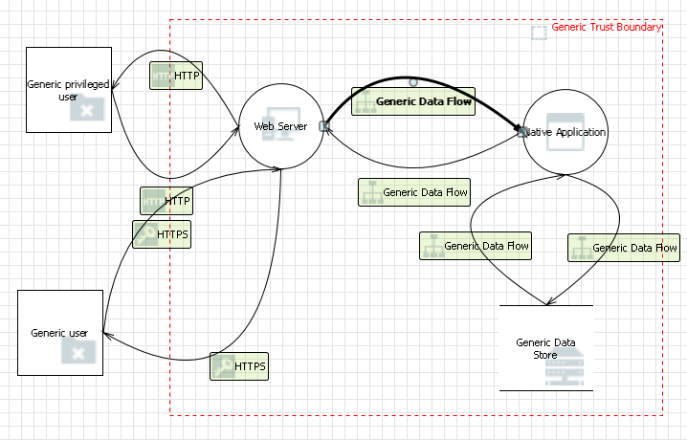
Microsoft Threat Model Tool
33 possible threats automatically identified

Slide 18
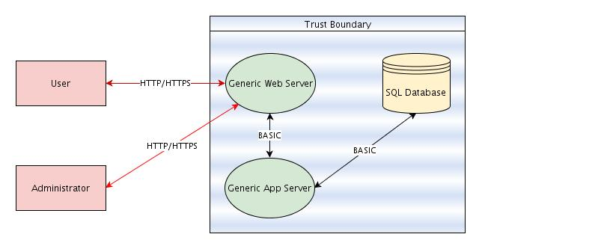
Cisco Threat Builder
50 possible threats automatically identified

Slide 19
OWASP Threat Dragon
0 threats identified (needs work)

Slide 20
Feeling overwhelmed
Simplest models 30 to 50 possible threats
Practical models around 450 possible threats
Not unusual to see upwards of 750
That is a lot of defect requests ...

Slide 21
Guage risk
Any not applicable?
Any already mitigated?
Remediation already in place?
Risk acceptable?
Prioritise the rest

Slide 22
Something is better than nothing
The days of 'the whip' are very last century
More tact and carrot
Think hard before modeling legacy systems
Incremental threat modeling

Slide 23
Threat models can save some clangers
Thinking of storing that private key in the binary image? Better threat model it first …
Opening up that ftp port for upload? Better threat model it first …
Tempted to use that serial port? … probably better to threat model it first.

Slide 24
Some threats can never be modeled
Government agencies
Service provider
Back doors
Wet ware (the human)

Slide 25
Exercise in futility
So, is this an exercise in futility ?
You can say 'yes' if you want
Notes:
Show of hands

Slide 26
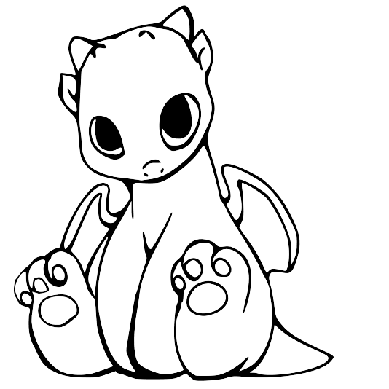
Demonstration of Threat Dragon
Welcome! (0.1.26)
Threat Dragon is a free, open-source threat modeling tool from OWASP. You are using the standalone desktop app for Windows, Macs and Linux. It can also be used as a web application.
The desktop app is great for local use, but if your project is in GitHub you should consider the web app for better integration with your dev workflow.

Slide 27
Cupcake's call for contributors
Contribute
Have a github account?
Node.js
Angular
Electron
MongoDB (well, not yet)

Slide 28
Questions (and answers)
Questions?
(and maybe some answers)

