Slide 1
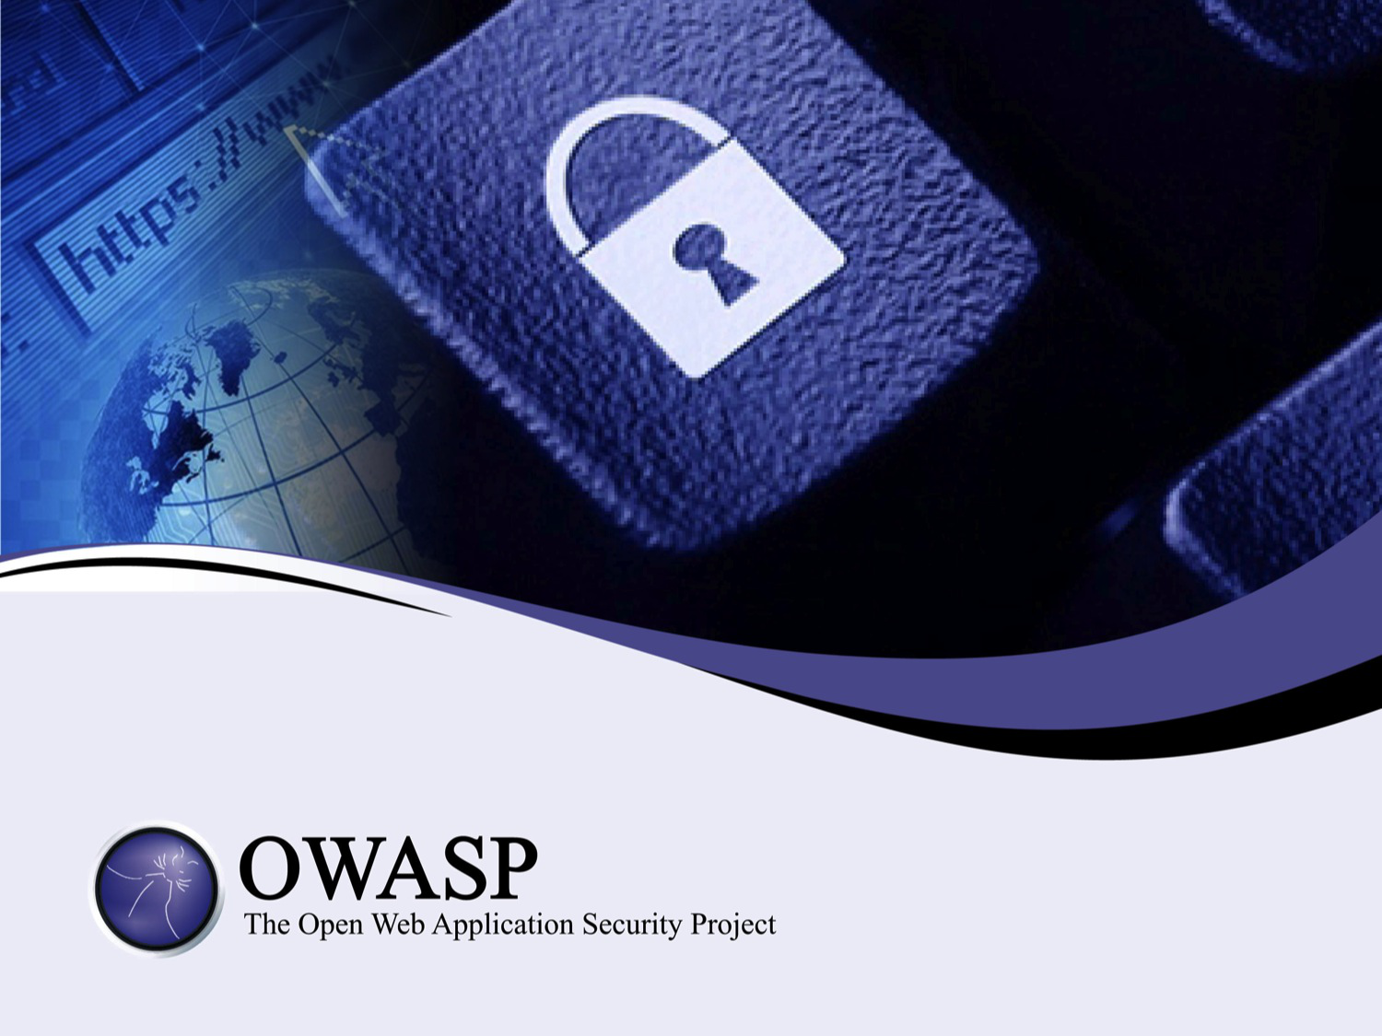

Slide 2
An Introduction to Threat Modeling
as part of a secure software development lifecycle

Slide 3
About Me
Jon Gadsden
Embedded software engineer and security advocate
… product security and secure development lifecycle activities. In his spare time he likes to help organise security conferences and contribute to open source projects - the latest being the OWASP Threat Dragon modeling tool.

Slide 4

What is a threat model?
Essentially a data flow diagram
Protected assets
Attack vectors
Threat surfaces
… that lists possible threats
Notes:
Show of hands

Slide 5
Who models threats?
So, who already uses threat modeling?
It can be diagrammatic
It can be a spreadsheet
It can be descriptive
Notes:
Show of hands

Slide 6
Who enjoys threat modeling?
… and who thinks it is 'a good thing'?
If not, then you are in good company
If so, then you are also in good company
Notes:
Show of hands
Exercise in futility

Slide 7
Recap on vulnerability, asset, threat, trust
Vulnerability
an exploitable weakness in a system or its design
Asset
anything that is valuable to an organization.
Threat
potential danger to an asset
Trust boundary
change in level of trust for information or execution

Slide 8





Actors, Processes and Trust Boundaries
Threat Model components
Actor
Process
Storage
Data flow
Trust boundary

Slide 9
OWASP
OWASP top ten threats
OWASP top ten remediations
OWASP threat modeling cheat sheet

Slide 10
OWASP Threat Dragon
0 threats identified (needs work)

Slide 11
Something is better than nothing
The days of 'the whip' are very last century
More tact and carrot
Think hard before modeling legacy systems
Incremental threat modeling

Slide 12
Some threats can never be modeled
Government agencies
Service provider
Back doors
The human (wet ware)

Slide 13
Exercise in futility
So, is this an exercise in futility ?
You can say 'yes' if you want
Notes:
Show of hands

Slide 14
Questions (and answers)
Questions?
(and maybe some answers)

