Slide 1


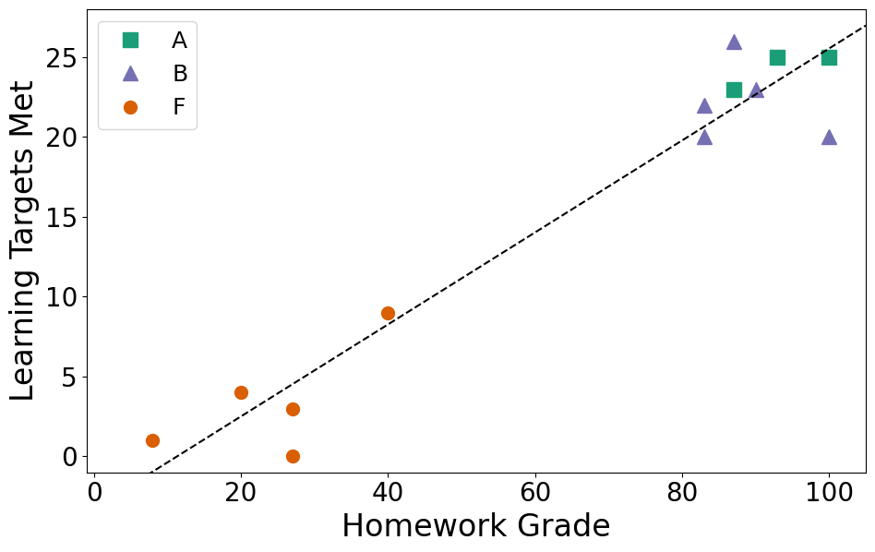

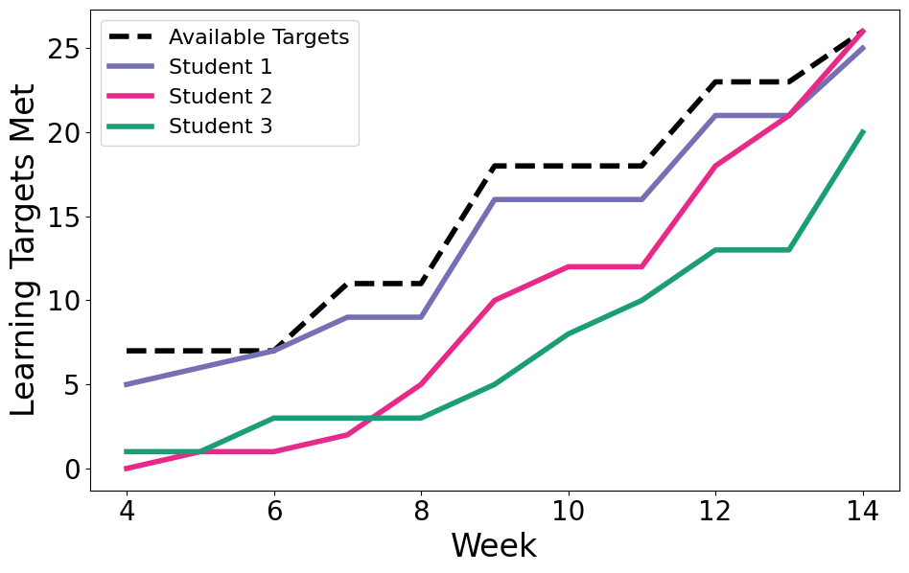

Students who fail and the professor who let them
Standards-based grading and student growth in general chemistry
General Chemistry I with Lab
Lecture: Remote, once a week with additional
pre-recorded videos
Lab: In person, once a week
Bunker Hill Community College
66% Part-time students
67% Students of Color
Jennifer Mortensen
Bunker Hill Community College, Boston
IRACDA Scholar at Tufts University
Engagement → Success
Effort and engagement appear to be a key component to student success. While many students did poorly on the first exam, those who consistently submitted homework assignments and completed learning target retakes were able to improve their grades and pass the course. Students who didn’t engage with the material continued to do poorly in the course. This trend is clear when comparing homework grades (an indicator of student engagement) to the final number of learning targets met (Figure 1). Overall, standards-based grading allowed students who performed poorly on initial exams to catch up and demonstrate their learning over time (Figure 2).
Grade Distributions
Standards-based grading allowed students to recover from setbacks and disruptions. Course outcomes were related to effort, not test-taking ability or prior exposure to the material.
Figure 1: Final homework grades compared to the number of learning targets met for the 13 students who finished the course (5 students withdrew).
Standards Based Grading
Weekly Homework
Submitted / Late / Not Complete (100 / 50 / 0).
Lab
Pre-lab, Attendance, Post-lab questions
Submitted / Late / Not Complete (100 / 50 / 0).
Learning Targets
Core (11) and Supplemental (15)
Assessed with a 2 to 5 question quiz
Grouped into 4 exams
Scored as “Meets Standard” or “Not Yet”
Students can retake up to 3 LTs each week
Grades were determined using the following grading table.
Improvements for next time
Encourage fewer retakes by discouraging ‘blind’ first attempts
Recognize and address “magical thinking” early
Reach out to struggling students earlier
Report course grades multiple times throughout the semester
Questions to ponder
Why didn’t students submit homework or retake learning targets?
What answers are “good enough” to meet a learning target?
How can this approach be scaled up in a larger classroom?
Why don’t the final grades include any Cs?
Learning Target Progress
Grade | Core LT | Suppl LT | HW | Lab
A | 11 | 14 | 90 | 88
A - | 11 | 13 | 85 | 88
B+ | 11 | 12 | 85 | 77
B | 10 | 11 | 80 | 77
B - | 10 | 10 | 75 | 77
C+ | 10 | 9 | 75 | 66
C | 10 | 8 | 70 | 66
C - | 10 | 7 | 65 | 66
D | 9 | 5 | 60 | 66
Poster and syllabus:
https://github.com/jgaines42/Chemistry2022/
jennifercmortensen@gmail.com
Figure 2: Learning target progress of three students showing various pathways towards success. The black dotted line shows the number of learning targets that were available during each week of the course.

