Slide 1
Tracing Summit 2017
Babeltrace 2
Tailor-made trace analyses
jeremie.galarneau@efficios.com 
jgalar 

Slide 2
Presenter
 Jérémie Galarneau
 EfficiOS Inc.
  Vice President
  http://www.efficios.com
Maintainer of
  LTTng-Tools
  Babeltrace

Slide 3
Babeltrace 1.x
MIT licensed Common Trace Format (CTF) reference implementation (2011)
  Served as the de facto LTTng command-line trace reader
Introduced Python bindings to read traces (2013)
  Provide users a way to prototype an analysis rapidly without using text-based tools (awk, sed, grep, etc.)
    Debugging
    Testing
  Scripts maintained as internal tools by some users
  Basis of LTTng analyses
Provides a CTF production library (CTF writer) (2014)
  Used by perf to convert traces to CTF

Slide 4
Limitations of Babeltrace 1.x
Only supports in-tree plugins
  Does not expose a stable ABI to plugins
  No solution to support proprietary (or niche) trace formats out of tree
Design makes it impossible to implement “LTTng-live” support as a plugin
API quirks
  Does not allow caching of events
  One iterator per trace
  Hard/impossible to work with multiple clock sources

Slide 5
Redefining Babeltrace’s scope
Realized that trace analysis tools were not keeping up with the tracers
  Capturing trace is only half of the battle
  Use in production shows that working with huge traces is challenging
  Text-based analyses do not scale and are hard to maintain... but they are useful!
Project scope changed from a trace converter to a trace manipulation tool
  Support more input and output formats
  Trim, filter, and add information to traces
  Make it easy to assemble “blocks” to build a custom trace analysis pipeline

Slide 6
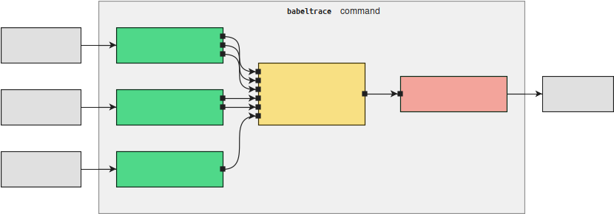
Redefining Babeltrace’s scope
The babeltrace client becomes a “host” application for trace processing graphs
User-defined processing graphs
  Standardize trace processing (shareable graph configurations)
  Can be assembled programatically
    Usable from external tools, such as viewers
  Can be used to process trace “chunks” independently

Slide 7
Building a graph
Building a graph on the command line
  $ babeltrace run
  --component=my-source:src.plugin-name.my-src
  --component=my-sink:sink.plug.my-sink
  --connect=my-source:my-sink
  Don’t worry, there are helpers for common scenarios...
You can build graphs using the C and Python APIs

Slide 8
Redefining Babeltrace’s scope
Cross-platform
  Linux
  Windows (native and Cygwin)
  Solaris
  BSDs
  macOS
Preserve the current Babeltrace 1.x Python and CTF writer interface

Slide 9
Babeltrace 2.0
Provides components which allow everything Babeltrace 1.x could do
  CTF file system source
  CTF file system sink
  LTTng-live source
  dmesg source
  Muxer
  Trimmer
  Debugging information injecter
Components can be written in C, C++, and Python
  Stable ABI allows out-of-tree components

Slide 10
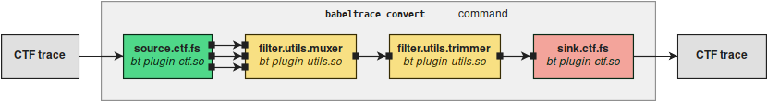
Scenarios – Trimming a trace
$ babeltrace /path/to/trace --begin=22:14:38 --end=22:15:07
--output-format=ctf --output=/path/to/trace2

Slide 11
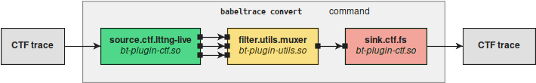
Scenarios – Record part of a live trace
$ babeltrace --input-format=lttng-live
net://localhost/host/my_host/my_session
--output-format=ctf --output=/path/to/trace

Slide 12
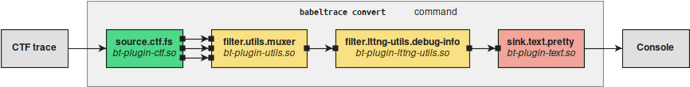
Scenarios – Print debugging information
$ babeltrace --debug-info /path/to/trace

Slide 13
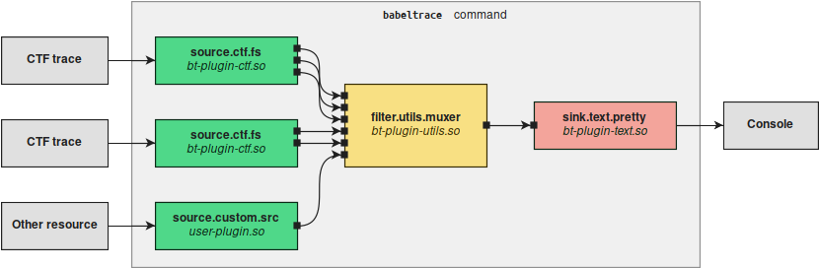
Scenarios – Mux multiple formats
$ babeltrace
/path/to/trace1 /path/to/trace2
--component source.custom.src --path /path/to/trace

Slide 14
Easy to prototype new components
You can write components in Python and use them from command line just like built-in components
  Insert only the logic you need to build your analysis
Quick example: a callstack view inspired by uftrace in ~50 lines
  https://github.com/jgalar/TracingSummit2017

Slide 15
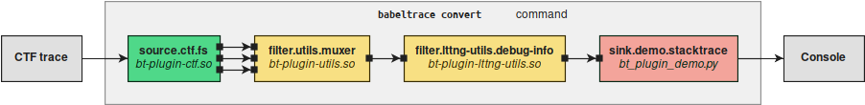
User space callstack view
Build binary using -finstrument-functions
Enable userspace tracing with LTTng (see GitHub link)
LD_PRELOAD=”liblttng-ust-cyg-profile-fast.so” ./my_binary

Slide 16
Demo

Slide 17
Future Work
Currently at v2.0.0-pre4
  APIs are not frozen yet
  Works on all supported platforms
Targetting the first Release Candidate for November
  Optimizations which may affect the APIs
  Documentation
Support for CTF 2 (v2.1, if CTF 2 is specified soon)
Future components
  Filtering (v2.1)
  State tracker, Period/span tracking, ideas?

Slide 18

Questions ?
Babeltrace
✶ diamon.org/babeltrace
 github.com/efficios/babeltrace
 lttng-dev@lists.lttng.org
✶ www.efficios.com
 @efficios

