Slide 1
CodeHint: Dynamic and Interactive Synthesis of Code Snippets
Joel Galenson, Ras Bodik, Koushik Sen
UC Berkeley

Slide 2






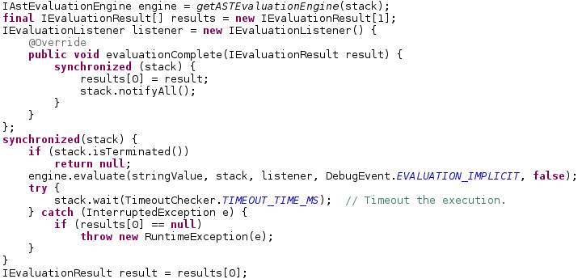
Motivation
Specification
Test cases
Desired type
Pictures by Mangpo Phitchaya Phothilimthana

Slide 3
CodeHint: Autocomplete for the modern age
Autocomplete is useful but very limited.
Our improvements:
  Being dynamic
  General specifications
  Synthesis

Slide 4
Overview
Source code
Combine
Test case
Find locals
Evaluate
Candidates
Candidates
Specification
CodeHint
Refine

Slide 5
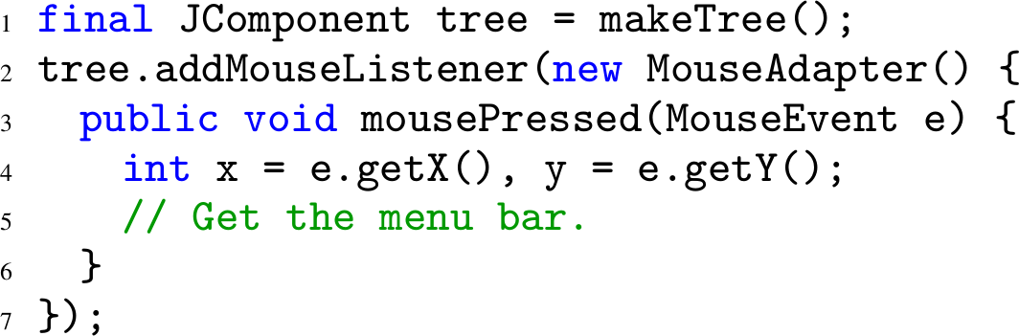
Example: The problem

Slide 6
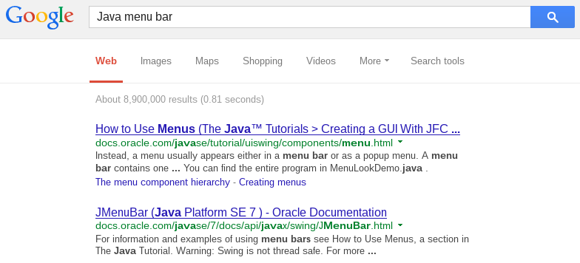
Example: First step
“Find a JMenuBar”

Slide 7
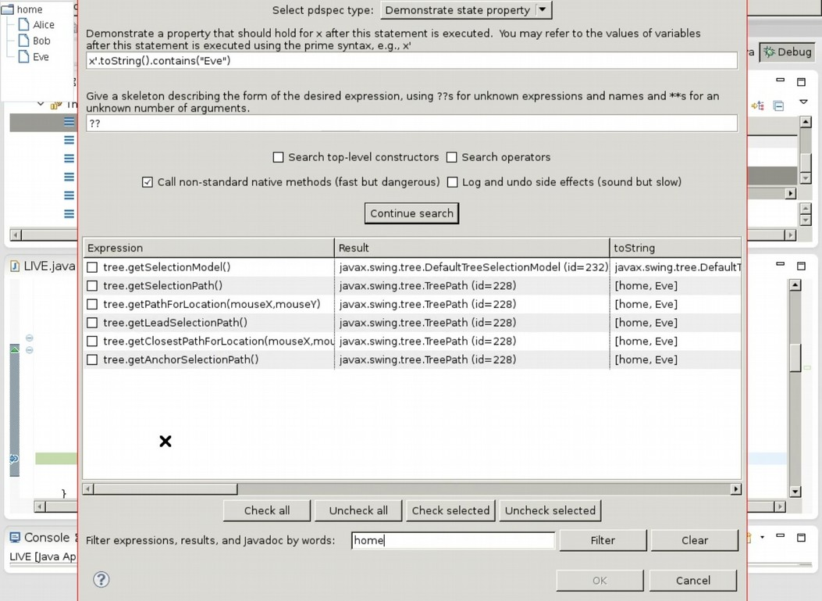
Demo
Notes:
Now I'll spend the next ten or so slides walking through how this example works in detail.

Slide 8
Basic algorithm
Find local variables, do BFS over Java statements, show user those that pass spec.
  Actually evaluate these statements, including file I/O, reflection, etc.
Iteration 1
Iteration 2
Iteration 3
+
x
average
x
y
...
max
max
+
y
x
y
x
y
x
y
...
...
...

Slide 9
First iteration
Find local variables.
x
y
tree
this
null
...

Slide 10
Second iteration
Get each expression's type and combine it with others in type-correct ways.
+
<
x
...
x
y
x
y
getPathForLocation
getPathForLocation
getTopLevelAncestor
tree
...
(JTree)
x
y
(JTree)
y
x
tree
tree
tree
getWindowAncestor
...
SwingUtilities
tree
Notes:
~240 candidates after this step (would be ~560 without equivalences and model)

Slide 11



Side effects
Handle in-memory and external effects.
In-memory:
add
Breakpoints
tree
makeTree()
...
tree.children changed from to
renderer
makeTree()
renderer
renderer
makeTree()
children
...
tree
External:
delete
file
SecurityManager
Notes:
Basic idea: use breakpoints to detect and undo effects after each evaluation.
Emphasize that the side effects happen during evaluation so I get the right result.
Special cases for arrays, array arguments, reflection, optimizations, and disabling external calls.

Slide 12

Equivalence classes
Group equivalent code to avoid unneeded work.
getTopLevelAncestor
getRoot
tree
SwingUtilities
tree
getName
getName
getTopLevelAncestor
getRoot
Next iteration:
tree
SwingUtilities
tree
getJMenuBar
getJMenuBar
getJMenuBar
End of search:
getTopLevelAncestor
getTopLevelAncestor
getRoot
tree
tree
SwingUtilities
tree

Slide 13
Probabilistic model
Mined 10MLOC to build model of likely code.
Use to avoid unlikely expressions.
Probability of accessing method/field m on type T:
Probability of using constant c as argument i to method m:
getNextMatch
getComponent
tree
...
tree
KeyEvent.VK_ENTER

Slide 14
Third iteration and result
getJMenuBar
+
(JFrame)
getRowForLocation
1
Third iteration:
...
getTopLevelAncestor
(JTree)
x
y
tree
tree
getJMenuBar
getJMenuBar
Result:
(JFrame)
(JFrame)
getTopLevelAncestor
getRoot
tree
SwingUtilities
tree
Notes:
We have generated over 700 expressions at this point.

Slide 15
Refinement
Users can give another demonstration in a different state to refine the results.
getJMenuBar
getJMenuBar
(JFrame)
(JFrame)
...
getTopLevelAncestor
getWindowAncestor
tree
SwingUtilities
tree

Slide 16
Synthesis from specifications
Context-
independent
API
exploration
Program
synthesis
Static type
rv instanceof JMenuBar
Correctness condition
isSorted(array)
Context-
dependence
x.toString().contains(“Eve”)
Programming
by demonstration
Context-
dependent
Value demonstrations
x == 42
Weak
Strength
Strong

Slide 17
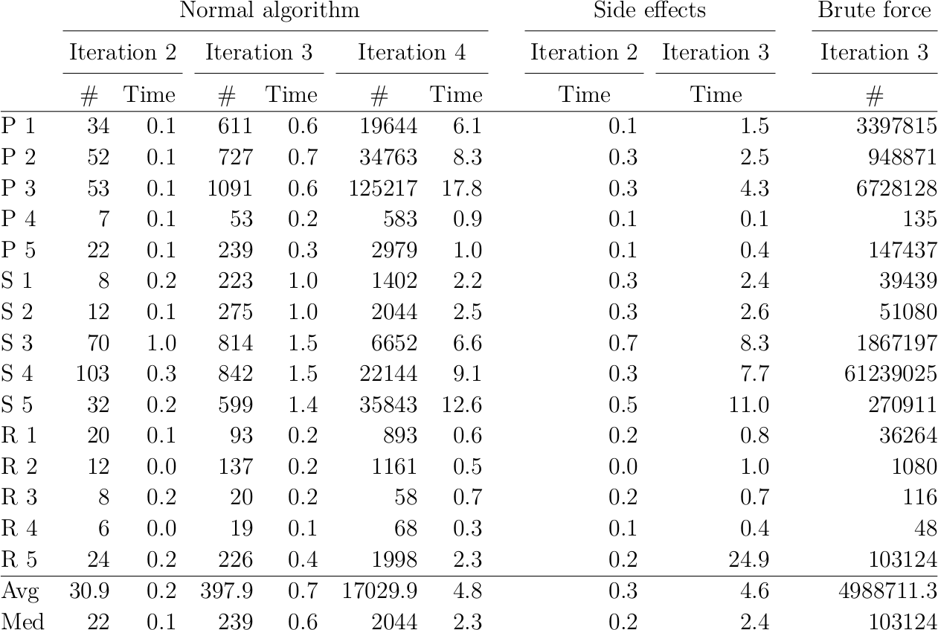
Empirical results
Our algorithms work
well in practice.
In real-world code, ~95% of expressions need ≤3 iterations and ~99% need ≤4.

Slide 18
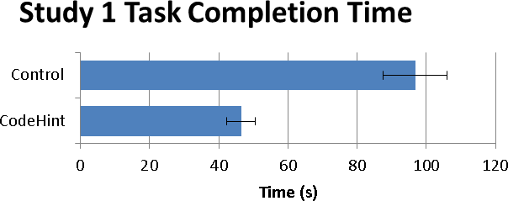
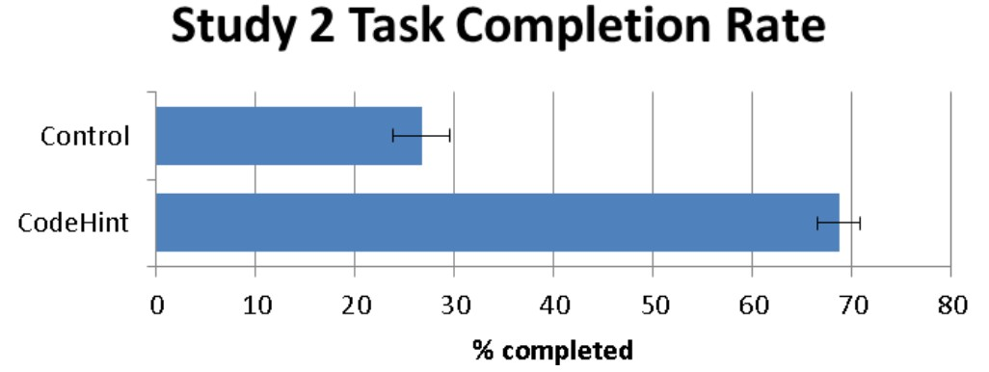
User studies
Completed two user studies with 28 subjects.
Found statistically-significant productivity improvements.
  Fewer bugs and more tasks completed in less time.
CodeHint makes programmers
more productive.
Lower is better
Higher is better

Slide 19
Future work
Improving the probabilistic model
CodeHint for JavaScript
  https://github.com/jgalenson/codehint.js
Integrating symbolic techniques

Slide 20

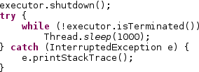
Probabilistic search
Model
getJMenuBar
getWindowAncestor
(JFrame)
SwingUtilities
tree
;
getWindowAncestor
foo
bar
SwingUtilities
tree
...
Candidates

Slide 21
Summary
Dynamic and interactive synthesis
Autocomplete for the modern age
User studies showed productivity improvements
Thanks!
https://jgalenson.github.io/codehint/

Slide 22
Backup slides

Slide 23
Type-directed search
class A {
public B f;
}
class A {
public B f;
public Object f2;
}
class B {
public C g;
}
class X {
public Y p;
}
class Y {
public Object q;
}
class Y {
public Object q = new C();
}
Locals:
Reachable:
A
B
C
Max iteration:
≤ N-2
≤ N-1
≤ N
≤ N-1
X
Y
Object
≤ N-2
≤ N-1
≤ N

Slide 24
Lazy initialization with breakpoints
Foo
a: 42
b: 0
Bar
x: 0
y: 0
Foo
a: 42
b: 5
Bar
x: 0
y: 1
int work(Foo foo, Bar b) {
…
… foo.a ...
...
}
Foo
a: 137
b: 0
Bar
x: 1
y: 0
Foo
a: 137
b: 5
Bar
x: 1
y: 1
16 combinations
162 combinations

Slide 25
Related work
Refinement used in PBD, Smalltalk.
  We let users control input and specification.
Side effect handling slow but simple.
  Transactions [RW02] and sandboxing [STM10, ST12] are faster but more complicated.
  [CS04] is simple but only resets static state.
  Breakpoints could be much faster [ZRARW08].
Skeletons simpler than [PGBG12], [SRBE05].
Notes:
Sell side-effect handling as a prototype implementation of a new idea.

Slide 26
Return type model
Bias method weights toward more helpful return types.
  Target types > possible target types
  Possible target types > new types
  New types > previously-seen types
    P(seen type) ~ 1 / # times seen
boolean
int
IUnicorn
Object
JMenuBar
Low
Probability
High

Slide 27
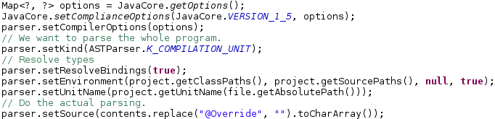


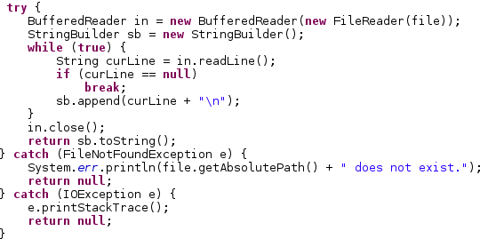
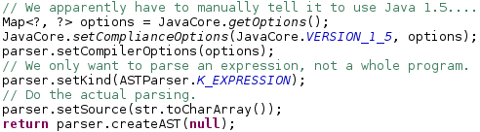
Mining larger snippets
+
+
getRowForLocation
1
...
x
y
(JTree)
x
y
tree
expand [CJS09]

Slide 28
Integrating small and large models
Bigram
P(snippet)
Bigram
P(snippets)

Slide 29
CodeHint for JavaScript
class Foo {
String bar(String f, int x) { … }
}
+
toString
tree
x
1
tree
Foo.prototype.bar = function (f, x) { … }
=> undefined
?
?
+
toString
tree
x
1
tree

Slide 30
CodeHint for JavaScript
x.handle
function fun (f, x) {
…
h = x.handle
h(f)
h[2]
?
}
?
x.handle
is function
f
x.handle[2]
?
x
[PHG12] does statically for Java

Slide 31
CodeHint for JavaScript
https://github.com/jgalenson/codehint.js
Large search space due to first-class functions.
Synthesizing lambdas.
  array.map(function (x) { return x.a + x.b; })
New use scenarios.
  $('select#carmakes').append($('<option />').attr({value:"VAG"}).append("Volkswagen"));
Improve usability with a library.
  CodeHint.synthesize({x: x, person: person}, function (rv) { return typeof rv == 'string'; })

Slide 32
Integrating symbolic techniques
Do part of search with symbolic solver.
int sum(int a, int b, int c, int d) {
return a + b + c + d;
}
int complicated(String s, File f) {
...
}
+
CodeHint
… (99 more)
Symbolic
x
y
CodeHint
Symbolic

