Slide 1
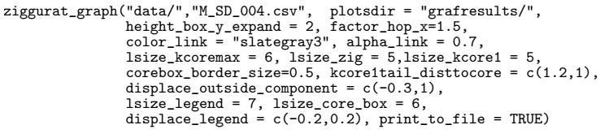
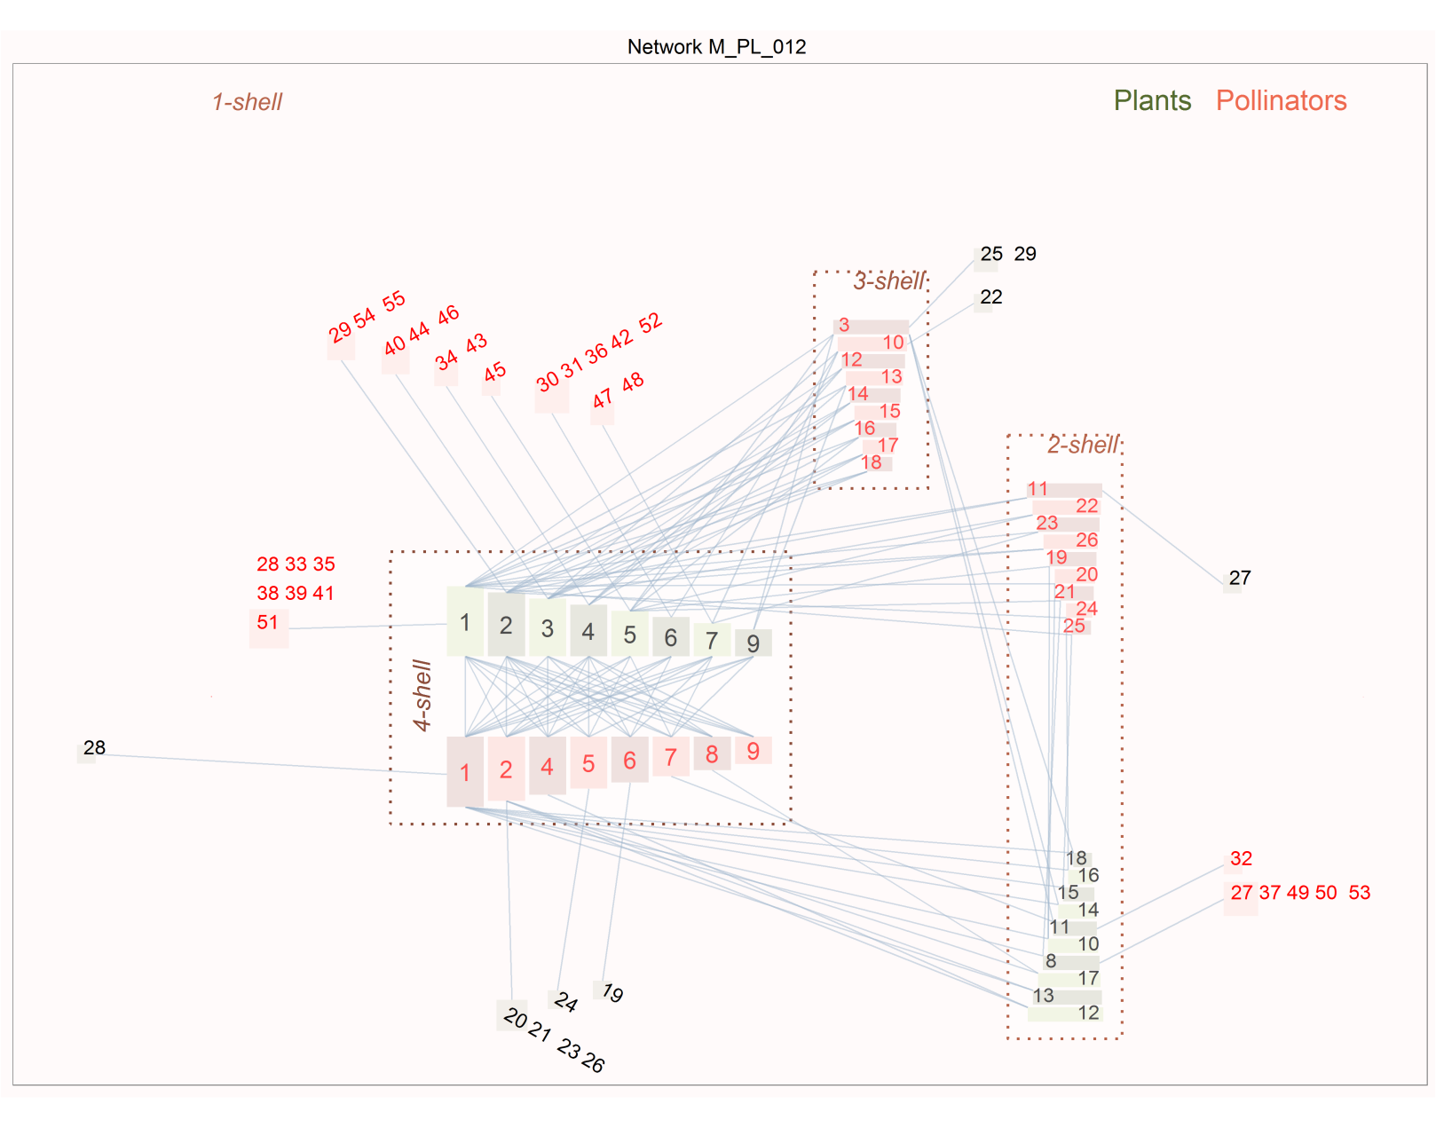
ziggurat_graph("data/","M_PL_012.csv", aspect_ratio = 1, height_box_y_expand = 2,
factor_hop_x=1.3, plotsdir="grafresults",
color_link = "slategray3, alpha_link = 0.5,
color_guild_a=c("darkolivegreen","darkolivegreen3"),
color_guild_b=c("coral2","coral4"),
labels_color= c("black","red"),backg_color = "snow",
lsize_legend = 7, lsize_core_box = 6,corebox_border_size=1,
innertail_vertical_separation = 2,lsize_kcoremax = 6,
lsize_zig = 5,lsize_kcore1 = 5,displace_legend =c(-0.2,0.2),
horiz_kcoremax_tails_expand = 3,displace_y_a=c(0,0.5,0,0),
displace_y_b=c(0,-0.2,0.1,0),rescale_plot_area=c(1.2,1),
coremax_triangle_width_factor = 1.15,
coremax_triangle_height_factor = 1.1,
fattailjumpvert = c(1.2,1.2),fattailjumphoriz = c(1.25,0.8),
print_to_file = TRUE, hide_plot_border = FALSE,
use_spline = FALSE, file_name_append = "improved")

