Slide 1
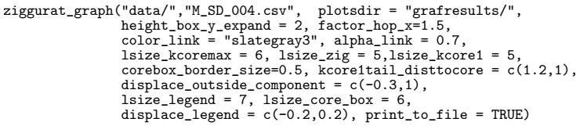
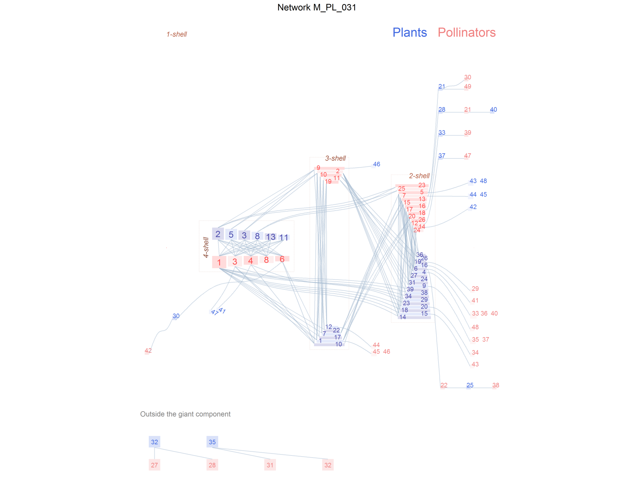
ziggurat_graph("data/","M_PL_031.csv", aspect_ratio =0.50, height_box_y_expand =3,
plotsdir = "grafresults",color_link = "slategray3",
alpha_link = 0.5, lsize_core_box = 4,
displace_legend = c(-0.2,0.2),factor_hop_x = 1.4,
lsize_kcoremax = 5,lsize_zig = 3.5,lsize_kcore1 = 3.5,
corebox_border_size=0.2, displace_outside_component = c(-0.5,0.8),
outsiders_separation_expand = 2,
outsiders_legend_expand = 2, kcore2tail_vertical_separation = 3,
weirds_boxes_separation_count=3,root_weird_expand = c(0.5,1),
weirdskcore2_horizontal_dist_rootleaf_expand = -0.3,
weirdskcore2_vertical_dist_rootleaf_expand = 0.5,lsize_legend = 7,
print_to_file = TRUE, file_name_append = "improved")
Flattened plot
Weirds modified position
aspect_ratio
weirdskcore2_horizontal_dist_rootleaf_expand,
weirdskcore2_vertical_dist_rootleaf_expand
These species’ vertical distance
Weird root leaf is closer
kcore2tail_vertical_separation
root_weird_expand
displace_outside_component,
outsiders_separation_expand,
outsiders_legend_expand
Displaced outsiders and increased separation.

