Slide 1
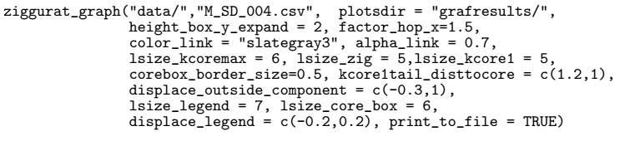
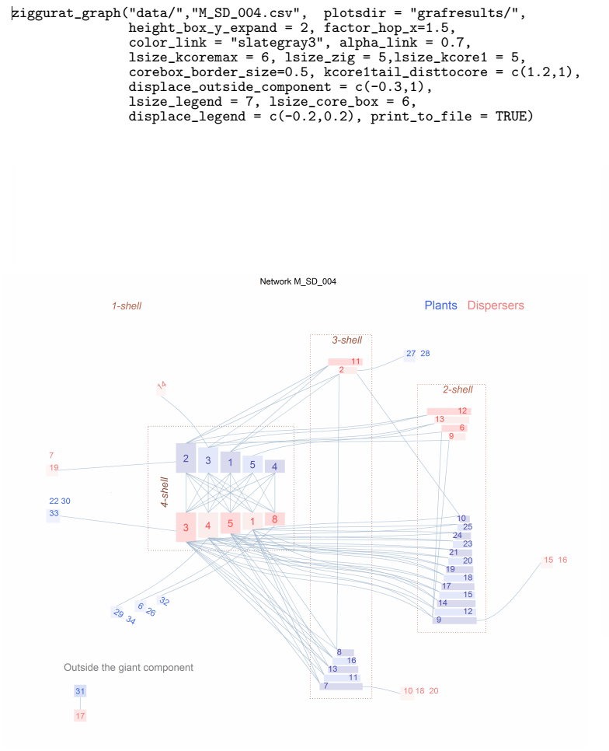
ziggurat_graph("data/","M_SD_004.csv", plotsdir = "grafresults/",
height_box_y_expand = 2, factor_hop_x=1.5, color_link = "slategray3",
alpha_link = 0.7, lsize_kcoremax = 6, lsize_zig = 5,lsize_kcore1 = 5,
corebox_border_size=0.5, kcore1tail_disttocore = c(1.2,1),
displace_outside_component = c(-0.3,1), lsize_legend = 7,
lsize_core_box = 6, displace_legend = c(-0.2,0.2), print_to_file = TRUE)
height_box_y_expand
Ziggurat boxes height increased by a factor 2
lsize_legend, displace_legend
Legend displaced leftwards -20%, upwards 20%
Corebox_border_size
lsize_coremax
Darker links
color_link, alpha_link
kcore1tail_disttocore
Species of kshell 1 linked to kshell max moved leftwards
lsize_zig lsize_kcore1
Species out of the giant component moved
Wider horizontal gap between ziggurats
displace_outside_component
factor_hop_x

