Slide 1

LP Optimization: Industrial Cogeneration Operation
MATH 7205-Fall 2020
Joshua Galloway

Slide 2
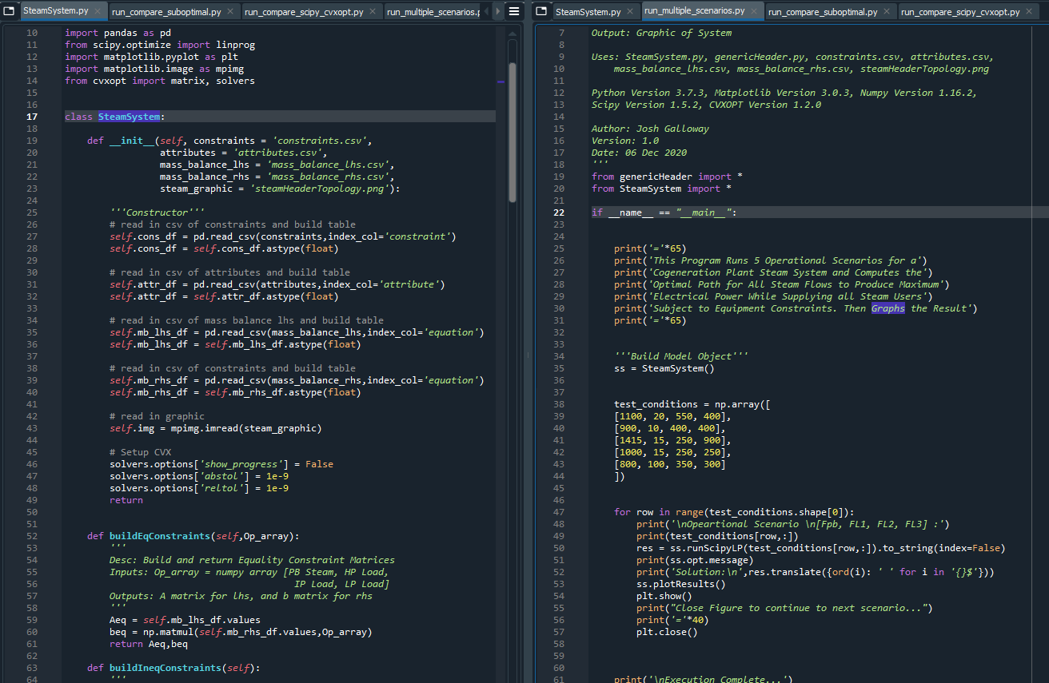
Presentation Outline
Introduction
Cogeneration Plant Operation Overview
Problem Statement
Fitting to Constrained Optimization Paradigm
Process Model and Constraints
Process Model
Process Constraints via Mass Balances and Equipment Limits
Objective Function via Energy Balance
Canonical Form
Results
LP Optimization
Solution Slightly Off LP Optimization Solution
Conclusion

Slide 3
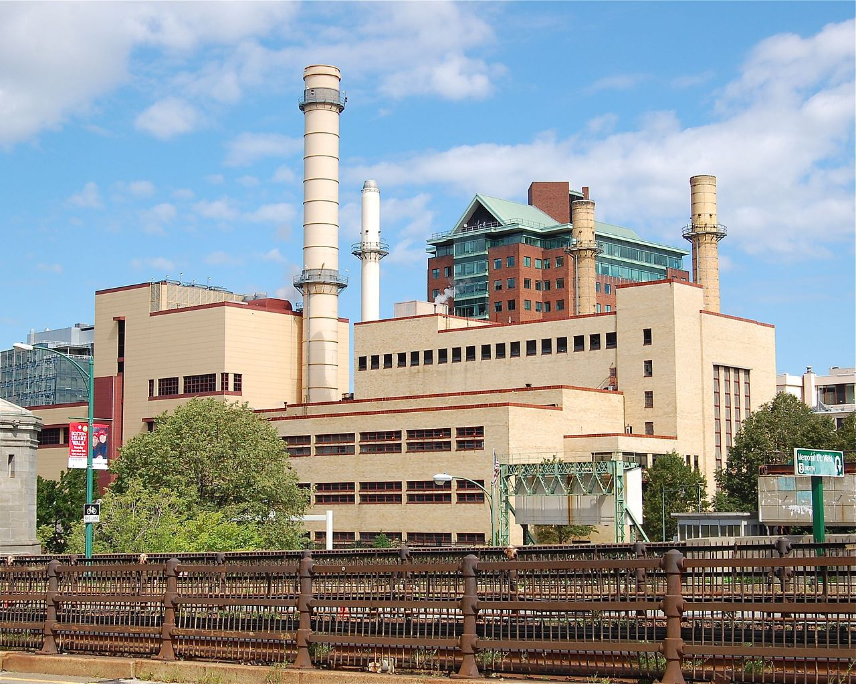
Introduction
Cogeneration Plant:
Also called Combined Heat and Power (CHP)
Produce Superheated Steam of Varying Pressures to Supply Industrial and Other Processes
Steam is Produced By Large Industrial Boilers from Combustion of Fuels
Biomass (Saw Dust, Bark, Corn Cobbs, Peanut Shells….)
Fossil Fuels (Natural Gas, Fuel Oils, Coal)
Steam is Generated at Higher than Required Pressure and Then Stepped-Down Through A Steam Turbine Generator to Produce Electrical Power
Kendall Square Cogeneration Station

Slide 4
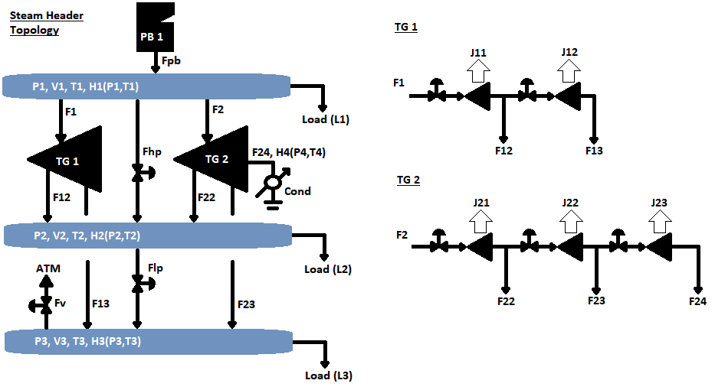
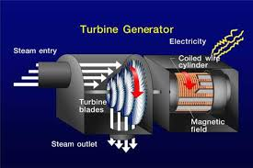
Introduction
Header System:
Equipment
Distribution Headers
Industrial Boiler (Steam Producer)
Turbine Generators
Condenser
Pressure Reducing Valves
Steam Vent Valve
Superheated Steam Enters Turbine and Is Run Across Fins to Rotate a Coil of Wire In a Magnetic Field Producing Current
TG1 has 2 Sets of Fins (called generating sections)
TG2 has 3 Sets and a Condenser

Slide 5
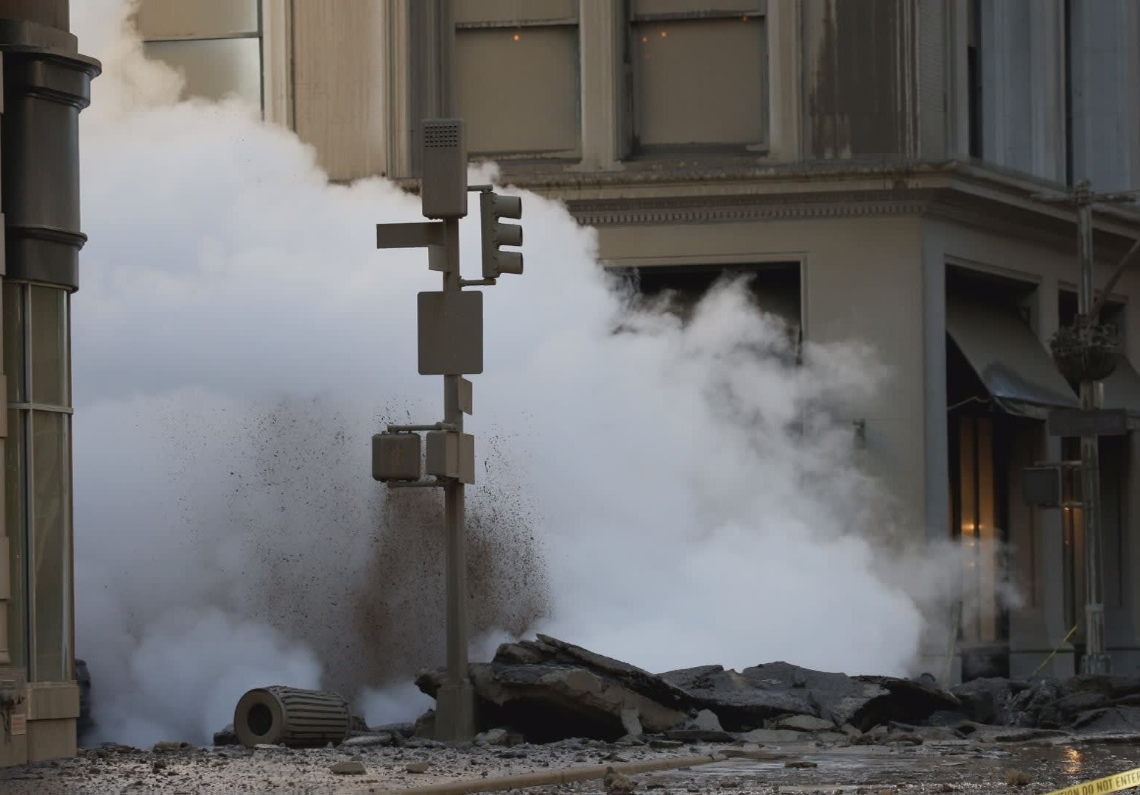
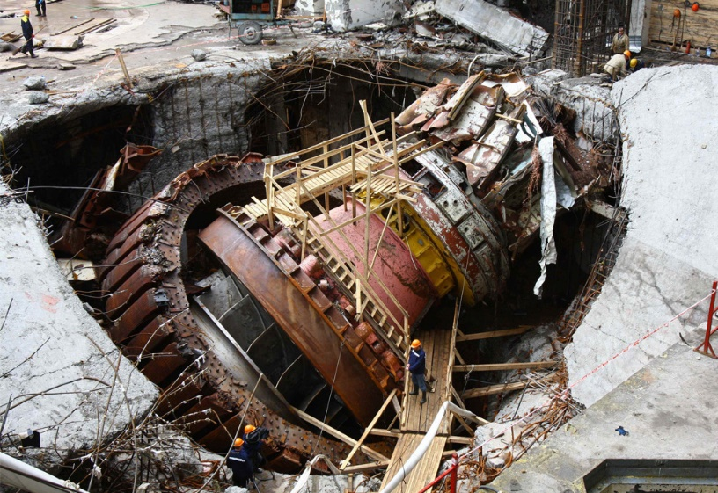
Problem Statement
Physical System Requirements and Optimization:
Mass Balance
Steam Flows at All Nodes (Headers and Forks in Path) Must Sum to Zero
Energy Balance
Energy (Enthalpy Flows) must Sum to Zero at all Nodes
Process Requirements
Steam Users Must Receive Required Steam
Equipment Design Limits Must be Obeyed or the Equipment will Fail
Optimization:
Choose the Best Path for Steam to Supply all Users and Obey Equipment Limits While Producing the Most Electricity Possible
Steam Pipe Failure, New York; Hydroelectric Turbine Failure, Russia

Slide 6
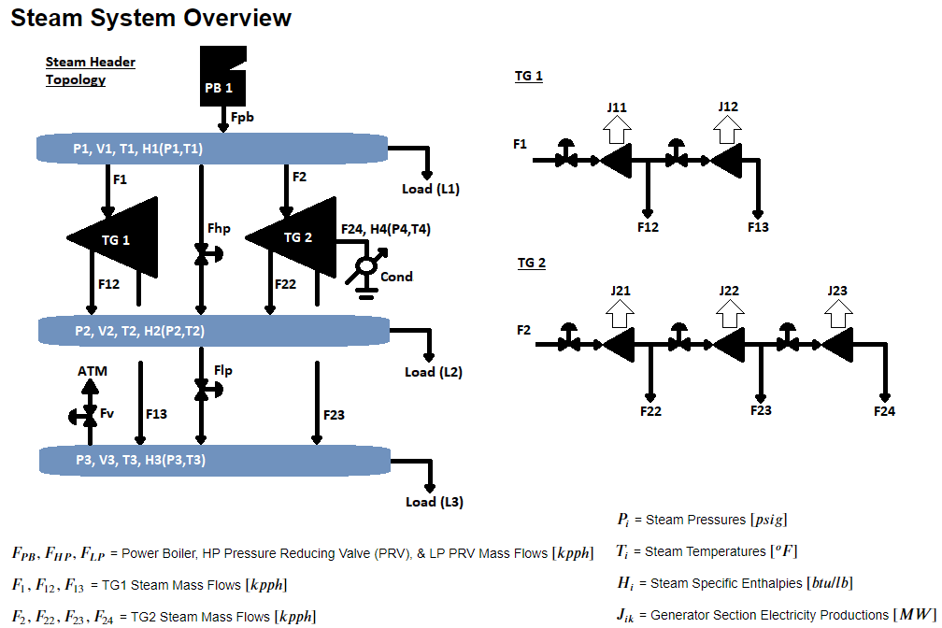
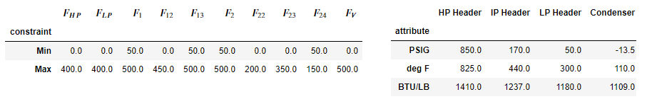
Process Model and Constraints

Slide 7
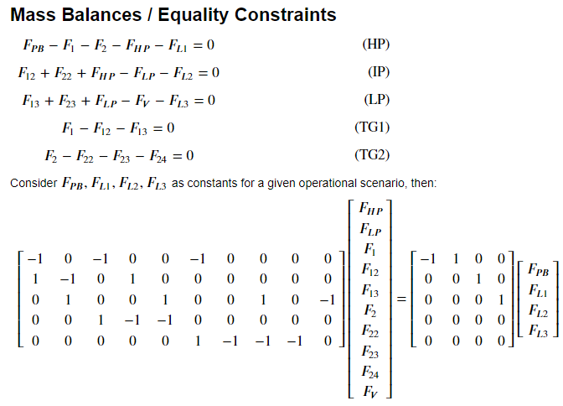
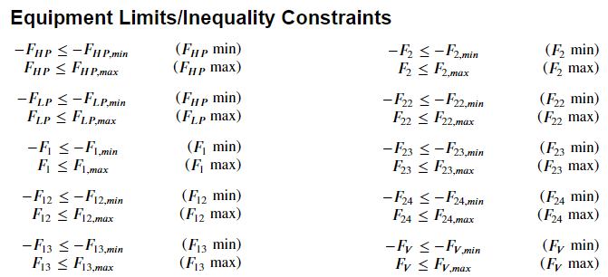
Process Model and Constraints

Slide 8
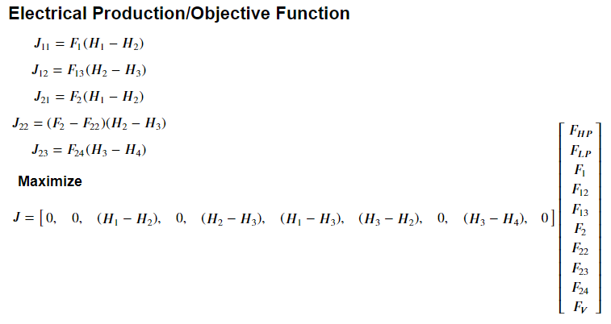
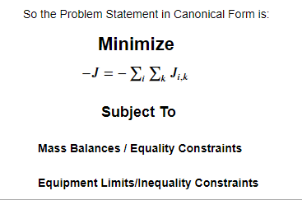
Process Model and Constraints
Energy Balance for Objective Function

Slide 9
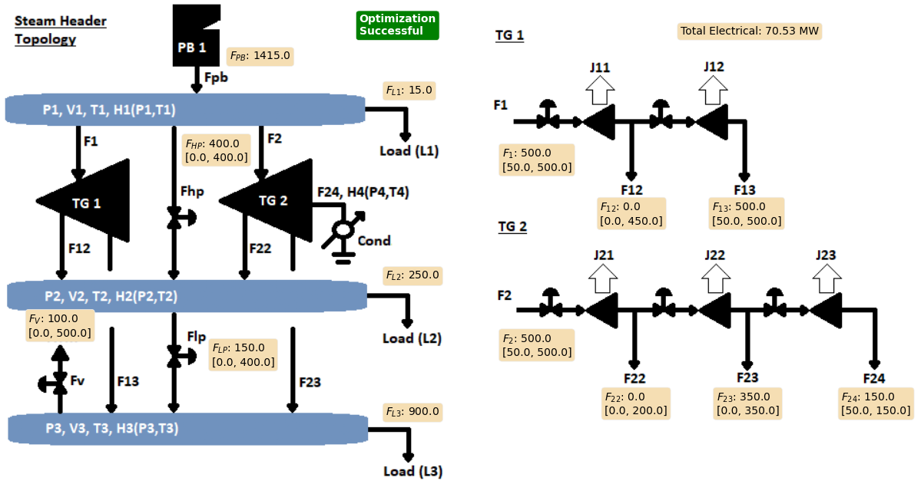
Results
LP Solution:
J23 is Most Efficient so TG’s are Loaded to Send Max Steam Through to Condenser
An Overall Excess of Steam is Produced, So Vent is Open
Low Press Extraction is at Max so F_LP PRV is Open

Slide 10
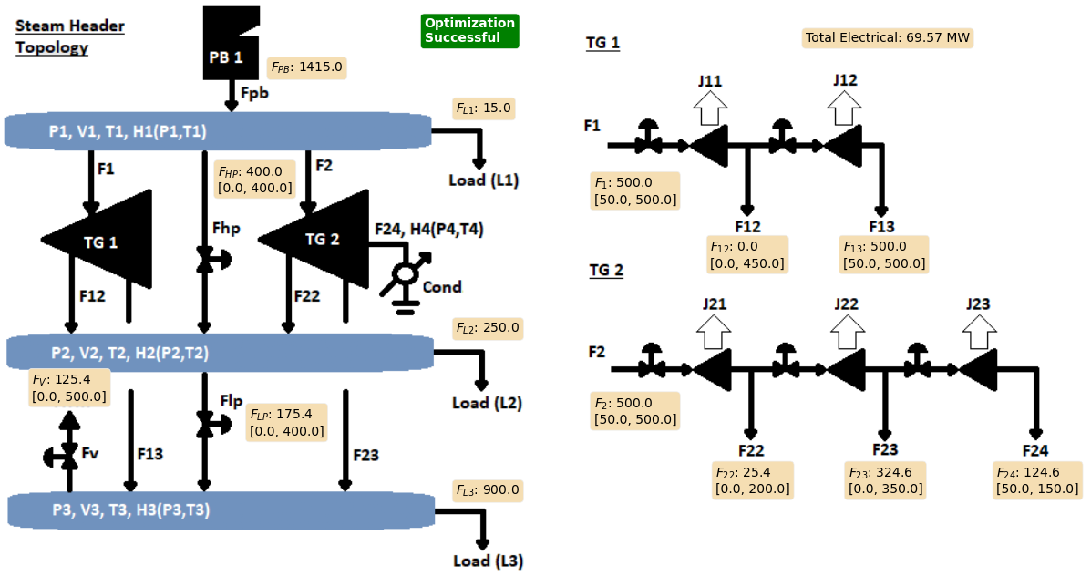

Results
Slightly Off LP Solution:
Steam Moved From Condenser to Vent
Slight Redirection of Extractions and PRV’s
Results in Loss of ~1 MW
Worth ~ $400K per year

Slide 11
Conclusion
We Saw…
Introduction
Cogeneration Plant Operation Overview
Problem Statement
Fitting to Constrained Optimization Paradigm
Process Model and Constraints
Mass and Energy Balances Used to Produce LP Canonical Form
Results
LP Optimization and Comparison
LP Solution Roughly $400k More Production per Year
Demo and Questions?

