Slide 1

Using Jupyter Notebooks to Explore Public CVE Data
VulnCon 2025
Jerry Gamblin

Slide 2
About Me
Jerry Gamblin
Principal Engineer Cisco TD&R
gambling@cisco.com
@jgamblin (X/Etc)
jerrygamblin.com
cve.icu

Slide 3
Rough Agenda
15 Minutes – Introduction
45 Minutes – Review Prebuilt Notebooks
15 Minutes – Break
1 Hour – Collaborative Development

Slide 4

Why This Talk?
I want to make CVE data analysis and enrichment a core part of this conference and wider discussions around vulnerabilities.

Slide 5
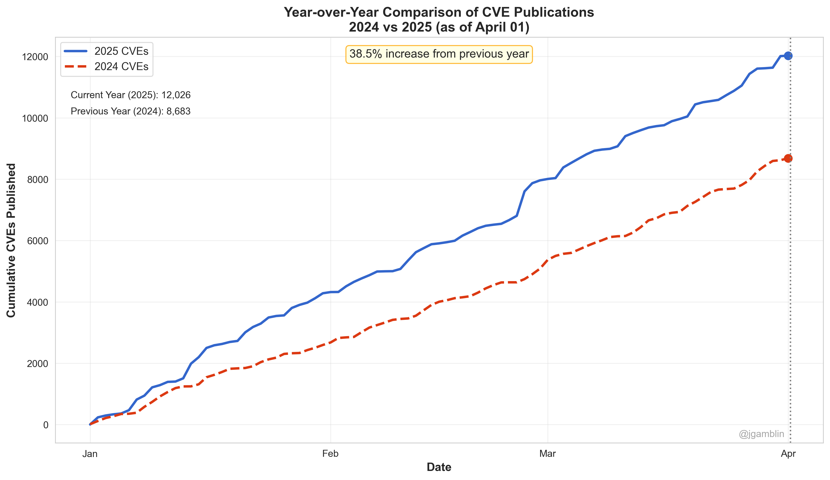
Vulnerability Visualizations Work

Slide 6
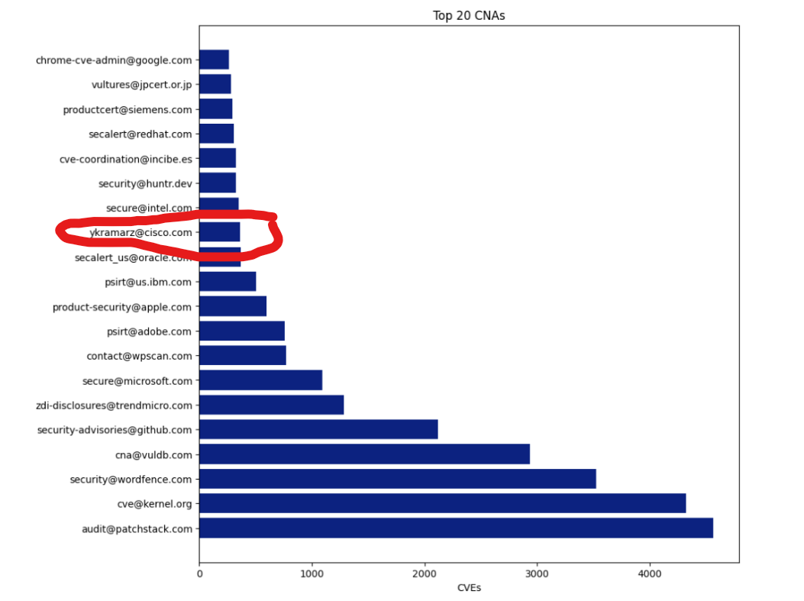
Sometimes the company you work for CAN’s contact email is listed as a single engineer instead of your PISRT for 10 years and no one notices it until someone reads your personal blog.

Slide 7
Direct People To CVE Program Data
CVE Data User
NVD
CVE Program
Other Sources
OSV
CIRCL
Paid Data

Slide 8
Workshop Goals
Baseline Understanding of CVE Data and Sources.
More People Creating and Sharing Notebooks.
More Public Usage Of CVEv5 GitHub Repo

Slide 9
Workshop Overview

Slide 10
Data Sources Used
NVD
2.0 API
NVD JSONL File
nvd.handsonhacking.org/nvd.jsonl
1.5 GB
CVE
CVE V5 List
Individual JSON Files
github.com/CVEProject/CVElistv5
Limited to CVE-2025-* CVEs
200 MB

Slide 11
Technology Used
Jupyter Notebooks
Pandas
Matplotlib
MyBinder

Slide 12
Workshop Material
GitHub Repository:
https://github.com/jgamblin/vulnconworkshop
MyBinder Preferred:
https://mybinder.org/v2/gh/jgamblin/VulnconWorkshop/HEAD

Slide 13
Notes
Please Ask Questions!
This is a Hybrid Course
Please Utilize Discord for any technical coding questions
I am available to assist with local setup.
Unsure if network can download data files.
AI Coding agents are super useful, although not part of MyBinder
The notebook walk through is high level but happy to take a deep dive in the second hour.

Slide 14
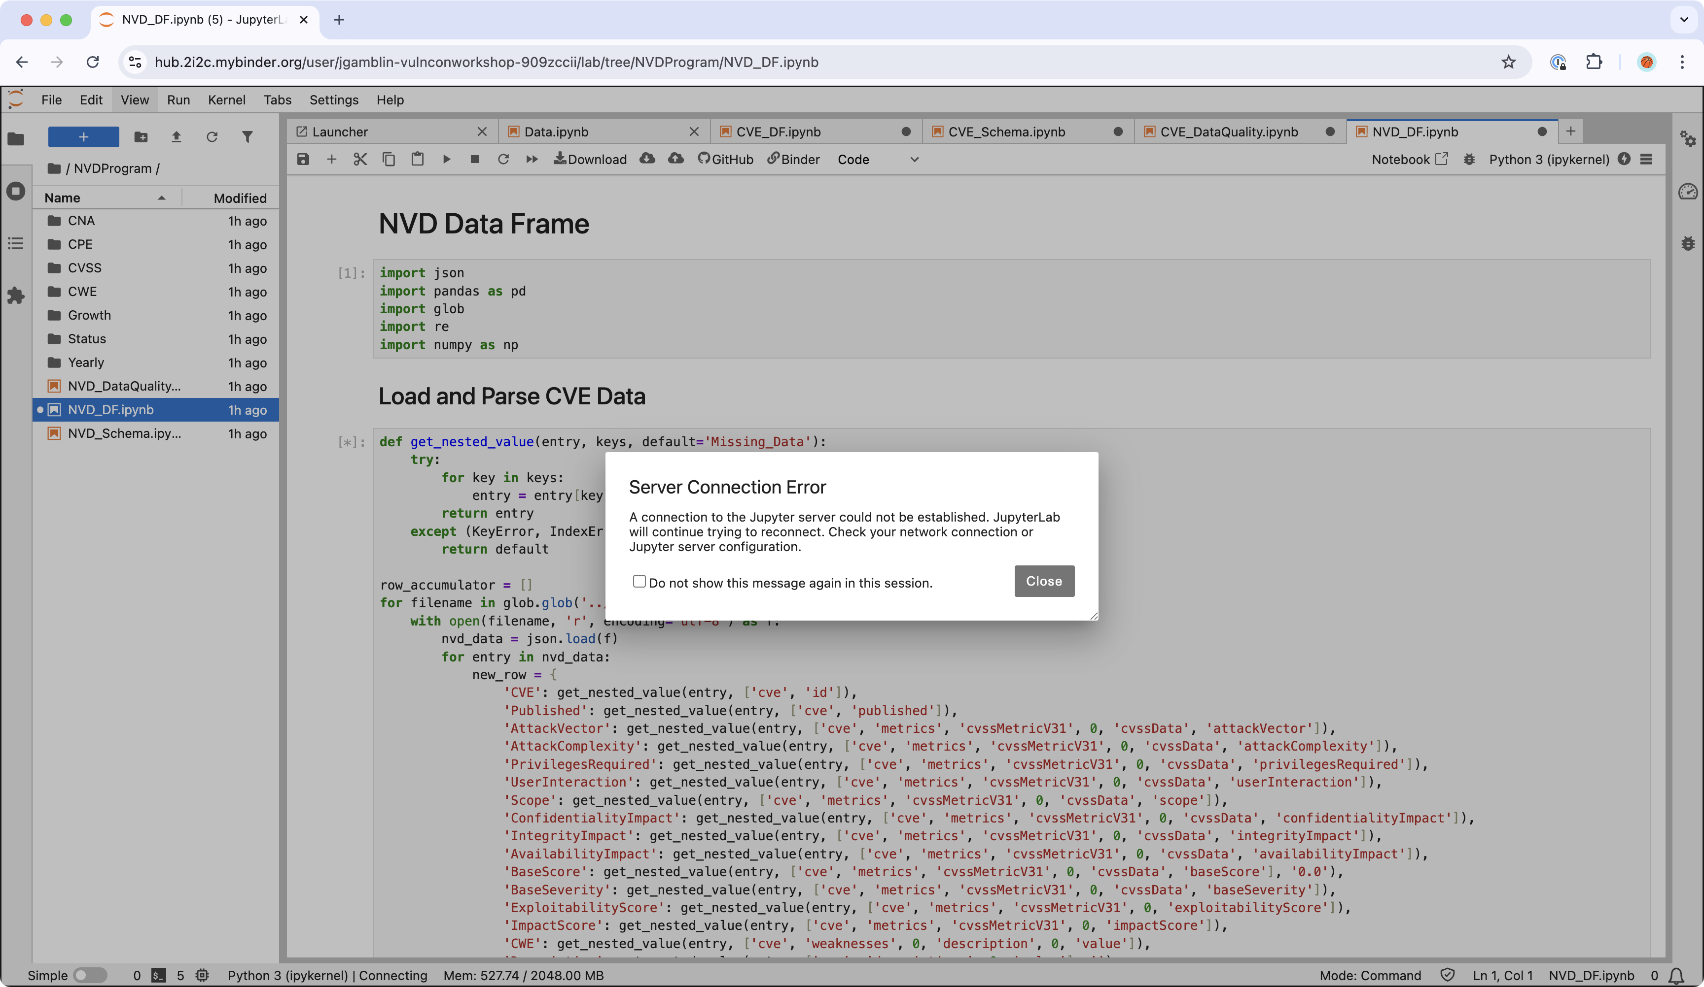
Possible Demo Issues On NC State WIFI

