Slide 1
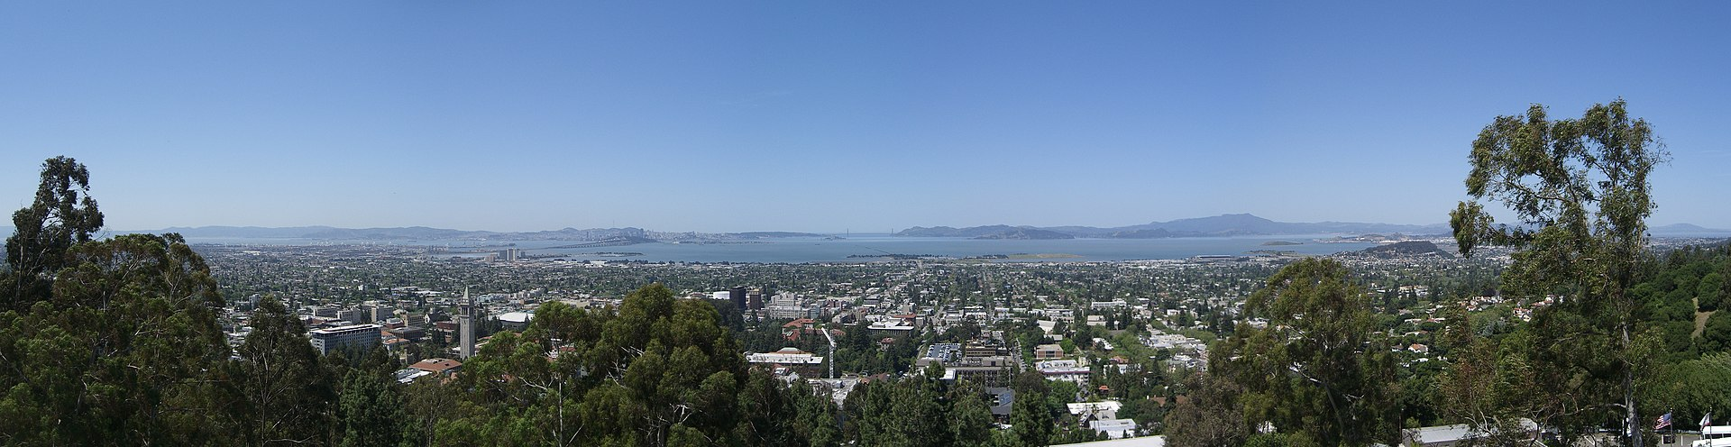
BEST OFFICE LOCATION IN THE SAN FRANCISCO BAY AREA

Slide 2

INTRODUCTION – OUR BUSINESS
New start-up developing augmented reality glasses
Focused on geolocation features
Telemetry (speed, heart rate…) while doing sports
Maps navigation while driving
Live stats when attending any event (NFL, NBA matches, NASCAR races…)
Important companies investing and supporting us (Strava, Google, Apple…)
We are going to hire 50 people for our start-up

Slide 3
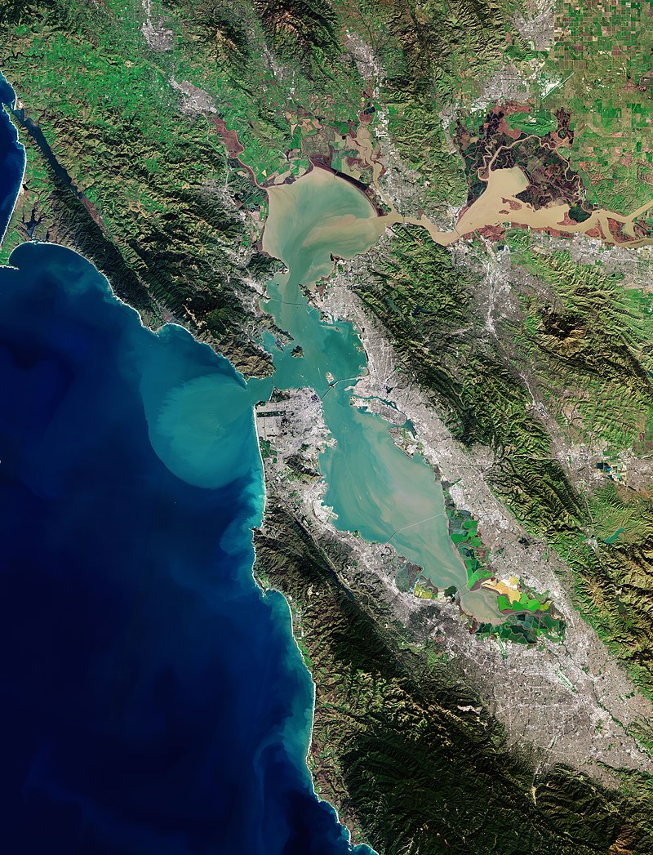
INTRODUCTION – OUR PROBLEM
We want to find an office location within San Francisco Bay Area
We don’t want to waste our time visiting all the cities in the Bay
Our requirements:
Medium size city (between 20 and 120k inhabitants)
Office located in the city center
Enough number of interesting venues (restaurants, sports venues, bars, stores, etc…)
Public transport facilities

Slide 4
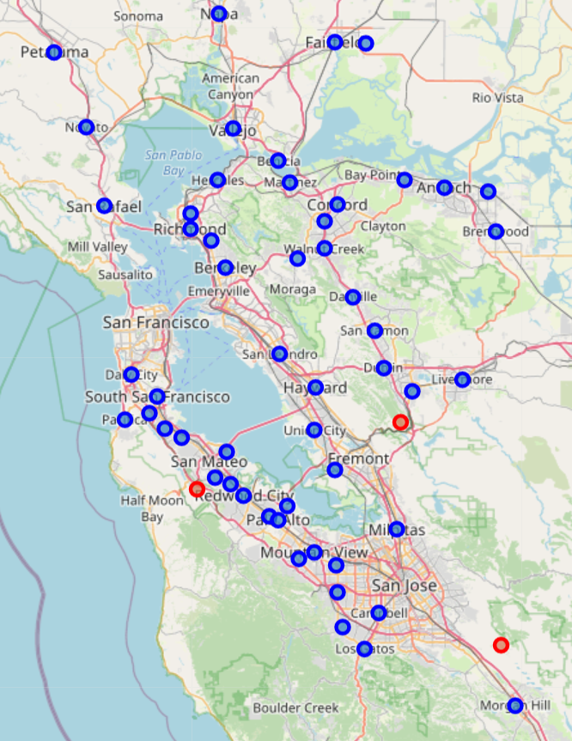
DATA ADQUISITION - SOURCES
List of municipalities around SF Bay Area
Wikipedia - https://en.wikipedia.org/wiki/List_of_cities_and_towns_in_the_San_Francisco_Bay_Area
101 municipalities and their population retrieved, 60 after population filter
Longitude and Latitude for Each City
Geopy-Nominatim Python package
Venues around each city center
FourSquare API

Slide 5
DATA ADQUISITION – VENUES DATAFRAME
City | City Latitude | City Longitude | Venue | Venue Latitude | Venue Longitude | Venue Category
Alameda | 37.670135 | -122.080198 | Los Compadres | 37.671547 | -122.082623 | Mexican Restaurant
Alameda | 37.670135 | -122.080198 | The Twilight Zone Gift & Smoke Shop | 37.667470 | -122.079115 | Smoke Shop
Alameda | 37.670135 | -122.080198 | Caspers Hot Dogs | 37.671328 | -122.082266 | Hot Dog Joint
Alameda | 37.670135 | -122.080198 | The Bistro | 37.672883 | -122.082600 | Bar
Alameda | 37.670135 | -122.080198 | Le Paradis | 37.669716 | -122.082025 | Vietnamese Restaurant
Alameda | 37.670135 | -122.080198 | Wendy’s | 37.667801 | -122.080493 | Fast Food Restaurant
Alameda | 37.670135 | -122.080198 | Favorite Indian Restaurant | 37.667740 | -122.079572 | Indian Restaurant
Alameda | 37.670135 | -122.080198 | Hayward Farmers Market | 37.671309 | -122.084977 | Farmers Market
Alameda | 37.670135 | -122.080198 | Charlotte's | 37.673275 | -122.081865 | Cupcake Shop
Alameda | 37.670135 | -122.080198 | Peet's Coffee & Tea | 37.672146 | -122.084228 | Coffee Shop
Defined a search radius of 500 meters around city centers
2077 venues retrieved for the 60 pre-selected municipalities
Will use the Venue Categories to classify the venue into different types (Restaurants, Sports Venues, Shops, etc…)
Showing the 10 first venues retrieved from FourSquare

Slide 6
DATA PREPARATION – CATEGORY AGGREGATION
Venue Category
Mexican Restaurant
Smoke Shop
Hot Dog Joint
Bar
Indian Restaurant
Vietnamese Restaurant
Fast Food Restaurant
Farmers Market
Coffee Shop
Cupcake Shop
There are 265 different unique Venue Categories within our 2077 retrieved venues
Need to group into more general categories
Will group into 15 “aggregated categories”:
Restaurants, Casual Food, Sports, Bar, Public Transport, Store, Soft Drinks, Entertainment…
Aggregated Category
Restaurant
Casual Food
Bar
Store
Soft Drinks
Sports
…
Examples of category aggregations

Slide 7
DATA PREPARATION – VENUES PER CITY & CATEGORY
City | Bar | Casual Food | Entertainment | Public Transport | Restaurant | Soft Drinks | Sports | Store
Alameda | 7 | 11 | 1 | 0 | 21 | 2 | 2 | 3
Antioch | 0 | 0 | 0 | 0 | 5 | 1 | 2 | 2
Belmont | 0 | 3 | 0 | 0 | 1 | 0 | 1 | 2
Benicia | 4 | 4 | 1 | 0 | 11 | 4 | 1 | 0
Berkeley | 4 | 4 | 5 | 0 | 14 | 7 | 3 | 3
Brentwood | 3 | 7 | 1 | 1 | 8 | 1 | 0 | 0
Burlingame | 2 | 9 | 0 | 0 | 13 | 3 | 0 | 1
Campbell | 3 | 13 | 3 | 1 | 9 | 2 | 4 | 8
Concord | 3 | 13 | 1 | 0 | 23 | 5 | 0 | 1
Cupertino | 1 | 5 | 0 | 0 | 12 | 4 | 2 | 9
10 first venues count per city and category – Final data frame to be used for our statistical analysis
Using one-hot encoding technique -> Group by city and category and counting number of venues of each type per city

Slide 8
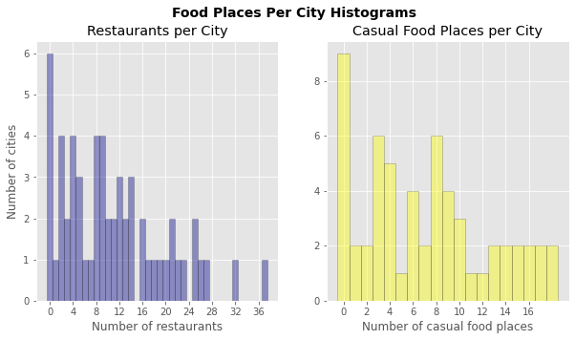
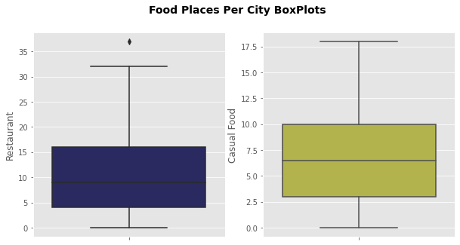
DATA ANALYSIS – FOOD PLACES
Median for each category: 9 for restaurants & 7 for casual food places
Using median as minimum threshold = Enough for our employees doesn't need to repeat restaurants at least in couple of weeks
Still around 50% of cities above the threshold

Slide 9
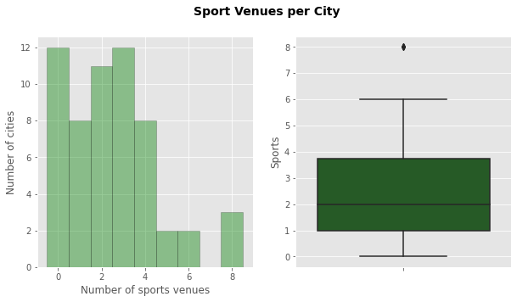
DATA ANALYSIS – SPORTS VENUES
Median in this case is 2 sports venues per city
Consider it a low number for our requirements, so we set the threshold to 3
Still more than 25% of cities above the threshold

Slide 10
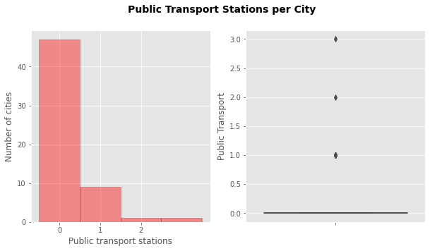
DATA ANALYSIS – PUBLIC TRANSPORT
Most of the cities have 0 public transport stations
We know there are train, buses and metro in most of the cities in the Bay
It seems to be an anomaly in the FourSquare API
We don’t use this as restrictive filter

Slide 11
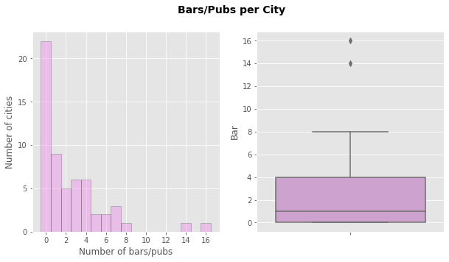
DATA ANALYSIS – AFTERWORK DRINKS (BARS/PUBS)
Median for bars is 1 for each city
There are still a lot of cities with 2 or more bars (around 40%)
Will set the threshold to at least 2 different bars

Slide 12
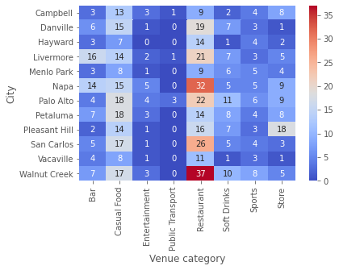
DATA ANALYSIS – CANDIDATE CITIES HEAT MAP
After applying the filters, there are 11 final candidates
Will select 3-4 that fit best our criteria
Compare cities through a heat map where we explore and compare number of venues per city
Difficult to compare if there are categories with a number of venues >> other categories

Slide 13
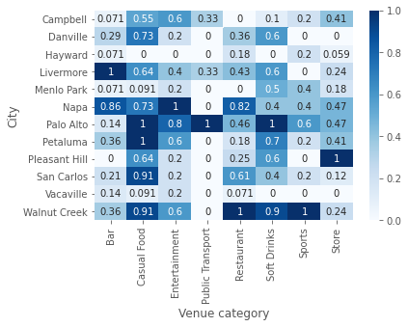
DATA ANALYSIS – NORMALIZED HEAT MAP
The solution consists on normalize each category
Now the range for each one will be between:
0 -> If the number of venues is the minimum for that category (9 for restaurants, 2 for bars, etc…)
1 -> If is the maximum number inside a category (37 for restaurants, 18 for casual food places, etc…)

Slide 14
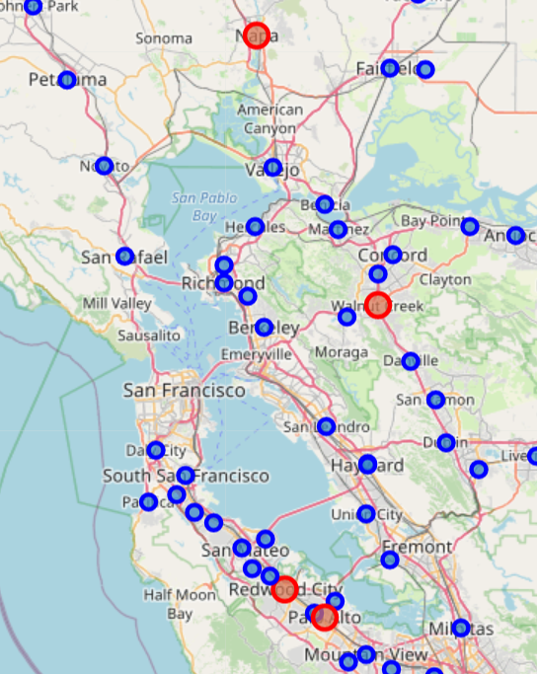
RESULTS – FINAL SELECTION (I)
4 selected cities:
Napa
Walnut Creek
Redwood City
Palo Alto
After checking map once again, we discard Napa
Far from most of the cities in the Bay

Slide 15
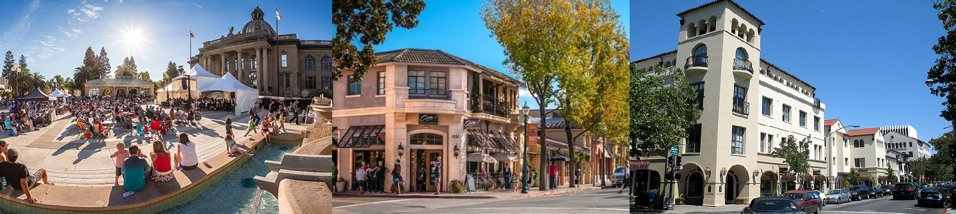
RESULTS – FINAL SELECTION (II)
We will only need to visit our 3 final candidate cities in order to find the best place for our offices
Redwood City
Walnut Creek
Palo Alto

