Slide 1
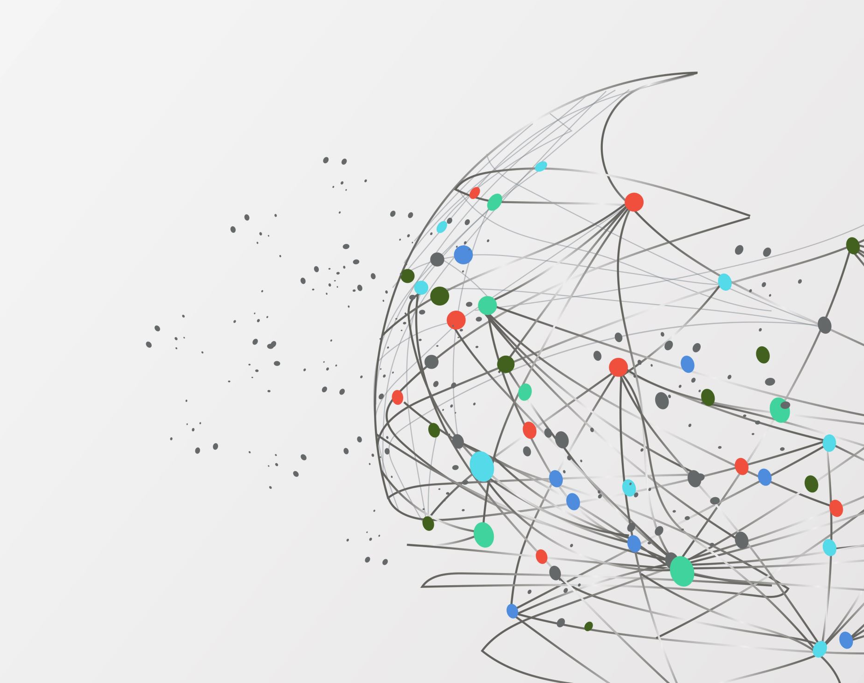
Final recap

Slide 2
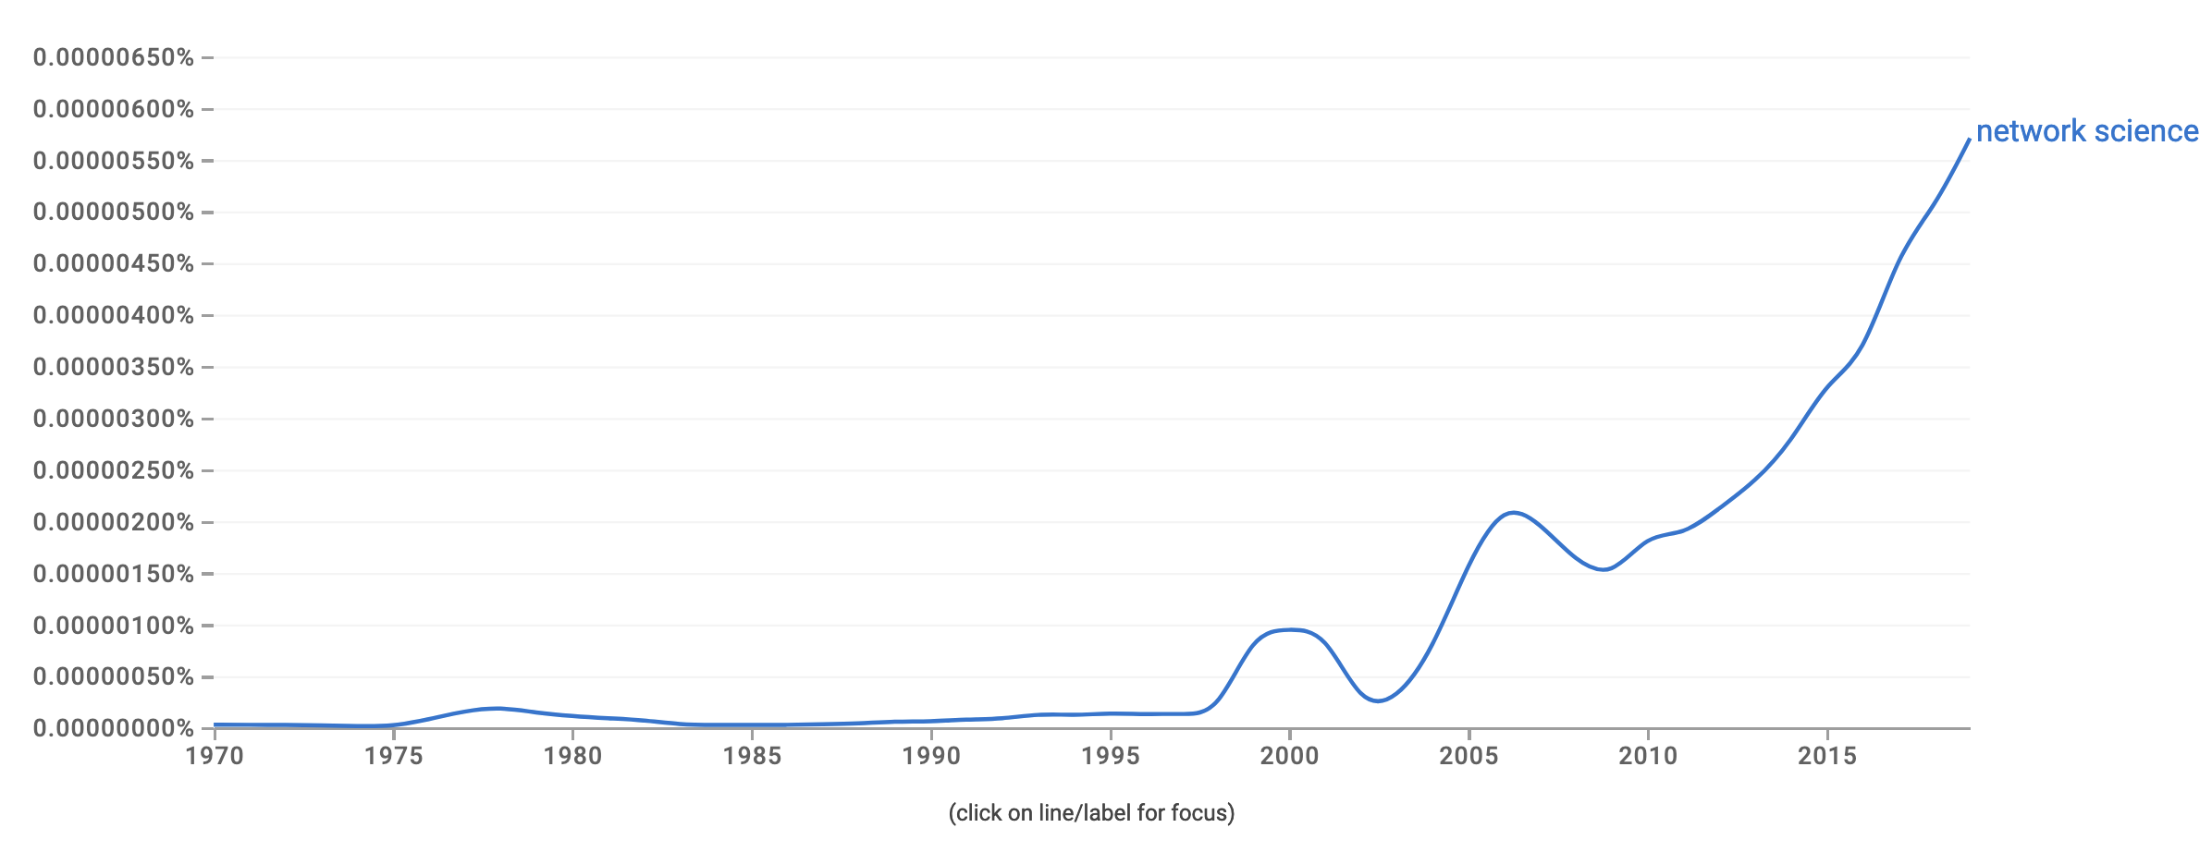
Network science is a huge field

Slide 3
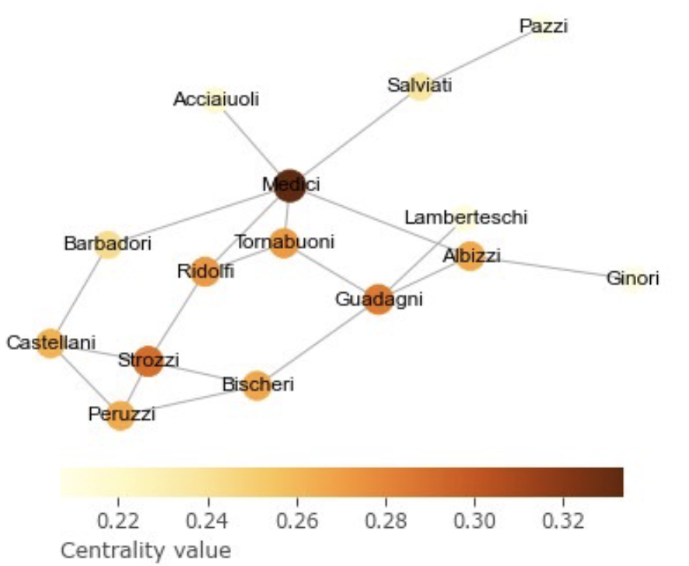
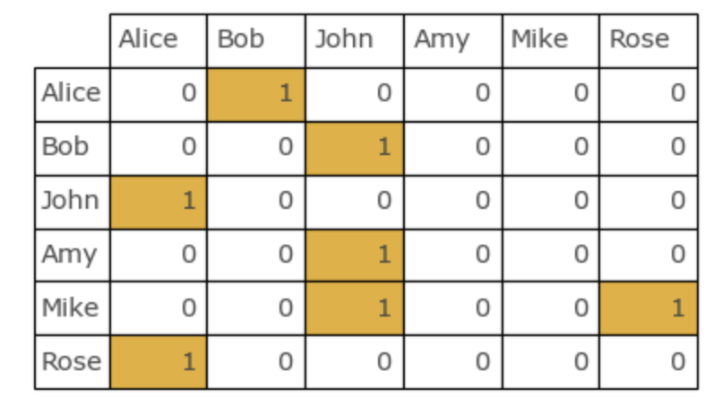
Day 1 – Javier
Introduction to the summer school
Represent networks
Describe networks (e.g. centralities)

Slide 4
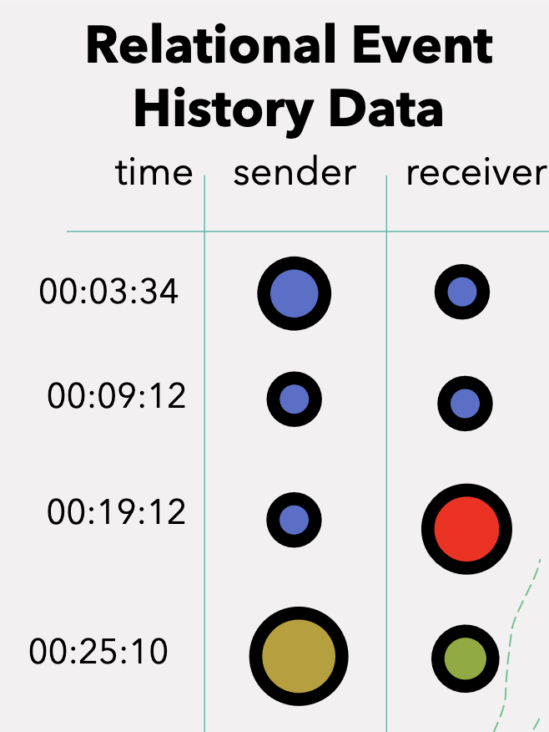
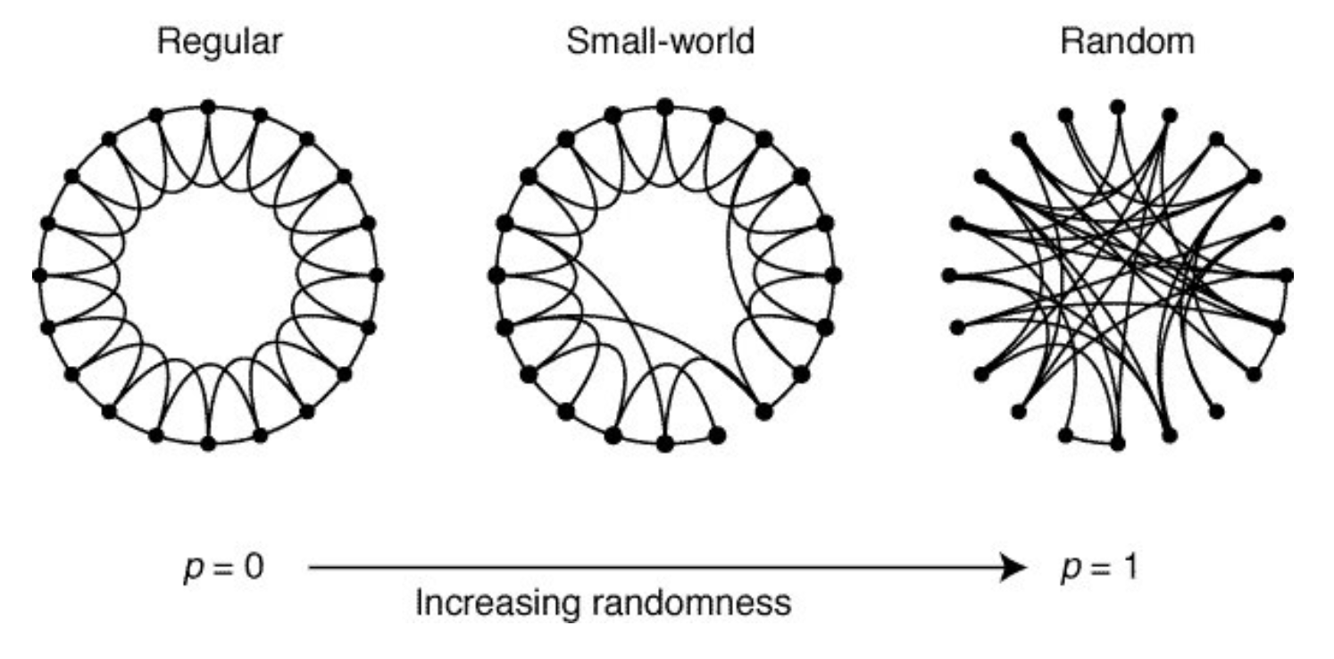
Day 2 – Leto and Mahdi
Testing hypothesis using network models
Studying event dynamics using REM

Slide 5
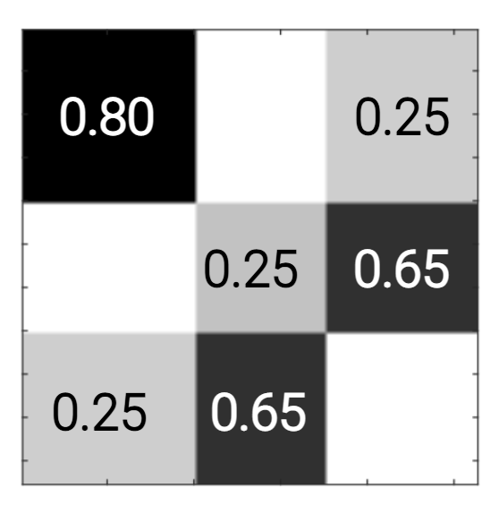
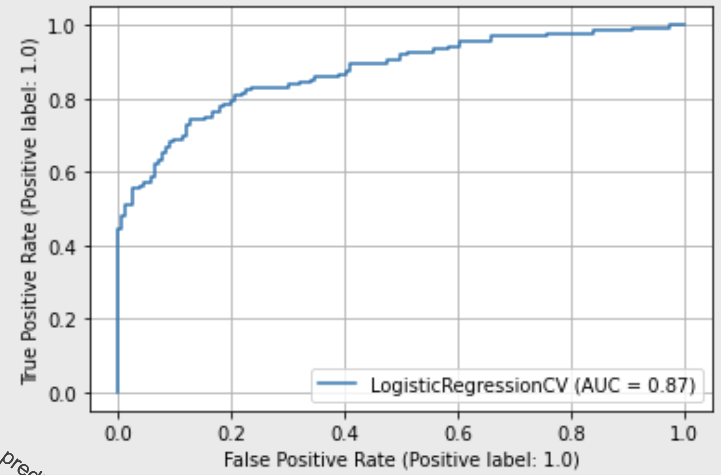
Day 3 – Leto and Javier
Inferring community structure: SBM
Predicting links and node embeddings

Slide 6
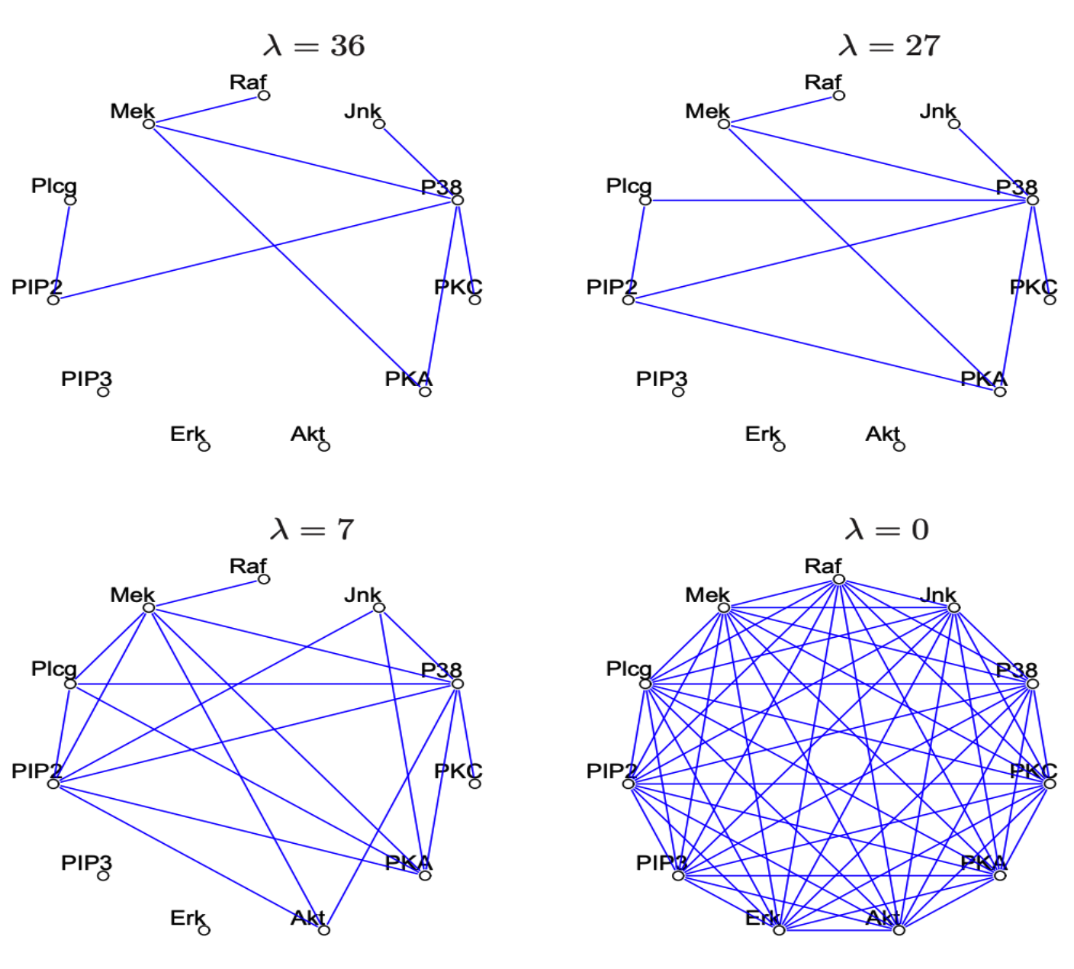
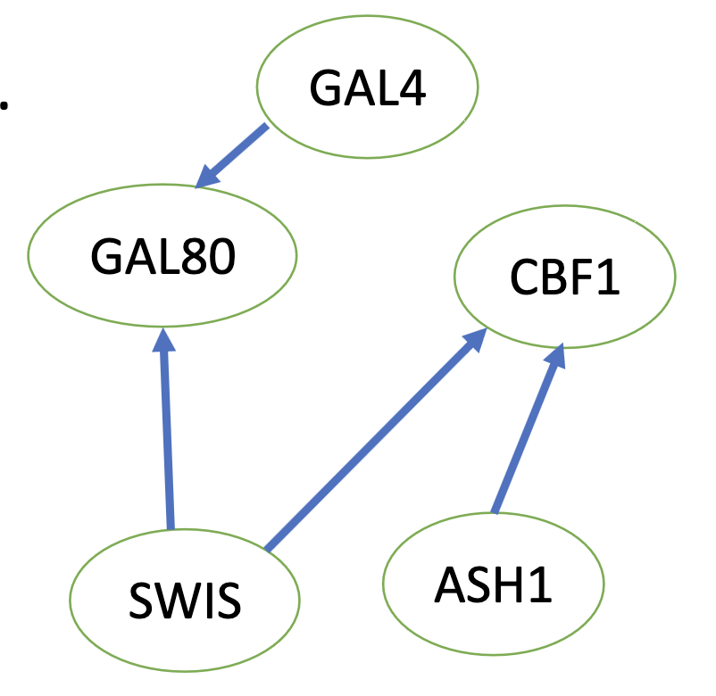
Day 4 – Mahdi
Network inference:
Probabilistic Graphical Models

Slide 7
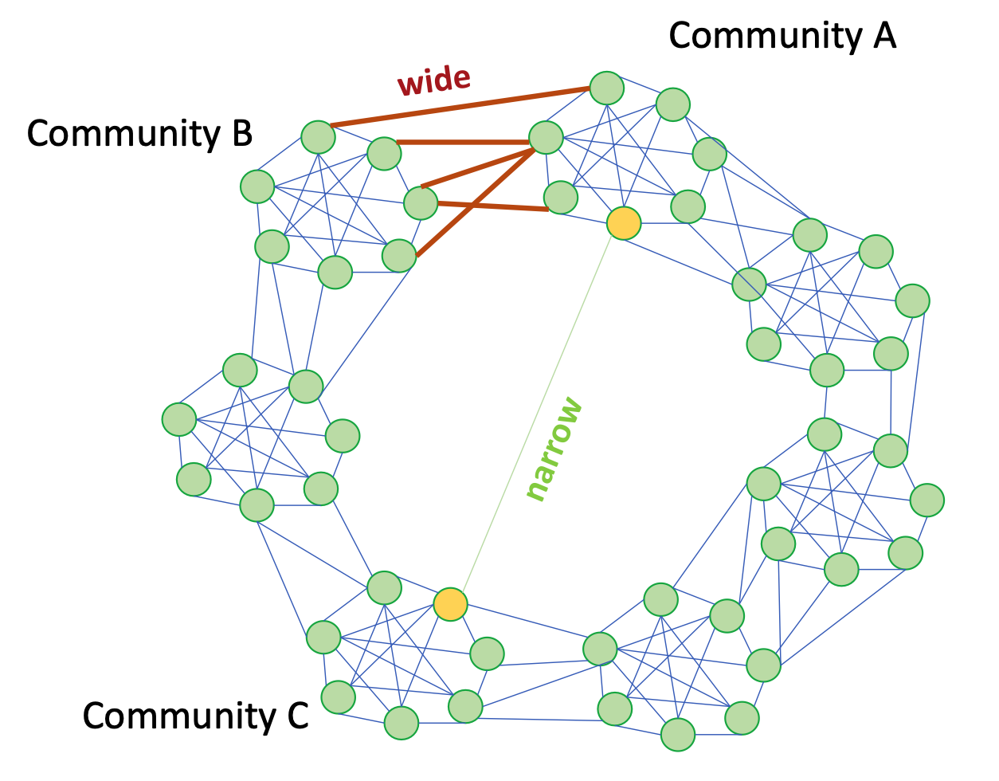
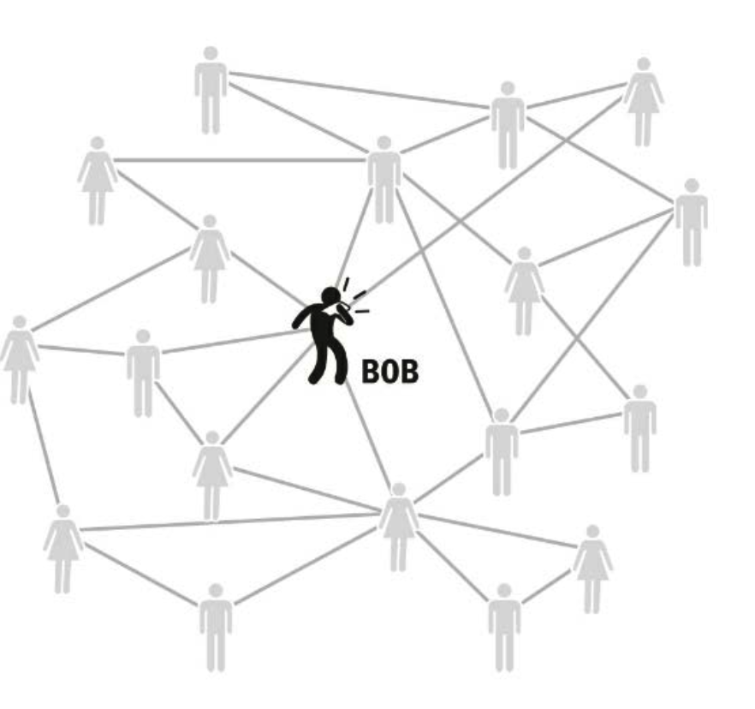
Day 5 – Vincent and Jiamin
Understanding dynamics: simple and complex contagion

Slide 8
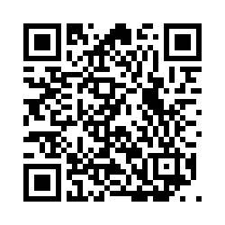
Evaluation of the course
Network Science
Special Interest Group: bit.ly/netsci-sig
Keep in touch!
javier.educ@proton.me

