Slide 1


Diffusion in Networks
Jiamin Ou
Summer School: Network Science
Day 5, Afternoon Session
2026

Slide 2

Memberships of civil rights activists in 1964- “Freedom Summer” :
Despite the fact that weak ties offered an obvious advantage for rapidly increasing the movement’s exposure, memberships grew primarily through recruitment networks composed of strong ties.
(Lisa Berkman and Ichiro Kawachi, 2011)
Notes:
In the tutorial of this morning, we have showed that weak ties are very powerful ..40 years later

Slide 3
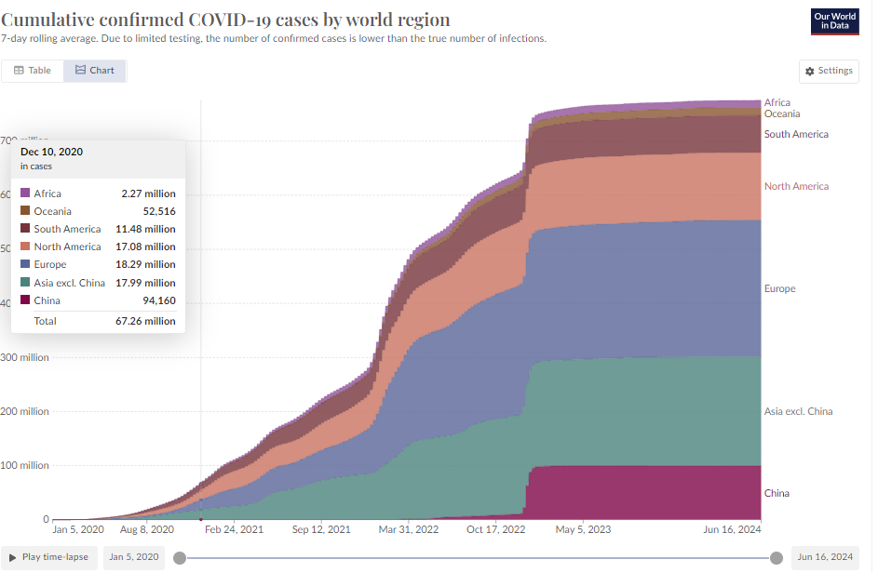
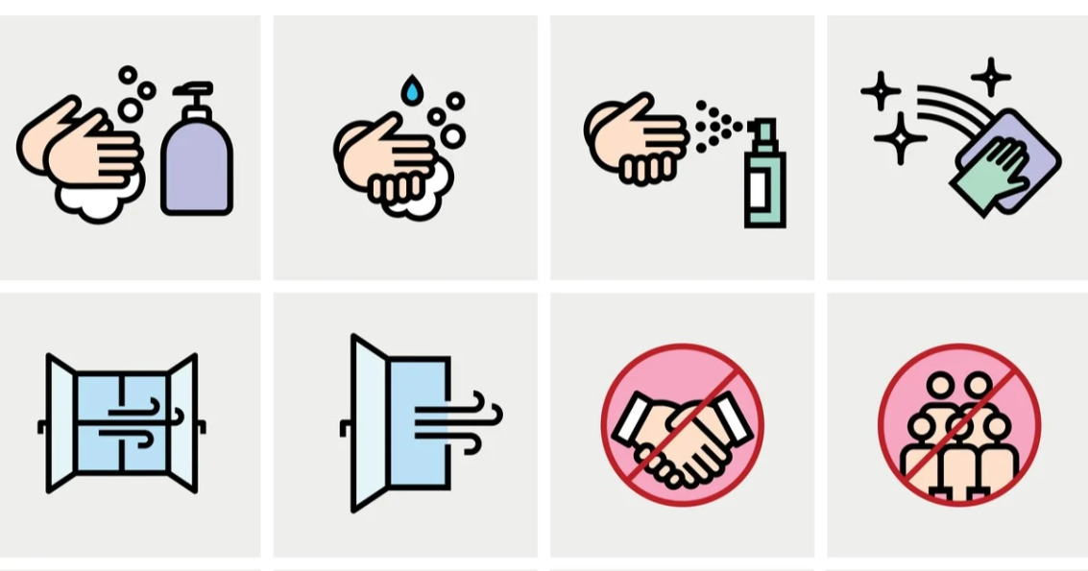
The spread of personal hygiene behaviour is much slower than COVID. Why?
VS
Spread of hand-washing, mask-wearing and other behaviours
Spread of COVID
Notes:
When we talk about Diffusion in social network, it is so complicate that we can not use simple contagion to explain everything. Here, I show two examples, the first one is the spread of covid, the spread of virus can go quickly in the network.
Morning…. There is other mechanism other than simple contagion. For example, one thing that we noticed is….
“Why things spread and why they stop?”

Slide 4
Today’s programe
Simple contagion
Mechanism and the strength of ‘weak ties’
Diffusion model for simple contagion
Independent cascade model and other variants
Complex contagion
Mechanism and the strength of ‘strong ties’
Diffusion model for complex contagion
Threshold model and seeding
Notes:
Contagiousness of disease and behaviour

Slide 5
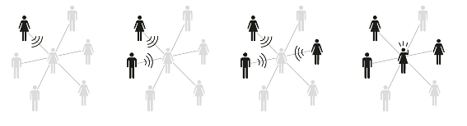
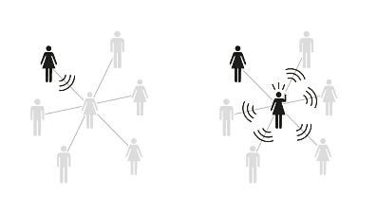
Mechanism of complex contagion
Multiple (and credible) sources are required for transmission
Examples
Change of diet
High-risk social movements
Other risky/costly behaviours
Recall for simple contagion:
Notes:
Simple contagion: Single contact sufficient for transmission. For the pppl central in the network, she will get infected if one of her contacts in the network in infected. Or she only needs one friend to tell her the juicy gossip.

Slide 6
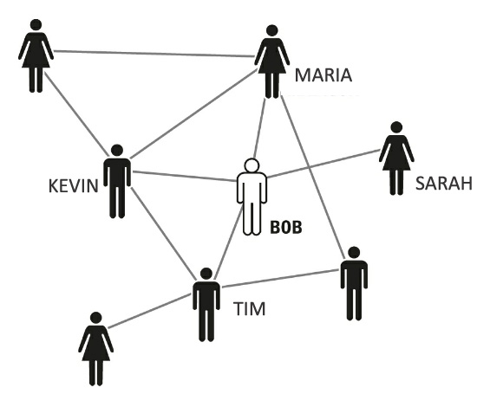
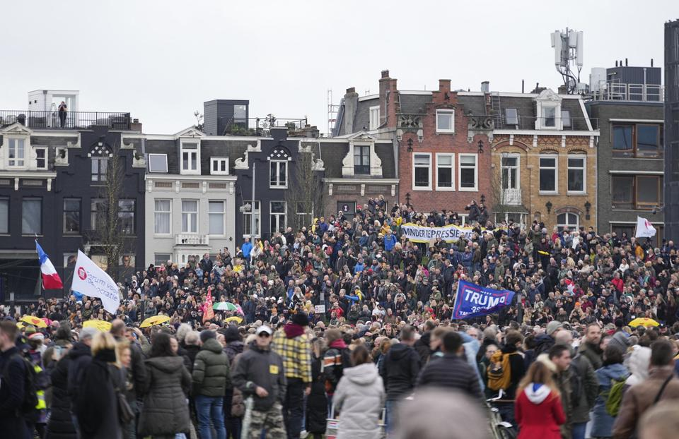
Demonstration of complex contagion in a small network
Bob is now considering joining an illegal climate change protest
(High-risk social movement)
?
1st round: Bob
MILA
?
?
ALICE
?
Luuk
Notes:
Strong-tie networks—in which people interact with one another in trusted, close-knit groups

Slide 7
Demonstration of complex contagion in a small network
Bob is now considering joining an illegal climate change protest
(High-risk social movement)
Kevin and Bob are both going. I will join them!
Maybe not….Bob told me he will join. But I don’t know him that well and my other friends are not going!
1st round: Bob
2nd round: Bob → Kevin, Maria, Tim, Sarah
MILA
×
The connection between Bob and Sarah is not strong enough to convince Sarah.
(Weak tie fails!)
I know Bob very well and he convinces me!
ALICE
Luuk
Thanks to the redundancy of strong ties, Kevin, Maria and Tim have multiple sources to confirm the credibility of the behavior and support each other.
Notes:
Strong-tie networks—in which people interact with one another in trusted, close-knit groups

Slide 8
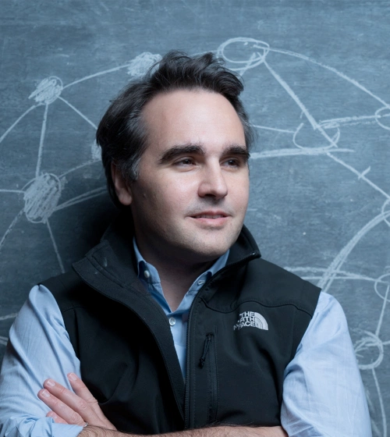
Complex Contagions and the Weakness of Long Ties, Centola &Macy, 2007 Complex contagions depend primarily on the width of the bridges across a network, not just their length.
Damon Centola
https://www.damoncentola.com/
Notes:
By this small example, we already touched the key point raised by Centola, a social scientists speciliazes in complex contagion. What he argues is that, as what we showed in the example, weak ties are not always useful to the diffusion of complex contagion. The diffusion of complex contagion depends on the width of bridge.

Slide 9
Width of a bridge decides the diffusion of complex behavior
The width of a bridge between two communities is defined as the number of overlapping ties between them.
Community A
wide
Community B
narrow
Community C
Notes:
What he means for the “width of a bridge” is the number of….

Slide 10
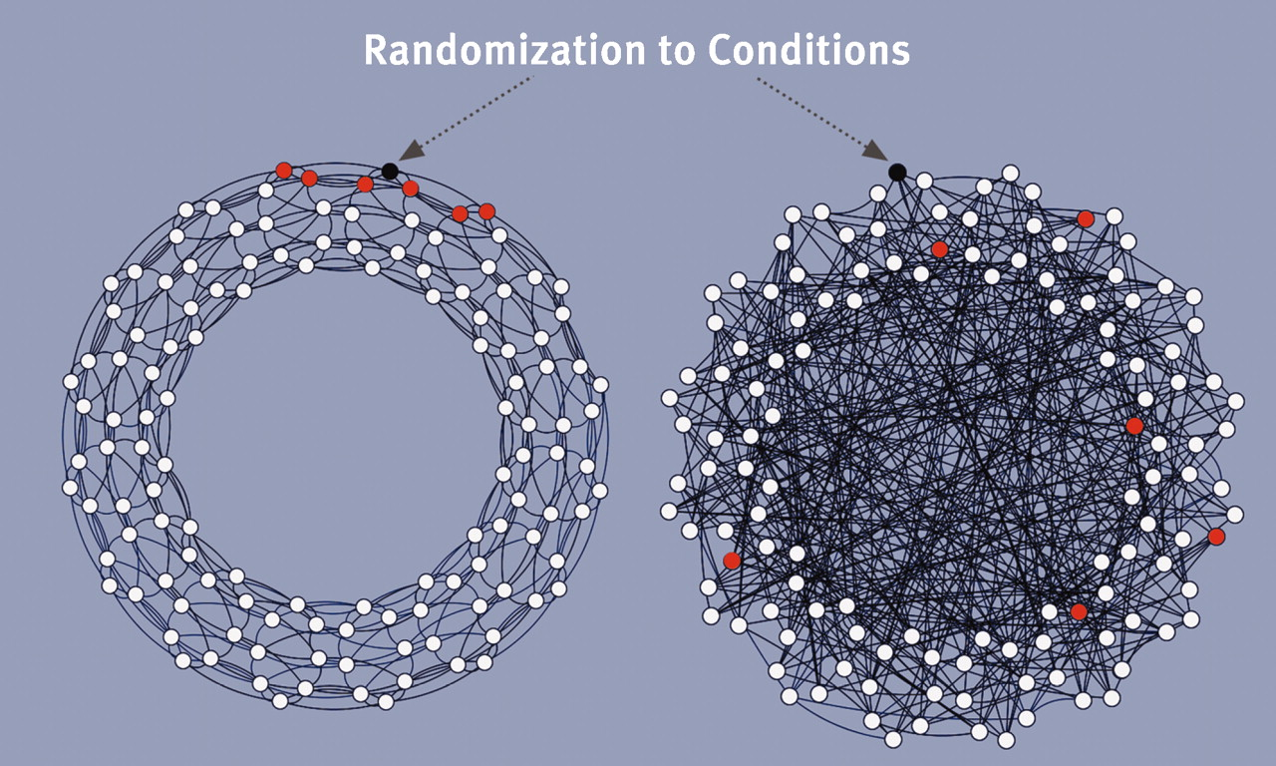
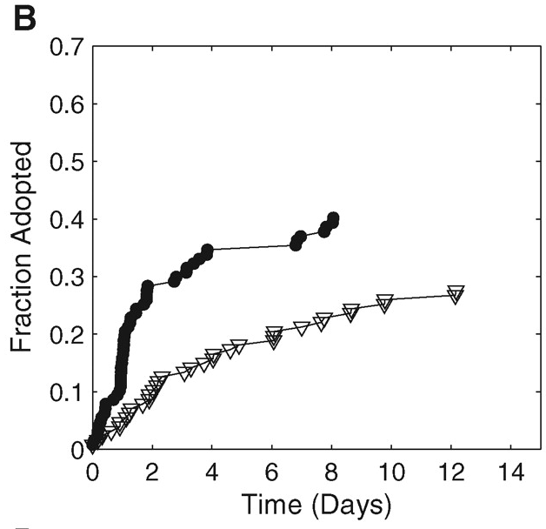
Het “Health Buddies”-experiment
Deelnemers werden gekoppeld aan andere deelnemers — aangeduid als “health buddies” — binnen een online gezondheidsgemeenschap.
Deelnemers konden niet rechtstreeks contact opnemen met hun health buddies, maar ontvingen wel e-mails van het onderzoeksteam over de activiteiten van hun health buddies.
Belangrijkste inzicht: gedragsverandering verspreidt zich beter en blijft langer bestaan wanneer mensen samen van elkaar leren in meer samenhangende groepen.
Clustered network
Random-network
Clustered network
Random network
Begin met kleine samenhangende groepen in plaats van individuele, geïsoleerde vrijwilligers
Damon Centola. The Spread of Behavior in an Online Social Network Experiment. SCIENCE, 329, 2010.
Notes:
Participants were matched with other participants—referred to as "health buddies"—as members of an online health community.
Participants could not contact their health buddies directly, but they could receive emails from the study informing them of their health buddies’ activities.
Take-away: Behavior change is more likely to spread and persist when people learn, discuss, and act together.

Slide 11
Two trails inspired by “clustered seeding”, and compared to conventional approach
Budgets/resources to engage with 30 households in a few streets (e.g., offering tailored information and solutions, or in-depth interviews and conversations, or start with local initiatives):
Clustered engagement through social referrals
Clustered engagement after recruitment
Conventional individual recruitment
Randomly select 10 households from those who sign up;
Ask each household to invite or nominate three neighbours, friends, or nearby households;
Work with these naturally connected clusters.
Recruit 30 volunteer households.
Organize them into small neighbourhood groups (e.g., three households living close together or sharing similar circumstances).
Deliver engagement activities at the group level rather than individually.
Randomly select 30 households from those who sign up;
Work with each household individual;
Households engage in the process largely on their own.
Potential advantages:
Conversations continue outside the program. Participants reinforce one another.
Measure outcomes: 1) engagement and changes in the directly involved households 2) spillover effect to other households

Slide 12
Diffusion of simple and complex contagion in the same network
Community A
Community A
Community B
Community B
×
Community C
Community C
Under simple contagion, the only tie between A and C can spread the rumor/virus to Community C and thus fasten the diffusion process.
Under complex contagion, the only tie between A and C cannot spread the new norm to Community C;
Complex contagion can only spread through multiple connections (“wide bridge”) between nearby communities.
Notes:
In simple contagion, the narrow bridge

Slide 13
Today’s programe
Simple contagion
Mechanism and the strength of ‘weak ties’
Diffusion model for simple contagion
Independent cascade model and other variants
Complex contagion
Mechanism and the strength of ‘strong ties’
Diffusion model for complex contagion
Threshold model and seeding
How to translate the complex contagion theory into numerical models?
Notes:
Contagiousness of disease and behaviour

Slide 14
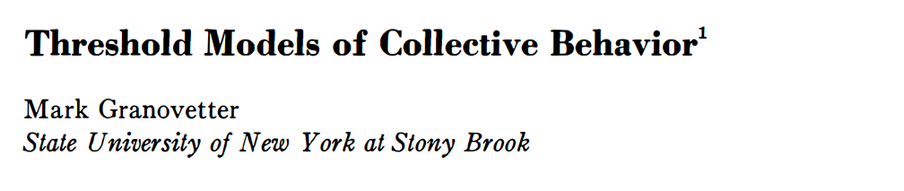
Translate complex contagion into numerical models by “Threshold”
Threshold: To adopt a new behavior, an individual needs to be convinced by an absolute number or a fraction of his/her social contacts (e.g., the riskier the behavior the higher the threshold)

Slide 15
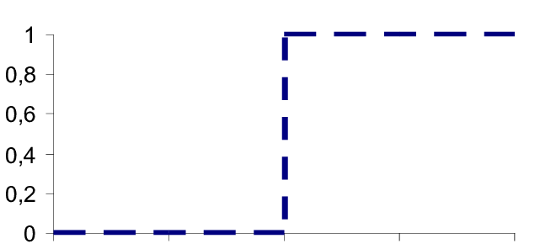
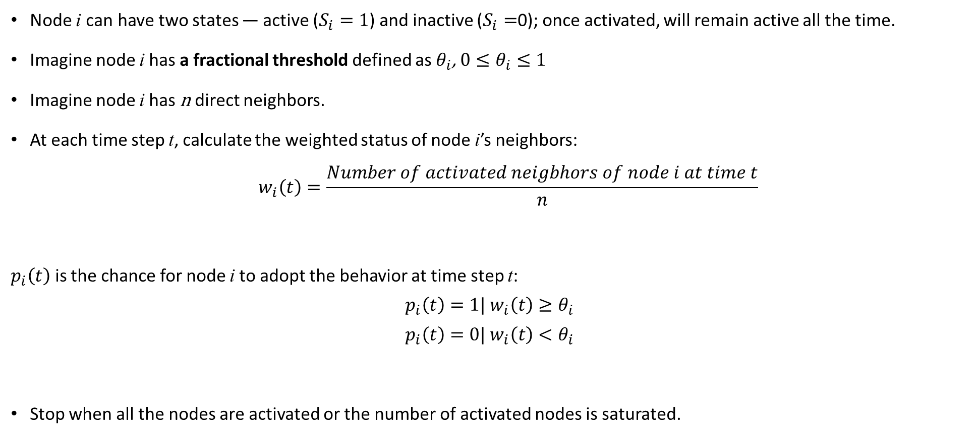
Formalization of a threshold model
Node i can have two states — active ($S_{i}=1$) and inactive ($S_{i}=$0); once activated, will remain active all the time.
Imagine node i has a fractional threshold defined as $θ_{i}$, ${0≤θ}_{i}≤1$
Imagine node i has n direct neighbors.
At each time step t, calculate the weighted status of node i’s neighbors:
$${ w}_{i}\left(t\right)=\frac{Number of activated neigbhors of node i at time t}{n}$$
$p_{i}\left(t\right)$ is the chance for node i to adopt the behavior at time step t:
$$p_{i}\left(t\right)=1| w_{i}\left(t\right)≥θ_{i}$$
$$p_{i}\left(t\right)=0| w_{i}\left(t\right)<θ_{i}$$
Stop when all the nodes are activated or the number of activated nodes is saturated.

Slide 16
Today’s programe
Simple contagion
Mechanism and the strength of ‘weak ties’
Diffusion model for simple contagion
Independent cascade model and other variants
Complex contagion
Mechanism and the strength of ‘strong ties’
Diffusion model for complex contagion
Threshold model and seeding
What kind of insights can you get from the model?
Notes:
Contagiousness of disease and behaviour

Slide 17
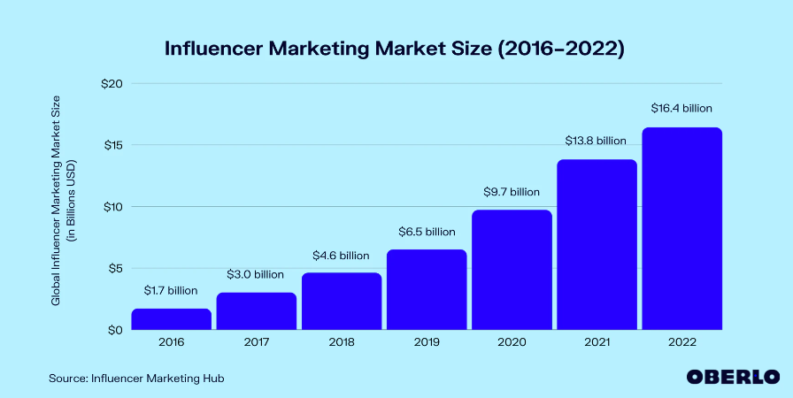
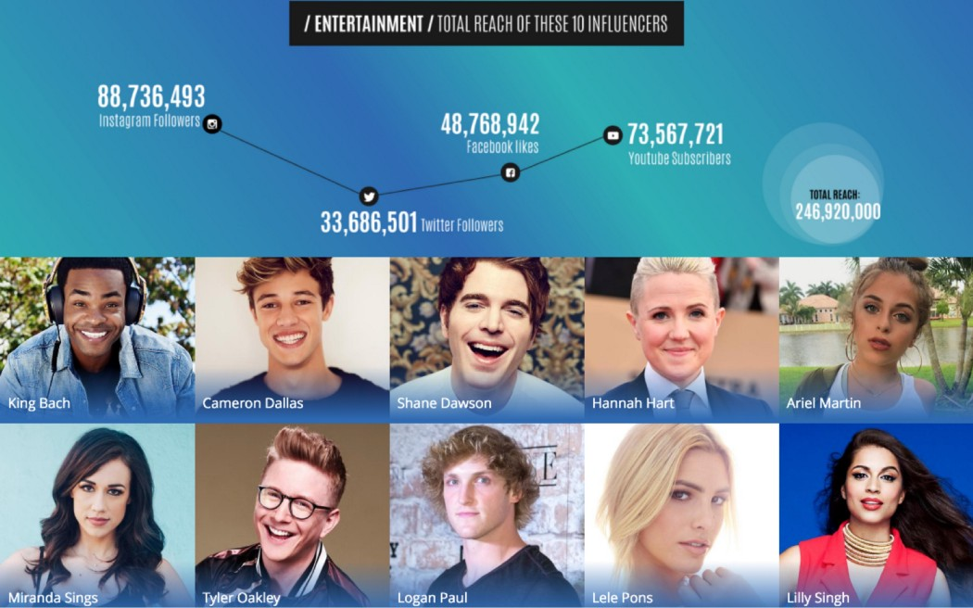
Influencer marketing industry: around $16.4bn in 2022
Almost half of marketers spent more than 20% of their budget on influencer posts
Are the ones with most followers always the best brand ambassadors?
Notes:
Seeding is highly relevant to many real-world examples such as marketing industry.

Slide 18
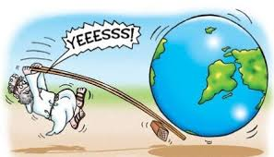
Let’s try to find out:
Seeding: To find out a small set of influential nodes for activation/immunization
“Influencers”
“Super spreaders”
“Brand ambassadors”

Slide 19
Finding out this set of influential nodes is an influence maximization problem (IMP)
Given a network G(V, E) with V and E respectively being the set of nodes and the set of links, there exists a function f(S) from a subset S ⊆ V to a real number
Influence maximization problem (IMP): To find a set S of a given size k (usually, k ≪ n = |V|) that maximizes/minimizes f(S).
Example of f(S):
With limited marketing budget, to find a small group of customers to offer discounts to eventually maximize total sales→ f(S): the number of people who use the product

Slide 20
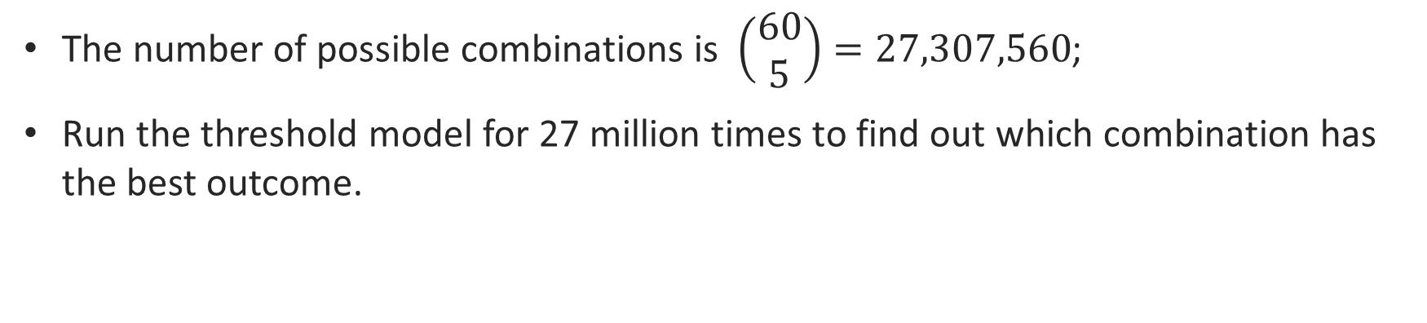
Obtaining an exact solution of IMP is very challenging
f(S): For a network of 60 people, to find out 5 people as the “seeds” to maximize the diffusion
The number of possible combinations is $\left(\begin{matrix}60 \\ 5\end{matrix}\right)=27,307,560$;
Run the threshold model for 27 million times to find out which combination has the best outcome.
Notes:
But to find out the best solution of the IMP, it is indeed very difficult.

Slide 21
Using centrality heuristics to approximate the exact solution
Centrality heuristics:
To rank all nodes according to their degrees or other centrality measures and pick up the k top-ranking nodes
Naive but widely used due to simplicity (or used as references for other advanced algorithms)
Top-k nodes from different measures:
Degree centrality; Local Rank (Neighbourhood-based)
Closeness centrality; Betweenness centrality (Path-based)
Eigenvector centrality (Position-based)

Slide 22
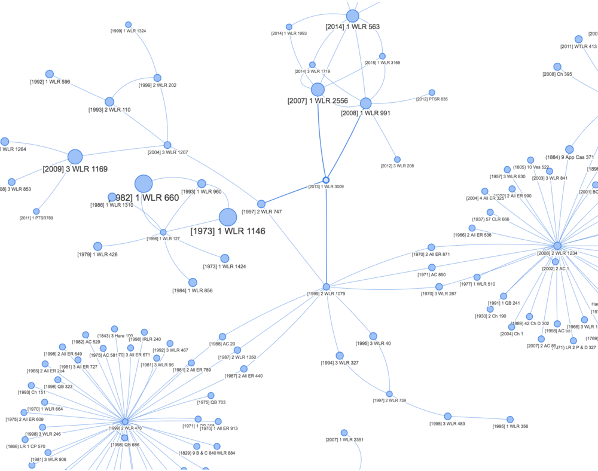
The choice of centrality heuristics depends on contagion mechanism
Community 2
Degree heuristic
High degree node (‘hub’);
Can reach many people within one path length
Betweenness heuristic
High betweenness node;
Cannot reach many people within one path length, but can lead to a potentially large outbreak
Community 1

Slide 23
Other sophisticated algorithms inspired by centrality heuristics
(Top-k nodes: sometimes inefficient since nodes of highest centrality may be highly clustered)
High Degree Adaptive (HDA): First choose the node of the largest degree, then recalculate the degree of nodes after every step of node removal;
Top-k spreaders from different communities: Network is divided into many communities by community detection algorithm. Then all communities are ranked in decreasing order according to their sizes. The first spreader is selected from the largest community according to a certain centrality index (e.g., to choose the node with the highest degree). Similarly, the node with the largest centrality index in the second largest community and having no edges incident to the previous communities.
LocalRank: Consider the number of neighbors within path length 4

Slide 24
Using greedy algorithm to approximate the exact solution
For a network of 60 people, in order to find out 5 people as the “seeds” to maximize the diffusion, try $\left(\begin{matrix}60 \\ 5\end{matrix}\right)=27,307,560$ times
Only try 60+59+58+57+56=290 times
Add nodes one by one to the target set, ensuring that each addition brings the largest increase of influence to the previous set (maximize the incremental influence)
k is the number of size of the seed set S;
Start with an empty set of S={};
At each time step, scan all nodes to find the one v that maximizes f( S∪ {v} ) and then updates S by including v
After k time steps, one gets the target set S containing k influential nodes.
Reduce the computational time by considering the incremental spread of the k nodes individually rather than combined

Slide 25
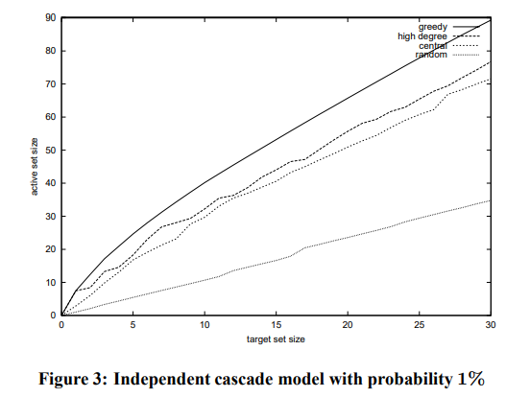
Approximation guarantee of greedy algorithm
Greedy algorithm approximates to the optimum S* within a factor of around 60% or more in most cases: A seed set whose spread will be at least 60% of the spread of the optimal seed set.
Cost-effective lazy forward (CELF) algorithm: Improve greedy algorithm to further reduce the computational time.
D. Kempe, J. Kleinberg, ´ E. Tardos, Maximizing the spread of influence through a social network, in: Proceedings of the 9th ACM SIGKDD International Conference on Knowledge Discovery and Data Mining, KDD ’03, ACM Press, 2003, pp. 137–146.
Notes:
Both result in the same seed set

Slide 26
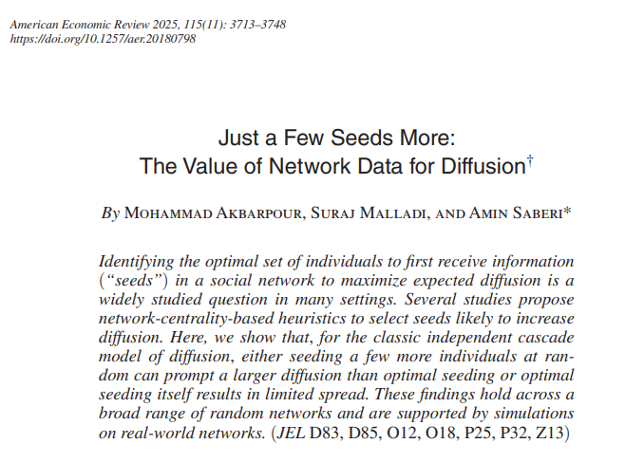

Slide 27
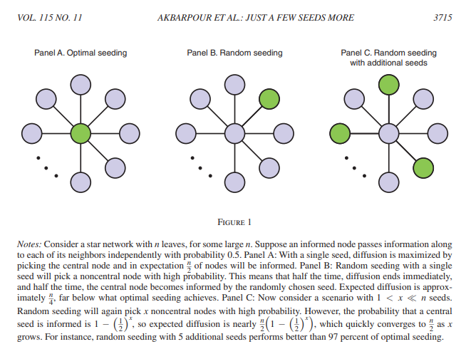

Slide 28
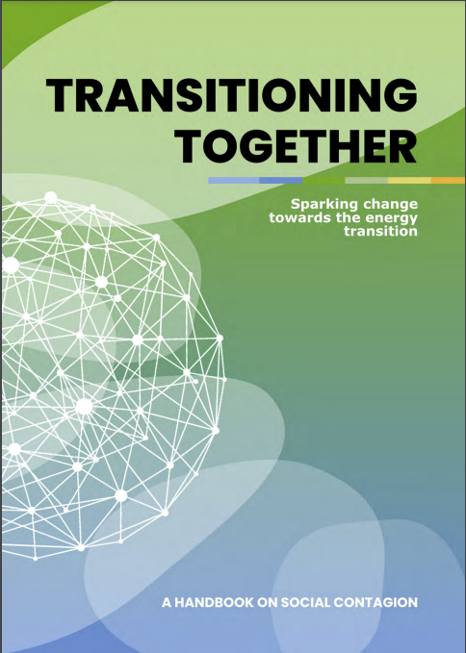
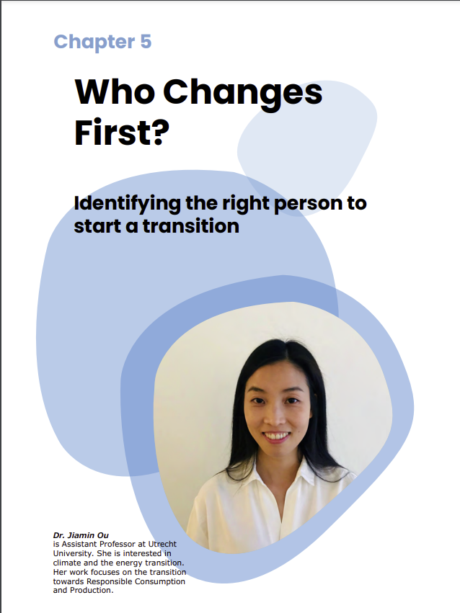
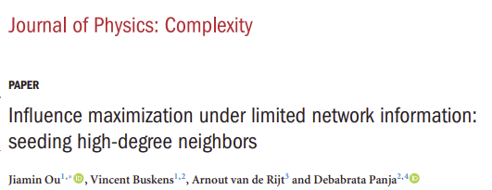
Social network-based interventions
(Implementation in real-world)
Social network-based interventions
(Theoretical modeling)

Slide 29
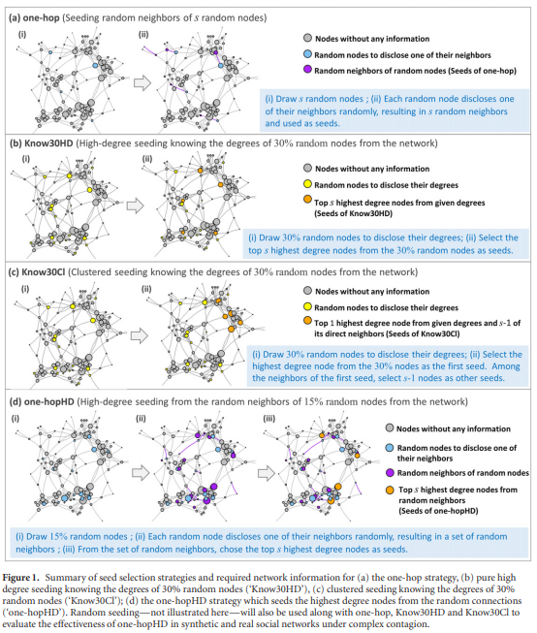

Slide 30
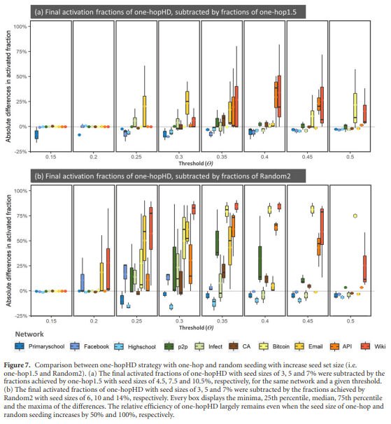

Slide 31
See the world as a web of people, and harness the power of influence through connections.
Ending remarks

Slide 32
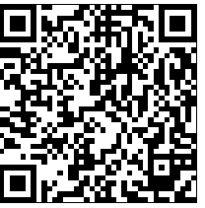
Let us know how you feel about this summer school
https://survey.uu.nl/jfe/form/SV_6hbTmSu8fgFbT3o?Q_CHL=qr

