Slide 1
Machine learning
Javier Garcia-Bernardo
Assistant Professor, Department of Methodology & Statistics
j.garciabernardo@uu.nl

Slide 2
Machine learning
”A computer program is said to learn from experience E with respect to some class of tasks T and performance measure P if its performance at task T, as measured by P, improves with experience E.” (Samuel/Mitchell, 1959)
Experience: Data
Task: Goal
Performance measure: Accuracy, R², etc

Slide 3
Machine learning
Supervised ML: Output is available. Performance = discrepancy between predicted output and real output
Regression
Classification
Unsupervised ML: No labels/output. Performance = reduction of some error
Clustering (e.g. cluster points so they are as close as possible within clusters, as far as possible between clusters)
Dimensionality reduction (e.g. combine variables to maximize the amount of variability explained)

Slide 4
Machine learning
Typically focuses on large, high-dimensional datasets with interactions between features
Output-driven:
Typically aims to solve a problem (rather than to test a hypothesis)
Emphasizes predictive accuracy: Uses theory if it improves accuracy (to build new features)
Cannot and should not replace thinking about causation

Slide 5
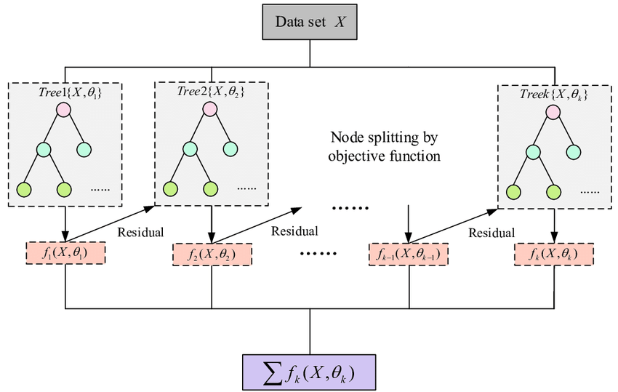
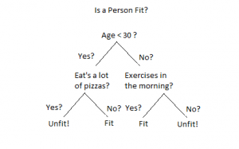
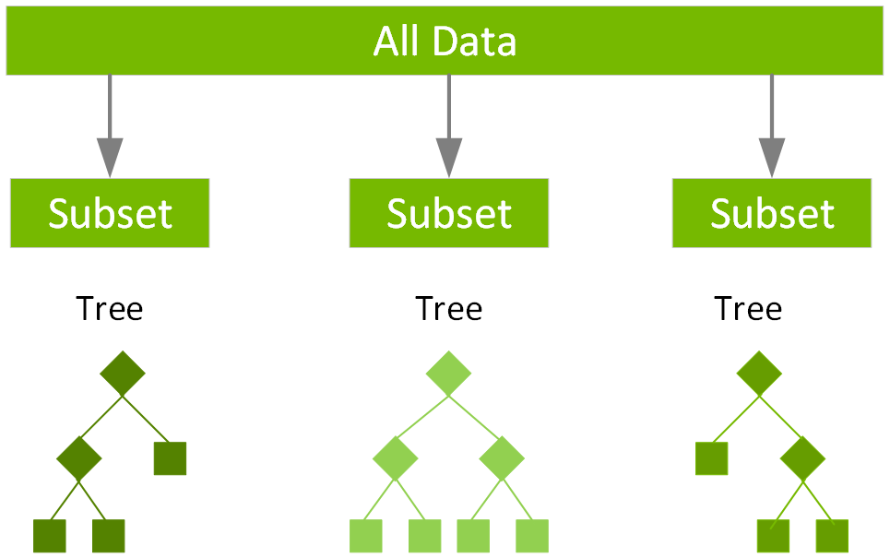
Algorithm of the day: XGBoost
Army of weak learners → Strong predictors (~wisdom of crowds)
Boosting: Incrementally build trees to fix observations previously miscategorized
Gradient Boosting
Decision tree
Ensemble (e.g. random forest)
Xoriant.com
NVIDIA
Guo et al, 2020

Slide 6
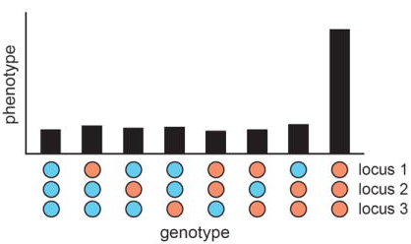
Some uses of ML in epidemiology
Missing data imputation
Prediction of outcomes with interpretability at the individual level (e.g., LIME, SHAP)
Theory building:
ML can detect higher-order interactions and other complicated responses
Run the ML model on the full data → Does it increase prediction compared to the traditional model?
You may be missing an important variable
Your model may be missing interactions
Evaluate model using interpretability tools

Slide 7
Main issues in Machine Learning
Issue 1: Overfitting
Lots of data and features → can be a recipe for disaster
Evaluation of overfitting: cross-validation
Prevention of overfitting: Regularization, weak learners, dropout, etc
Issue 2: Interpretability of the model
Complex models are more difficult to interpret
New measures of interpretability

Slide 8
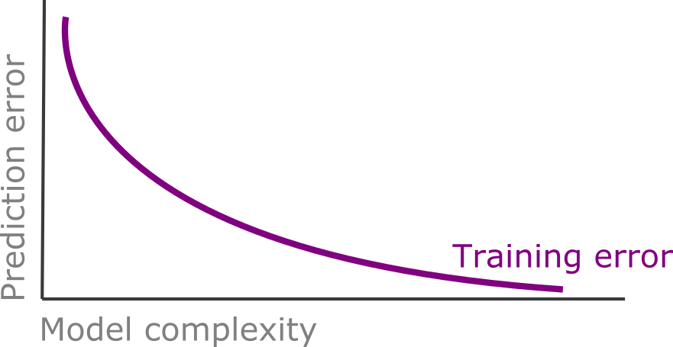
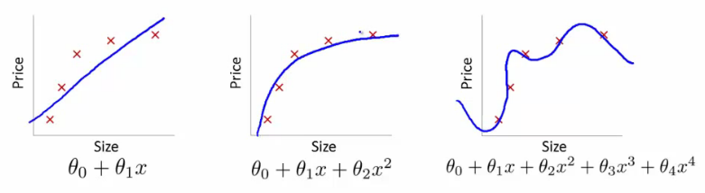
Issue 1: Overfitting
Adding more variables always decreases R^2 (within- sample prediction error)
One option: adjust for the degrees of freedom
The “ML” option: evaluate prediction accuracy in an external dataset

Slide 9
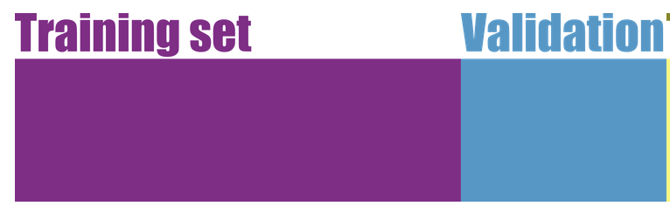
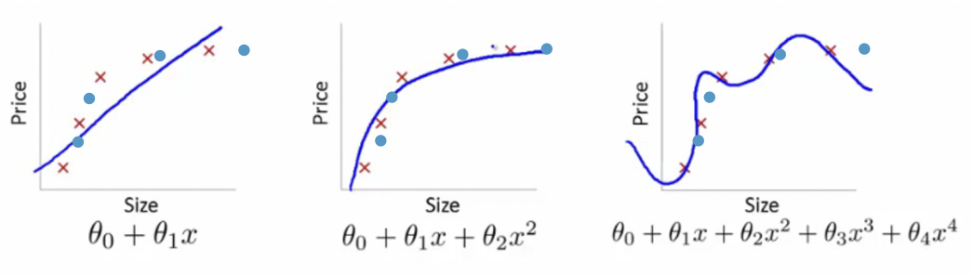
1: Evaluate overfitting using a validation dataset
Training dataset → Use to train different models
Validation dataset → Evaluate out-of-sample prediction error
(Test dataset) → Evaluate out-of-sample prediction error of final model

Slide 10
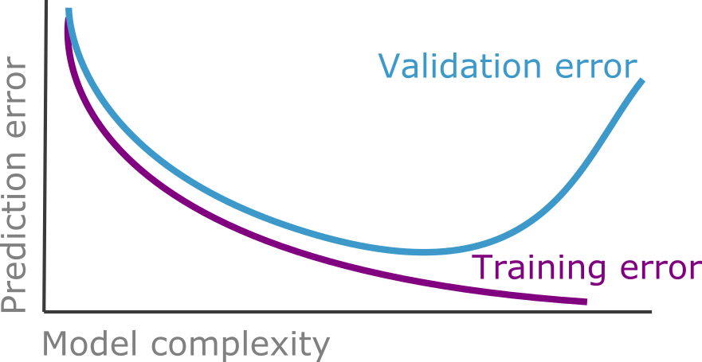
1: Evaluate overfitting using a validation dataset
But with this:
We reduce the training dataset (number of observations)
We validate on a small dataset (maybe not representative)

Slide 11
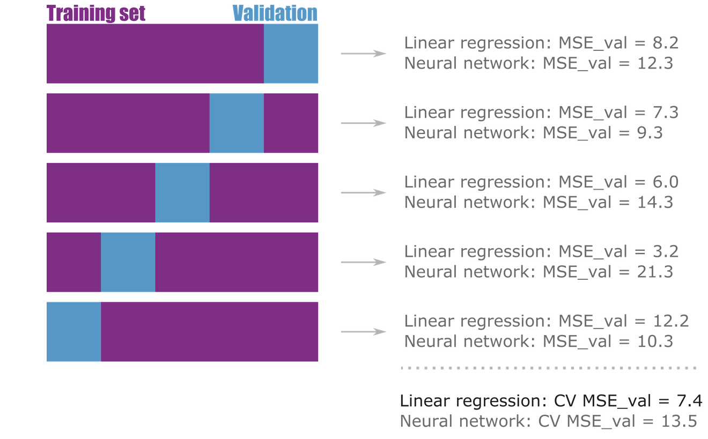
1: Evaluate overfitting using cross-validation
Do you want to understand the error due to the splitting? → Run this procedure several times with random splittings

Slide 12
1: Hyperparameter tuning
Hyperparameter tuning using cross-validation → Balance between flexibility and overfitting:
Regularization (e.g. sum of |coefs| < l)
Ensembles:
Train trees with different data
Bootstrap
Subset of predictors
Use shallow trees
Neural networks:
Train disabling neurons (dropout)
Early stopping
Machine learning
Prevent overfitting

Slide 13
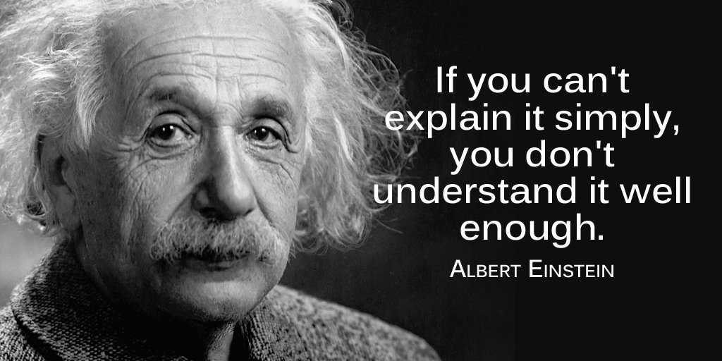
Issue 2: Interpretability
Notes:
Being Right for the Right Reasons

Slide 14
2: Interpretability
Being Right for the Right Reasons
Choices:
Global vs Local interpretability
Model-dependent vs model-agnostic interpretability

Slide 15
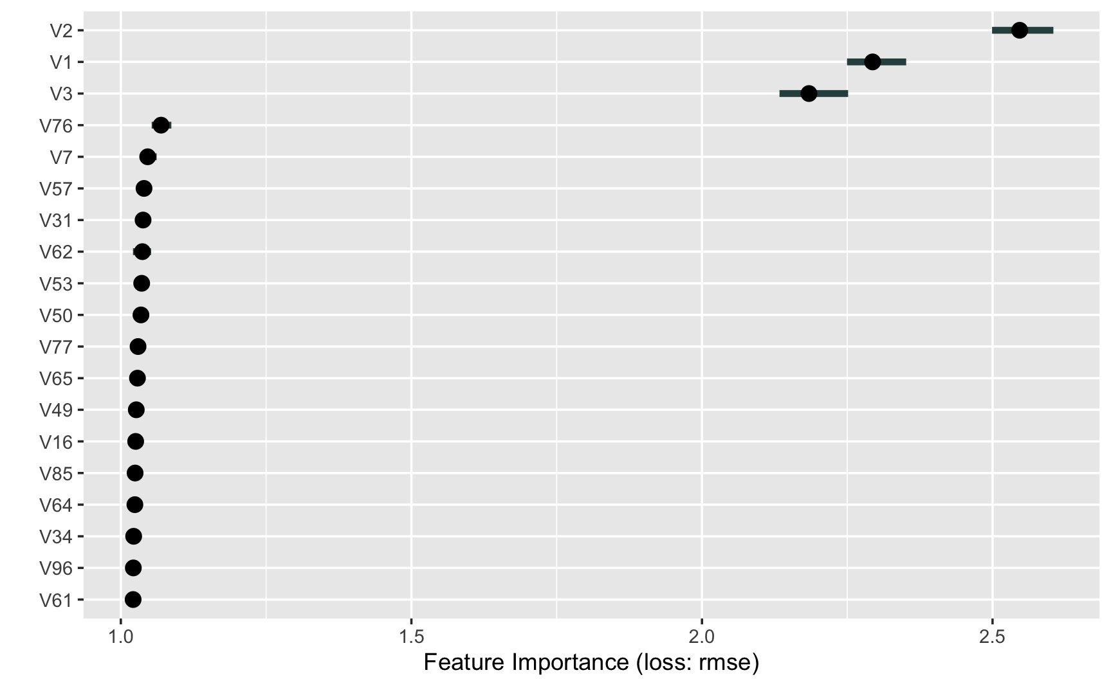
2: Global interpretability
Goal: Understand what are the main features/interactions in the model
Example 1: Feature importance: Increase in model error when the information is removed
No need to retrain the model
Correlated variables are problematic

Slide 16
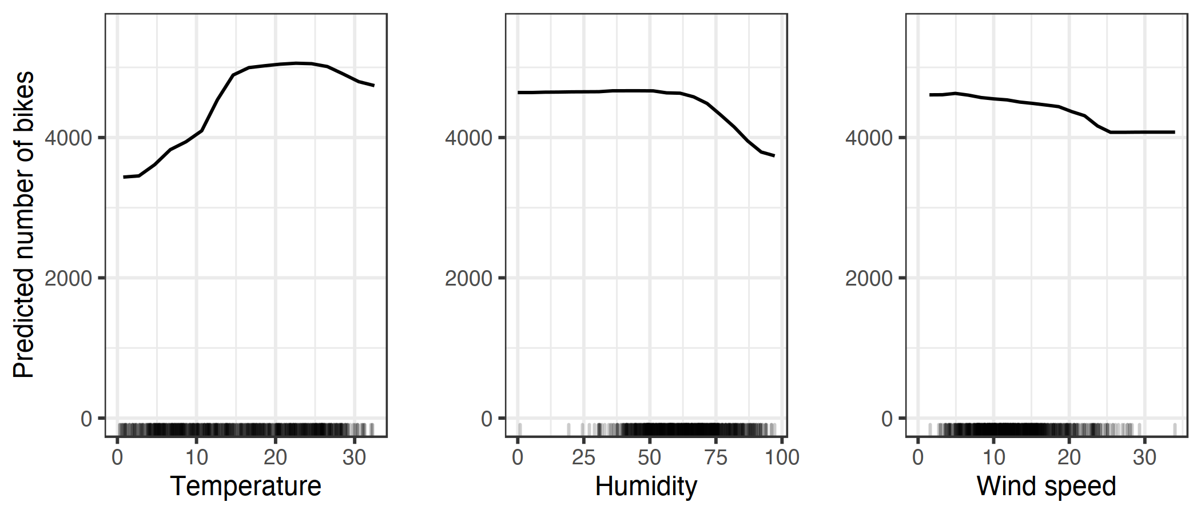
2: Global interpretability
Goal: Understand what are the main features/interactions in the model
Example 2: Partial dependencies plots (marginal effects)

Slide 17
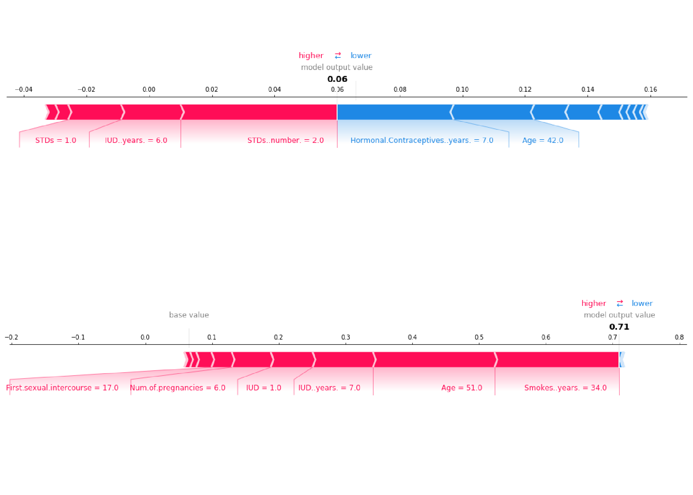
2: Local interpretability
Goal: Inform the human about the factors determining the prediction
Many advances in the last decade (SHAP, LIME, Anchors, Counterfactuals)
Basic idea: Change the observations slightly to observe how the prediction will change
Two examples of women diagnosed with cervical cancer (Interpretable Machine Learning, C. Molnar 2022)

Slide 18
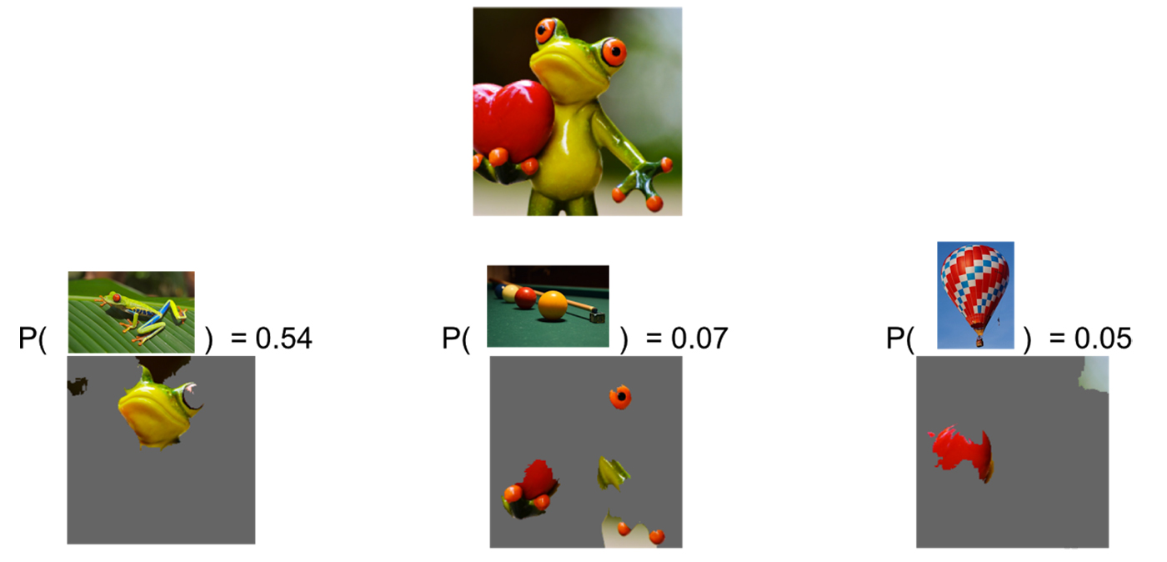
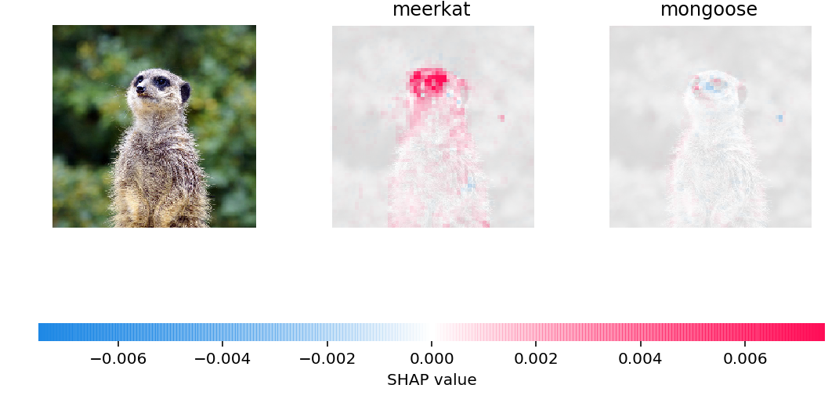
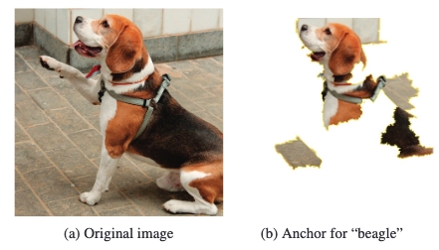
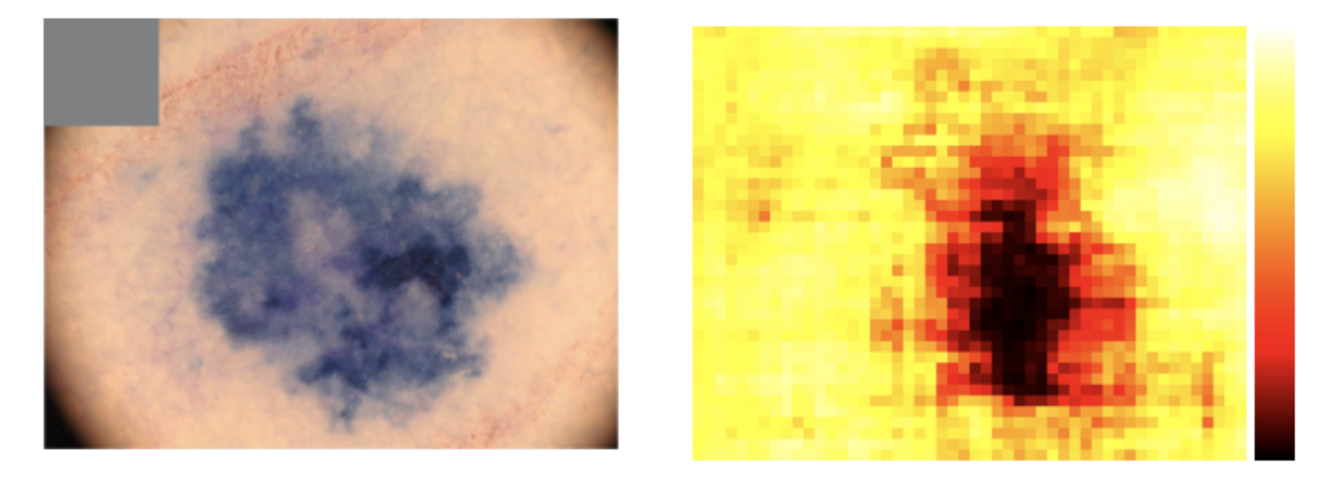
2: Local interpretability
Goal: Inform the human the reason of the prediction
Basic idea: Change the observations slightly to observe how the prediction will change
LIME // Ribeiro, Singh and Guestrin, 2016
Scott M. Lundberg, Su-In Lee, 2017
Anchors // Ribeiro, Singh and Guestrin, 2018
https://silverpond.com.au/2018/04/17/an-ai-tells-us-what-it-knows-when-we-poke-it-in-the-eye/

Slide 19
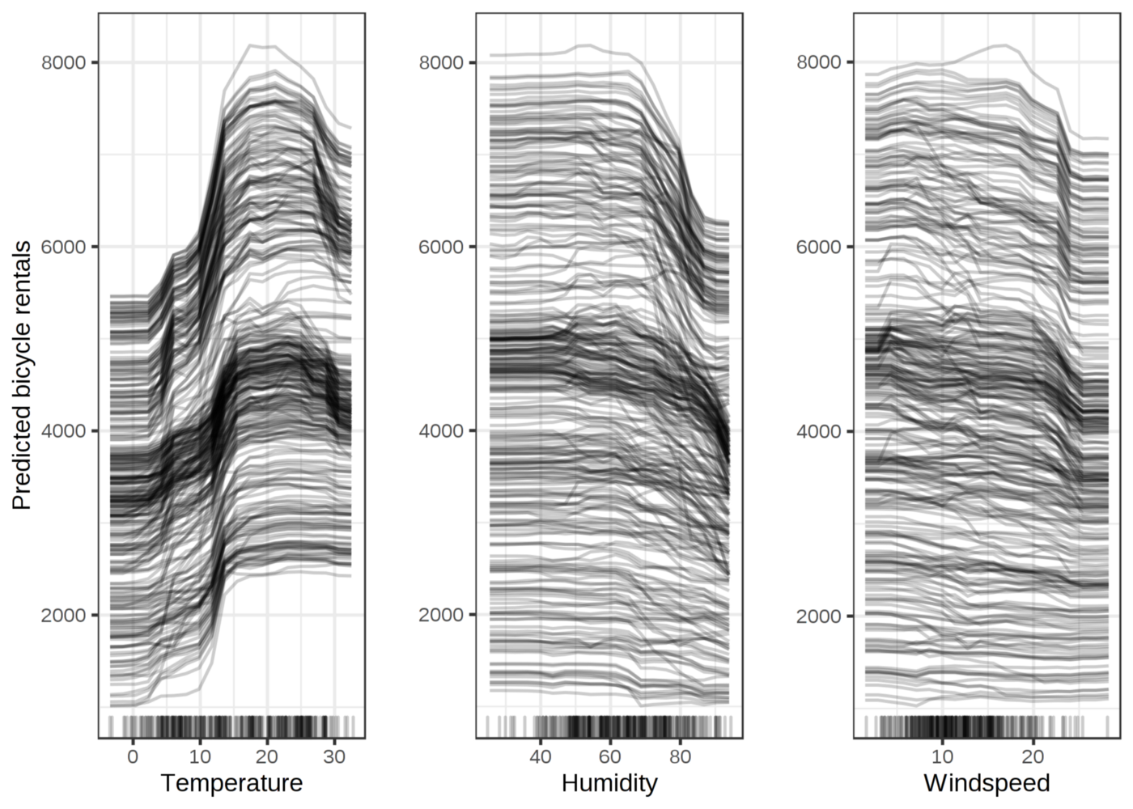
2: Local → Global interpretability
Goal: Understand what are the main features/interactions in the model
Basic idea: Average individual predictions
→
Individual Conditional Expectation (ICE)
Partial Dependency Plot (PDP)

Slide 20
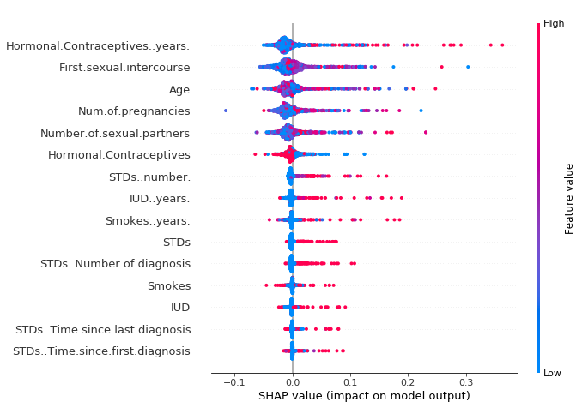
2: Local → Global interpretability
→

Slide 21
Exercise (javier.science/ml_julius)
Synthetic data:
X = 105 features (100 quantitative, 5 categorical)
Y = Quantitative response (depending on interaction between 3 quantitative and 1 categorical)
Goal:
Try two methods: LASSO regression and XGBoost
Hyperparameter tuning using cross-validation
Use feature importance to understand the results of XGBoost
Instructions: (in groups)
Read the code line by line
Run de code
Adapt the code with other possible outputs in the data (e.g. increase number of features)

Slide 22
Some uses of ML in epidemiology
Missing data imputation
Prediction of outcomes with interpretability at the individual level (e.g., LIME, SHAP)
Theory building:
ML can detect higher-order interactions and other complicated responses
Run the ML model on the full data → Does it increase prediction compared to the traditional model?
You may be missing an important variable
Your model may be missing interactions
Evaluate model using interpretability tools

Slide 23
Final remarks
Use the following questions when using ML in epidemiology:
How much better is the fancy model? → Use cross-validation to evaluate. Don’t use complicated methods if they are not better than simple methods.
What can we learn about the world from the model? → Interpretability helps here
Is our method able to generalize? → If we use our algorithm to predict new observations, make sure it keeps predicting well (i.e., do not blindly trust it)
Is our algorithm fair? → http://aequitas.dssg.io/audit/_g5htt_b/compas_for_aequitas/
Thanks!

