Slide 1

AE Clothes Store
The App Experts
October 2014

Slide 2
Index
App description
Technical contribution
Web Services
Initial approach vs Final product
Responsibilities
Next Steps
Demo
Questions

Slide 3
Main Features
Catalogue
Store
Store locator
Customer area

Slide 4
Technical contribution
Flexible UI for smartphones and tablets in both portrait and landscape modes
Responsive use of fragments
Internet connection status control
Extensive use of Volley and Picasso to optimize network request

Slide 5
Technical contribution
SQLite database to store user’s bag
Remote database and web service make changes easier to the customer
Registration form for new customers
Integration of Google Map, with custom markers that give to the user additional information

Slide 6
Technical contribution
PayPal integration to make payments
Authentication with social network (Facebook)
Share app feature via different methods
Multiple dialogs to inform the users about different errors

Slide 7
Technical contribution
English and Spanish language
Intensive use of Git
Java doc

Slide 8
Web Service
Only show categories with products
State of the products to do fast changes of stock
Products on offer will be displayed in a different area

Slide 9
Initial Approach vs. Final Product

Slide 10
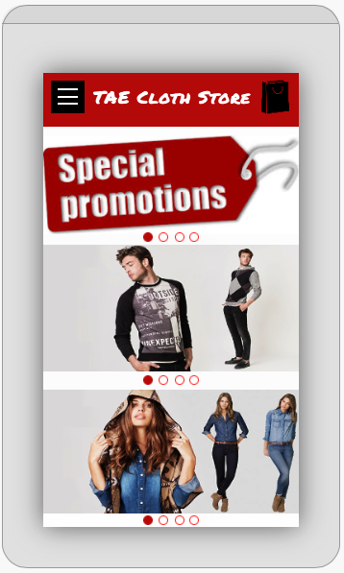
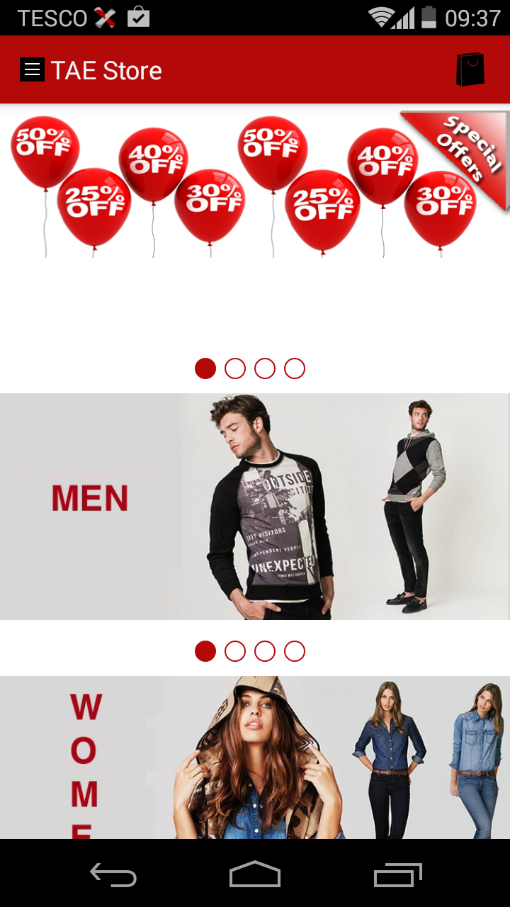
I.A. vs. F.P

Slide 11
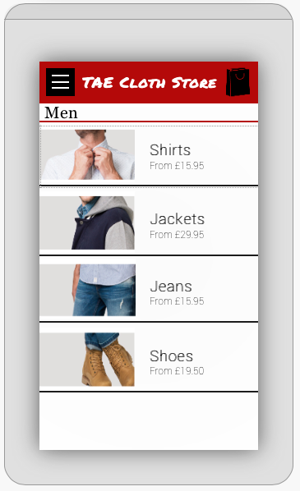
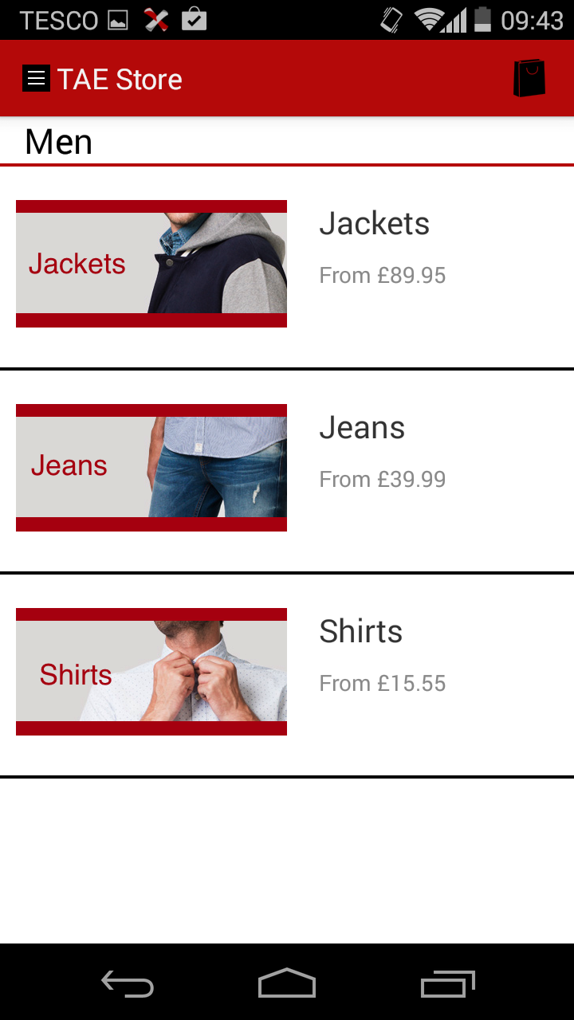
I.A. vs. F.P

Slide 12
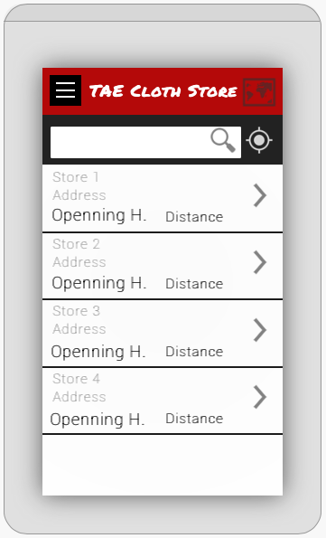
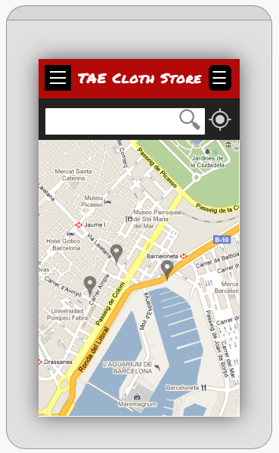
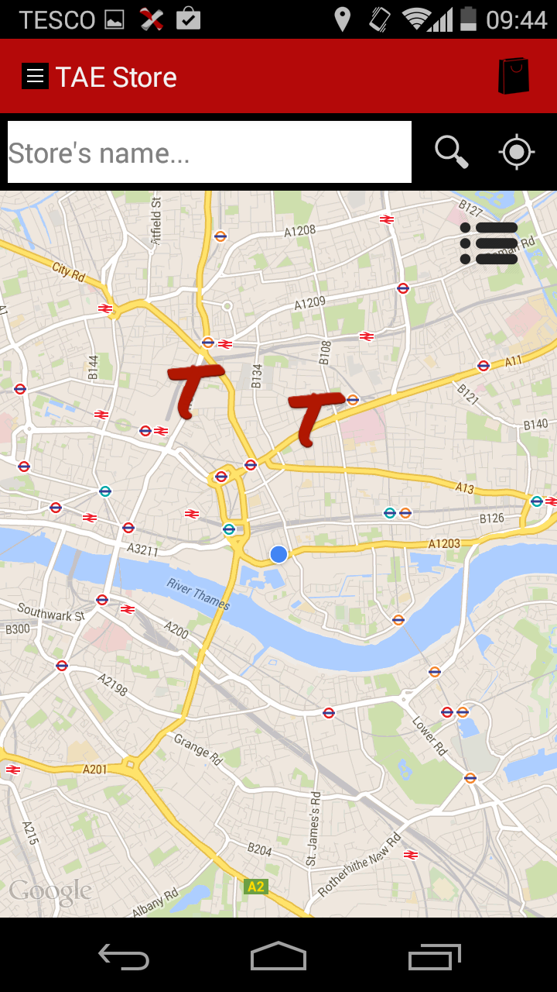
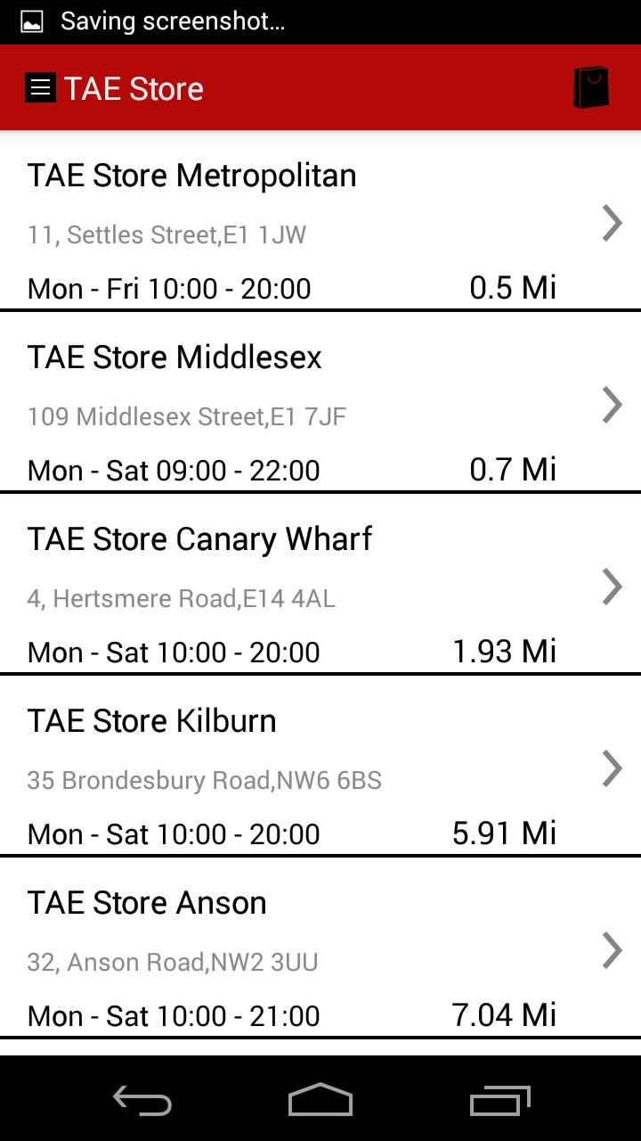
I.A. vs. F.P

Slide 13
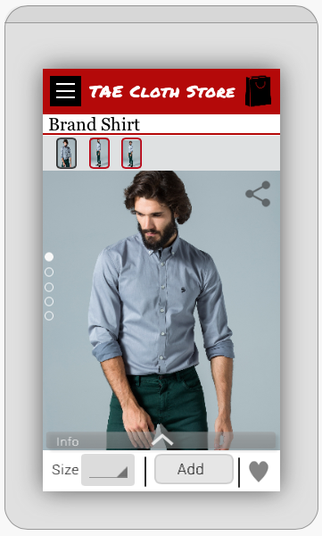
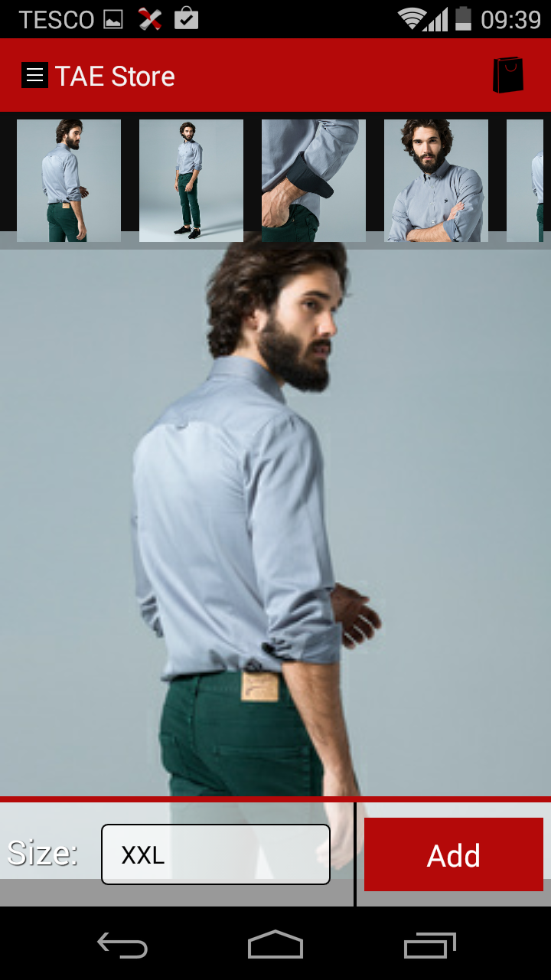
I.A. vs. F.P

Slide 14
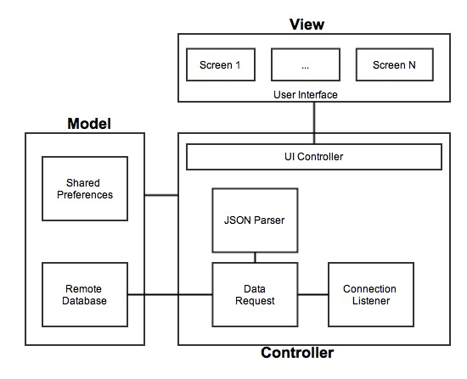
Responsibilities
System architecture

Slide 15
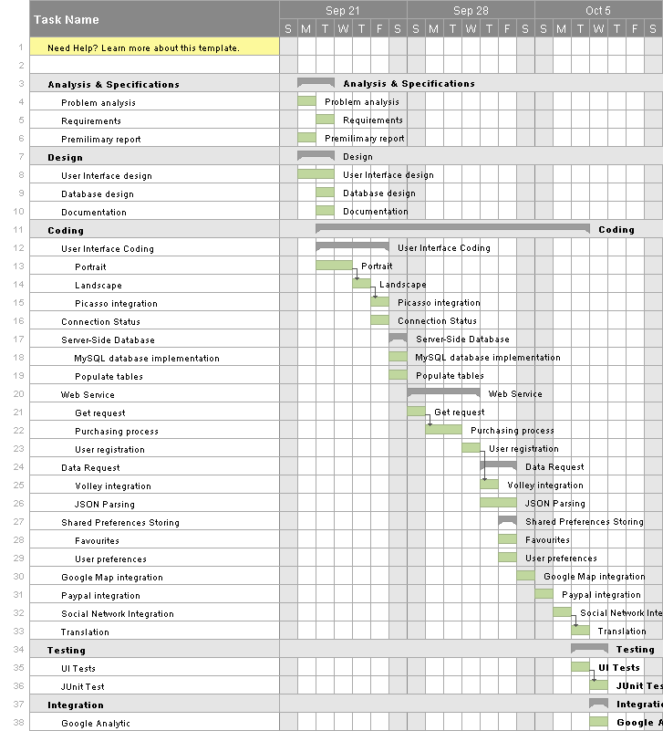
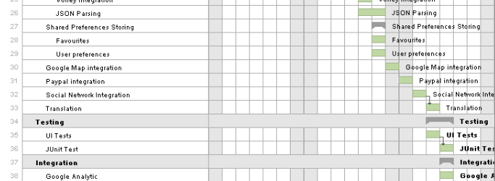
Responsibilities
Planning

Slide 16
Next steps
Include GCM
Include a slider with more information of a product.
Wish list to share with friends
Pre-order products
Upgrade store locator feature to filter stores by name, location
Product filters

Slide 17
DEMO

Slide 18
QUESTIONS

