Slide 1

Thanksgiving break is ruined…thanks Prof K!
di·dac·tic
/dīˈdaktik/
in the manner of a teacher, particularly so as to treat someone in a patronizing way.
"slow-paced, didactic lecturing”
“if it feels like the teaching is just telling you what to think explicitly, that's didactic in a bad way.”
Case 3
This is a regression case, rf, dt, lm and others can be applied
RMSE and MAPE are appropriate
EDA is still important!
Code consistency, logical flow, avoiding redundant objects are important
Tone, volume, cadence and limited use of filler words are important
Agenda, problem statement, data description, EDA, Assessment are all important
https://i.pinimg.com/736x/3a/38/19/3a38195c96de241560714610f32b8532.jpg
This course is not didactic. The real world is not slow-paced, or tells you expectations explicitly. Bosses rarely if ever say I want A. They give you an ambiguous problem statement, you must apply judgment, learn and try. As you become an executive, this is more important.

Slide 2
Text Mining

Slide 3
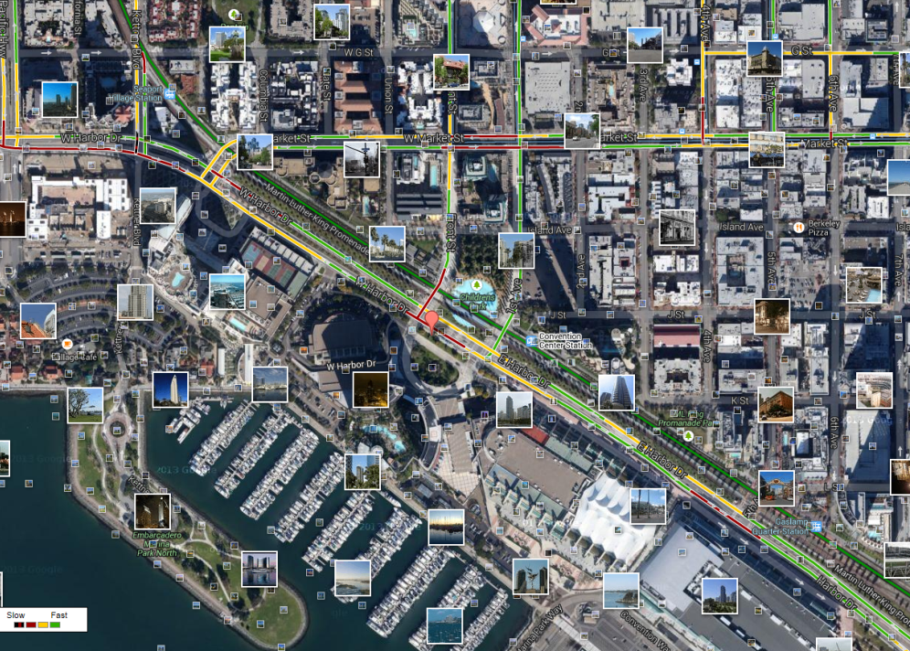
What is Text Mining?
Before Text Mining
Extract new insights from text
Let’s you drink from a fire hose of information
Language is hard; many unsolved problems
Unstructured
Expression is individualistic
Multi-language/cultural implications

Slide 4
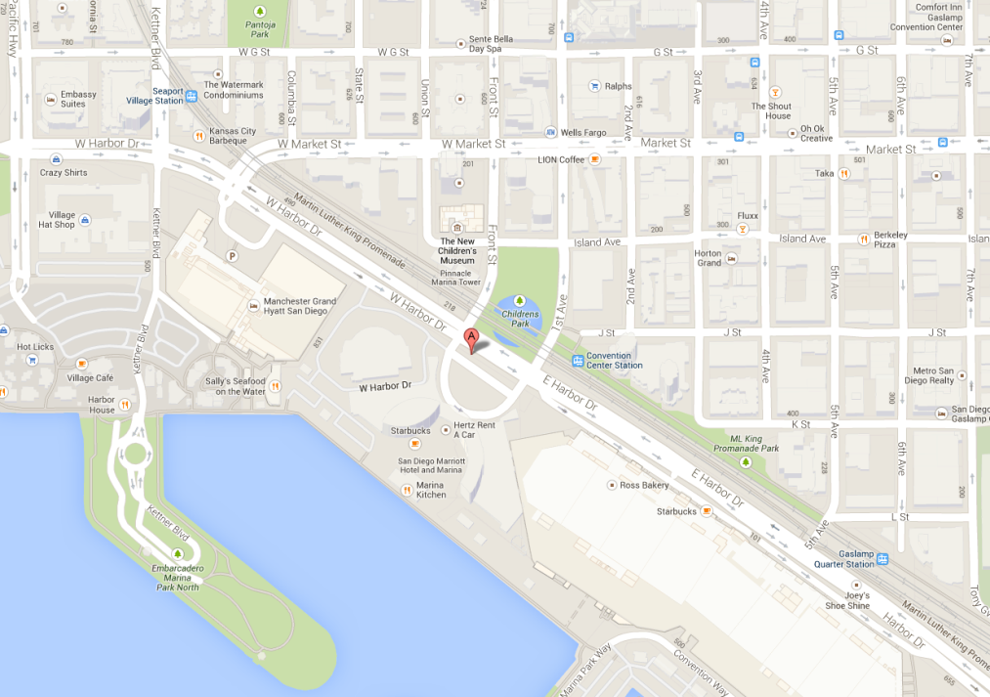
What is Text Mining?
After Text Mining
Extract new insights from text
Let’s you drink from a fire hose of information
Language is hard; many unsolved problems
Unstructured
Expression is individualistic
Multi-language/cultural implications

Slide 5
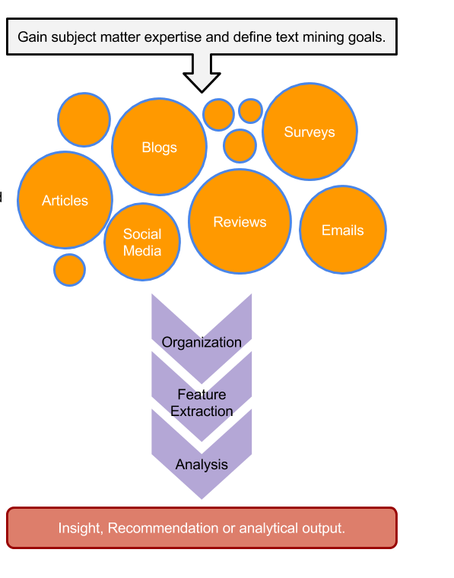
TM Project Workflow
Unorganized State
Natural Language Processing & Analysis
Organized State

Slide 6


R for Cleaning Steps
Tomorrow I’m going to have a nice glass of Chardonnay and wind down with a good book in the corner of the county :-)
Remove Punctuation
Remove extra white space
Remove Numbers
Make Lower Case
Remove “stop” words
blogs
reviews
articles
tomorrow going nice glass chardonnay wind down good book corner county

Slide 7
For Bag of Words, how is data organized?
Document Term Matrix
 | Term1 | Term2 | Term3 | … | Term_n
Tweet1 | 0 | 1 | 1 | 0 | 0
Tweet2 | 0 | 1 | 0 | 0 | 0
Tweet3 | 0 | 0 | 0 | 3 | 0
… | 0 | 0 | 0 | 1 | 1
Tweet_n | 0 | 0 | 0 | 1 | 0
Code to Create the DTM/TDM and change to a matrix
Why are DTM & TDM Sparse? What do they represent?
txtDtm<-DocumentTermMatrix(txtCorpus)
txtDtmM<-as.matrix(txtDtm)
??
The matrices are sparse (many 0’s) so additional steps may be needed to extract information.

Slide 8
Let’s Practice Review!
A_text_organization_REVIEW.R

