Slide 1
Regression

Slide 2


Your Data Mining Toolbox
Previous Lessons
Some R Programming
Knowledge of Data Preparation
Exploratory Data Analysis
Basic Visualization
After today
You can predict continuous business outcomes using linear regression
Regression is an initial starting algorithm. It puts you on a path to more complex machine learning but more importantly you can start to frame business problems in terms algorithms can understand.

Slide 3
Agenda
Start | End | Item
 |  | Regression in Action
 |  | Partitioning Data
 |  | Understanding Regression (simple univariate)
 |  | Build & Evaluate a Multiple Linear Regression
 |  | Housekeeping

Slide 4
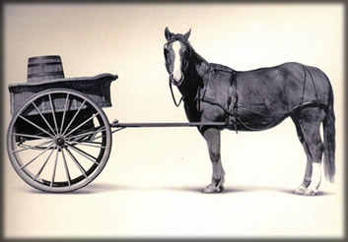
Let’s Practice
Open A_Regression.R
Predict Diamond Prices with linear regression.

Slide 5


Slide 6
Agenda
Start | End | Item
 |  | Regression in Action
 |  | Partitioning Data
 |  | Understanding Regression (simple univariate)
 |  | Build & Evaluate a Multiple Linear Regression
 |  | Housekeeping

Slide 7
The Problem of Overfitting
Statistical models can produce highly complex explanations of relationships between variables
The “fit” may be excellent
When used with new data, models of great complexity may do not do so well.
Notes:
7

Slide 8
100% fit – not useful for new data
Notes:
8

Slide 9
Another view of overfitting to a problem…

Slide 10
Overfitting, continued.
Causes:
Too many predictors start to inject noise not signal
Not adhering to a priori partitioning – up next
Lack of data knowledge & problem understanding
Consequence: Deployed model will not work as well as expected with completely new data.

Slide 11
Minimize Overfitting - Partitioning
Divide data into training portion and validation portion
Test model on the test portion
Training Data
All Data
Test Data
Notes:
How do you want to “spend” data

Slide 12
Minimize Overfitting - Partitioning
Divide data into training portion , validation & test portions
Tune a model and/or compare models with the validation portion
The “true” way a model will behave when launched on new data.
Training Data
All Data
Validation
Data
Test Data
Notes:
How do you want to “spend” data

Slide 13
Best Practice
If you have enough data and the model impact is large, this is a good partitioning schema
However, this much effort is not always undertaken.
Feature Engineering
Data
Training Data
All Data
Validation Data
Test Data
Notes:
How do you want to “spend” data
For large data – production, 10% improvement = $500M; 10% overfitting = $-500m
Additional layer of partitionoing CV discussed later

Slide 14

Next Glass
Next Glass is now out of business but leveraged chemistry & modeling for it’s business model.

Slide 15
Let’s Practice
Open B_anotherGlass.R
Engineering/Train/
Validation/Test
Train/Test
Train/Validation/Test

Slide 16
Review
Data Mining:
Supervised - Classification & Prediction
Unsupervised- Association Rules, Data Reduction, Data Exploration & Visualization
Before algorithms can be applied, data must be explored then pre-processed (treated)
To evaluate performance and to avoid overfitting, data partitioning is used
Models are fit to the training partition and assessed on the validation and test partitions
Today’s lesson explores partitioning and simple prediction.

Slide 17
Agenda
Start | End | Item
 |  | Regression in Action
 |  | Partitioning Data
 |  | Understanding Regression (simple univariate)
 |  | Build & Evaluate a Multiple Linear Regression
 |  | Housekeeping

Slide 18
Supervised Learning
Goal: Predict a single “target” or “outcome” variable
Training data, where target value is known
Score to data where value is not known
Methods: Classification and Prediction

Slide 19
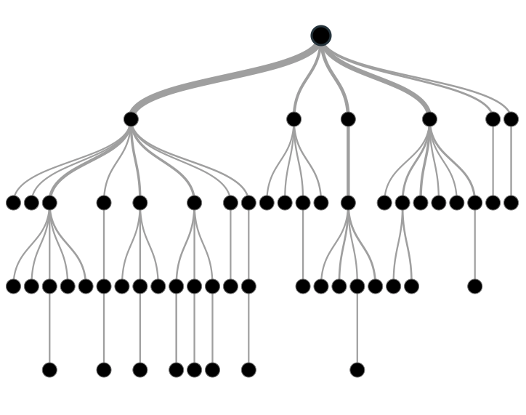

Supervised Learning
Inferring a function from labeled data.
“Learn from telling”, “Look at my data and I will tell you what to predict”
Data Setup
Algorithm
Business Context
Application
Marketing-Will a customer buy yes or no? How much will a customer spend?
Operations- Will an applicant default? When will a machine break?
Sports Analytics- How many points will the Bears’ QB score? What is the Bears’ probability of winning?
Requires expertise and stakeholder buy in
Flat “Excel” file. Each row is a record or observation. Each column is an attribute of the record.
One column is the outcome, y or target attribute.
Modeling e.g. K-NN, linear regression, decision tree, random forest etc.
Use the model to make predictions for the target label on the new data.

Slide 20

Supervised Learning Example
Inferring a function from labeled data.
“Learn from telling”, “Look at my data and I will tell you what to predict”
What impacts ice cream sales?
#
=ƒ(…)
Notes:
Just did carat to diamond prices
Now let’s add more than 1 input

Slide 21
Linear Regression for continuous outcomes
#
= $β$ + ($β$*temperature) + ($β$*day) + ($β$*price) + error
Some linear combination of temperature values, day of the week dummy variables and price estimate the number of cones that will sell.
Notes:
What should we expect the beta signs to be? Whats the relationship the information has with ice cream sales?
Temp goes up? Sales go up. Temp goes down? Sales go down. Positive relationship
Price goes up? Sales go down. Price goes down? Sales go up. Negative relationship

Slide 22

The linear combination equation captures information
outcome
coefficients
constant
error (noise)
predictors

Slide 23
The linear combination equation captures information
Outcome:
The “dependent”, “y” or “target”.
Number of Ice Cream Cones

Slide 24
The linear combination equation captures information
Constant:
The “intercept” or “beta-naught” has no predictor associated with it.
Avg. Number of Ice Cream Cones expected to sell if predictors were all 0.

Slide 25
The linear combination equation captures information
Predictors:
The “informative features”, “x” or “independent” variables.
Variables affecting sales in the data, temp, day, & price.

Slide 26
The linear combination equation captures information
Coefficients:
The “weight”, “betas” or “coefficients” multiplied with the specific “x” variable value.

Slide 27
The linear combination equation captures information
Error:
The “error” or “noise” represents the value the equation is wrong compared to the actual Y.

Slide 28
The linear combination equation captures information
outcome
coefficients
constant
error (noise)
predictors
The combinations of beta coefficients seeks to minimize the squared errors between the actual Y values and the equation. This combination manifests as the “best fit line”

Slide 29
#
= $6$ + 0.$25$*temperature + $3$*saturday_dummy + -0.5*price
Beta-Naught | Temperature | Saturday_dummy | Price
6 | 0.25 * 80 degrees | 3 * 1 | -0.5 * 5
6 | 0.25 * 88 | 3 * 0 | -0.5 * 2

Slide 30
#
= $6$ + 0.$25$*temperature + $3$*satudray_dummy + -0.5*price
Beta-Naught | Temperature | Satuday_dummy | Price | Best Fit Prediction
6 | 0.25 * 80 degrees | 3 * 1 | -0.5 * 5 | 26.5
6 | 0.25 * 88 | 3 * 0 | -0.5 * 2 | 27

Slide 31
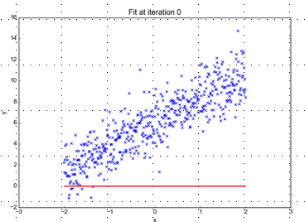
Minimizing the Sum of Ordinary Least Squared Errors
Equation:
Y= 0 +(0*x)
Beta “Naught” = 0
Intercept is 0
X beta coefficient = 0
No slope
Blue points Y Values represent actual outcome.
MINUS
Red line is the predicted outcome
Equals the Error

Slide 32
Big Errors
Equation:
Y= 0 +(0*x)
Beta “Naught” = 0
Intercept is 0
X beta coefficient = 0
No slope
Blue points Y Values represent actual outcome.
MINUS
Red line is the predicted outcome
Equals the Error

Slide 33
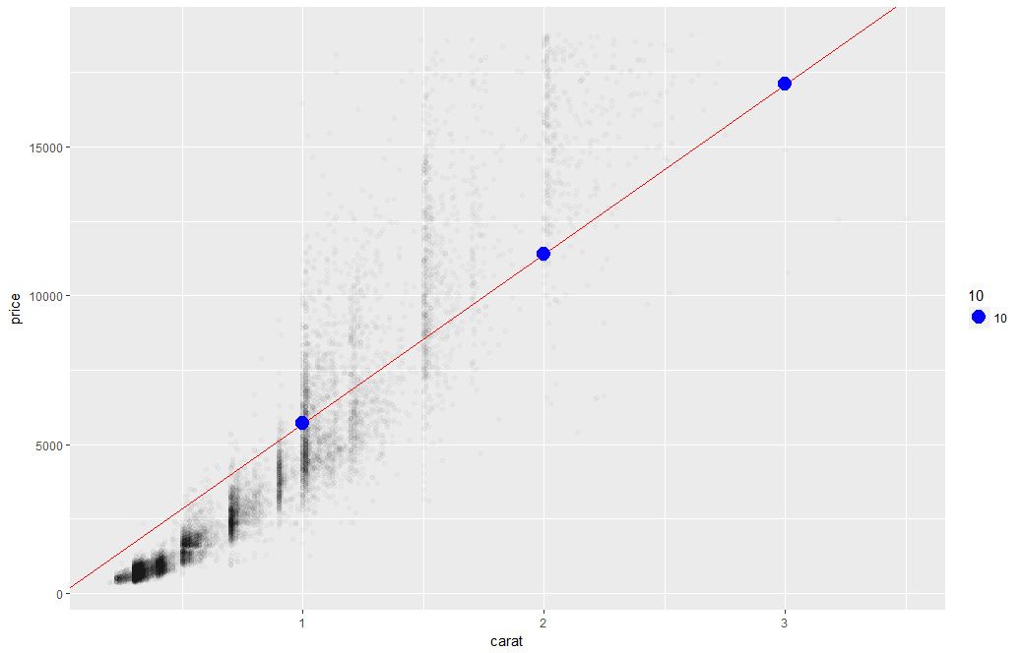
What’s really going on?
Errors between a prediction and actual.
Notice some are negative and some are positive

Slide 34
Why Squared Error?
Blue points Y Values represent actual outcome.
MINUS
Red line is the predicted outcome
Equals the Error
Cones
85
48
45
27
32
30
69
80
15
61
Prediction
67
42
54
95
1
48
51
95
20
22
Error
18
6
-9
-68
31
-18
18
-15
-5
39
-3
(18 + 6 + -9 + -68 + 31 + -18 + 18 + -15 + -5 + 39)
Notes:
Is this a good model?
18 + -18 cancel each other out

Slide 35
Why Squared Error?
Without squaring the errors positive & negative prediction errors cancel each other out.
(18² + 6² + -9² + -68² + 31² + -18² + 18² + -15² + -5² + 39²)
8445
324 + 36 + 81+ 4624 + 961 + 324 + 324 + 225 + 25 + 1521
Squaring the error means negative errors have the same impact on the optimization function.
Notes:
Is this a good model?
18 + -18 cancel each other out

Slide 36
So what is really going on?
The algorithm is optimizing the inputs and weights (beta’s) to minimize the sum of squared errors.
This is called “ordinary least squares (OLS).

Slide 37
Let’s Practice
Open C_Regression.R

Slide 38
Evaluating a Prediction Model
RMSE- Root Mean Squared Error
MAPE- Mean Absolute Percentage Error
y
y-hat
Actual Values | Predicted/Forecasted
10 | 16
12 | 8
20 | 17
36 | 34
Besides P-Values which is a variable level KPI, and adjusted R-Sq there are two popular KPI for evaluating continuous model predictions.

Slide 39
RMSE
RMSE- Root Mean Squared Error
y
y-hat
ERROR
ERROR-SQ
Actual Values | Predicted/Forecasted | Errors | Squared Errors
10 | 16 | -6 | 36
12 | 8 | 4 | 16
20 | 17 | 3 | 9
36 | 34 | 2 | 4
Mean
36+16+9+4
4
To manually calculate RMSE, work the acronym backwards.

Slide 40

RMSE
RMSE- Root Mean Squared Error
ERROR
SQUARED
MEAN
ROOT
Actual Values | Predicted/Forecasted | Errors | Squared Errors
10 | 16 | -6 | 36
12 | 8 | 4 | 16
20 | 17 | 3 | 9
36 | 34 | 2 | 4
Mean
Square Root
36+16+9+4
$$\sqrt{16.25}$$
4
=4.03
In the same units being measured, tells you +/- the prediction error.

Slide 41
MAPE
MAPE- Mean Absolute Percentage Error
ERROR
ABSOLUTE
PCT
MEAN
Actual Values | Predicted/Forecasted | Errors | Absolute | As % of Forecast
10 | 16 | -6 | 6 | =6/16 or 37%
12 | 8 | 4 | 4 | =4/8 or 50%
20 | 17 | 3 | 3 | =3/17 or 17%
36 | 34 | 2 | 2 | =2/34 or 5%
Mean of Percentages
37%+50%+17%+5%
4
=27.7%
Instead of squaring error, take the absolute error. Then divide that by the forecast value. Lastly calculate a mean average of all the percentage errors.

Slide 42

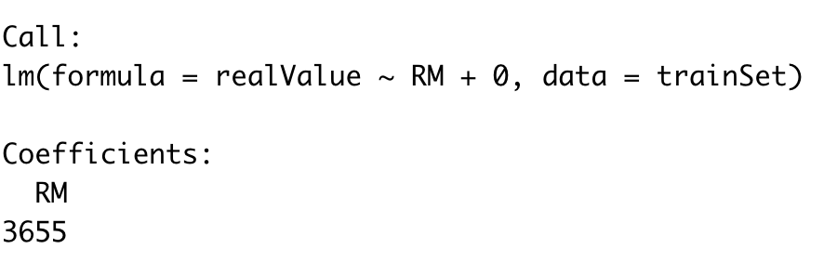
Explanatory Vs Predictive
Reviewing beta coefficients can explain relationships, some positive, some negative >>>
There is a positive relationship between number of rooms and housing prices.
Holding all other inputs constant the median price would increase $3655 for each room.
Notes:
Fancy way of saying reviewing identical houses but with 1 bedroom and 2.

Slide 43
Explanatory Modeling
Goal: Explain relationship between predictors (explanatory variables) and target
Familiar use of regression in data analysis
Model Goal: Fit the data well and understand the contribution of explanatory variables to the model
“goodness-of-fit”: R², residual analysis, p-values

Slide 44
Predictive Modeling
Goal: predict target values in other data where we have predictor values, but not target values
Classic data mining context
Model Goal: Optimize predictive accuracy
Train model on training data
Assess performance on validation (hold-out) data
Explaining role of predictors is not primary purpose (but useful)

Slide 45

Explanatory Vs Predictive Modeling
Make sure you understand the point of your project
(explanatory or predictive)
Do leaders want to understand a phenomena?
Do leaders want to make accurate predictions about the future?
This impacts how you evaluate the model and even what variables you choose.

Slide 46
Agenda
Start | End | Item
 |  | Regression in Action
 |  | Partitioning Data
 |  | Understanding Regression (simple univariate)
 |  | Build & Evaluate a Multiple Linear Regression
 |  | Housekeeping

Slide 47
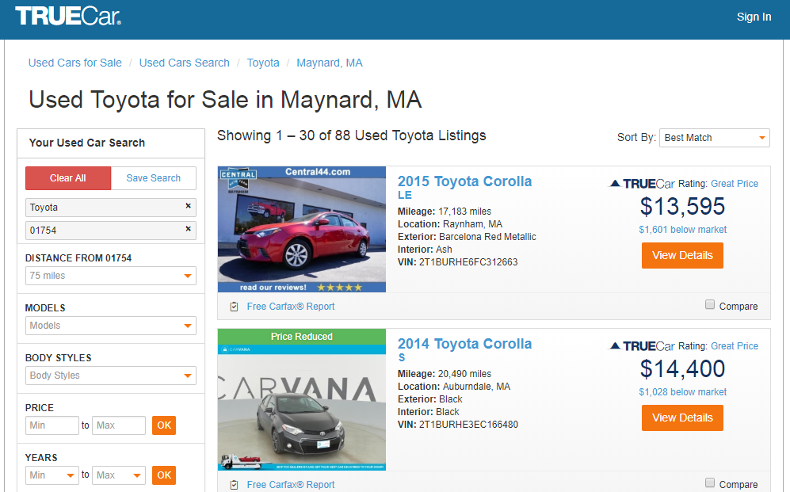
How does truecar.com know the price is “great?”

Slide 48

Yeah! I got a new job!

Slide 49

Welcome Dale to TrueCar’s Competitor: OldCar
Dale, can you predict used car prices? Then we will know if a car is priced above/below expected value

Slide 50

Let’s help Dale again.
But of course. This sounds like a predictive modeling project.

Slide 51
Let’s practice.
Open D_oldCar.R
Price in Euros
Tires binary 0/1 are new tires on car
Age in months as of 8/04
KM (kilometers)
Fuel Type (diesel, petrol, CNG)
HP (horsepower)
Metallic color (1=yes, 0=no)
Automatic transmission (1=yes, 0=no)
CC (cylinder volume)
Doors
Quarterly_Tax (road tax)
Weight (in kg)
Using the preprocessing and partitioning code in your toolbox, create a linear model of Toyota prices.

Slide 52
Regression is susceptible to multi-colinearity
Math
The presence of two or more predictor variables sharing the same linear relationship with the outcome variable.
Don’t shock the cat by having multi-collinearity.
In other words
Two+ informative features are measuring essentially the same thing.
Example
When predicting ice cream sales you include Fahrenheit and Celsius temperatures as two separate informative features.

Slide 53

Regression is susceptible to multi-colinearity
What happens with multi-collinearity?
The effect is exaggerated e.g. double counted.
The good news
The problem is so prevalent/impactful that R’s linear regression function handles it.
Other algorithms are not affected by double counting
Best Practice
Even though R removes it, do not rely on the function. Understanding the data you put in will avoid “garbage in, garbage out” scenarios.
Make happy cats by
knowing your data.

Slide 54
Back to R, script D!

Slide 55
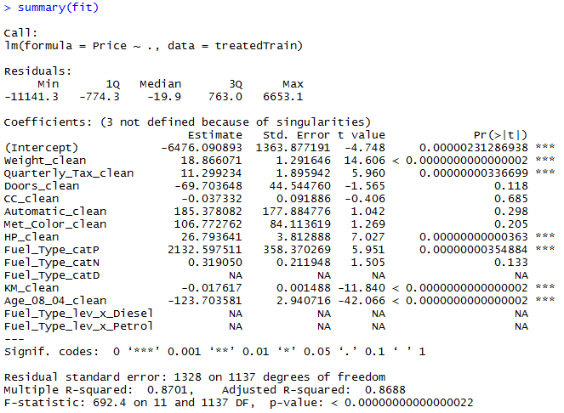
The Summary of the Fit

Slide 56
The Summary of the Fit
Auto ID of multi colinearity

Slide 57
The Summary of the Fit
Another name for errors.
Summary stats for the errors.

Slide 58
The Summary of the Fit
Treated Variable Names i.e. informative features

Slide 59
The Summary of the Fit
Coefficients or Beta values

Slide 60
The Summary of the Fit
The average amount that the coefficients vary from the actual average value of our response variable.
Notes:
We’d ideally want a lower number relative to its coefficients. In other words, the lower the better since it measures how much we can trust the coefficient relationship. If the std error is more than the coefficient you can’t really trust the coefficient since it could be positive or negative…the model couldn’t figure it out.

Slide 61
The Summary of the Fit
The coefficient t-value is a measure of how many standard deviations our coefficient estimate is far away from 0. In another way, values away from 0 indicate a real relationship
Notes:
T-VALUE We want it to be far away from zero as this would indicate we could reject the null hypothesis - that is, we could declare a relationship between weight and price exist. According to T, We are less confident about cylinder displacement (cc) and price’s relationship. The signal of price isn’t really in the variable “cc” and is likely captured in weight and hp.

Slide 62
The Summary of the Fit
P-Values
The probability of seeing a value larger than the t value.
Small p-values mean its less likely due to chance.

Slide 63
The Summary of the Fit
P-Values
In stats p <0.05 is good but in business I have seen p<0.2.
It’s a good idea to rebuild a model without variables that do not meet the cutoff.

Slide 64
The Summary of the Fit
P-Values
We could drop ??? Based on p values?
What variables should we drop with a p-value >=0.2?
Notes:
After slide back to script
CC_clean
Automatic_clean
Met_Color_clean
Fuel_Type_catP (prevalence) ie. 42% of the time that level appeared. X_catP =.42 for all level A observations.
GO BACK TO SCRIPT ~LINE60

Slide 65
Back to the script D

Slide 66
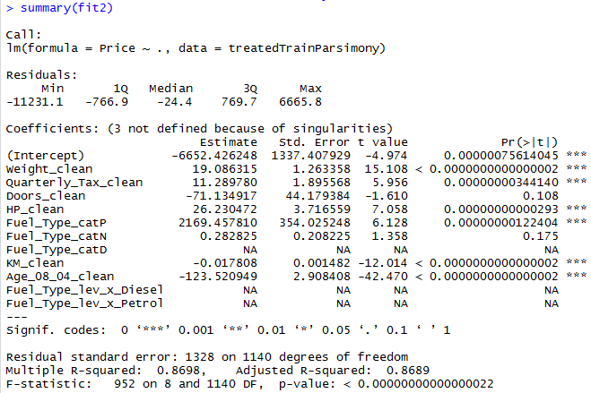
Parsimonious Model
Parsimony or compactness is desirable in models. The more features in a model, the more complexity we introduce, data integrity, data interactions, time to fit and time to predict are all impacted.
Notes:
We could drop yet another engineered variable but let’s continue. P =.175

Slide 67
Parsimonious Model
R-Sq: how much of the variation are the model is fitting. R-Sq measures the linear relationship between Price & features It always lies between 0 and 1
Notes:
We could drop yet another engineered variable but let’s continue.

Slide 68

Compare the two models
fit1
fit2
It can be said that both models explain ~87% of the variation in car prices. Dropping the variables improved accuracy and reinforces the fact that the variables didn’t add value.

Slide 69

Back to script D
How good is Dale’s model?
Notes:
For the predict warning about rank deficient matrices:
Rank of the matrix is reduced since it throws out multi-collinear variables. Often can be safely ignored.

