Slide 1
Hosting a static website with different Cloud providers
Jonathan Garrels
Project submission for the Project Gallery – a student-led initiative Udacity/Bertelsmann Technology Scholarship Challenge - Cloud Track

Slide 2
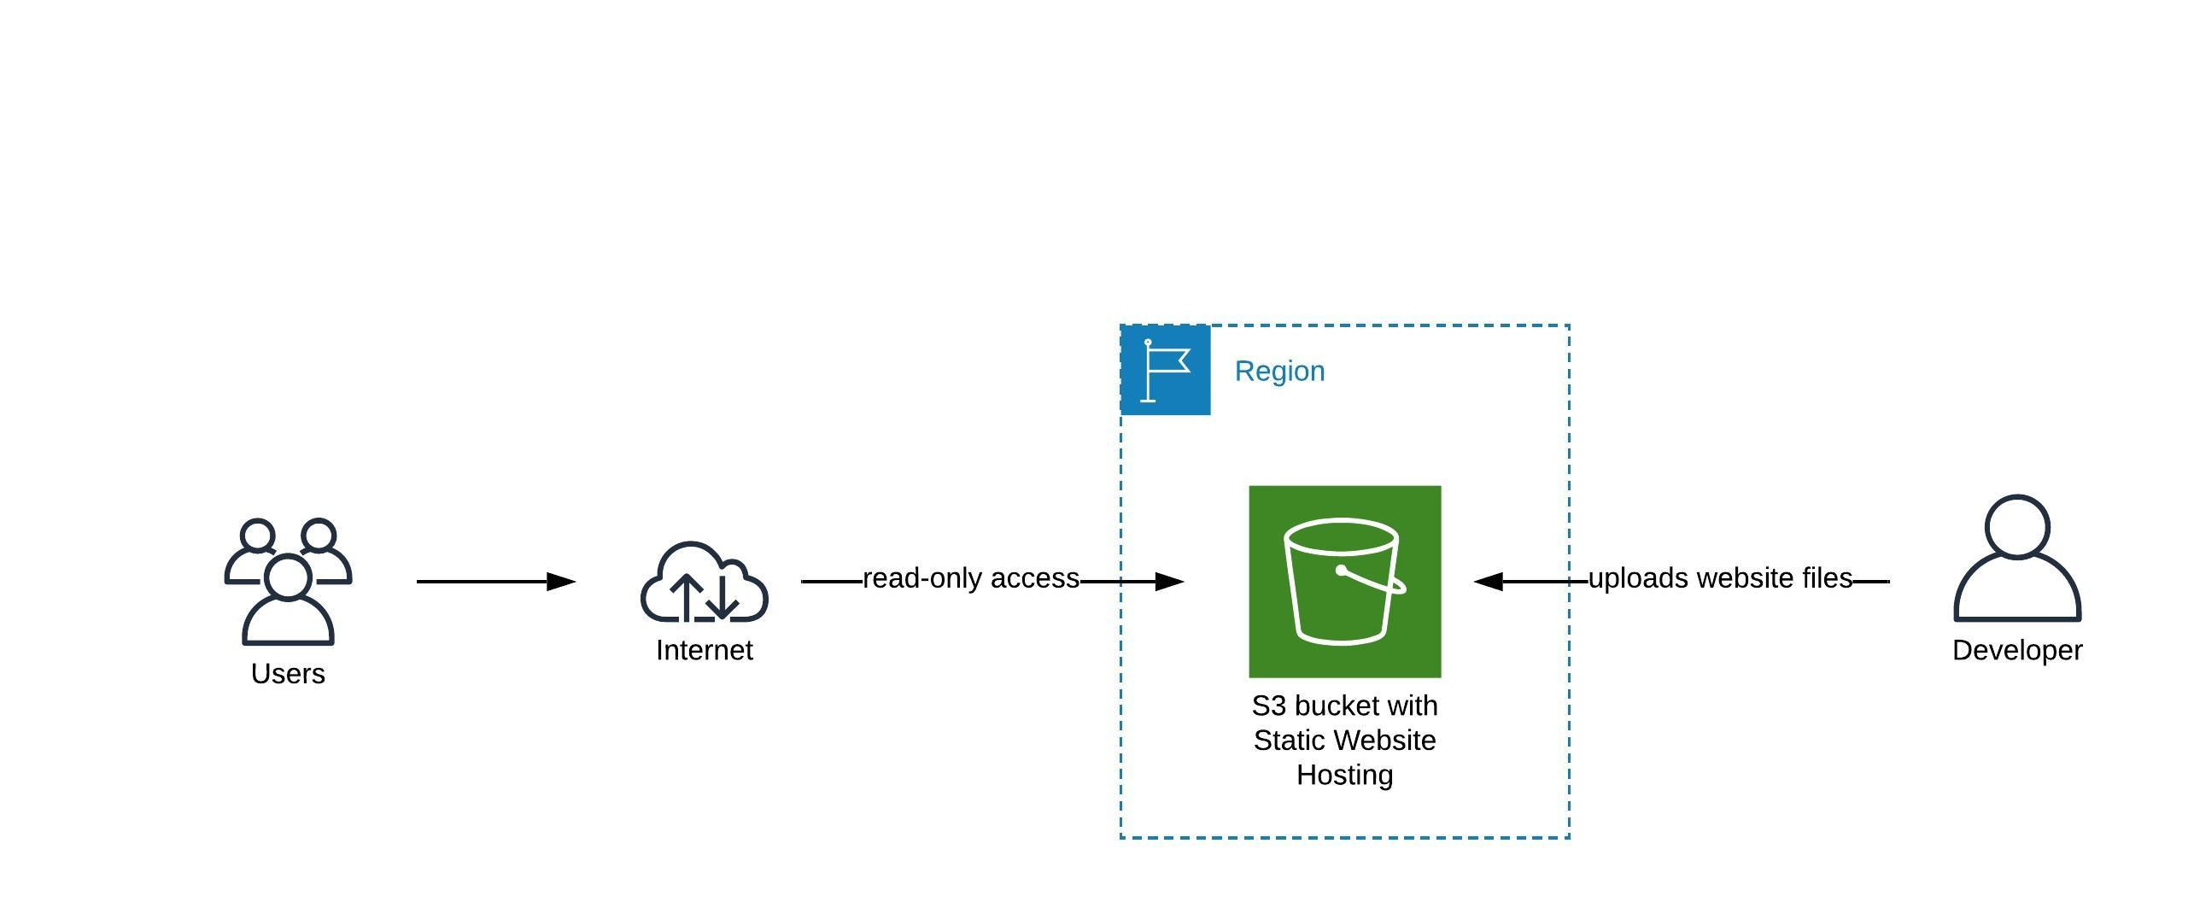
Hosting a static website with an AWS S3 bucket
For this project, I decided to use AWS S3 with its Static Website hosting option.
The architecture (see also the diagram) consists only of an S3 bucket.
The S3 bucket is in a specific region (in my case us-east-1) and is automatically replicated in several AZs (https://aws.amazon.com/en/s3/storage-classes/).
The developer uploads his website files to the S3 bucket with the Access Policy set to public-read (so that everyone can access the website).
Users access the website and have read-only access.
This project was done using the AWS CLI only. For instructions on how to do this, please see http://static-website-with-cloud.s3-website-us-east-1.amazonaws.com/guides/aws.html .

Slide 3
Possible improvement
I would like to add similar instructions on how to host a static website for Azure and GCP.
The website could be improved in terms of appearance, e.g. adding a menu and styling it.
The solution I implemented is very basic and falls within the AWS Free Tier. Improvement could be made by using Route53 to get a custom URL instead of the standard one provided by the S3 bucket.

