Slide 1
Aplicaciones y Sistemas Colaborativos en la Web 2.0
REBRAYER
Jorge Garrido Balaguer

Slide 2


Motivación

Slide 3
Disponible en:
  ec2-50-17-49-201.compute-1.amazonaws.com
  138.100.9.10:8080

Slide 4


Aplicación

Slide 5
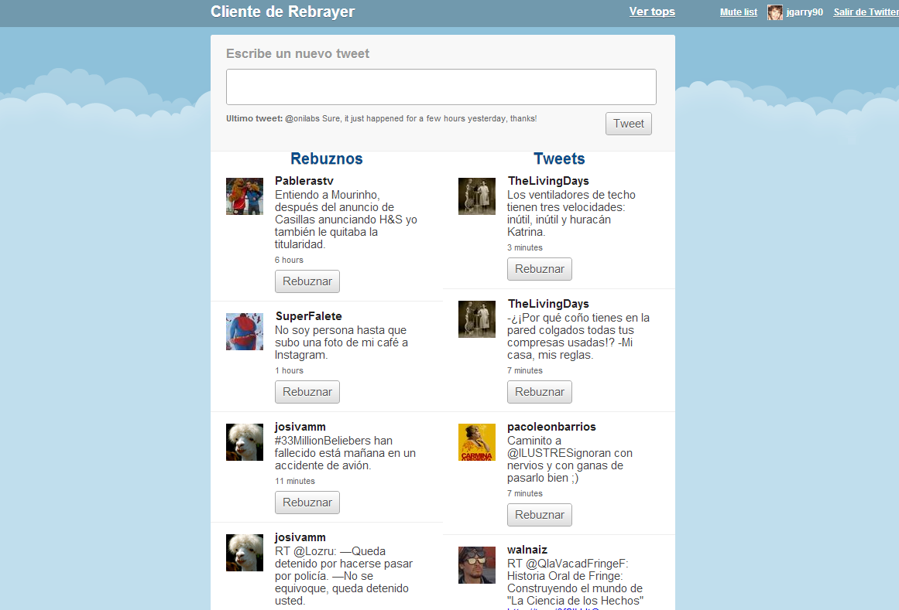

Slide 6
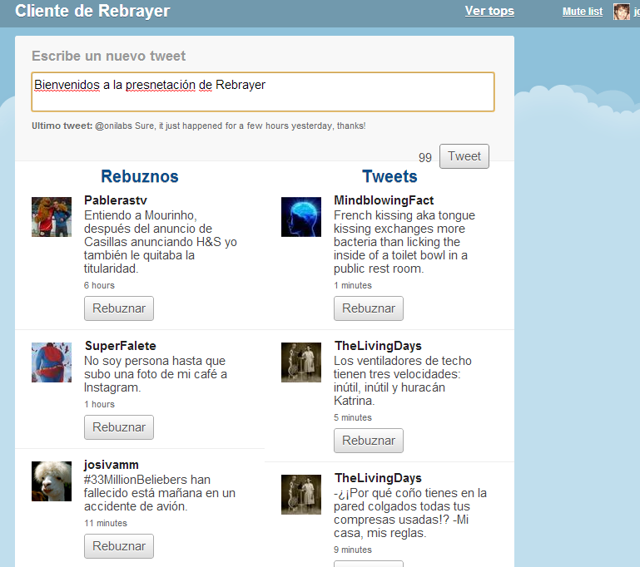

Slide 7
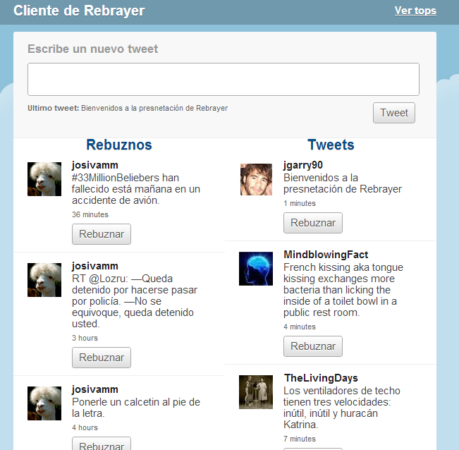

Slide 8
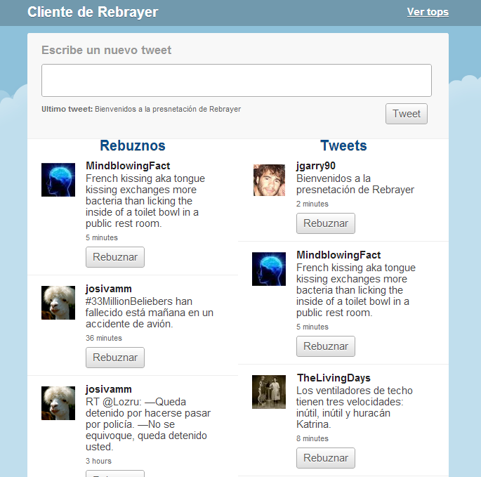

Slide 9
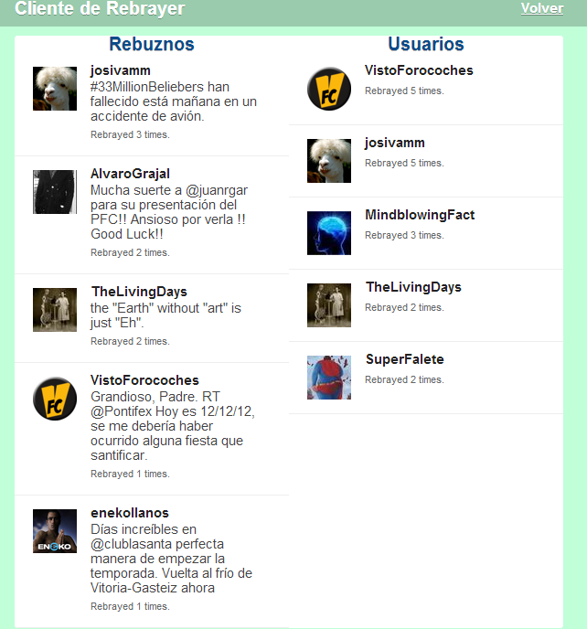

Slide 10
Servidor
Desarrollado en Node.js
Servidor express
Base de datos NoSQL: mongodb
  Código abierto
  Programado en C++
  Almacena documentos JSON
  Foursquare, Craiglist, etc.

Slide 11
Servidor
var postRebray = function(req, res){
// Parte Usuario
var date = new Date();
users.findOne({id_u: req.body.id_u.toString()},{'id_u':1}, function(e,i){
if (i == null){
var new_u = {id_u : req.body.id_u, rebrays_c : 1, rebrayed_c : 0, reg_date: date, last_date: date, rebrays:[{id_t: req.body.id_t, date: date}]};
users.insert(new_u, function(e,j){});
}
else{
users.update({id_u: req.body.id_u},{$push: {rebrays:{id_t: req.body.id_t, date: date}},$inc: {rebrays_c:1}},function(e,j){});
}
});
// Parte Rebuzno
rebrays.findOne({id_t: req.body.id_t.toString()},{'id_t':1}, function(e,i){
if (i == null){
var new_r = {id_t: req.body.id_t, id_u: req.body.id_u, id_d: req.body.id_d, rebrayed_c: 1, rebrayers : [req.body.id_u], date: date};
rebrays.insert(new_r, function(e,j){});
}
else{
rebrays.update({id_t: req.body.id_t},{$push: {rebrayers: req.body.id_u},$inc: {rebrayed_c:1}},function(e,j){});
}
});
// Parte Rebuznado
users.findOne({id_u: req.body.id_d}, function(e,i){
if (i==null) {
var new_u = {id_u : req.body.id_d, rebrays_c : 0, rebrayed_c : 1, reg_date: date, last_date: null, rebrays:[], rebrayed:[req.body.id_t]};
users.insert(new_u, function(e,j){});
}
else{
users.update({id_u: req.body.id_d}, {$inc: {rebrayed_c:1}, $push: {rebrayed:req.body.id_t}}, function(e,j){});
}
});
res.send('OK');
};

Slide 12
Servidor
var date_sort = function (date1, date2) {
if (date1.date > date2.date) return -1;
if (date1.date < date2.date) return 1;
return 0;
};
var getFollows = function(req, res){
users.find({id_u: {$in : req.body}}, {rebrays: 1, _id:0}, {$orderby : { 'rebrays.date' : 1 }}, function(e,i){
i.toArray((function(err, items) {
var toSend = [];
for(var x = 0; x < items.length; x++){
for(var y = 0; y < items[x].rebrays.length; y++){
toSend.push(items[x].rebrays[y]);}
}
items = [];
toSend = toSend.filter(function(elem, pos) {
if (items.indexOf(elem.id_t) == -1 ){
items.push(elem.id_t);
return toSend.indexOf(elem) == pos;
}
})
toSend.sort(date_sort);
toSend = toSend.slice(0,9);
toSend = JSON.stringify(toSend);
res.send(toSend);
}));
});
};

Slide 13
Servidor
var getTops = function(req, res){
var usersRes;
var rebraysRes;
users.find({$query: {}, $orderby : {'rebrayed_c' : -1 }}, {'_id':0, 'rebrayed_c' :1, 'id_u':1}, {limit : 5}, function(e,i){
i.toArray((function(err, items) {
usersRes = items;
rebrays.find({$query: {}, $orderby : {'rebrayed_c' : -1 }}, {'_id':0, 'rebrayed_c' :1, 'id_t':1}, {limit : 5}, function(e,ii){
ii.toArray((function(err, items) {
rebraysRes = items;
var finalRes = JSON.stringify({users: usersRes, rebrays: rebraysRes});
res.send(finalRes);
}));
});
}));
});
};
app.get('/', routes.index);
app.get('/users', user.list);
app.post('/rebray', postRebray);
app.post('/follows', getFollows);
app.get('/tops', getTops);

Slide 14
Cliente
var T = require("apollo:twitter").initAnywhere({v:VERSION, id:API_KEY});
require("apollo:jquery-binding").install();
var common = require("apollo:common");
var profile = T.call("users/show", {user_id: T.currentUser.id});
id_u = profile.id_str;
var follows = T.call("friends/ids");
var follows_arr = follows.ids;
for (var i=0;i<follows_arr.length;i++){
follows_arr[i] = follows_arr[i].toString();
}
follows_arr[follows_arr.length] = "702822542";
var request = makeHttpObject();
request.open("POST", "/follows", true);
var follows_send = JSON.stringify(follows_arr);
request.setRequestHeader("Content-Type", "application/json;charset=UTF-8");
request.send(follows_send);
request.onreadystatechange = function() {
if (request.readyState == 4) {
var data = JSON.parse(request.responseText);
//pintar tweets en rebuznos...
for (var i=data.length-1;i>=0;i--){
Mostrar3(data[i].id_t);
}
}

Slide 15
Cliente
function showTweet(tweet, append) {
var ini = tweet.id_str.slice(0,12);
var fin = tweet.id_str.slice(12);
var c = tweet.id_str;
$("#timeline")[append ? "append" : "prepend"](common.supplant("\
<div class='timeline_item user_{screenname}'>
<div class='tweet_wrapper' tweetid='{tweetid}'>
<span class='tweet_thumb'>
<img src='{image}' width='48' height='48'/>
</span>
<span class='tweet_body'>
<span class='screenname'>{screenname}</span>
<span class='content'>{text}</span>
<span class='meta'>{meta}</span>
<span class='rebraying_button_container'>
<span class='rebraying_status'></span>
<button OnClick='{Rebuznar({tweet_ini},{tweet_fin},{id_d})}'>Rebuznar</button>
</span></span></div></div>
", {
tweetid: tweet.id,
text: tweet.text,
image: tweet.user.profile_image_url,
screenname: tweet.user.screen_name,
meta: date_string,
tweet_ini: ini,
tweet_fin: fin,
id_d: tweet.user.id_str
}));
}

Slide 16
Cliente
function Rebuznar(ini, fin, id_d){
var a = ini.toString() + fin.toString();
a = a.toString();
var tweet = T.call("statuses/show", {id: a });
var request = makeHttpObject();
request.open("POST", "/rebray", false);
var resp = {id_t: tweet.id_str, id_u: id_u, id_d: id_d} ;
resp = JSON.stringify(resp);
request.setRequestHeader("Content-Type", "application/json;charset=UTF-8");
request.send(resp);
}

Slide 17
Cliente
</head>
<body>
<div id="top_bar">
<div id="session_buttons">
<div id="current_user"></div>
<div id="login"></div>
<div id="logout"></div>
</div>
<div id="top_wrapper_bar">
<div id="title_bar">Cliente de Rebrayer</div>
<div id="tops_bar" ><a href="/tops.html">Ver tops</a></div>
</div>
</div>
<div id="wrapper">
<div class="tweet_box">
<h2>Escribe un nuevo tweet</h2>
<div id="info">
<textarea id="status" onkeyup="update_counter(this)"></textarea>
<span id="latest"><strong>Ultimo tweet: </strong><span></span></span>
<span id="tweeting_button_container">
<span id="tweeting_status"></span>
<button id="tweeting_button">Tweet</button>
</span>
</div>
</div>
<div id="wrapper_timeline">
<div id="rebuznos_bar">Rebuznos</div> <div id="tweets_bar">Tweets</div>
<div id="rebuznos_timeline"></div> <div id="timeline"></div>
</div>

Slide 18
Conclusiones
Muy sencillo desarrollar con:
  JavaScript
  Express
No tan sencillo:
  MongoDB
Si no se es un iniciado, cuidado con:
  HTML
  CSS
Fácil y barato (0€) desarrollar una buena idea

Slide 19
Aplicaciones y Sistemas Colaborativos en la Web 2.0
REBRAYER
Jorge Garrido Balaguer

