Slide 1
Accessibility Gotchas with CAPTCHAs
CGI Federal
Human Factors Practice (HFP)
CSUN 2016, March 25, 2016

Slide 2
CGI: 65,000 strong
IT services that meet our client’s business and mission needs anywhere, anytime

Slide 3
Presentation Slides Are Available for Download
Slides are available for download in Microsoft PowerPoint 2013 (PPTX) format from Dropbox at: http://tinyurl.com/CAPTCHAS-CSUN2016

Slide 4
Overview and Learning Objectives
Many in the accessibility industry agree that CAPTCHAs still present a barrier to participation in online services for people with disabilities.
But if your client requires the use of a CAPTCHA what’s the best alternative available for enterprise-level websites?
After the conference session, participants should understand:
What is CAPTCHA?
What are common accessibility “gotchas” with different CAPTCHA variations?
What Section 508 accessibility requirements apply and how should CAPTCHA solutions be evaluated against those requirements?
What are some of the technical aspects of developing your own Text-Based Logic CAPTCHA?

Slide 5
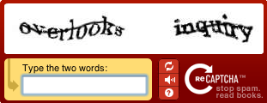
What is CAPTCHA?
CAPTCHA = Completely Automated Public Turing test to tell Computers and Humans Apart
An online test designed so that humans but not computers (bots) are able to pass it.
CAPTCHAs are used as a security measure to deter hackers and spammers from abusing online services by preventing:
Bots from creating numerous phony accounts.
Automated scripts from submitting forms, especially ones that generate email which can be turned into spam
Spammers from entering fraudulent comments on contact us pages or blog sites.

Slide 6
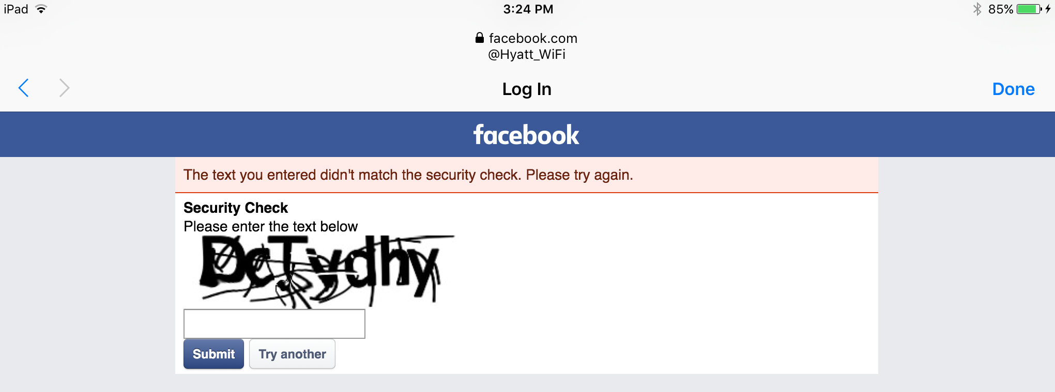
For instance, here at CSUN…

Slide 7
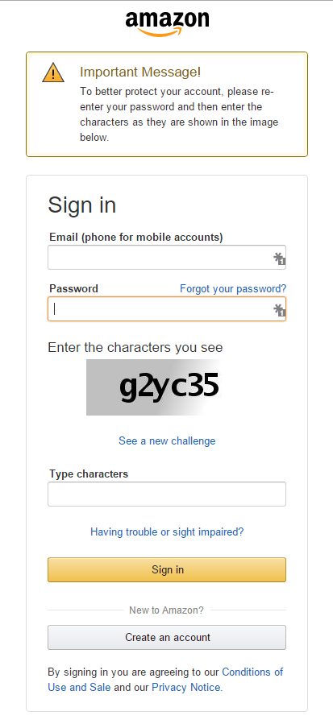
CAPTCHAs are Hard for Humans to Use
For people with disabilities (PWD), CAPTCHAs can present a complete barrier to entry or participation in online services.
Use of CAPTCHA is more common than you might think.
Websites use CAPTCHAs as part of their web pages for:
Sign in
Account Creation
Password Reset
Contact Us
Order/Payment
Let’s look at few CAPTCHA variations and the problems they pose for PWD…

Slide 8
CAPTCHA Variations
Common Accessibility “Gotchas”

Slide 9
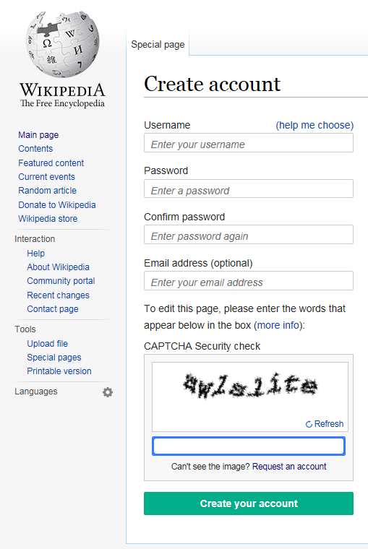
Image CAPTCHAs
CAPTCHAs are normally based on reading images of text that have been distorted and typing the characters into a text box.
Limitations:
The use of an image of text creates a barrier to use for people who are:
blind or visually impaired
dyslexic
Because CAPTCHAs are designed to stop machine-based attacks, adding alt text to the CAPTCHA image is not a viable alternative.
Universal Usability – Text is often so hard to read that even users without a vision impairment cannot efficiently complete the challenge

Slide 10
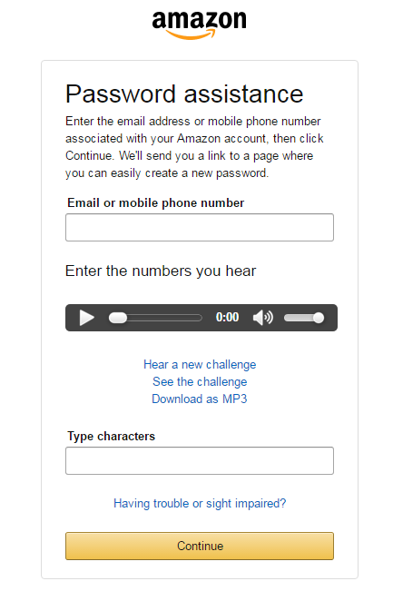
Audio CAPTCHAs
Audio CAPTCHA is sometimes offered as an alternative for users who are blind or have low-vision to use their sense of hearing instead of relying on the sense of sight.
Limitations:
The use of an audio challenge creates a barrier to use of the page by people who are:
Deaf or Hard of Hearing
Blind and Deaf
Universal Usability – Often include background noise which then makes it difficult for many users to efficiently discern the words, numbers or characters to type
Language – Can rely on English words which doesn’t support internationalization

Slide 11
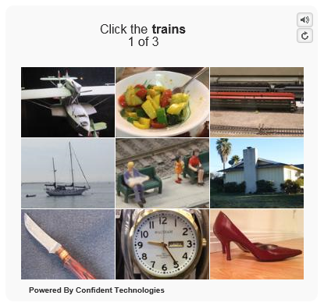
Image-based Logic CAPTCHA
May seem to be a better alternative to traditional CAPTCHA with distorted text or audio, but it still is not a complete solution.
Limitations:
In this vendor’s demo, a person who uses a keyboard cannot navigate to or select any of the images or the buttons that offer an audio-alternative or to load a different challenge.
A person using a screen reader will hear the screen reader announce the visible text of ”Click the trains” but will be unable to perceive or click the image of the trains.
After activating the audio option the recording says “Please type the letters you hear” but the UI does not provide an input textbox for user to enter the answer!

Slide 12
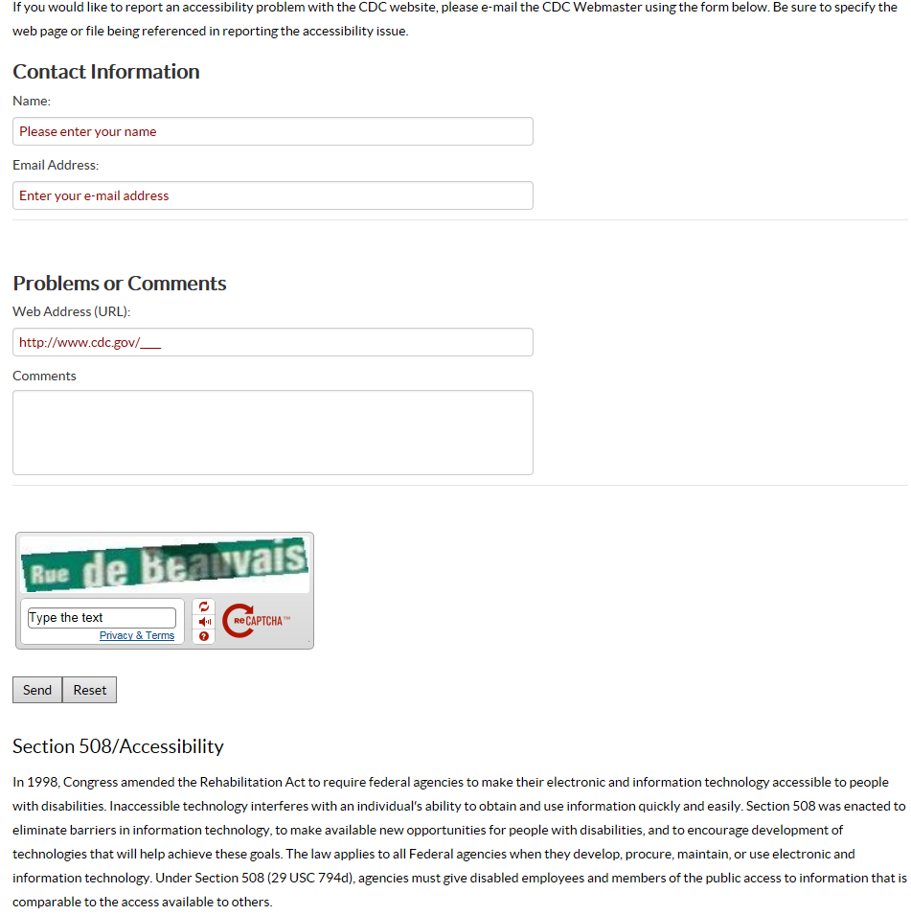
reCAPTCHA V1
Google’s original “reCAPTCHA” is a popular solution, offering options for vision or hearing impaired users. But in practice there are still shortcomings…
Limitations:
No accessible alternative is provided for people who are both vision and hearing impaired.
People using the keyboard cannot navigate to or activate the stacked set of 3 controls to reload a new challenge, switch to the audio CAPTCHA option, or get help.

Slide 13
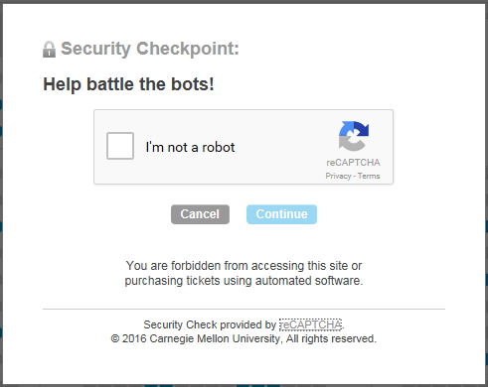
reCAPTCHA V2 (aka “NoCAPTCHA)
In 12/2014, Google released a newer “NoCAPTCHA” version of their reCAPTCHA solution.
At first glance it appeared to be an improved alternative to standard reCAPTCHA as the user is simply asked to check a checkbox indicating “I’m not a robot”.
But functional testing with screen reader software soon proved otherwise…

Slide 14
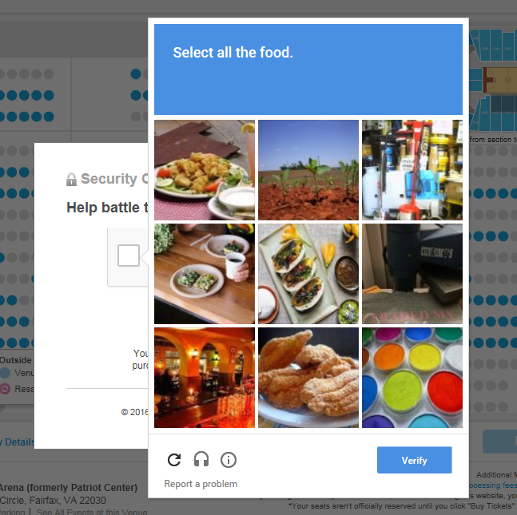
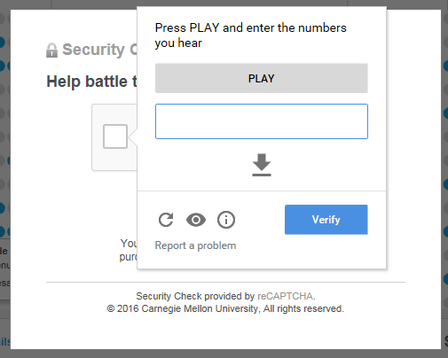
reCAPTCHA V2 Secondary Verification Challenges
There is additional security logic in place that determines if a user is a risk.
If so, the solution falls back to require the user to complete one or more verification challenges (distorted audio recording or an image-based logic CAPTCHA).
Screen reader users often report that they are unable to easily use the solution:
2014 WebAIM Discussion Thread (http://webaim.org/discussion/mail_thread?thread=6692)
2015 “reCAPTCHA Accessibility Revisited” TT Post (http://terrillthompson.com/blog/682)

Slide 15
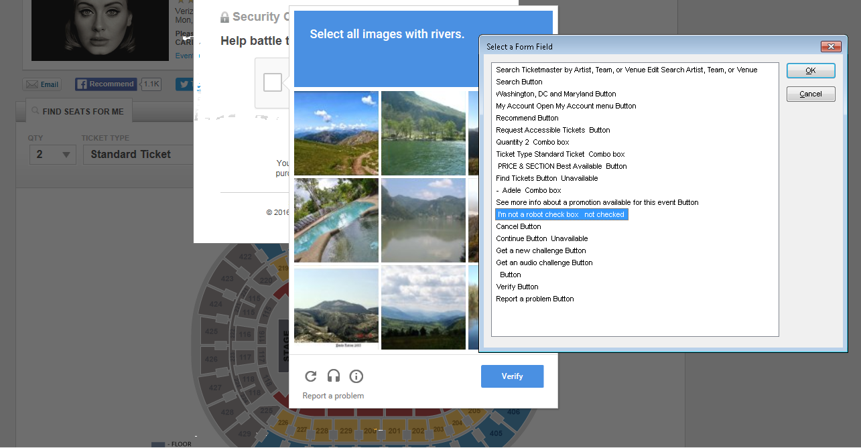
TicketMaster.com: JAWS List of Forms Fields for reCAPTCHA V2 Secondary Verification Challenge

Slide 16
Looking for a Better Option…
Text-based CAPTCHAs

Slide 17
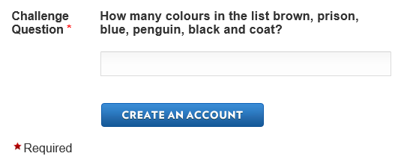
Text-based CAPTCHAs Using Logic Questions
The use of simple text removes the traditional accessibility barriers found in most image and audio CAPTCHA solutions.
People with disabilities can read the text-based challenge question and then enter their answer into the text box.
User interface is an accessible label (text-based question) and input text box (answer) which is:
natively keyboard accessible
can be read by assistive technologies
supports the use of alternate style sheets, high contrast colors, or larger text size for low-vision users.
Limitations:
Logic questions could be confusing for people with cognitive disabilities.
Third-Party Services (like TextCaptcha.com) may only support English (UK) question challenges.

Slide 18
Logical CAPTCHA is generally most accessible, allowing more people to receive all the information they need to be able to pass the test and use the website. - U.S. Section508.gov Blog https://www.buyaccessible.gov/blog/CAPTCHA

Slide 19
Evaluating CAPTCHAs against Section 508 Technical Standards
Are all aspects of the control keyboard accessible and all results for the control presented textually? [1194.21(a), 1194.31(f)]
For a CAPTCHA image, is alt text provided to describe the function of the image (and not the CAPTCHA text in the image)? [1194.22(a)]
e.g., alt="If you cannot view this image an audio challenge is provided."
Does any image-based CAPTCHA solution also offer an audio-based alternative for persons using screen reader applications? [1194.22(a)]
Do all the form controls in the CAPTCHA solution have proper labeling so that there is an accessible name, role, and state available to Assistive Technology (AT)? [1194.22(n)]

Slide 20
Evaluating CAPTCHAs against Section 508 Functional Performance Criteria & Support
Can the CAPTCHA be successfully completed by a user who is blind or visually impaired? [1194.31(a)]
e.g., CAPTCHA can be used with a screen reader
Can the CAPTCHA be successfully completed by a user who has low-vision? [1194.31(b)]
e.g., CAPTCHA adapts when using Windows High Contrast Mode, a User-Defined Style Sheet, and/or a Screen Magnifier
Can the CAPTCHA be successfully completed by a user who is deaf or hard of hearing? [1194.31(c)]
e.g., if the default CAPTCHA is audio-based there must be a text-based or image-based alternative
Is there an accessible alternate means for a user to request help if they are unable to successfully complete the CAPTCHA challenge [1194.41(c)]

Slide 21
Our Challenge
For one of our Federal clients we needed to find a viable CAPTCHA approach that would:
conform to Section 508 accessibility requirements
be accessible to the broadest user audience
be cost effective to implement and maintain
support internationalization (as needed)
scale for high-volume websites
We considered TextCaptcha (www.textcaptcha.com), a service that provides access to a text-based logic question and answer database.
However, this was not a viable alternative for our Federal client as:
They did not want to have a dependency on an external service
TextCaptcha only offers logic questions in English (UK)
Instead, our project teams developed custom Text-based Logic CAPTCHA solutions

Slide 22
Case Study 1:
Technical Details on Implementing a Custom Text-Based Logic CAPTCHA

Slide 23
Logic Question & Answer Content Creation
Keep questions simple. Questions that can be answered extremely fast are preferred over complex questions.
Good question: What is the sum of 5 + 0?
Bad question: What is 642 * 13?
If possible, give the answer within the question
Good question: What color is the green grass?
Bad question: What color is the sky?
Try to keep a balance of each type of question. Questions will be picked at random so you want them to have an equal chance of being selected.
Want the greatest flexibility in question format.

Slide 24
Data Model
The data model for the questions is small with only 3 attributes:
Question ID – A unique number for a question and answer pair
Integer
Used as an index for the Business Logic.
Question Text – The question to present to the user
String
Presented to the end user
Question Answer Text – The answer to the question
String
Business Logic will compare this value to the answer entered by the end user

Slide 25
Encrypting the Database
The ideal solution for an attacker would be to have the bank of questions and answers to feed into an automation script.
Although extremely unusual, we can protect against such a data breach by encrypting both the question and the answer within the database.
The question is encrypted using a block cipher algorithm (such as AES 256) as we need to be able to decrypt it to display the plain text question on the user interface.
The answer may be encrypted using a one-way hash as it is only relevant to the business logic, not the user interface.

Slide 26
Caching for Enhanced Performance
The data service fetches 50 questions at random from the database to store in the user’s session.
These 50 questions are treated like reference data to improve system performance.
The index can be used to categorize questions based on user needs. An example for localization:
An application can dedicate questions 1-100 to be in English and 101-200 to be in Spanish
The data service can take in specific parameters such as a locale and select questions from a specific range within the database.

Slide 27
Business Logic
Looks at the reference data fetched by the data service for the logic questions. Selects one question at random to serve to the user interface. We call this the selected question.
Accepts the answer that has been submitted by the user through the user interface.
Converts string to all lowercase automatically to permit answers to not be case sensitive
Trims extra white space before validating to eliminate leading or trailing spaces which might otherwise flag an accurate answer as wrong
Hashes the lowercase, trimmed answer the same way the correct answer is stored
Compares the hashed values
If the hashed user supplied answer does NOT match the hashed stored answer then the validation logic for the page tracks the error and displays it to the user via the standard error handling mechanism and a new logic question is displayed for the user to answer.

Slide 28

User Interface (UI)
Displays the question as an <input> and explicit <label> combination.
<label for=“question”> <span class=“required”>*</span> Give the answer to 90 + 5 </label> <input type=“text” id=“question” aria-required=“true” />
A refresh button can be provided to the user to request a new question without penalty if they are unable to answer the question.

Slide 29
Case Study 2:
Evolving the Solution

Slide 30
“Mad Libs” Style Logic Questions
Another solution that was based off of the first case study involves using templated questions and randomly generated words.
This differs from the first case study where the data model allowed for free-form questions and structure did not matter.
This solution implemented different templated questions such as
What color is the [text1] [text2]
Where text1 is a randomly generated color
Where text2 is a randomly generated object
What is [number1] + [number2]
Where number1 and number2 are randomly generated numbers.
Type the first and last number of [number1]
Where number1 is a randomly generated number.

Slide 31
“Mad Libs” Formula
The data model consists of templated sentences as objects.
What to fill in the blanks with is stored within an XML file. This file can hold many possible words and/or numbers to use to fill in the blank.
Templated sentences and answers are defined in two languages: English and Spanish
Which template and what values to fill in the blanks are each selected at random by the Data Service and the Business Logic. The constructed sentence becomes the selected question.
The Business Logic validates the user inputted answer and determines if it is the correct answer to the selected question.
This entire service is self-contained within a compiled library that can be imported within a project as needed.

Slide 32
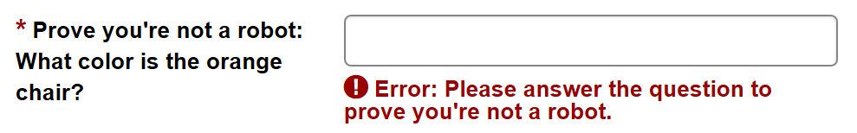
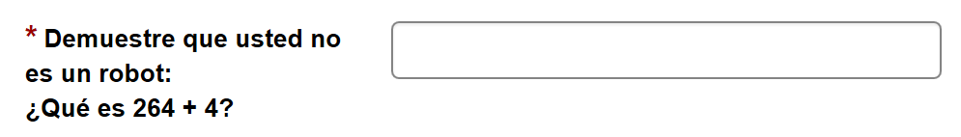
UI Examples of English and Spanish Versions

Slide 33
Maintaining Your Custom CAPTCHA Solution
Attackers are always improving and innovating automation scripts that can detect CAPTCHAs accurately and defeat them.
More volume and having important information or functions makes a site a more favorable target to the attackers. It is therefore important to maintain these solutions by refreshing their questions.
The first case study is more cumbersome to update but allows for greater freedom in creating questions and answers.
The second case study allows for easier and faster updates but restricts the questions down to template formats.
A sample time frame to update is when a new version of the application is deployed to production.

Slide 34
Reference: URL Sources for CAPTCHA Examples Discussed in this Presentation
Slide 8: Wikipedia Create Account page https://en.wikipedia.org/w/index.php?title=Special:UserLogin&returnto=Main+Page&type=signup
Slide 9: Amazon Password Assistance page http://tinyurl.com/AmazonPwdAssistExample
Slide 10: Confident Technologies’ Image-based Logic CAPTCHA Demo page http://confidenttechnologies.com/confident-captcha-demo/
Slide 11: CDC’s Report an Accessibility Problem page (reCAPTCHA v1) http://www.cdc.gov/contact/accessibility.html
Slides 12 - 14: Find Tickets or Buy Tickets workflow on ticketmaster.com website (reCAPTCHA v2) http://www.ticketmaster.com/event/15004F2E969B1A51?SREF=P_PageModule_main
Slide 15: We the People, Create a WhiteHouse.gov Account web page https://petitions.whitehouse.gov/register?destination=user/password

Slide 35
What do you think?
Open Discussion and Q&A

Slide 36
Administrative Wrap-Up
Download Our PowerPoint Slides (from Dropbox) OR email us for a copy. http://tinyurl.com/CAPTCHAS-CSUN2016
Questions after the session? Contact us at:
Jennifer Gauvreau, @jlgauvreau jennifer.gauvreau@cgifederal.com
Karen Herndon, @kwherndon karen.herndon@cgifederal.com
Ivan Valdez, @ijvaldez89 ivan.valdez@cgifederal.com
How did we do? Please review this session (http://www.csun.edu/cod/conference/2016/sessions/index.php/public/session_surveys/review/221)

