Slide 1
Reinforcement Learning – Q Learning
Seeks to learn a policy that maximizes its total reward
A q-table is created to assign values to each state and action as a reference point for it to select its next best action
Agent interacts with environment and updates q-table to reflect whether or not the reward was positive or negative
Common variable in Q-Learning models is gamma, or the discount factor, and it helps assess what the future rewards will be
Epsilon is another common variable, and it determines how aggressive, or greedy, the model will be in seeking rewards

Slide 2
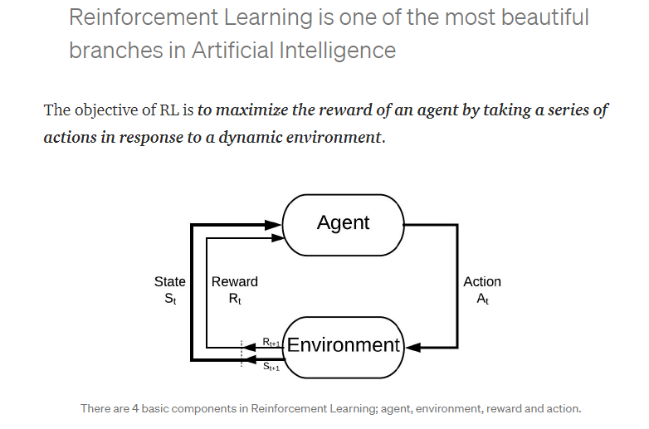

Slide 3
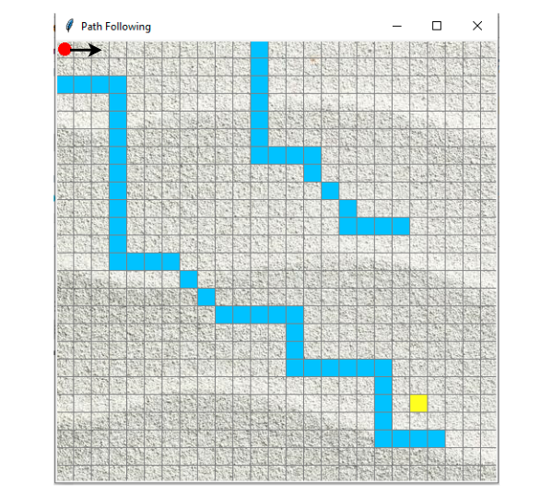

Slide 4
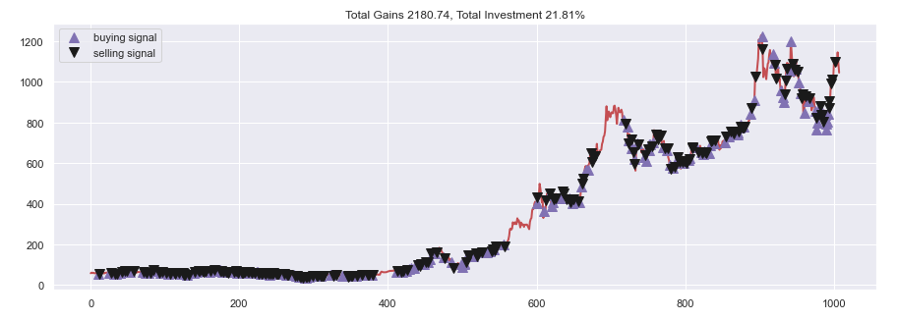
TSLA Stock Analysis

Slide 5
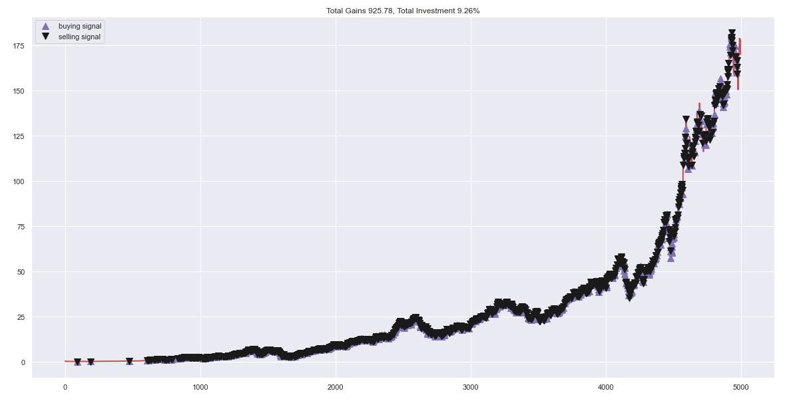
AAPL Stock Analysis

