Slide 1
FinTrust
Digital Bank
Final presentation, Data Analytics track
Yawa Jacqueline GBEDEVI | AnalystLab Africa Experience Lab
FinTrust is a fictional bank. All data is synthetic, and the risk review flag is an educational label, not fraud detection.
Notes:
Hello, I'm Jacqueline Gbedevi, a Data Analytics intern at AnalystLab Africa. This is my final presentation for the FinTrust Digital Bank project.
FinTrust is a fictional digital bank. It has 1,500 customers and 12,000 transactions from January to March 2026, but nobody has put them together into one clear picture. My job, in the Data Analytics track, was to turn that data into KPIs, a dashboard and recommendations that someone could really act on.
One thing before I start. All the data is synthetic, and the risk review flag is an educational label. It is not fraud detection.

Slide 2
A bank with data, but no clear picture
FinTrust has customer and transaction data, but nobody has joined it into one view. My job was to turn it into KPIs, a dashboard and recommendations someone can act on.
1,500
customers
12,000
Tools
transactions
Excel
SQL (DuckDB)
Python
Power BI
GitHub
560M NGN
total value, January to March 2026
Notes:
Over four weeks I went from understanding the problem, to cleaning the data, to analysis, and finally to a full dashboard.
I used Excel for the first checks, SQL with DuckDB for the main queries, Python for testing and validation, Power BI for the dashboard, and GitHub to keep everything organised. Everything I show today is my own individual work.

Slide 3
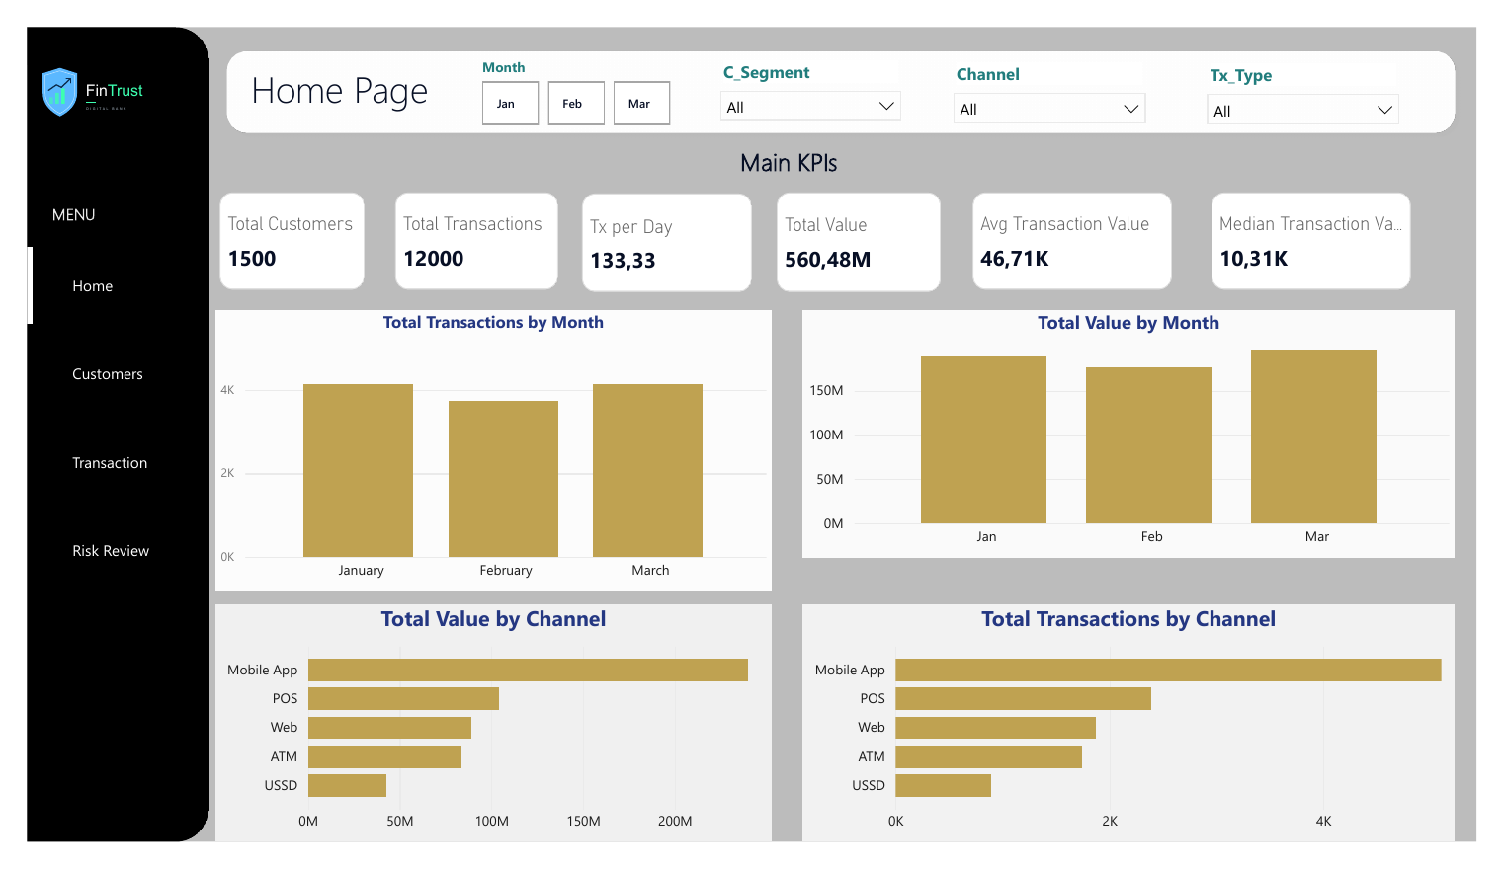
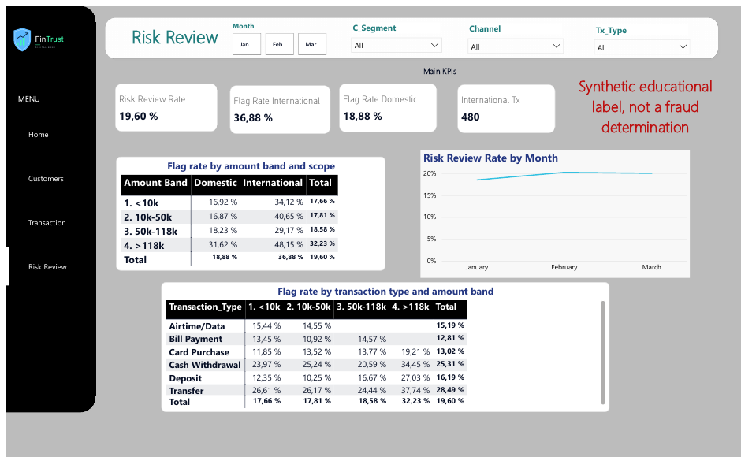
The dashboard: four pages, one story
Home: main KPIs, with the median next to the average
Risk Review: flag rates, with the reminder that the flag is synthetic
Customers and Transactions pages complete the story: segments, channels, failures and transaction types.
Notes:
[Home page] This is the Home page. 1,500 customers, 12,000 transactions, and about 560 million naira in total value.
Look at these two cards. The average transaction is around 46,700 naira, but the median is only 10,300. That gap is the most important thing on this page, and I will come back to it. February looks lower only because it has fewer days. The Mobile App carries the most traffic, over 40 percent.
[Customers page] On the Customers page, the four segments look almost the same, with about eight transactions per customer. This table shows where customers really transact, depending on the channel they say they prefer. It is very flat. Whatever they declare, about 42 percent of their transactions happen on the Mobile App.
[Transactions page] Here the success rate is 90.47 percent and the failure rate is 5.25. The Mobile App has the most failed transactions, 296, but it also has the most traffic. If I pick the Mobile App in this slicer, every card updates. Transfers and card purchases together are more than half of all activity.
[Risk Review page] On the last page, the red note reminds everyone that the flag is synthetic. International transactions are flagged about twice as often as domestic ones, and the rate is highest, 48 percent, for international transactions above 118,000 naira. There are only 480 international transactions, so I read this as a direction, not as an exact number.

Slide 4
Three things the data says
4.5x
47%
2.7x
The average misleads
Mobile App failures are about volume
The flag follows a few factors
The average transaction is 4.5 times the median. About 12% of transactions carry 62% of the value.
It holds 47% of failures with 42.5% of traffic. A weaker rate is not proven (p = 0.11 after correction).
International, Transfer, Cash Withdrawal and amounts above 118k. Customer segment does not matter. Synthetic label.
Notes:
I will keep three insights. The first one is about the average. About 12 percent of transactions carry 62 percent of the total value. So if we only reported the average, we would think a normal transaction is 47,000 naira, when half of them are below 10,000. That is why the median now sits next to the average.
The second is about the Mobile App. It has the most failures in number, and the largest failed value, 13 million naira. That deserves attention. But, as I will show in a moment, I cannot say that the app is less reliable.
The third is about the risk flag. International transactions, transfers, cash withdrawals and amounts above 118,000 naira are the things linked to it. The customer segment is not. And I want to repeat that this is a synthetic label, so it describes the dataset, not real fraud.

Slide 5
I tested my own work before trusting it
What testing changed
21 of 21
The preferred-versus-actual table showed column percentages. It now shows row percentages.
Median added to the Home page, the hidden SME row restored, filter names unified.
Mobile App result moved from p = 0.022 to p = 0.11 once corrected for 5 comparisons.
Small errors in earlier documents fixed (for example 40.7% became 40.6%).
dashboard values matched an independent recalculation in Python
6 of 6 findings re-tested with a second method. All held, 2 needed softer wording.
Notes:
I did not want to trust the dashboard just because it looked right. So I recalculated 21 of its values in Python, and all 21 matched.
While doing that review, I found problems that I could not see at first. A table was titled percent of each row, but it actually showed column percentages. The SME row was hidden in another table. The filters had different names from one page to another, and the median was missing from the Home page. I fixed all of them and ran the checks again.
Then I tested my six main findings a second time, with a different method. They all held, but two needed softer wording. The best example is the Mobile App. At first, it looked clearly worse, with a p-value of 0.022. But I had compared five channels after looking at the data. Once I corrected for that, the p-value became 0.11. So I can say the app has the most failures, but not that it is the weakest channel.
I also corrected small mistakes in my own earlier documents. For example, 40.7 percent became 40.6.

Slide 6
Links to the wider solution, and limits
Ready for the other tracks
What this data cannot show
Cleaned data and 12 data quality tests
Flag drivers and the 118k threshold
KPI definitions and validated figures
Synthetic data, and the flag is not fraud detection
Only 3 months, with exactly 500 transactions in every hour: no peak hours, no growth
Device type and location do not match channel or city
Only 480 international transactions: read the direction, not the exact rate
Received from other tracks: add only what really happened.
Notes:
[Say only what really happened. Pick one of the two versions below and delete the other.]
[Version A, if you exchanged work] I shared my cleaned data rules and my findings on the risk flag with the Data Science track. They used them to compare their features. [Add what changed, and where there is evidence.]
[Version B, if there was no exchange] My outputs are ready for the other tracks, for example the data quality rules and the findings on the risk flag, but I did not receive or use any output from another track.
About limits. The data covers only three months, and it is unusually regular, exactly 500 transactions in every hour. So I cannot say anything about peak hours or growth. The device type and the location do not match the channel or the customer's city, so I did not use them. And again, the flag is synthetic.

Slide 7
What I learned, what I recommend
Lessons
Recommendations for FinTrust
Show the median next to the average
Recalculate dashboard numbers in a second tool
Be ready to change your own findings
Investigate Mobile App failure causes before calling the app weaker
Review how Premium and Dormant are defined
Prioritise transfers, cash withdrawals and international transactions for review
Thank you
Notes:
Three lessons stay with me. Always show the median next to the average. Recalculate your dashboard numbers in a second tool. And be ready to change your own findings, because two of mine changed.
My recommendation for FinTrust is simple. Investigate the causes of Mobile App failures before deciding the app is weaker. Check how Premium and Dormant are defined, because they do not match what customers do. And look first at transfers, cash withdrawals and international transactions if a review team needs to prioritise.
Thank you for watching.

