Slide 1

Necessary and sufficient winners of forecasting competitions
Gerdus Benadè Jens Witkowski
benade@bu.edu

Slide 2
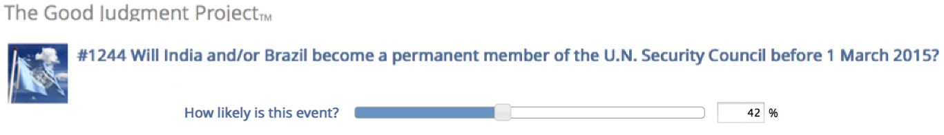
Probabilistic predictions
Crowd predictions
Machine predictions: What is the probability of this applicant defaulting on this loan?
For fixed test instances and outcomes Y, when can we say that
a forecaster/model is best for all reasonable loss functions?

Slide 3


Proper loss functions and 1-dominance
Forecasts are evaluated by loss functions or scoring rules
(Strictly) concave functions give (strictly) proper scoring rules
Squared error
Inst. | Y
1 | 1 | 0.25 | 0.6
Proper scoring rules reward accuracy and incentivizes truthful reporting
Forecast A dominates forecast B if there is no proper scoring rule under which A achieves lower loss
Notes:
1-dominance has been used even with many forecasters, but does not tell the whole story

Slide 4
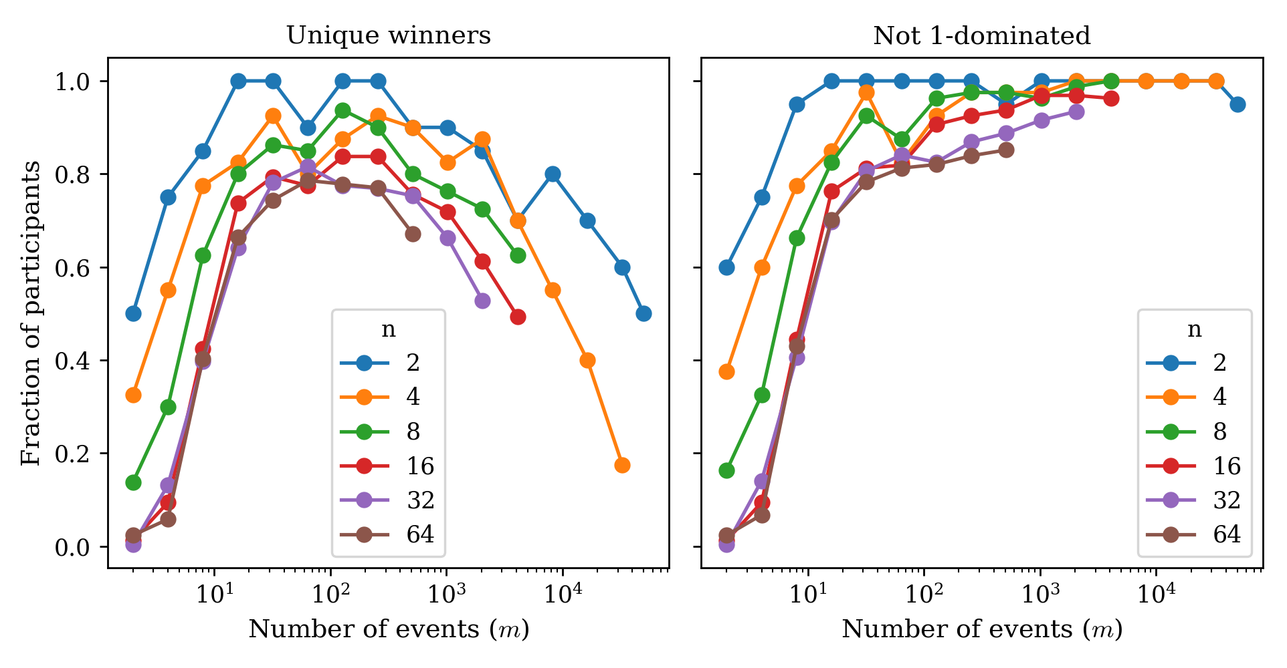


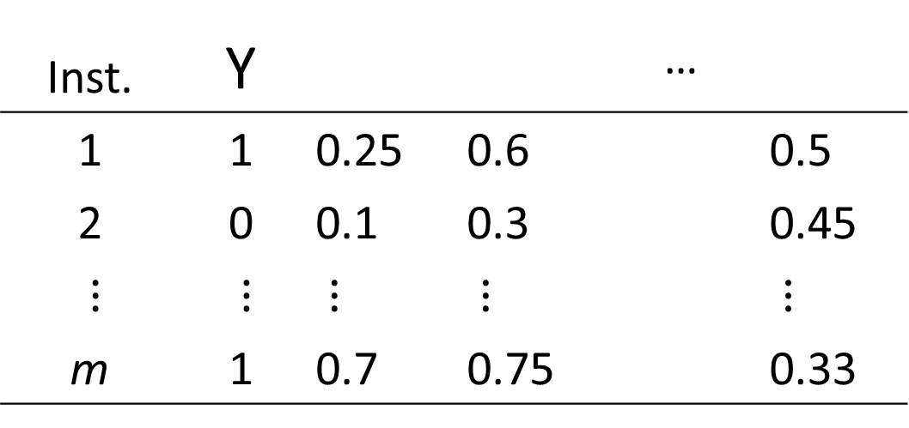
Set-dominance: when can a forecaster win a forecasting competition?
Give a notion of set-based dominance - derive necessary and sufficient conditions for being a conceivable winner
Show that this can be checked in polynomial time with an LP
Inst. | Y |  |  | …
1 | 1 | 0.25 | 0.6 |  | 0.5
2 | 0 | 0.1 | 0.3 |  | 0.45
$⋮$ | $⋮$ | $⋮$ | $⋮$ |  | $⋮$
m | 1 | 0.7 | 0.75 |  | 0.33

