Slide 1
Programs and proofs

Slide 2
Introduction

Slide 3
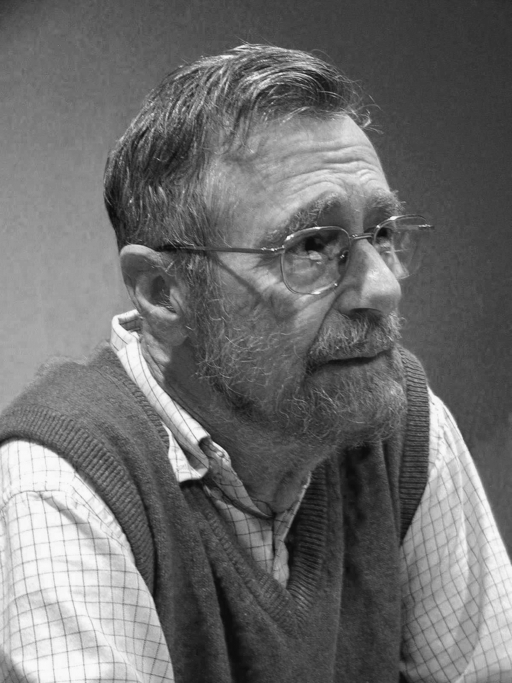
As long as there were no machines, programming was no problem at all; when we had a few weak computers, programming became a mild problem, and now we have gigantic computers, programming had become an equally gigantic problem.
… I now suggest that we confine ourselves to the design and implementation of intellectually manageable programs
— E. W. Dijkstra, “The Humble Programmer”

Slide 4
I’m going to talk about the propositions as types (Curry-Howard-Lambek) correspondence.
Propositions as types is an organizing principle for logic and computation
The story of propositions as types stretches from the origins of computer science to today’s research frontiers in programming languages and mathematics.

Slide 5
The foundational crisis in mathematics

Slide 6
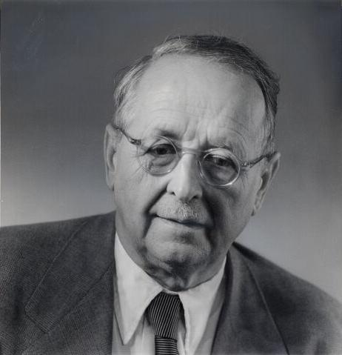
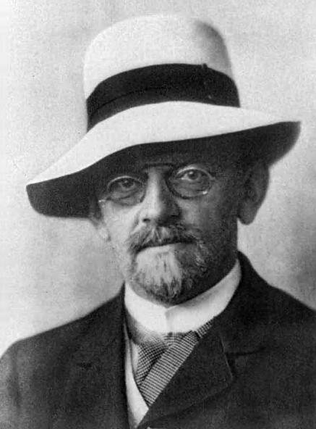
Forgetful of this limited origin, one afterwards mistook that logic for something above and prior to all mathematics, and finally applied it, without justification, to the mathematics of infinite sets. This is the Fall and original sin of [Cantor's] set theory…
— Hermann Weyl, “Mathematics and logic: A brief survey”

Slide 7
No one will drive us from the paradise which Cantor created for us.
— David Hilbert, “Über das Unendliche”

Slide 8
... to capture this field we must—this is my conviction—make the concept of specific mathematical proof itself the object of an investigation, just as the astronomer must take his position into account, the physicist must take care of the theory of his apparatus, and the philosopher criticizes reason itself.
— David Hilbert, “Axiomatisches Denken”

Slide 9
The structure of proofs

Slide 10
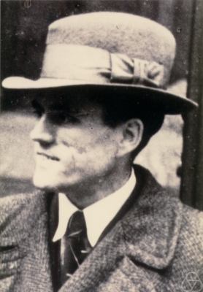
First, I wanted to establish a formalism that came as close as possible to real reasoning. This resulted in a “calculus of natural deduction”.
— Gerhard Gentzen, “Untersuchungen Über das Logische Schließen”

Slide 11
Natural deduction
Represent proofs by trees of inferences.
R₁
R₂
R₃
R₄
R₅
Inference #3
Inference #2
Q₁
Q₂
Inference #1
P

Slide 12
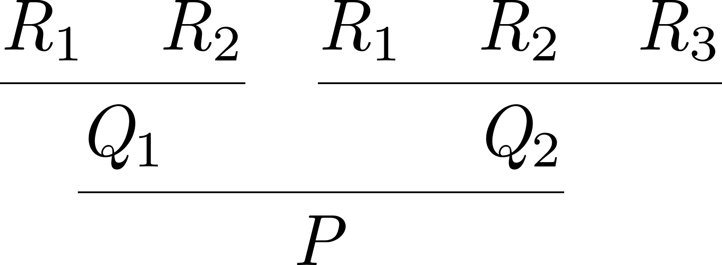
Natural deduction
Represent proofs by trees of inferences.
Inference #3
Inference #2
Inference #1

Slide 13
The rules of inference

Slide 14
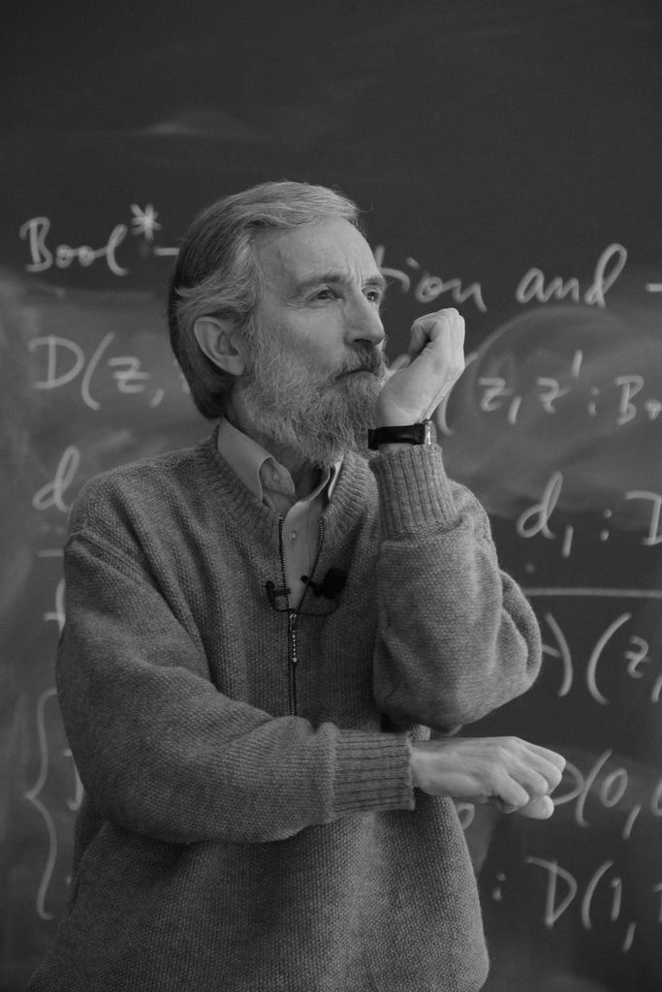
Thus, a proposition is defined by what counts as a direct proof of it.
— Per Martin-Löf, “Truth of a proposition, evidence of a judgment, validity of a proof”

Slide 15
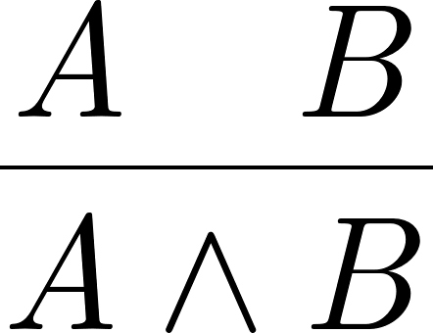
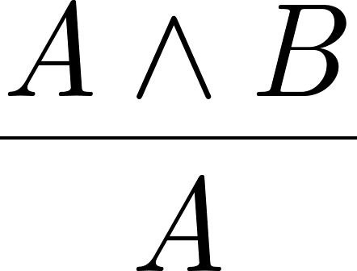
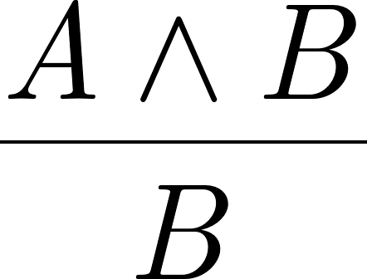
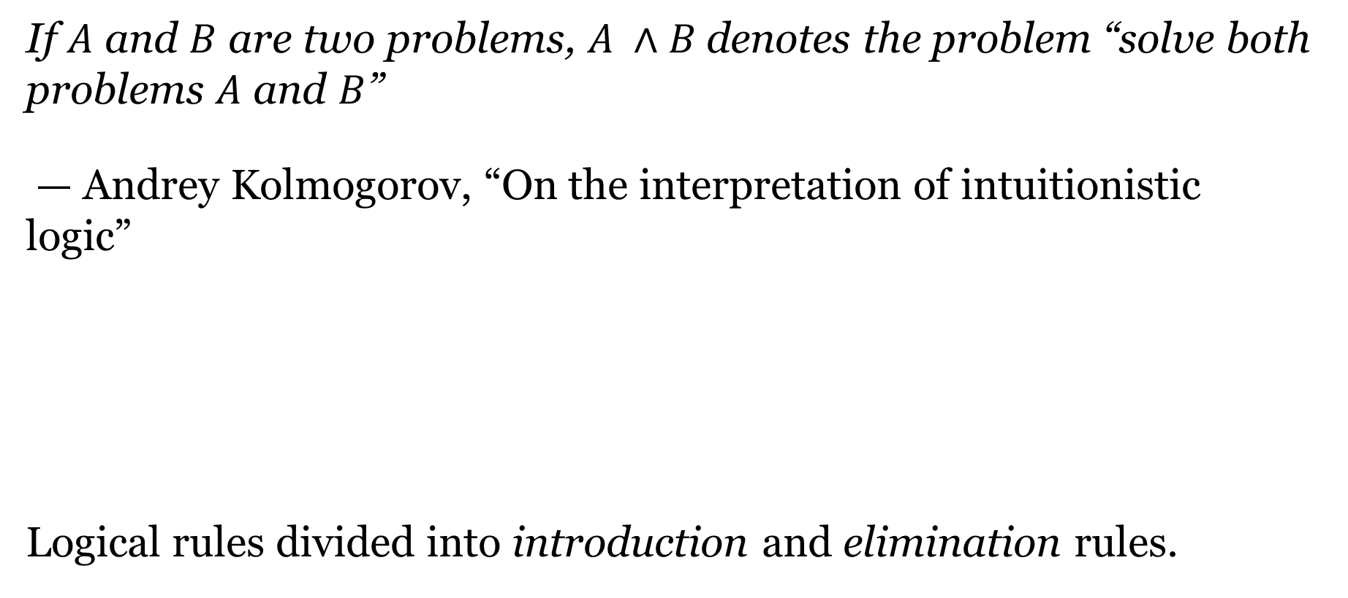
Conjunction
If $A$ and $B$ are two problems, $A ∧B$denotes the problem “solve both problems $A$ and $B$”
— Andrey Kolmogorov, “On the interpretation of intuitionistic logic”
Logical rules divided into introduction and elimination rules.

Slide 16
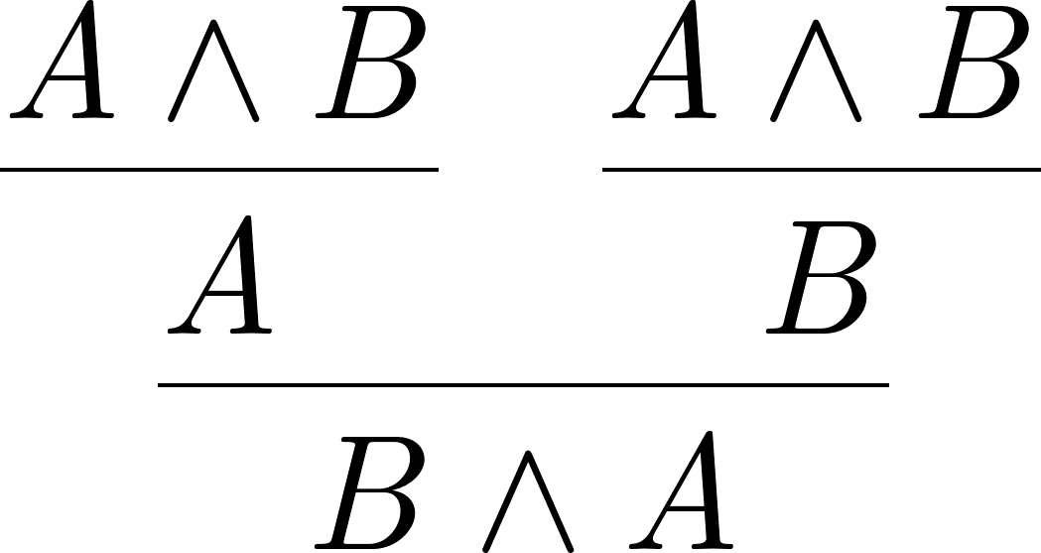

Example of conjunction
Symmetry of conjunction (part 1):
“Open” proof tree―unsolved $A∧B$ obligations at the top of the tree

Slide 17
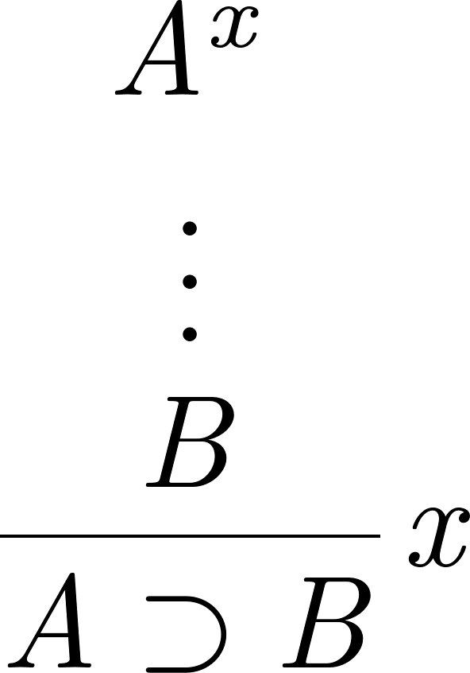
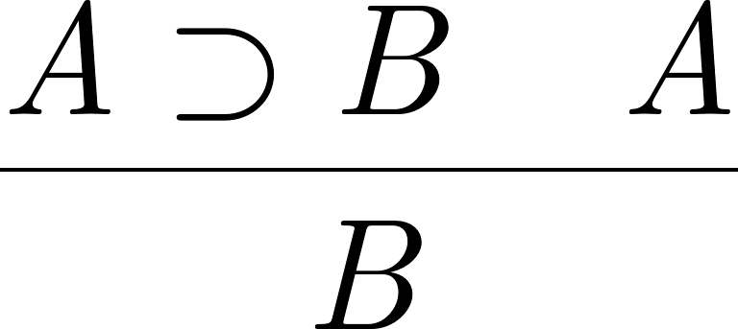

Implication
Further, $A ⊃B$ is the problem “given the solution to $A$, solve $B$”, or,
which means the same, “reduce to the solution of $B$ to the solution of $A$”.

Slide 18
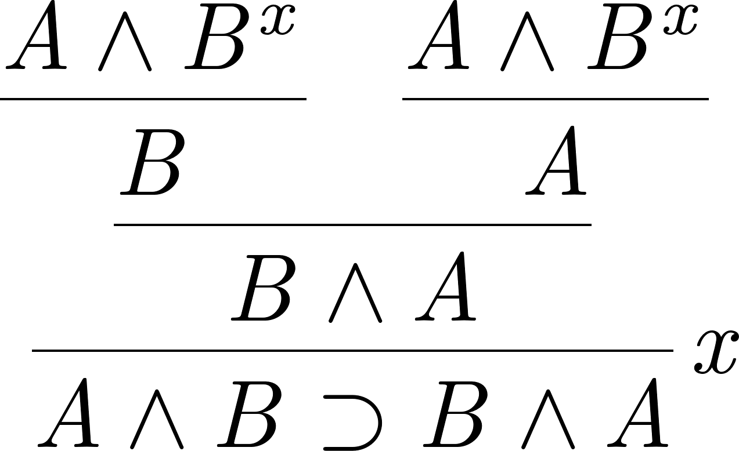
Examples of implication
Symmetry of conjunction (part 2):
“Closed” proof tree–no unsolved obligations

Slide 19
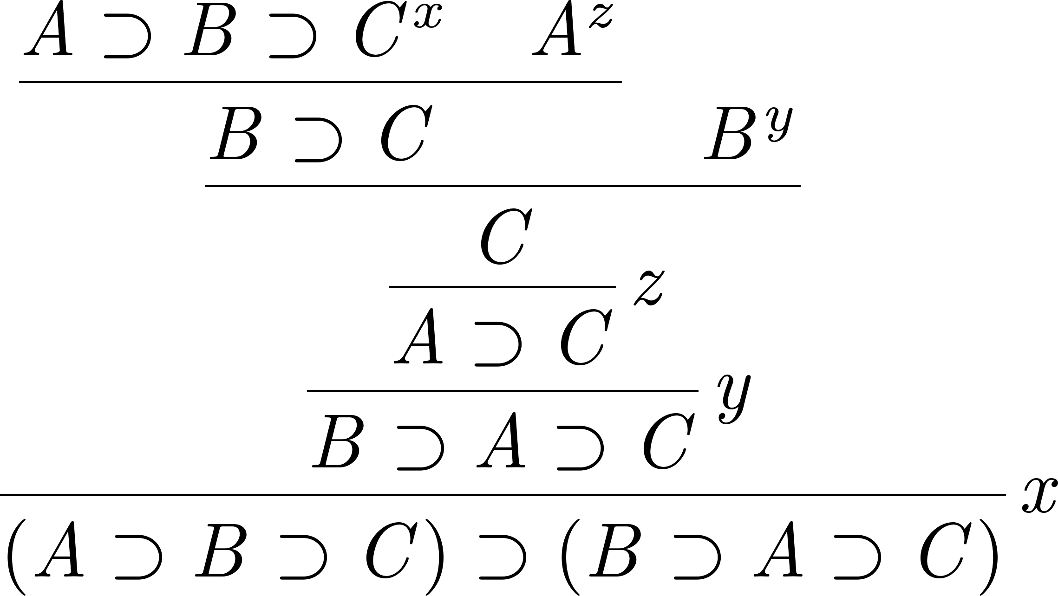
Examples of implication
Order of implications

Slide 20
The λ-calculus

Slide 21
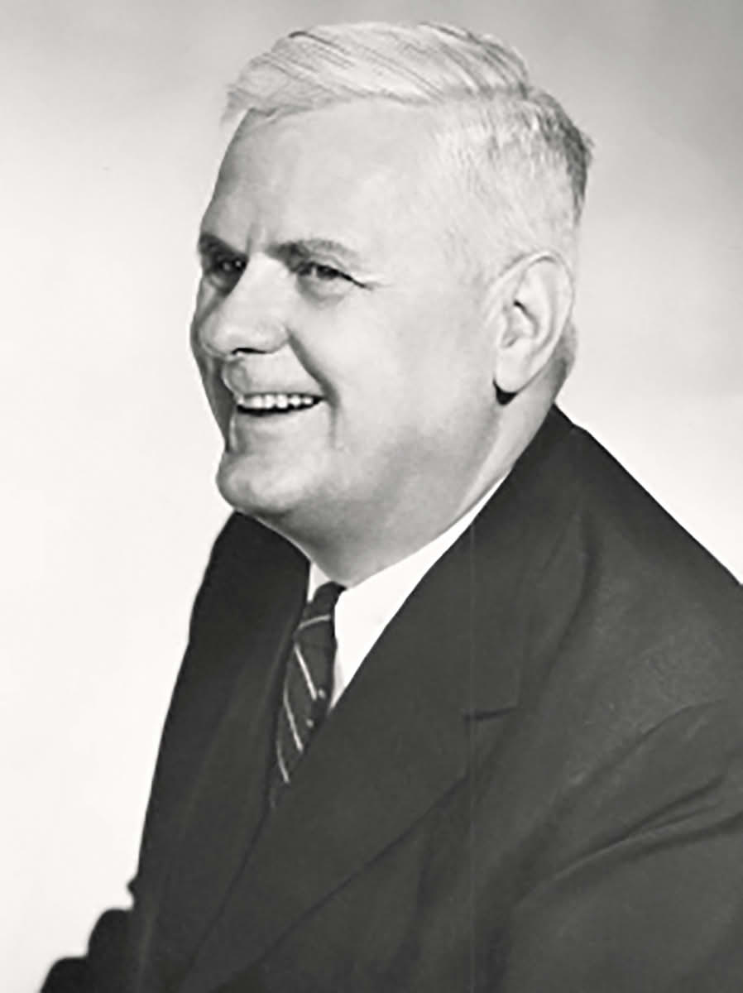
The purpose of the present paper is to propose a definition of effective calculability which is thought to correspond satisfactorily to the somewhat vague intuitive notion in terms of which problems of this class are often stated, and to show, by means of an example, that not every problem of this class is solvable.
— Alonzo Church, “An Unsolvable Problem of Elementary Number Theory”

Slide 22
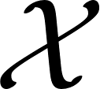
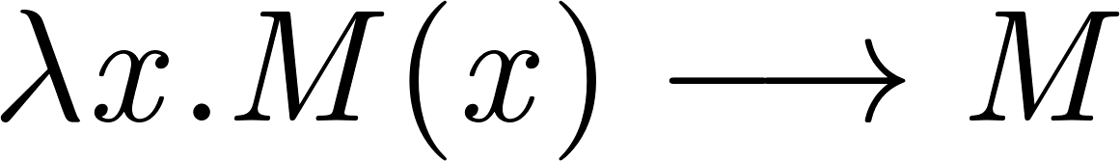
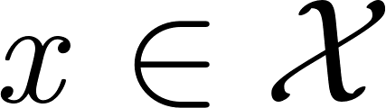
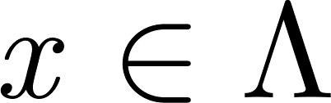
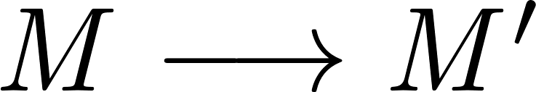
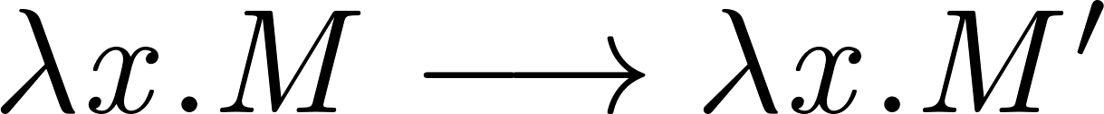

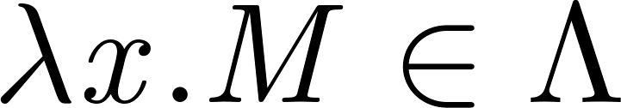
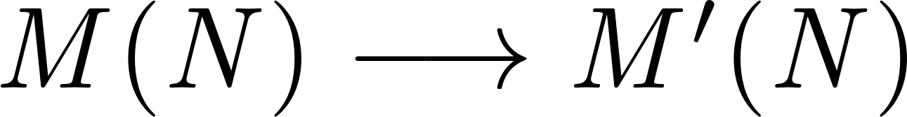


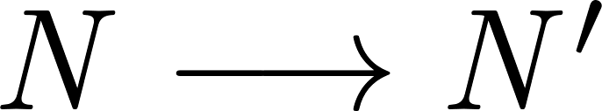
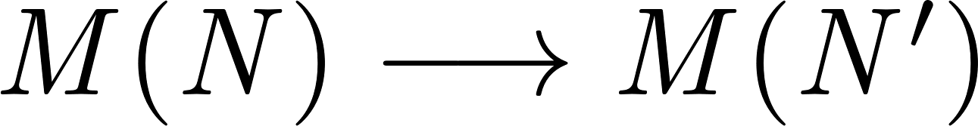


The λ-calculus
Syntax
Let be a (countably infinite) set of variable names.
Define $Λ$ by:
If then
If then
If then
Semantics
Define $⟶ ⊂Λ×Λ$ by:
If then
If then
If then

Slide 23
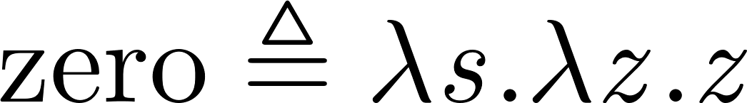
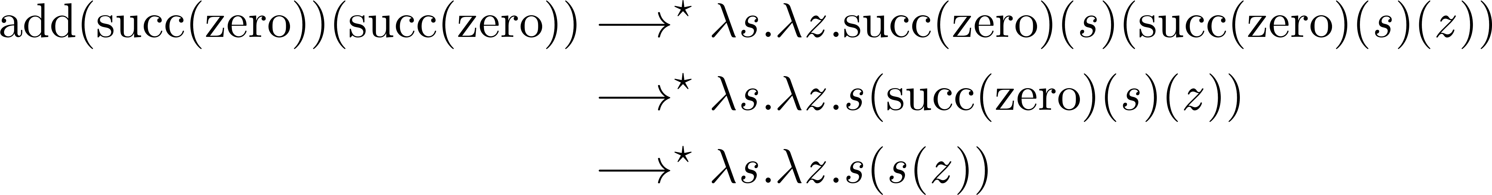
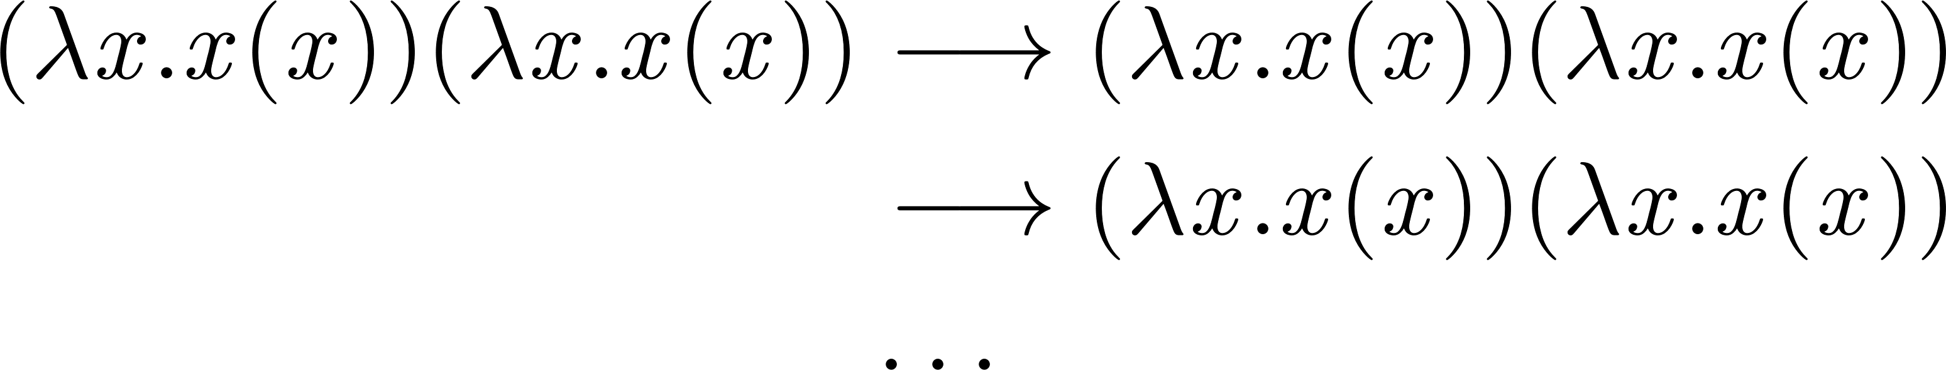
Programming in the λ-calculus
Natural numbers:
Computation:
Divergence:
Addition:

Slide 24

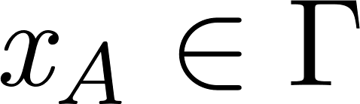
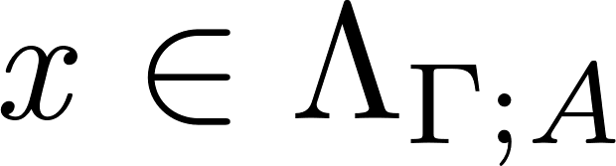
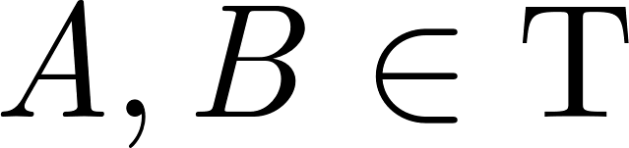

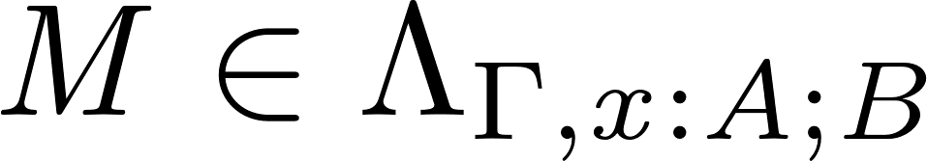
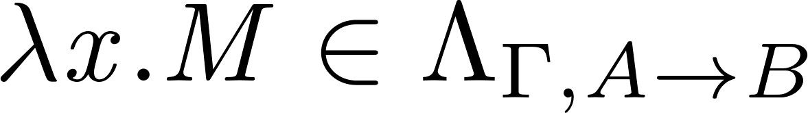
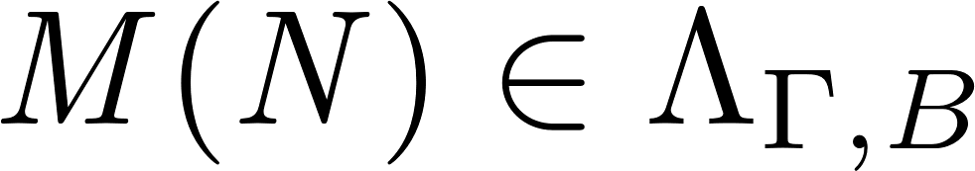
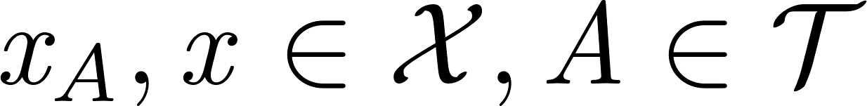
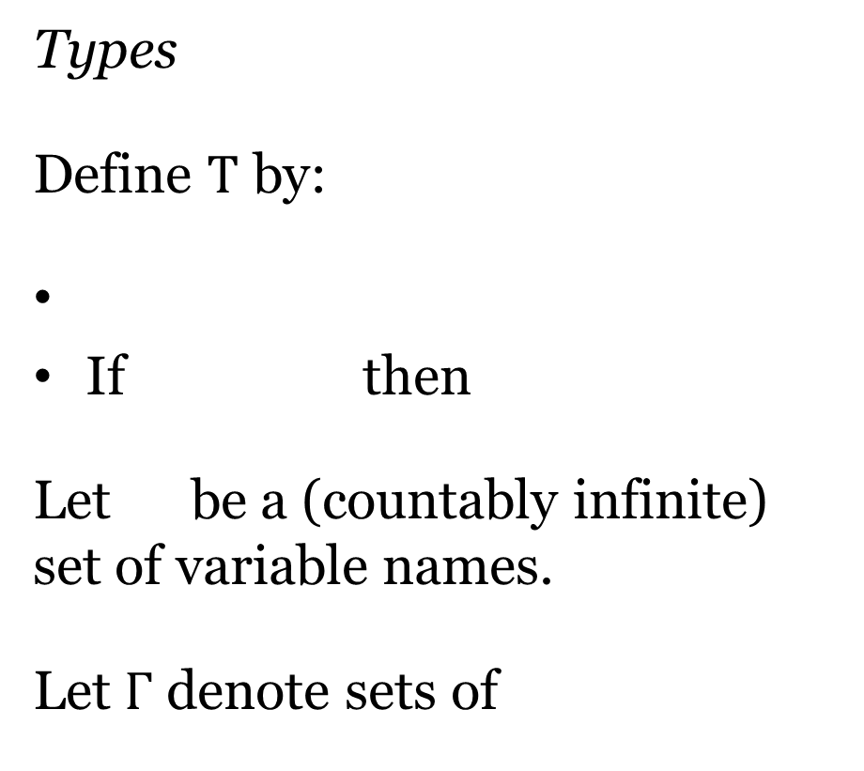

The simply typed λ-calculus
Types
Define $T$ by:
If then
Let be a (countably infinite) set of variable names.
Let $Γ$ denote sets of
Terms
Define $Λ_{Γ;A}$ by:
If then
If then
If then

Slide 25
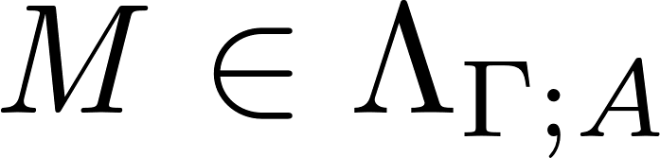

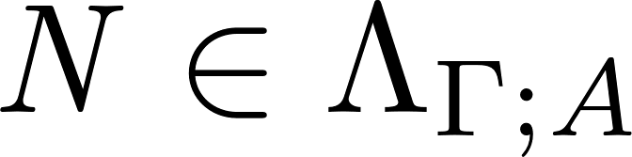
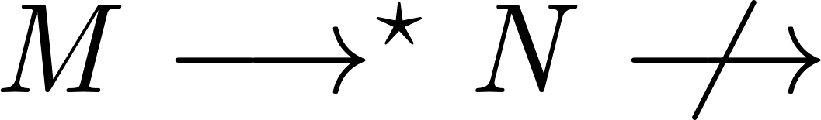


The simply typed λ-calculus
Terms
Define $Λ_{Γ;A}$ by:
If then
If then
If then
Semantics
Define $⟶$as before.
Metatheory
If and then
If then

Slide 26
Propositions as types

Slide 27
As can be seen from this table, or from recent programming texts with their little snippets of set theory prefaced to the corresponding programming language constructions, the whole conceptual apparatus of programming mirrors that of modern mathematics (set theory, that is, not geometry) and yet is supposed to be different from it. How come?
— Per Martin-Löf, “Constructive Mathematics and Computer Programming”

Slide 28
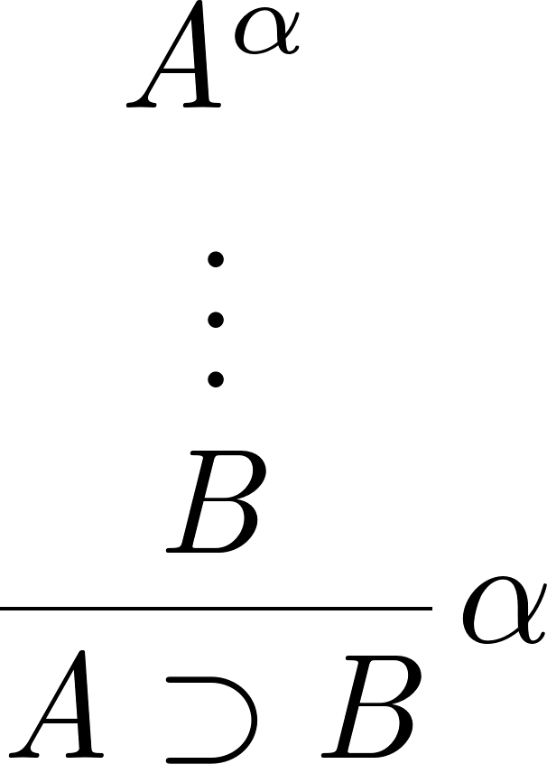
Functions and implications
Introduction
If , then
Elimination
If , then

Slide 29
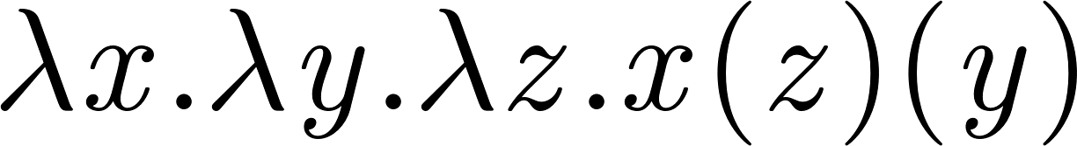
Functions and implications
Order of implications

Slide 30
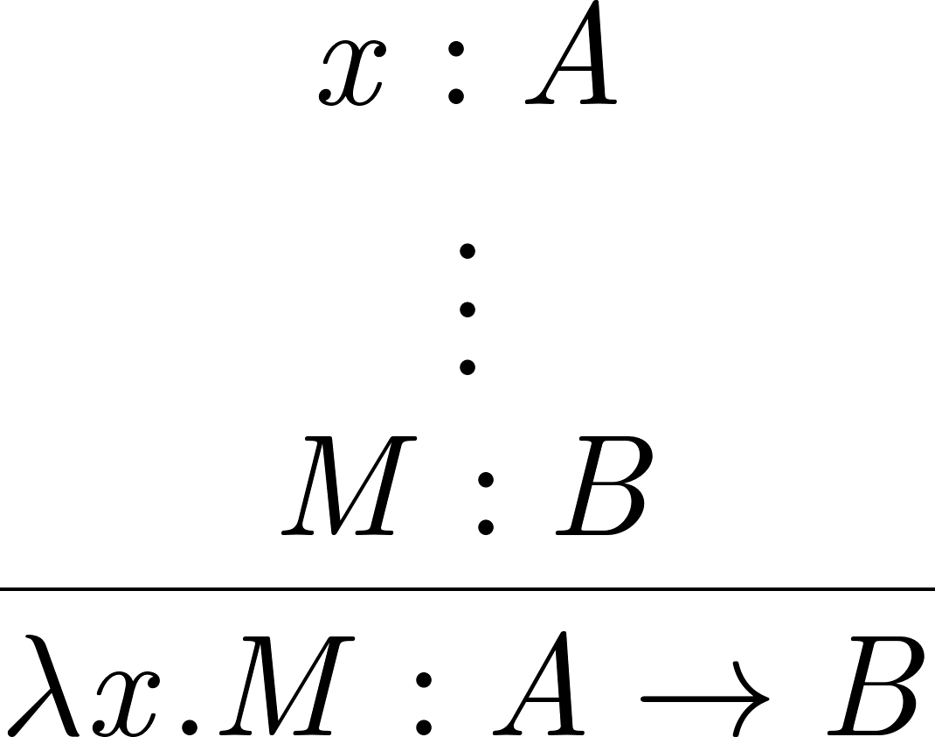

A combined view
Introduction Elimination

Slide 31

A combined view
Order of implications:

Slide 32




More propositions as types
Explains many types, not just implication:
Pairs:
Explains much metatheory, not just typing:
Proof normalization:

Slide 33
Dependent types

Slide 34



Quantifiers
$A ⊃B$ is the problem “reduce to the solution of $B$ to the solution of $A$”
$∀x. A$ is the problem “produce a solution of $A$ for each choice of $x$”
Implication Quantification
But what if proofs are data?

Slide 35





A grand unification
Products (functions, universals):
Sums (pairs, existentials):

Slide 36

Nothing new...
In mathematics, a group is a set with an operation that combines any two elements of the set to produce a third element within the same set…
… and the following conditions must hold:
the operation is associative,
it has an identity element, and
every element of the set has an inverse element.

Slide 37



The identity type
Introduction
Group laws
“Elimination”

Slide 38
Conclusion

Slide 39
I do not think that the search for logically ever more satisfactory high level programming languages can stop short of anything but a language in which (constructive) mathematics can be adequately expressed.
— Per Martin-Löf, “Constructive Mathematics and Computer Programming”

