Slide 1
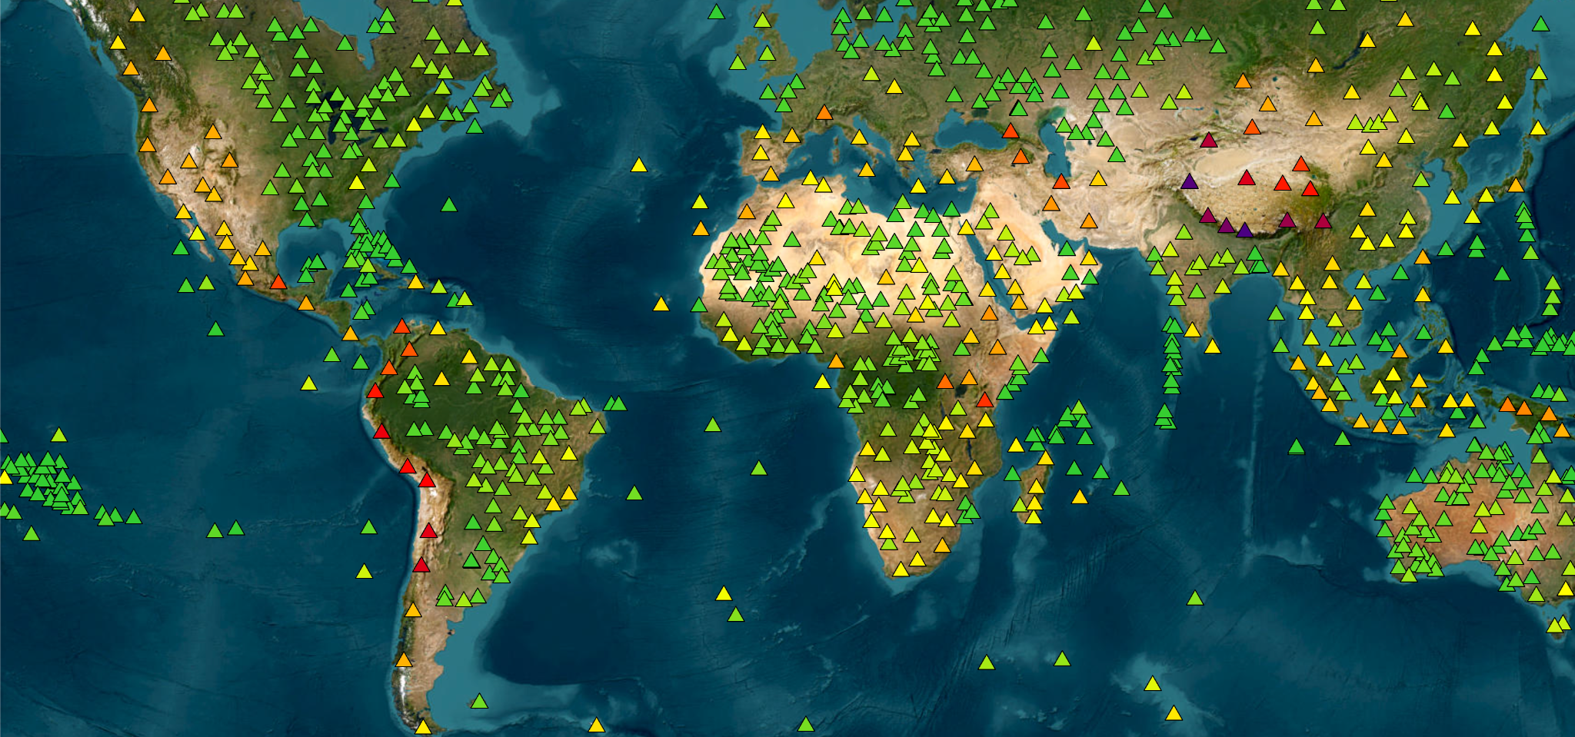
Pinnacle Points
Points from which no higher point can be seen
Jamie Breault

Slide 2
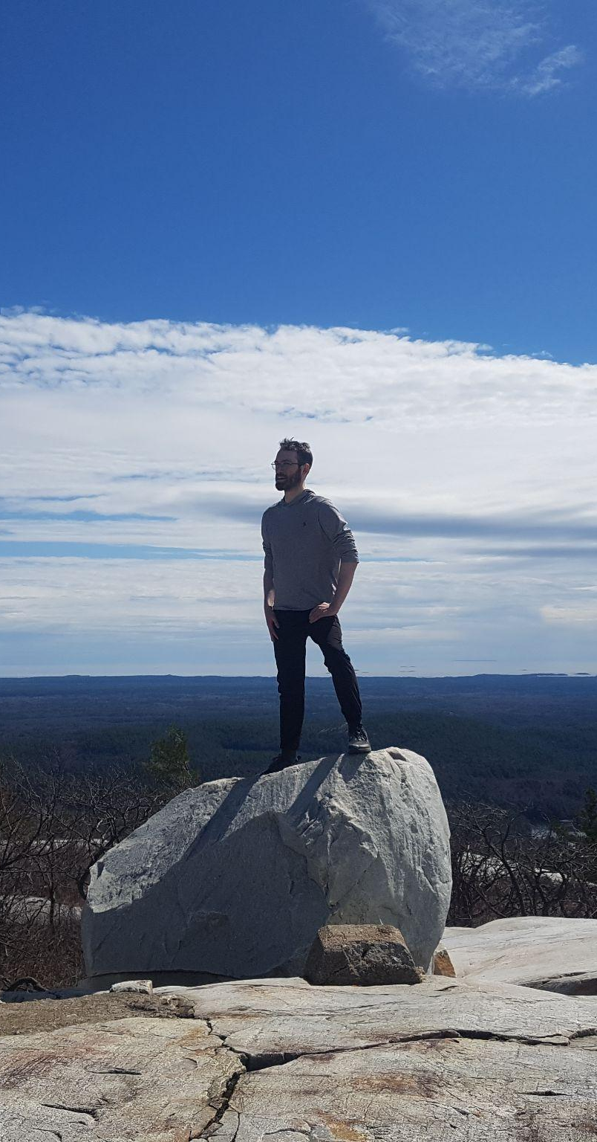
About Me: Jamie Breault
Master of Data Science at UBC
6 years developing insurance software
Undergrad in Physics at the University of Waterloo
Avid backpacker
52 multi-day hikes
Often wonder if I am at the highest point in sight

Slide 3
Data Sources
Global Summits
25 million summits with over 100 feet of prominence
OTOTW Mountains
6500 summits where no land rises above its horizontal plane
Open-Meteo’s Elevation API
Fetches elevation by latitude and longitude
Beyond Horizons
73 extreme lines-of-sight confirmed by photograph

Slide 4
Finding Pinnacle Points
Every OTOTW mountain is a pinnacle point candidate. For each:
Validate higher local summits to test if line-of-sight analysis is worthwhile
Do line-of-sight analysis for summits that pass validation
Earth’s curvature with topography
Atmospheric refraction
Atmospheric scattering
If no higher summits have line-of-sight with the candidate, then it is a pinnacle point

Slide 5
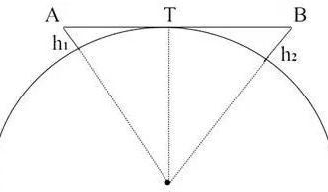
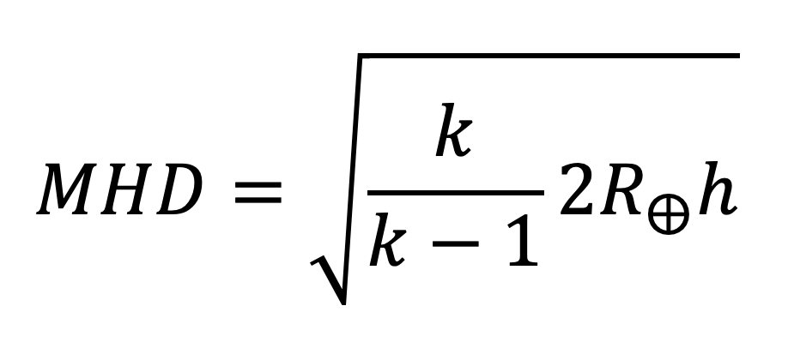
Maximum Horizon Distance (MHD)
MHD is the maximum distance that can be seen from a point assuming all surroundings are at sea level
Line-of-sight is impossible if the distance between the observer and target is greater than the sum of their MHDs
MHD₁
MHD₂

Slide 6
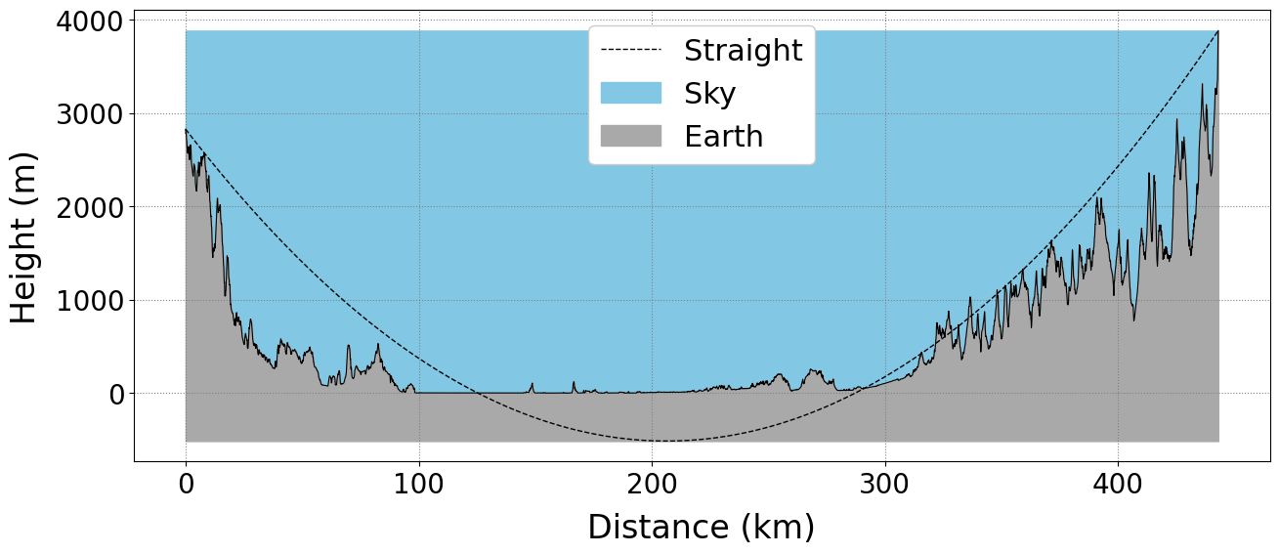
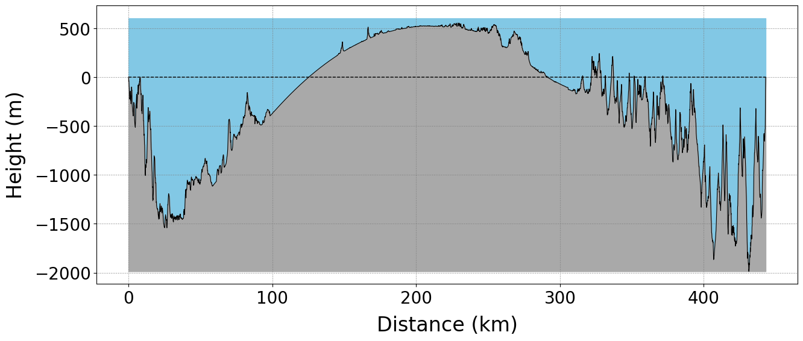
Earth’s Curvature with Topography
Before Step 3:
Space points 100 m apart between the observer and target
For each, get elevation and distance from observer
Transform to a physically representative coordinate system
After Step 3:

Slide 7
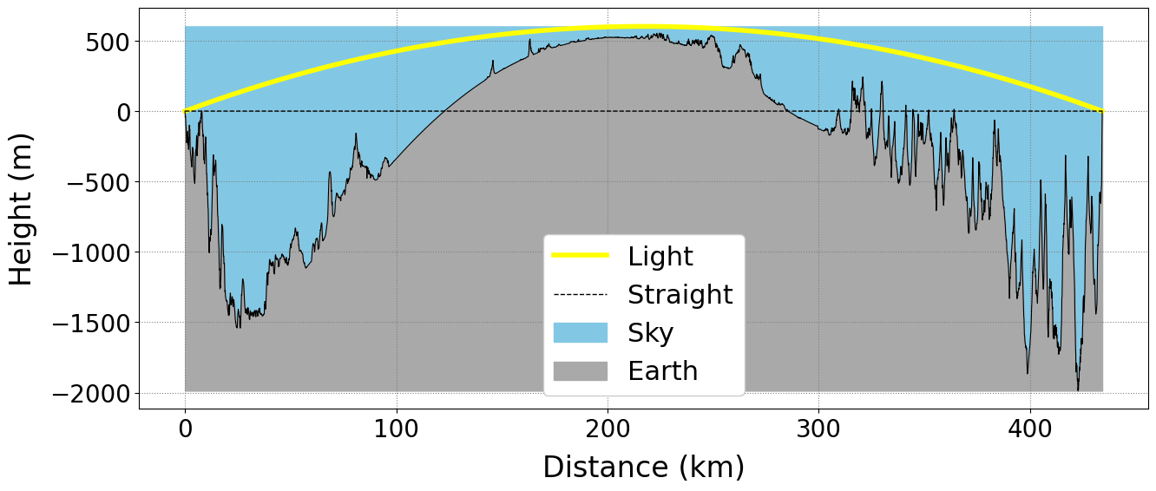
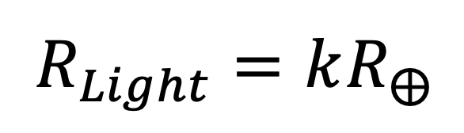
Atmospheric Refraction
Determine the minimum light curvature needed for all confirmed lines-of-sight to be theoretically possible (k=6.4)
Use this curvature whenever doing line-of-sight analysis for pinnacle point candidates

Slide 8
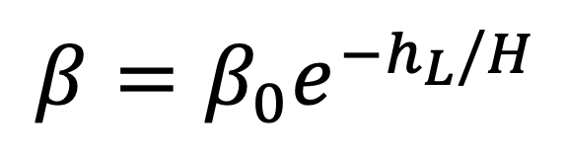
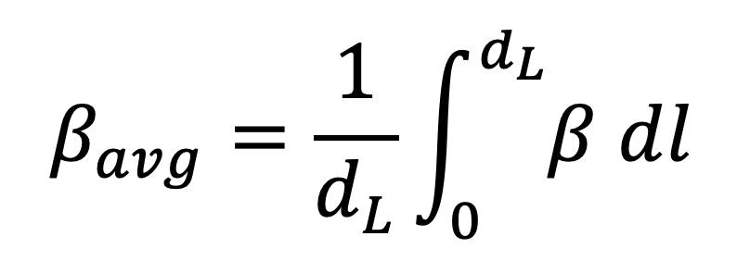
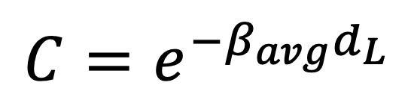
Atmospheric Scattering
A point’s scattering coefficient (β) can be calculated from its altitude (h_{L})
Integrate over the light’s path to get the average (β_{avg})
Calculate contrast (C), >0.02 is required for visibility

Slide 9
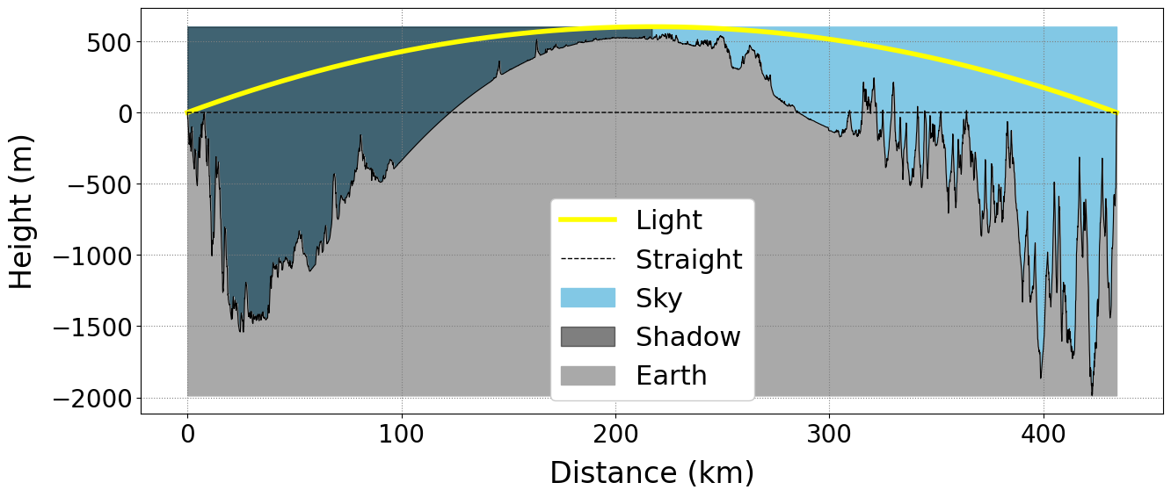
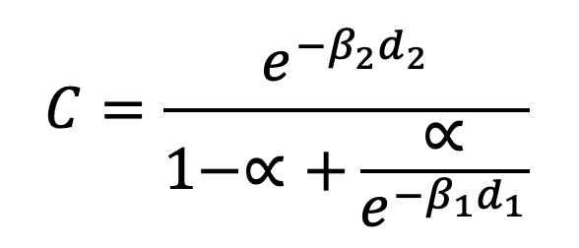
Partial Irradiation
Extreme lines-of-sight are observed just before sunrise when there is partial irradiation to increase contrast.
Suppose there are two regions, the final region is fully irradiated and the first region is reduced by a factor α.

Slide 10
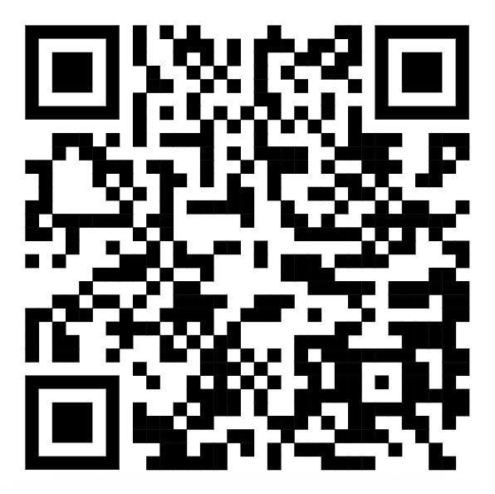
Result and Validation
1553 pinnacle points were identified. An interactive map was shared online:
prominence@groups.io on Email
Mountain metric specialists
World-record-holding mountaineers
r/mountaineering on Reddit
Mountaineering enthusiasts
The 4 confirmed errors discovered so far are the result of inaccuracies in elevation data.

Slide 11
Next Steps
Find all theoretical lines-of-sight on Earth above a threshold distance
Investigate alternate light modelling solutions based on feedback

Slide 12
Questions?

