Slide 1
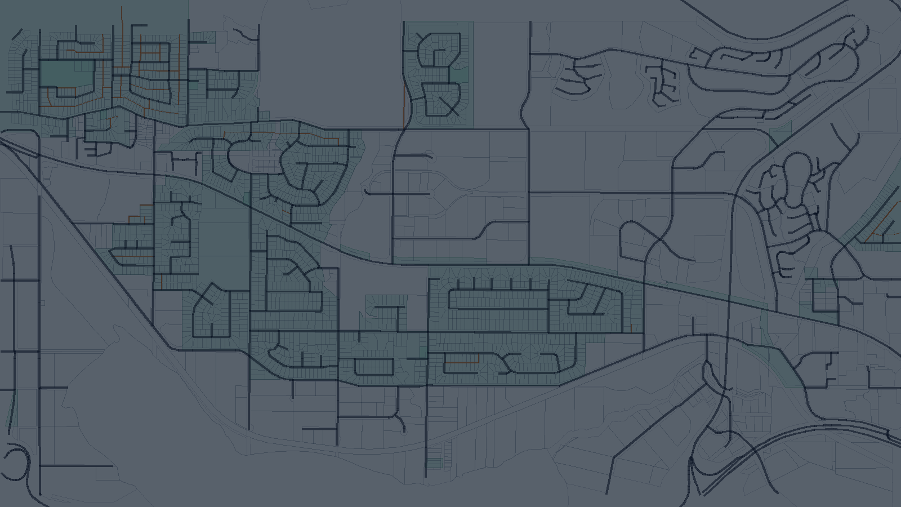
01
Can a laneway home fit here?
Week 3 update: we are turning official bylaw PDFs into verified rules that can later feed map checks.
1. Read bylaws
2. Prove rules
3. Map prep
Official PDF documents are the source of truth.
A rule must match an exact sentence before we trust it.
GIS prepares parcel layers for future buildable-area checks.
Jamie, Sasivimol, Zihao, Yusen
Notes:
Speaker note:
Open with the simple product question: can a laneway-family home fit on this parcel?
Explain that Week 3 is about trust: official PDFs are read, rules are verified against exact sentences, and GIS work prepares the map side for future checks.
Work owner/source:
Yusen: PDF-backed verification layer and verified-rule outputs.
Jamie: GIS parcel/map preparation.
Sasivimol and Zihao: rule extraction and candidate-rule work.
Team blocker reports: architecture framing.

Slide 2
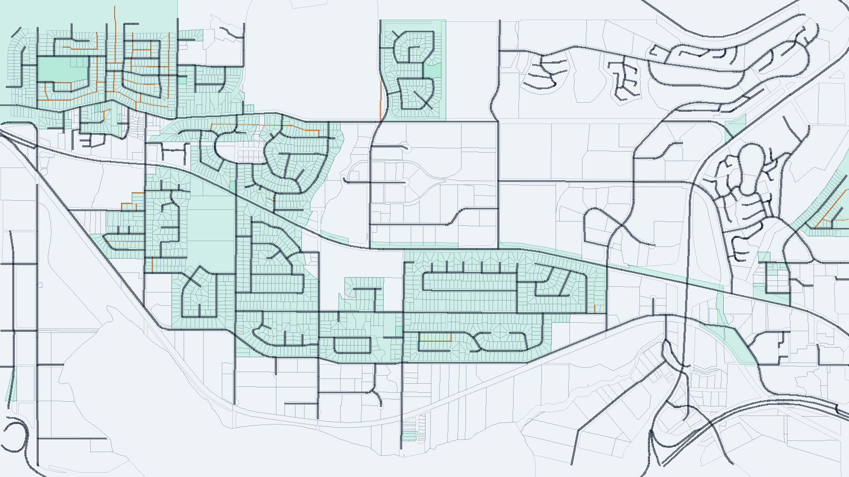
02
Project Overview
One narrow question, answered with map context and source-backed rules.
The user question
If I click a parcel on the map, can I likely build a laneway-family home there?
Our current scope
Only laneway-family homes: laneway house, coach house, garden suite, and backyard home.
The final answer should be simple. The proof behind it cannot be sloppy.
Presentation requirement: project overview; source: team scope discussion and Week 3 artifacts
GMT Week 3
Notes:
Speaker note:
Keep this slide non-technical. The audience should understand that the project is scoped to one family of homes, even though cities use different names for it.
The map is a preview of the kind of parcel context the final product should support.
Work owner/source:
Jamie: Burnaby GIS layers and map preview.
Yusen: laneway-family scope terms in the PDF manifest and verification pipeline.
Team discussion: decision to keep the scope focused on laneway-family homes.

Slide 3
03
Core Principle
A rule is not trusted just because the system found a PDF.
We need source matching at the sentence level.
Too weak
Better
What we need
The rule came from this bylaw PDF.
The rule came from this page and section.
The exact sentence says the same value, condition, and meaning.
No exact sentence match means the rule goes to review, not into the trusted registry.
Presentation requirement: key finding; source: Yusen verification pipeline and May 21 blocker report
GMT Week 3
Notes:
Speaker note:
This is the main message of the presentation. Finding a PDF is not enough. Even page-level matching is not enough for our core verification layer.
A usable zoning rule needs the exact sentence or table row that proves the same value, condition, and meaning.
Work owner/source:
Yusen: sentence-level verification design and registry/review split.
May 21 blocker report: extraction should create candidates, while source matching and verification decide whether a rule can be trusted.

Slide 4
04
Jamie: GIS And Boundary Algorithms
Start with Jamie's main summary, then compare the two boundary-labelling algorithms.
Jamie
Structure
Evidence & Outputs
GIS / buildable-area logic
Inputs: Burnaby parcel, street, lane, and zoning layers.
Built Burnaby R1 GIS project and map preview.
34h
Compared 4-sided and any-shape boundary algorithms.
Processing: join parcels to zoning and simplify parcel shapes with Douglas-Peucker tolerance tests.
Jamie worked on the map side of the project: parcel data, zoning joins, geometry simplification, and the boundary algorithms needed for setbacks.
0.1 m tolerance captured 85.9% of Burnaby R1 parcels.
Output: identify front, side, rear, and lane edges so setbacks can later create a buildable envelope.
Next slides show the algorithm options before the rest of the team work.
Why it matters: This turns verified zoning rules into a parcel-level map check; without boundary labels, setbacks cannot be applied correctly.
Presentation requirement: team contributions; sources: Jamie branch GIS files, buildable_area_algorithms.pdf, week3 log
GMT Week 3
Notes:
Speaker note:
Jamie's work is the GIS layer. Explain that zoning rules are not useful on a map until the system knows which parcel boundary is front, side, rear, or lane.
The structure is: load parcel and street/lane/zoning data, simplify geometry, then label boundaries for setback calculations.
After this summary, Jamie should walk through the two algorithm slides: first the simpler four-sided parcel approach, then the robust any-shape approach.
One important result is the 0.1 m Douglas-Peucker tolerance, which makes 85.9% of Burnaby R1 parcels near-4-sided candidates for a first pass.
Work owner/source:
Jamie: code/gis_files/burnaby, buildable_area.qgz, douglas_peuker_*.gpkg, buildable_area_algorithms.pdf, br_2026-05-21.pdf, personal-logs/jamie/week3.txt.

Slide 5
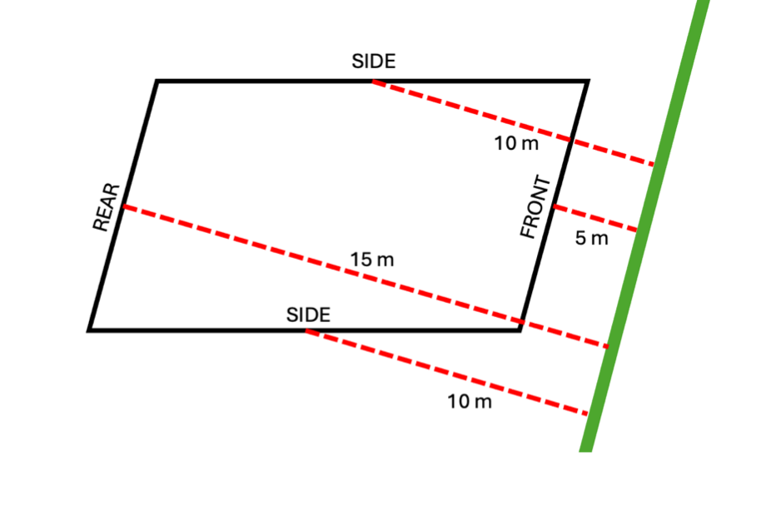
05
Algorithm Option 1: 4-Sided Parcels
Jamie: simpler first milestone for parcels that can be treated as four boundary lines.
How it works
Simplify parcel shape, find the boundary closest to its street as FRONT, label touching lines as SIDE, and the remaining line as REAR.
Why it helps
This is easier to implement and captured 78.5% of Burnaby laneway parcels at 0.01 m tolerance in Jamie's test.
Main limitation
It misses irregular parcels and depends on approximating parcel shape with Douglas-Peucker simplification.
Speaker: Jamie. Practical, near-term boundary-labelling option.
Source: buildable_area_algorithms.pdf, Labelling Boundary Lines for 4-Sided Parcels
GMT Week 3
Notes:
Speaker note:
Jamie should explain this as the simpler algorithm. It works when the parcel can be reduced to four clear boundary lines.
The core idea is: closest line to the street is FRONT, the two lines touching it are SIDE, and the remaining line is REAR.
The benefit is implementation speed and good early coverage. The tradeoff is that irregular parcels are excluded or approximated.
Work owner/source:
Jamie: buildable_area_algorithms.pdf, Burnaby GIS work, Douglas-Peucker tolerance outputs, and May 21 GIS blocker.

Slide 6
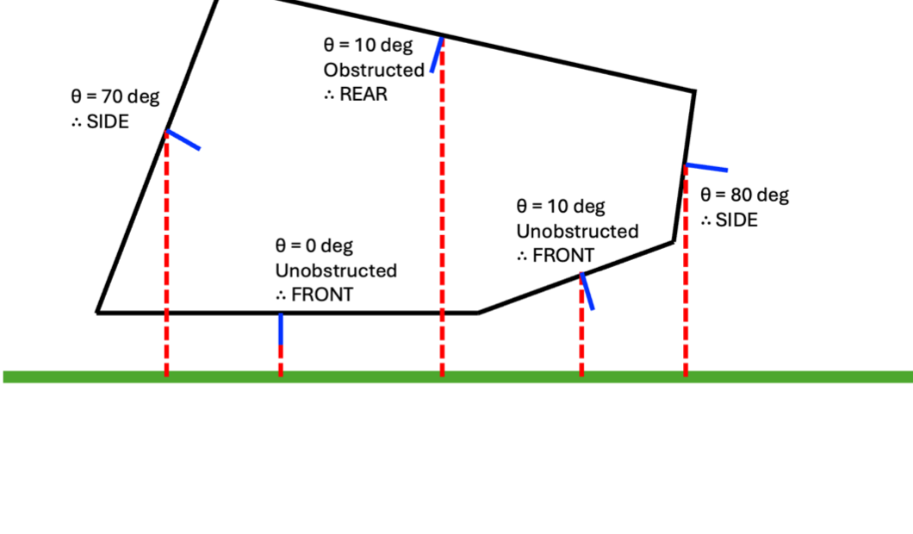
06
Algorithm Option 2: Parcels Of Any Shape
Jamie: more robust boundary labelling, but harder to implement.
How it works
For each boundary line, compare a perpendicular test line to the bee-line from the boundary midpoint to the street.
Decision logic
Low angle + unobstructed means FRONT. Low angle + blocked by the same parcel means REAR. Otherwise, label SIDE.
Tradeoff
It can handle irregular parcels using the true shape, but implementation and computation are more complex.
Speaker: Jamie. More complete option if robustness matters more than simplicity.
Source: buildable_area_algorithms.pdf, Labelling Boundary Lines for Parcels of Any Shape
GMT Week 3
Notes:
Speaker note:
Jamie should explain this as the robust algorithm. It tries to classify every boundary line, even for parcels that are not simple four-sided shapes.
The important idea is the bee-line test: if a boundary line points clearly toward the street and is unobstructed, it is front; if it is obstructed by the same parcel, it is rear; otherwise it is side.
The tradeoff is complexity. This may be better long-term, but it is harder to implement than the four-sided approach.
Work owner/source:
Jamie: buildable_area_algorithms.pdf and GIS boundary-labelling research.

Slide 7
07
GIS Progress: Why Boundary Labels Matter
Setbacks only work after the map knows which side of a parcel is front, side, rear, or lane.
First GIS milestone
None
67.9%
0.001 m
74.6%
0.01 m
78.5%
0.1 m
85.9%
1 m
90.5%
At 0.1 m tolerance, 85.9% of Burnaby R1 parcels become near-4-sided candidates for a first pass.
Presentation requirement: challenge and roadblock; source: br_2026-05-21.pdf and Jamie GIS artifacts
GMT Week 3
Notes:
Speaker note:
Explain why this matters: zoning setbacks depend on knowing which parcel edge is front, side, rear, or lane.
Jamie's blocker shows that a simple first milestone can cover many Burnaby R1 parcels, but irregular lots still need to be flagged.
Work owner/source:
Jamie: Burnaby GIS layers, Douglas-Peucker outputs, buildable_area_algorithms report, rough GIS notes, and May 21 blocker report.

Slide 8
08
Sasivimol: Config-Driven Extraction
How the team starts turning different city bylaw PDFs into comparable rule candidates.
Sasivimol
Structure
Evidence & Outputs
Extraction setup / ground truth
City layer: registry and PDF configs describe municipality-specific documents and zones.
Built and tested a laneway bylaw notebook prototype.
37h
Explored regex vs LLM parsing for varied PDF structures.
Rule layer: configs define target rule types such as max lot coverage and minimum setbacks.
Sasivimol focused on making rule extraction repeatable across cities instead of hard-coding one municipality.
Used block-cutting and prompts to handle large bylaw PDFs.
Evaluation layer: ground-truth specs and accuracy scoring are planned to check extraction quality.
Flagged Burnaby's collapsed tables as a reliability challenge.
Why it matters: This creates the repeatable candidate-extraction setup, so new cities can be added without rewriting the whole pipeline.
Presentation requirement: team contributions; sources: Sasivimol branch notebook, capstone_journey.md, week3 log
GMT Week 3
Notes:
Speaker note:
Sasivimol's work is the repeatable setup for extraction. The key idea is configuration: city configs, PDF configs, and rule configs.
This matters because each city writes bylaws differently. A scalable project cannot rely on one hand-built parser for one document.
Her work also introduces ground-truth thinking, which is important for measuring whether extraction is actually correct.
Work owner/source:
Sasivimol: origin/sasivimol laneway_v2.ipynb, capstone_journey.md, city/PDF/rule config work, personal-logs/sasivimol/week3_sasivimol.md.

Slide 9
09
Zihao: Multi-City Candidate Extraction
How broader PDF parsing and LLM extraction can find possible rules before verification.
Zihao
Structure
Evidence & Outputs
Candidate-rule extraction
Parse: compare PDF parsing methods and normalize pages into text blocks.
Built notebooks 00-19 for parser and extraction experiments.
35h
Phase 2 normalized 377 page blocks.
Extract: select relevant blocks and ask an LLM to produce structured candidate rules.
Zihao worked on the extraction engine: parser comparison, document blocks, LLM normalization, and source coverage checks.
Selected 8 verified relevant blocks and produced 62 deduped rule rows.
Audit: check source coverage, warning patterns, and cross-city extraction gaps.
Flagged ungrounded conditions and local-model reliability limits.
Why it matters: This gives broad rule candidates across cities, but also shows why a separate verification layer is needed before rules drive map decisions.
Presentation requirement: team contributions; sources: Zihao extraction branch notebooks, outputs, week3 log
GMT Week 3
Notes:
Speaker note:
Zihao's work is the broad candidate extraction track. It tries to find possible structured rules from many pages and city formats.
The result is useful because it can cover more material than manual extraction, but the warnings are just as important: LLM output can be incomplete or ungrounded.
This connects directly to Yusen's verification layer, which decides whether a candidate rule is trustworthy enough to use.
Work owner/source:
Zihao: origin/rule_extraction_test_zihao notebooks 00-19, extraction outputs, source coverage inventory, personal-logs/zihao/week3_zihao.md.

Slide 10
10
Yusen: PDF-Backed Verification
How the project decides which candidate rules are trustworthy enough to use.
Yusen
Structure
Evidence & Outputs
PDF-backed verification
Source: official PDF manifest lists municipality, URL, document, zone hint, and laneway-family terms.
Built pdf_ingestion.py and pdf_sentence_verification.py.
40h
Current run: 361 pages, 181 laneway sentences, 81 candidates.
Ingest: pypdf extracts page text, source URL, document name, and page number.
Yusen focused the prototype on one core requirement: a rule must match an exact sentence from an official PDF before entering the registry.
Verified 56 rules and sent 25 unclear cases to review.
Verify: laneway sentences become candidates, then registry records or review-queue items.
Next slide shows the end-to-end verification flow.
Why it matters: This is the trust layer: a rule can only be used downstream when it matches an exact official PDF sentence.
Presentation requirement: team contributions; sources: Yusen zoning_prototype code, output JSONs, week3 log
GMT Week 3
Notes:
Speaker note:
Yusen's work is the verification layer. The most important point is source matching at sentence level, not just document level.
The structure is official PDF URL to pages, pages to sentences, sentences to candidate rules, and candidates to either verified registry or review queue.
This makes the downstream deterministic rule engine safer because it only consumes rules with direct evidence.
Work owner/source:
Yusen: code/zoning_prototype/src/zoning_prototype/pdf_ingestion.py, pdf_sentence_verification.py, sentence_verification.py, outputs/pdf_sentence_verification, personal-logs/yusen/week3_yusen.txt.

Slide 11
11
Yusen's Verification Pipeline
Placed with the verification work: official PDF text becomes registry records or review items.
1
Download PDFs
2
Read pages
3
Find sentences
4
Draft rules
5
Verify
Use official online bylaw PDFs from a small manifest.
Extract each page with document name, URL, and page number.
Keep sentences about laneway-family homes only.
Turn useful sentences into possible zoning rules.
Accept or send to review.
Trusted output
Review output
A verified rule registry with page number, source URL, and evidence sentence.
A review queue for unclear tables, exceptions, or conditional wording.
Presentation requirement: technical progress; source: code/zoning_prototype pipeline
GMT Week 3
Notes:
Speaker note:
This slide now belongs directly with Yusen's verification section.
Walk through the pipeline slowly. The important thing is that the active source is official PDF text, not the workbook or hand-made JSON chunks.
The final split is intentional: clear evidence goes into the trusted registry, unclear cases go into review.
Work owner/source:
Yusen: pdf_ingestion.py, pdf_sentence_verification.py, sentence_verification.py, and output files.
Zihao and Sasivimol: upstream candidate-extraction work that can feed this verification layer later.

Slide 12
12
Verification Run Results
The evidence gate is working because uncertain cases stay out of the registry.
361
181
81
56
25
PDF pages read
laneway sentences
possible rules
verified rules
need review
Surrey, Burnaby, Vancouver
sentences in scope
candidate rules
safe for registry
not thrown away
What worked
What we refused to fake
All current verified rules are from Surrey, where the PDF text clearly uses laneway-family terms and sentence-level rules.
Burnaby produced 0 verified laneway-family rules because the PDF text did not clearly match our scope.
Presentation requirement: preliminary results; sources: pdf_sentence_verification output JSON files
GMT Week 3
Notes:
Speaker note:
Present these numbers as early verification results, not final coverage. The strongest point is that the system is conservative.
It verified 56 Surrey rules, kept 25 cases for review, and did not force Burnaby into the registry when the laneway-family wording was not clear.
Work owner/source:
Yusen: verification_summary.md, pdf_pages.json, source_sentences.json, candidate_rules.json, verified_rule_registry.json, and review_queue.json.

Slide 13
13
Week 3 Time Log Summary
Sourced from the team's personal-log entries, not estimated from the slide deck.
TOTAL LOGGED
Jamie
34h
Main time pattern
146h
Sasivimol
37h
Week 3 team total
Most logged hours went into three technical tracks: GIS boundary/setback logic, PDF/rule extraction, and source-matched verification.
Zihao
35h
Yusen
40h
This matches the Week 3 blocker themes.
Member
Total
Largest logged focus
Other logged work
Jamie
34h
Minimum-setback GIS: 22h
Max lot coverage, rule robustness, presentation, meetings
Sasivimol
37h
Pipeline design/prototyping: 25h
Bylaw research, presentation, team architecture discussion
Zihao
35h
Main extraction pipeline: 15h
Block workflow, normalization design, Gemini test, Calgary review, meetings
Yusen
40h
Source matching + workbook verification: 16h
Rule engine review, team review, blocker reports, architecture planning
Presentation requirement: team contributions and total hours; source: origin/main personal-logs/week3 entries
GMT Week 3
Notes:
Speaker note:
This slide is the formal time-log summary. The total is 146 hours for Week 3.
Emphasize that the hours were not reconstructed from memory; they come from personal-log entries.
The distribution shows that the team spent most time on the hard technical pieces: GIS boundary logic, scalable rule extraction, and verified source matching.
Work owner/source:
Jamie: personal-logs/jamie/week3.txt, total 34h.
Sasivimol: personal-logs/sasivimol/week3_sasivimol.md, total 37h.
Zihao: personal-logs/zihao/week3_zihao.md, total 35h.
Yusen: personal-logs/yusen/week3_yusen.txt, total 40h.

Slide 14
14
How The Work Fits Together
Candidate extraction creates coverage; verification creates trust; GIS turns trusted rules into map checks.
Find candidates
Check evidence
Use on map later
Sasivimol and Zihao help the system find possible rules from official PDF text and tables.
Yusen's layer verifies that the value, condition, and exact sentence match.
Jamie's GIS work is the map side that can later consume trusted rules.
The AI can help find rule candidates. It should not be the final judge of whether a rule is true.
Presentation requirement: what succeeded and what did not; sources: Zihao, Sasivimol, Yusen, Jamie branches
GMT Week 3
Notes:
Speaker note:
This slide explains the difference in approach constructively. Candidate extraction is useful because it creates coverage. Verification is needed because it creates trust.
The map side should come after trusted rules, not before.
Work owner/source:
Sasivimol: city config, parser workflow, prompt design, and ground-truth scoring.
Zihao: generalized multi-city block extraction and source coverage checks.
Yusen: verification gate and registry/review queue.
Jamie: GIS layer that can later consume trusted rules.

Slide 15
15
Blockers And Decisions
The blocker has shifted from finding sources to interpreting tables and conditions.
May 20: What should AI do?
May 21: Which parcels first?
Use AI for lookup and source-backed explanation. GIS/rule logic still calculates the envelope.
Start with 4-sided or near-4-sided lots, then flag irregular parcels for later.
May 21: Which rules count?
May 25: What is blocked now?
Only rules tied to exact PDF sentence or table-row evidence should enter the registry.
Prioritize table-aware extraction and condition modeling before expanding rule coverage.
Latest blocker: source ingestion works; the hard part is PDF tables and conditional wording like may, if, except, and subject to.
Presentation requirement: challenges and roadblocks; sources: May 20/21 blocker reports and May 25 zoning_prototype/BLOCKER_REPORT.md
GMT Week 3
Notes:
Speaker note:
These are not final next-week commitments. They are decisions the team needs to avoid building in different directions.
May 20 says RAG should help with lookup, source matching, and explanation, while GIS/rule logic calculates the envelope. May 21 says LLM rules must be verified before entering the registry.
The May 25 blocker adds the current technical priority: source ingestion is no longer the main blocker. The difficult part is table-aware PDF extraction and modeling conditional language.
The May 25 evidence was: 81 candidate rules checked, 56 verified, 12 possible sentence matches, 13 needing human review, 0 missing sentence evidence, and 0 PDF ingestion errors.
Work owner/source:
May 20 blocker report: RAG, Felt, and GIS architecture boundary.
May 21 blocker report: Jamie's GIS parcel-scope blocker and the extraction-versus-verification blocker from the rule work.
May 25 blocker report: code/zoning_prototype/BLOCKER_REPORT.md on table-aware extraction and condition modeling.

Slide 16
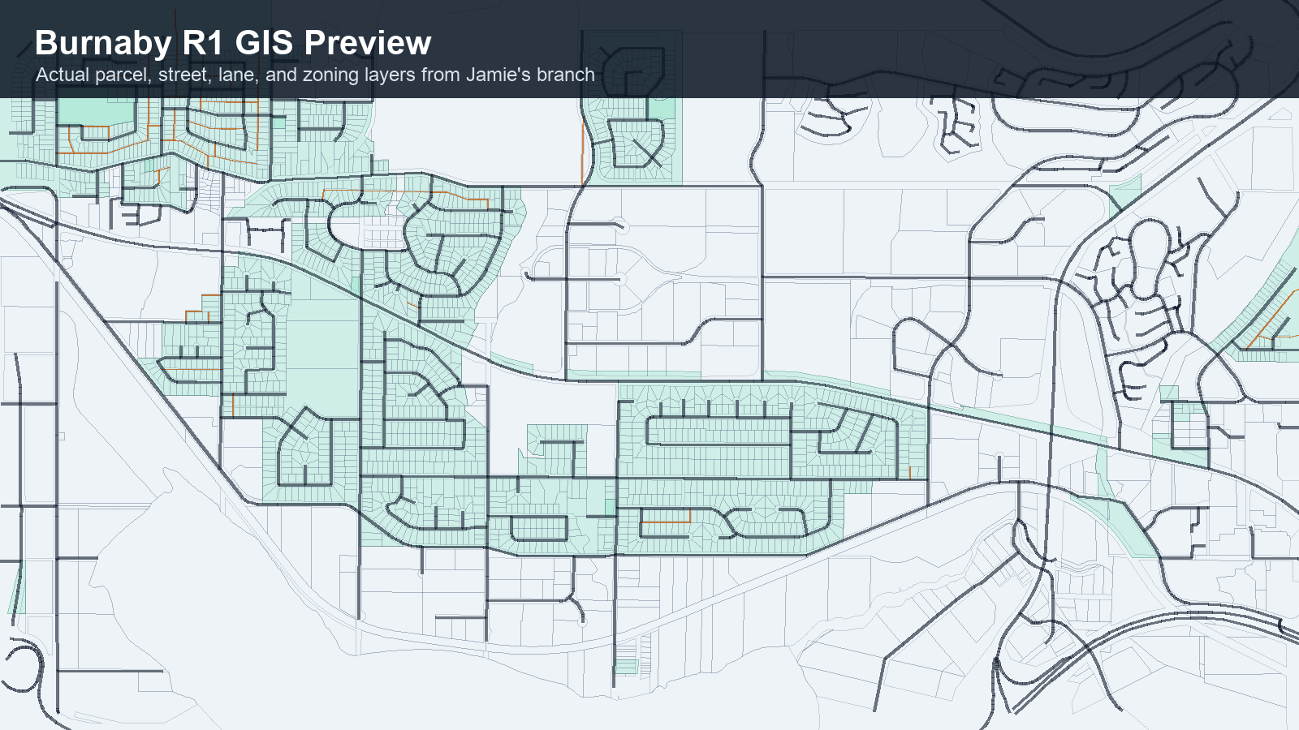
16
Product Tracking And Client Communication
This is not final UI; it shows how the pieces should connect after mentor decisions.
Parcel answer panel
Likely buildable?
Needs review
Why?
Setback rule needs table evidence.
Source
Show PDF page and evidence sentence.
Current progress
Client communication
Next discussion
Extraction, verification, and GIS prototypes exist.
RAG meeting with Andy moved to May 27 morning after accident-related injury.
Confirm decisions before locking assignments.
Presentation requirement: project tracking, client communication, and next-step discussion
GMT Week 3
Notes:
Speaker note:
Close by showing the product direction, project tracking, and client communication.
The map and answer panel are a concept for how the verified-rule and GIS work could eventually meet.
For client communication: the team was supposed to meet with Andy to discuss a potential RAG application, but he was unavailable because of an accident-related injury. The meeting is rescheduled for May 27 morning.
Work owner/source:
Jamie: Burnaby GIS map layers used in the preview.
Yusen: verification output fields such as source URL, page number, and evidence sentence.
May 20 blocker report: Felt dashboard and RAG explanation direction.
Team/client communication: planned Andy RAG discussion rescheduled to May 27 morning.

