Slide 1

Mountain Weather Forecaster
Jamie Breault
Spandan Dey
Rex (Po Kai) Tseng

Slide 2
Sources
Open Meteo
Weather forecasting API
Andrew Kirmse - Lead Developer of Google Earth
CSV file of every mountain on Earth with over 100 feet of prominence

Slide 3
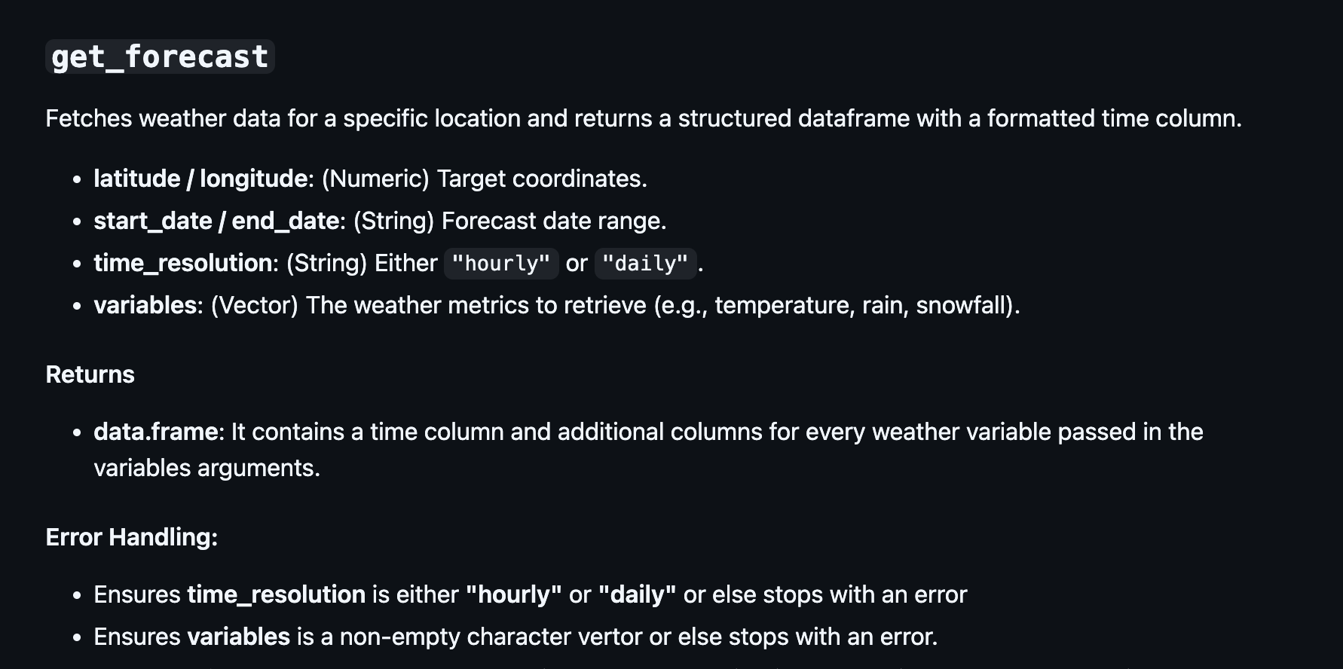

Slide 4
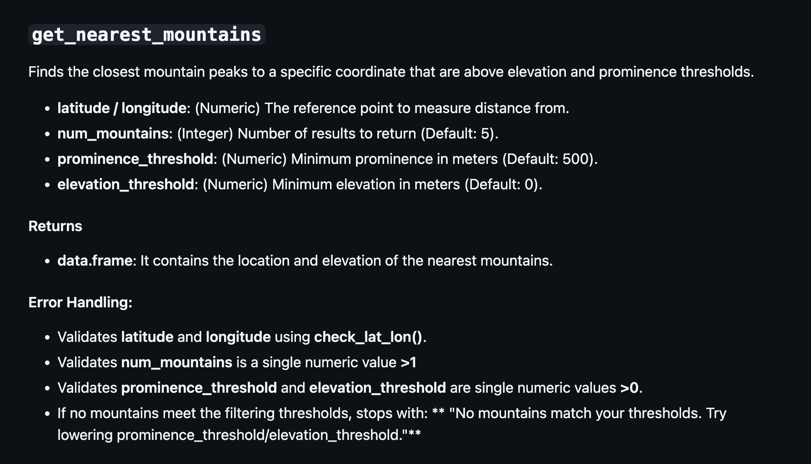

Slide 5
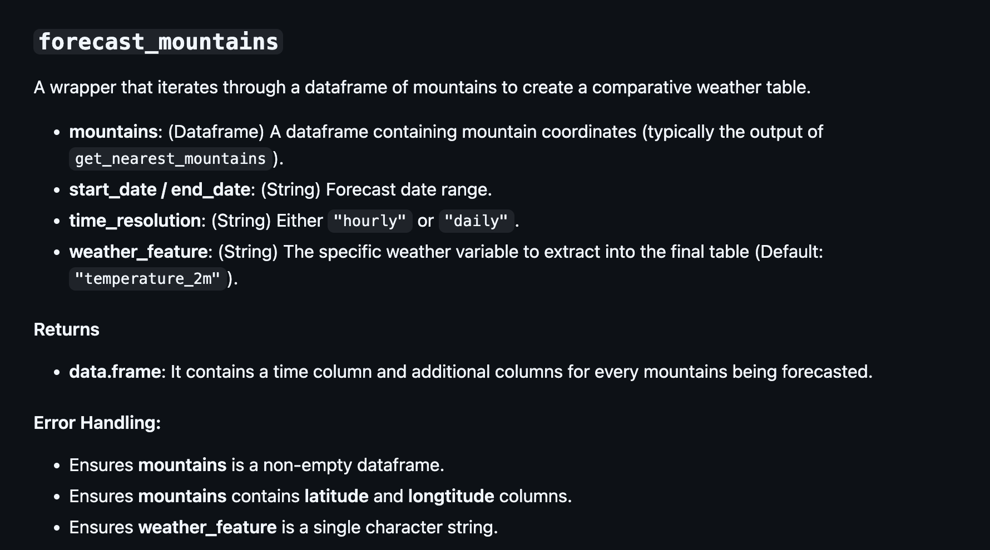

Slide 6
LIVE DEMO!

