Slide 1

Tagging Alpha-n Reactions in SNO+
Jamie Breault
April 22, 2016

Slide 2
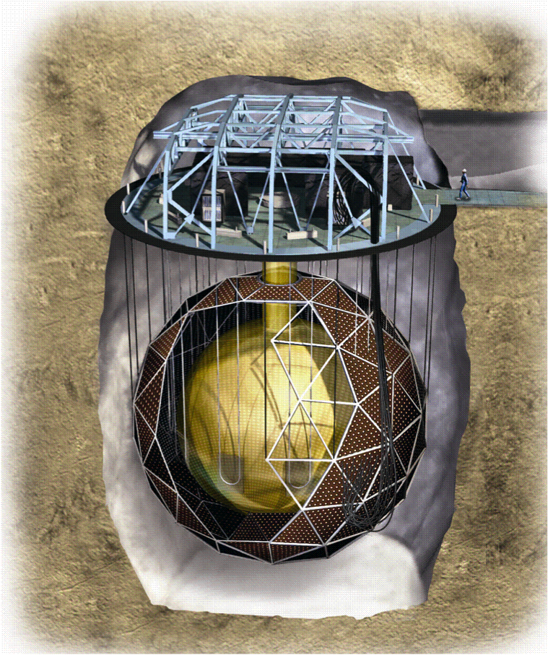
SNO+
– Multipurpose neutrino experiment
– 2 km underground
– Consists of an acrylic vessel (AV) 12 m in
diameter surrounded by about 9500 PMTs
– The experiment will have a scintillator
phase and a water phase
Acrylic Vessel
http://underground.physics.berkeley.edu/SNO+.html

Slide 3
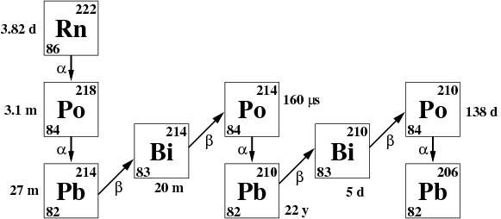
Alpha Source
Short Half-Life
Isotopes
http://inspirehep.net/record/883319/plots

Slide 4
Alpha-n Reactions
6.1 MeV γ (sometimes)
α
¹³C
¹⁷O*
¹⁶O
To tag alpha-n reactions:
Energy of the 1st trigger
Energy of the 2nd trigger
Time difference
Position difference
n
2.2 MeV γ
¹²C
p
d
4.4 MeV γ

Slide 5
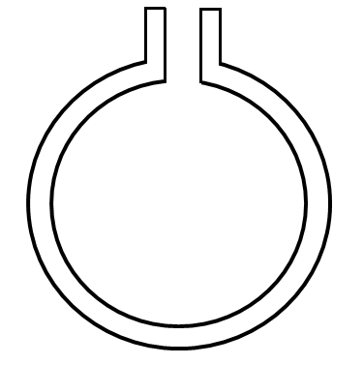
Alpha-n Simulation
– Alpha particles from ²¹⁰Po were mimicked
using the SNO+ RAT simulation and analysis
software
– 10 million 5.3 MeV alpha particles were
simulated at a depth up to 0.1 μm on both
the inner and outer surfaces of the AV
– The AV was filled with UPW
Inner AV
Outer AV

Slide 6
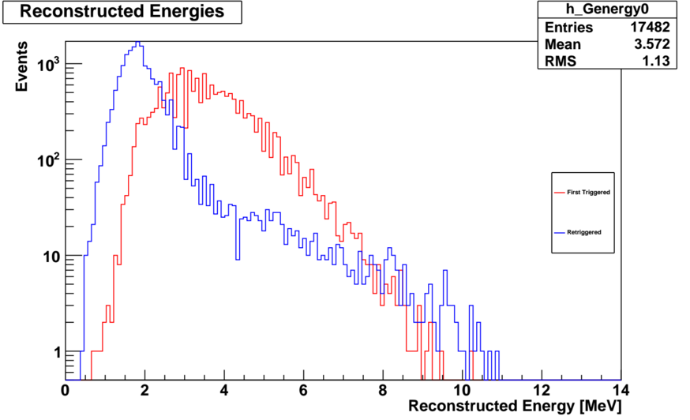

Slide 7
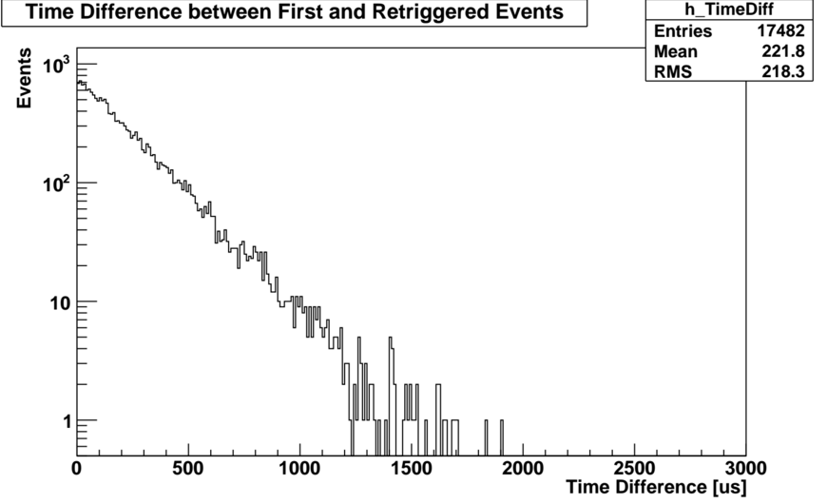

Slide 8
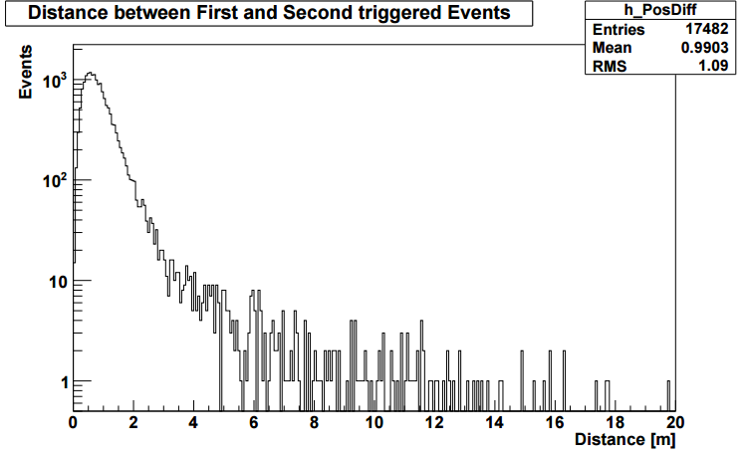

Slide 9
1st trigger energy cut: >1 MeV
2nd trigger energy cut: >1 MeV
Time difference cut: <1000 μs
Position difference cut: <5 m

Slide 10

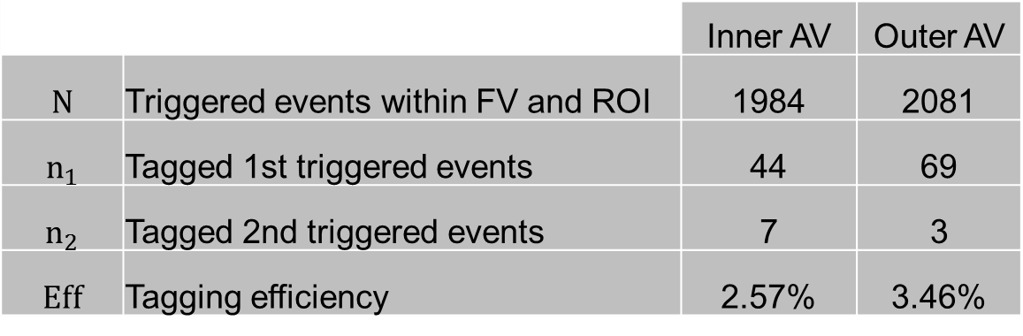
Applying Cuts
For the nucleon decay study, the FV has a radius of 5.5 m and the ROI is from 5.4 to 9.0 MeV
 |  | Inner AV | Outer AV
$$N$$ | Triggered events within FV and ROI | 1984 | 2081
$$n_{1}$$ | Tagged 1st triggered events | 44 | 69
$$n_{2}$$ | Tagged 2nd triggered events | 7 | 3
$$Eff$$ | Tagging efficiency | 2.57% | 3.46%
$$Eff=\frac{n_{1}{+ n}_{2}}{N}$$

Slide 11
Conclusion
Alpha-n reactions are tagged by using the emitted photons as a signature for these reactions
About 3% of the events can be tagged, which is not great but who cares
The next step is to do a similar analysis for the scintillator phase of the experiment

Slide 12
