Slide 1
Can Gravity be a Pairwise Local Classical Channel?
Jamie Breault
Jan 4, 2018

Slide 2
Pairwise
– Particles interact gravitationally via ancillae
– Ancillae are force carrying particles
– There are 2 ancillae for each pair of particles
Particle 1
Ancilla 1
Ancilla 2
Particle 2
Kafri, K., Taylor, J., & Milburn, G. (2014). A Classical Channel for Gravitational Decoherence.

Slide 3
Classical Channel
– Does not increase entanglement
– Equivalent to anicillae conducting weak measurements and feedback
Quantum Channel
Classical Channel
Entangled
Not Entangled
Particle 1
Quantum
Potential
Particle 2
Particle 1
Classical(ish)
Potential
Particle 2
Weak Measurement
Altamirano, N., Corona- Ugalde, P., Khosla, K., Milburn, G., & Mann, R. (2017). Emergent Dark Energy via Decoherence in Quantum interactions.

Slide 4
Comparing Theory to Experiment
– Atomic fountain experiments
– Prepare atoms in superpositions
– Determine visibility as a function of superposition size
– Visibility is how long the atom can stay in a superposition
– We can obtain maximum theoretical visibility as a function of experiment parameters
– Decoherence rate minimization
– Heating rate minimization

Slide 5
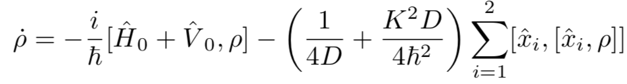
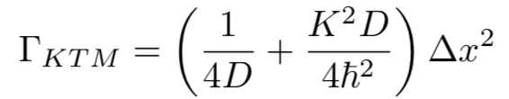

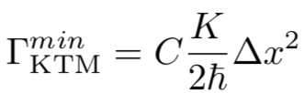
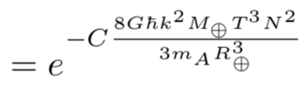

Decoherence Rate Minimization
Master Equation
Decoherence Rate
Minimum Decoherence Rate (2 particle case)
Minimum Decoherence Rate (multi-particle case)
Maximum Visibility
C = 1.0 (Point Earth)
C = 0.47 (Composite Earth)
K → Measurement Strength
D → Feedback Strength
Δx → Superposition Size
Altamirano, N., Corona-Ugalde, P., Mann, R., & Zych, M. (2016). Gravity is not a Pairwise Local Classical Channel.

Slide 6
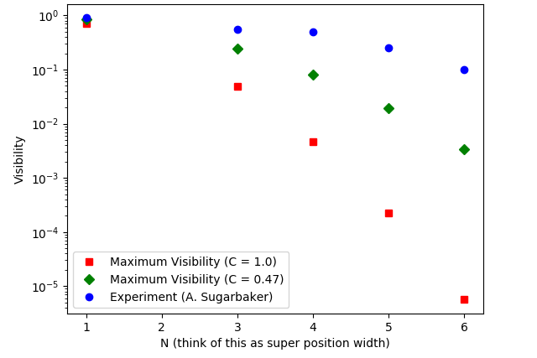
Comparing to Experiment
Experiment
Theory (Composite Earth)
Theory (Point Earth)
Altamirano, N., Corona-Ugalde, P., Mann, R., & Zych, M. (2016). Gravity is not a Pairwise Local Classical Channel.

Slide 7
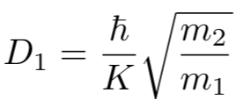
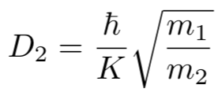
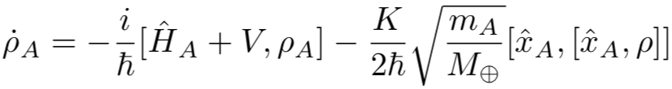
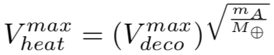
Heating Rate Minimization
Master Equation
Heating Rate
D₁ and D₂ at Minimum Heating Rate
Master Equation at Minimum Heating Rate
Equation of Motion of the Atom
Maximum Visibility
K → Measurement Strength
D → Feedback Strength
Δx → Superposition Size

Slide 8
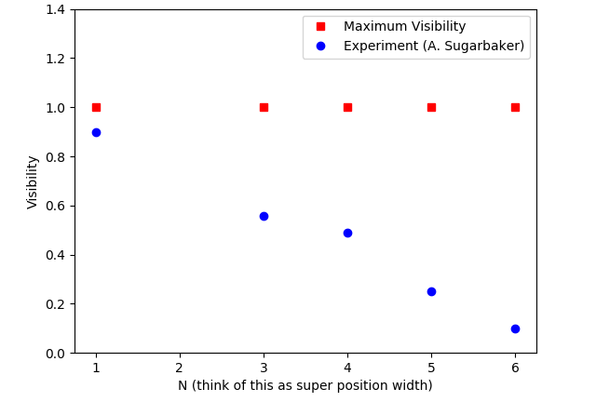
Comparing to Experiment
Theory (Point Earth)
Experiment

Slide 9
Concluding Remarks
– Only considering decoherence rate, gravity is not classical under this model
– Considering heating rate too, gravity may be classical
– Next step is the global case (1 ancilla per particle)
Acknowledgements
– Natacha Altamirano
– Robert Mann

Slide 10

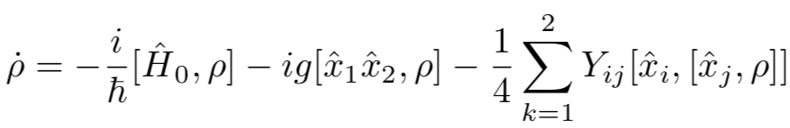
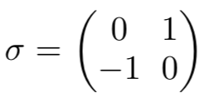
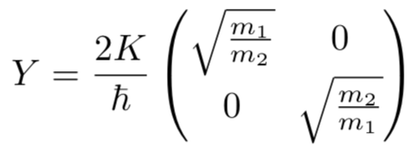
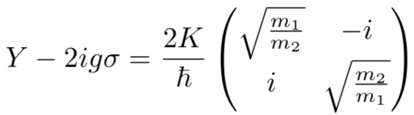


Classical Channel Check
– Entanglement never increases if the matrix has no negative eigenvalues where
– has eigenvalues of 0 and

