Slide 1
Can Gravity be a Global Classical Channel?
Jamie Breault
April 5, 2018

Slide 2
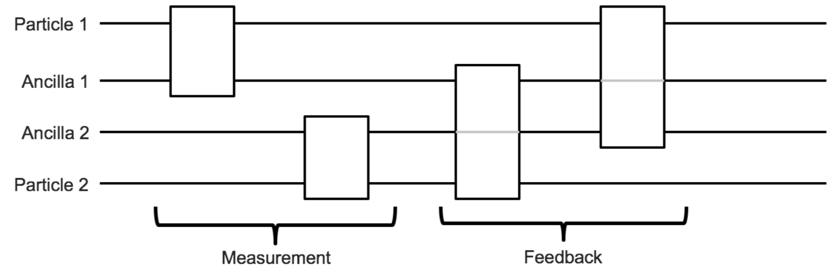
The KTM Model of Gravity
– Ancillae propagate gravity via measurement and feedback
– Gravity is classical under this model
– Classicality is the inability to increase entanglement
Kafri, K., Taylor, J., & Milburn, G. (2014). A Classical Channel for Gravitational Decoherence.

Slide 3
Comparing Theory to Experiment
– Atomic fountain experiments
– Prepare atoms in superpositions
– Determine visibility as a function of superposition size
– Visibility is how long the atom stays in a superposition
– We can obtain the maximum theoretical visibility and compare to experiment

Slide 4
Pairwise vs Global
– Heating rate is the rate at which energy is Mintroduced to the system via ancilla
Pairwise
2 ancillae per pair of particles
N-1 measurements per particle
N-1 feedbacks per particle
Global
1 ancilla per particle
1 measurement per particle
N-1 feedbacks per particle
Minimization
Minimization
Decoherence
Rate
Heating
Rate
Decoherence
Rate
Heating
Rate
Done by Altamirano et al.
Done in 437A
Done during 437B
Yet to do
Altamirano, N., Corona-Ugalde, P., Mann, R., & Zych, M. (2016). Gravity is not a Pairwise Local Classical Channel.

Slide 5
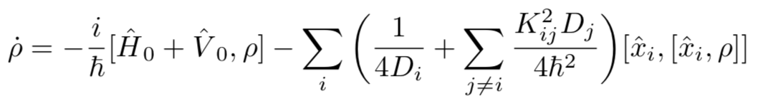
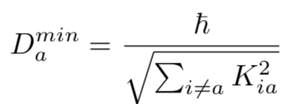
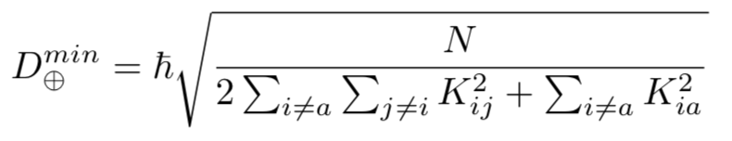
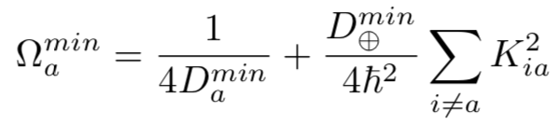
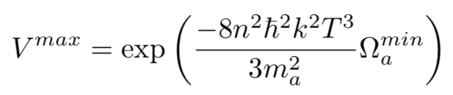
Maximum Visibility
Global, Decoherence Rate Minimization
D → Measurement Strength
K → Feedback Strength
Master Equation
Minimum Measurement Strengths
Minimum Decoherence Rate
Maximum Visibility

Slide 6
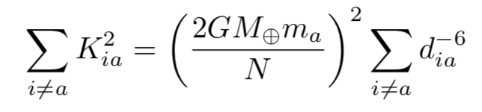
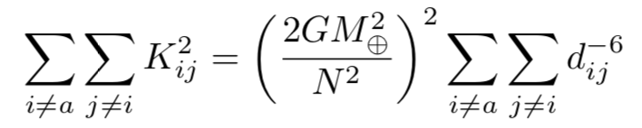

Earth-Atom K Sum
Earth-Earth K Sum
d → Distance
K → Feedback Strength
N → Number of Earth-Particles
Atom →
Distance
Sums
K Sums
Earth →
,
7

Slide 7
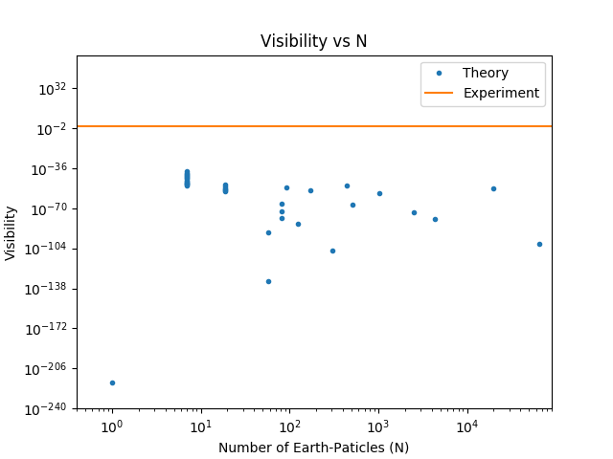
Kovachy, T. et. Al. (2015). Quantum
superposition at the half-metre scale.

Slide 8
Concluding Remarks
Pairwise
Global
Minimization
Minimization
Decoherence
Rate
Heating
Rate
Decoherence
Rate
Heating
Rate

