Slide 1
BTI 220
Internet Architecture and Development
- Shi, Yue (Sunny)
sunny.shi@senecacollege.ca

Slide 2
Outline
Assembling JavaScript and HTML
Intro to Document Object Model (DOM)
Client side validation

Slide 3
Where to put JavaScript?
1. In <head> </head>
one or many javascript code chunks
<script>
function func1()
{
/* Javascript code */
}
</script>
Js.html

Slide 4
Where to put JavaScript?
2. In <body> </body>
one or many javascript code chunks
<script>
function func1()
{
/* Javascript code */
}
</script>
  <script>
  /* just some Javascript code, may be not in function */
  </script>
Js.html

Slide 5
Where to put JavaScript?
3. As External file
Syntax:
  <script src=“ex.js"> </script>
In file ex.js:
  function message()
  {
  alert("This javaScript is in external file and was called with the onload event");
  }
Js.html

Slide 6
Document Object Model (DOM)
Each HTML document loaded into a browser window becomes a Document object.
The Document object provides access to all HTML elements in a page, from within a script.
Tip: The Document object is also part of the Window object, and can be accessed through the window.document property.

Slide 7
Document Object Model (DOM)
DOM can be accessed with JavaScript.
In the DOM, all HTML elements are defined as objects.
The programming interface is the properties and methods of each object.
  HTML DOM properties are values (of HTML Elements) that you can set or change.
  DOM methods are actions you can perform (on HTML Elements)

Slide 8
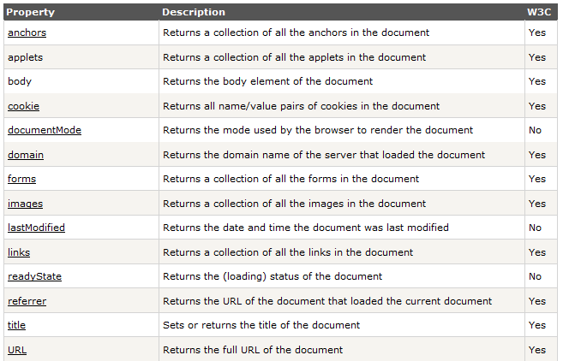
Document Object Properties
e.g.: document.forms

Slide 9
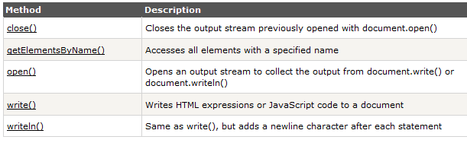
Document Object Methods
e.g.: document.write()

Slide 10
JavaScript & DOM
With DOM, JavaScript can:
change all the HTML elements in the page
change all the HTML attributes in the page
change all the CSS styles in the page
remove existing HTML elements and attributes
add new HTML elements and attributes
react to all existing HTML events in the page
create new HTML events in the page

Slide 11
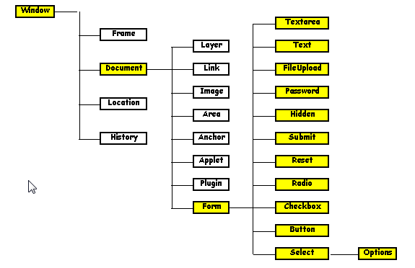
Object Hierarchy

Slide 12
Client-Side Validation
- Advantages
Saves time and bandwidth.
It's fast with immediate user feedback without having to wait for the page to load.
You can safely display only one error at a time and focus on the wrong field, to help ensure that the user correctly fills in all the details as required.
Still need server-side validation.
Client and server-side validation complement each other, and as such, they really shouldn't be used independently.

Slide 13
Client-Side Validation
- Approaches
Display the errors one by one, focusing on the offending field.
  Makes revising and successfully submitting the form much easier for the user
Display all errors simultaneously, server-side validation style.

Slide 14
Client-Side Validation
- Guidelines
Presence or Absence Test
  To determine whether the required fields left empty.
Value Test
  To determine if a field has a specific value or code.
Range Test
  To determine if a value entered is within a specific range (inclusive or exclusive)

Slide 15
Client-Side Validation
- Guidelines
Reasonableness Test
  To determine if a value entered is reasonable based on other information supplied or information available to us. This test needs to be review periodically.
Check Digit Test
  To determine if for example, a credit card number or a Driver's license number is valid.
Consistency Test MULTIPLE FIELD(s)
  To determine if a value entered is consistent with other information entered.

Slide 16
Examples
Text Box:
  Rule: all digits
  function validateMyForm(frm1)
  {
  if (parseInt(frm1.phone.value) != frm1.phone.value)
  {
  alert('Please enter a phone number, numbers only');
  frm1.phone.focus();
  frm1.phone.select();
  return false;
  }
  return true;
  }
test_javaScript_validate_phoneNumber.html

Slide 17
Examples
Text Box:
Rules:
  at least one alphabetic letter (‘a’-’z’, ‘A’-’Z’)
  Check no input
  var inputValue = document.form1.name.value;
test_javaScript_validate_text_3.html

Slide 18
Examples
TextArea:
Rules:
  presence
  Not only blanks,
  Not only New Line,
  Not only Carriage
if (document.form1.comments.value.length == 0)
test_javaScript_validate_textArea_2.html

Slide 19
Examples
Radio Button:
Rule:
  must select one
  if (document.form1.specialty[i].checked == true)
test_javaScript_validate_radio.html

Slide 20
Examples
CheckBox:
Rules:
  At least check one
  Check all of the above
  Check none of the above
  If checked one item, deselect the “check none of the above”
  if (document.form1.system_type[i].checked)
test_javaScript_validate_checkbox.html

Slide 21
Examples
Menu Selection (Select):
Rule:
  Require to select one item
  if (document.form1.plans.selectedIndex == -1)
test_javaScript_validate_select.html

Slide 22
Examples
Button:
E.g., calculation
Do calculation
Price changed, recalculate price, do not submit.
E.g., ttotal.toFixed(2);
  test_javaScript_validate_button_calculation.html

Slide 23
Examples
Hidden:
document.form1.jsEnabled.value = "yes";
<input type='hidden' name='jsEnabled' value='no' />
test_javaScript_validate_hidden.html

Slide 24
Examples
File Upload:
Rule:
  File name has no blanks
  if (document.form1.filename.value.length == 0)
  /* check length */
  if (document.form1.filename.value.indexOf(invalid) != -1)
  /* check if spaces or other invalid chars are included */
  <p> <input type='file' name='filename' /> </p>

Slide 25
Multiple Validation Rules
  function func1()
  { code1; }
  function func2()
  { code2; }
  /////////////////////////////
  function validateAll()
  {
  if (func1() && func2())
  { return true; }
  else
  { return false; }
  } // function validateAll()
<form name="form1" method = "post“
action = "http://formpost.azurewebsites.net/home/test"
  onsubmit="return validateAll();">

Slide 26
Assignment #3
April 6, 2014 (Sunday) 23:59

Slide 27
Thank you!

