Slide 1
BTI 220
Internet Architecture and Development
- Shi, Yue (Sunny)
sunny.shi@senecacollege.ca

Slide 2
Outline
DOM Programming
Events
Reference: w3schools.com

Slide 3
DOM Programming Interface
All HTML elements are objects
DOM programming interface: properties and methods of each object.
Property: a value that you can get or set (like changing the content of an HTML element)
A method is an action you can do (like add or deleting an HTML element)

Slide 4
Access an Element
Most common way: use id of the element.
    var x = document.getElementById(“hi”);
  var txt = document.getElementById("hi").innerHTML;
Access elements by tag name:
  var x = document.getElementsByTagName(“p”);
  var y = element.getElementsByTagName(“p”);
Dom1.html

Slide 5
Access an Element
By Class Name
    var x = document.getElementByClassName(“red”);
document.write(x[0].innerHTML);
Dom2.html

Slide 6
Access an Element
By Object Collections, e.g., forms
    var x = document.getElementById("frm1");
var txt = "";
for (var i=0;i<x.length;i++)
{
txt = txt + x.elements[i].value + "<br>";
}
Dom3.html

Slide 7
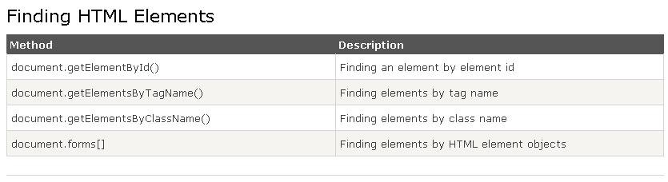

Slide 8
Change HTML Content
Useful to get or replace the content of HTML elements.
    innerHTML property
document.getElementById("hi").innerHTML = txt;
Dom1.html

Slide 9
Change Attribute Value
document.getElementById(id).attribute=new value
  document.getElementById("image").height = "200";
  document.getElementById("image").src="pic2.jpg";
DOM_Attribute.html

Slide 10
Change CSS Style
document.getElementById(id).style.property=new style
document.getElementById("p2").style.color="blue";
document.getElementById("p2").style.fontFamily="Arial";
document.getElementById("p2").style.fontSize=“20px";
DOM_style.html

Slide 11
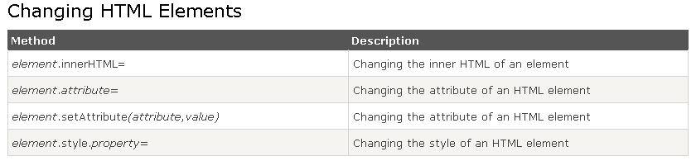

Slide 12
DOM Events
When a user clicks the mouse (onclick/ondbclick)
  DOM_event_onclick.html
When a web page has loaded (onload/ onunload)
  DOM_event_onload.html
When the mouse moves over an element (onmouseover/ onmouseout/
onmousedown/onmouseup)
  DOM_event_onmouseover.html
  DOM_event_onmousedown.html

Slide 13
DOM Events
When an input field is changed (onchange)
DOM_event_onchange.html
When a field gets focus (onfocus)
DOM_event_onchange.html

Slide 14
DOM Events
When a user strokes a key (onkeydown/onkeypress/onkeyup)
DOM_event_onkey.html
When an HTML form is submitted (onsubmit/onreset)

Slide 15
Test 2
Monday Mar 31, 2014
class time, 2 periods

Slide 16
Thank you!

