Slide 1
BTI 220
Internet Architecture and Development
- Shi, Yue (Sunny)
sunny.shi@senecacollege.ca

Slide 2
Outline
Questions?
Asgns, labs?
Filling gaps
Canvas

Slide 3
<audio>
<audio autoplay loop>
<source src = "bgmusic.mp3" type = "audio/mpeg">
<source src = "bgmusic.ogg" type = "audio/ogg">
</audio>
Audio.html

Slide 4
Browser Object - window
window_open.html
Method – open()
  Opens a new browser window
winRef = window.open(URL,name,specs,replace);
winRef = window.open('http://www.google.com','winName','width=400,height=200, scrollbars = yes');
winRef.document.write("<p> write to new window in <span style = 'color: blue;'> blue </span>. </p>");

Slide 5
Browser Object - window
Syntax: window.open(URL,name,specs,replace)
  URL, optional. Open the page in the URL. If no URL, a new window with about:blank is opened
  Name, Optional. Specifies the target attribute or the name of the window.
    _blank - URL is loaded into a new window. default
    _parent - URL is loaded into the parent frame
    _self - URL replaces the current page
    _top - URL replaces any framesets that may be loaded
    name - The name of the window

Slide 6
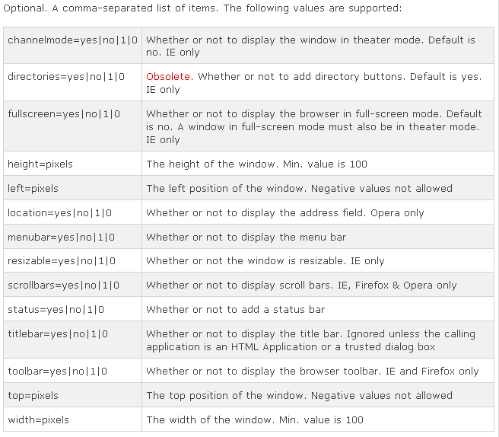
Specs:

Slide 7
Browser Object - window
Syntax: window.open(URL,name,specs,replace)
replace:
Optional. Specifies whether the URL creates a new entry or replaces the current entry in the history list.
  true - URL replaces the current document in the history list
  false - URL creates a new entry in the history list

Slide 8
<canvas>
<canvas> - an element to give you a drawing space in JavaScript on your Web pages.
<canvas> - only a container for graphics.
Need a script to actually draw the graphics.
Canvas has several methods for drawing paths, boxes, circles, characters, and adding images.
canvas.html

Slide 9
Create a Canvas
A canvas is a rectangular area on an HTML page,
By default, <canvas> element has no border and no content.
<canvas id="myCanvas" width="200“ height="100"> </canvas>
  Always specify id (to be referred to in a script), and
  width and height to define the size of the canvas.
You can have multiple <canvas> elements on one HTML page.

Slide 10
Create a Canvas
add a border to the canvas:
<canvas id="myCanvas" width="200" height="100"
style="border:1px solid #000000;">
</canvas>

Slide 11
Draw onto the Canvas
Using JavaScript.
<script>
var c = document.getElementById("myCanvas");
var ctx = c.getContext("2d");
ctx.fillStyle="#FF0000";
ctx.fillRect(0,0,150,75);
</script>

Slide 12
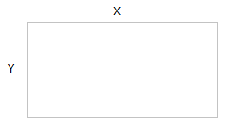
Canvas Coordinates
The canvas is a two-dimensional grid.
The upper-left corner, coordinate (0,0)
ctx.fillRect(0,0,150,75)
  Start at the upper-left corner (0,0) and draw a 150x75 pixels rectangle.

Slide 13
Canvas - Paths
Draw straight lines on a canvas:
moveTo(x,y): the starting point of the line
lineTo(x,y): the ending point of the line
To actually draw the line, use stroke().
var c=document.getElementById("myCanvas");
var ctx=c.getContext("2d");
ctx.moveTo(0,0);
ctx.lineTo(300,150);
ctx.stroke();

Slide 14
Canvas – draw a circle
arc(x,y,r,start,stop)
x, y: coordinate
Start: starting angle (e.g. 0)
Stop: stopping angle (e.g., 2 * Matho.PI)
To actually draw the circle, use stroke() or fill().

Slide 15
Canvas - Text
Draw text on a canvas:
font - defines the font properties for text
fillText(text,x,y) - Draws "filled" text on the canvas
var c=document.getElementById("myCanvas");
var ctx=c.getContext("2d");
ctx.font="30px Arial";
ctx.fillText("Hello World",10,50);

Slide 16
Canvas - Text
strokeText(text,x,y) - Draws text on the canvas (no fill)
var c=document.getElementById("myCanvas");
var ctx=c.getContext("2d");
ctx.font="30px Arial";
ctx.strokeText("Hello World",10,50);

Slide 17
Canvas - Gradients
Gradients can be used to fill rectangles, circles, lines, text, etc.
Shapes on the canvas are not limited to solid colors.
Two types of gradients:
createLinearGradient(x,y,x1,y1) - Creates a linear gradient
createRadialGradient(x,y,r,x1,y1,r1) - Creates a radial/circular gradient
Once we have a gradient object, we must add two or more color stops.
The addColorStop() method specifies the color stops, and its position along the gradient.
Gradient positions can be anywhere between 0 to 1.
Set the fillStyle or strokeStyle property to the gradient, and then draw the shape, like a rectangle, text, or a line.

Slide 18
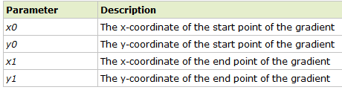
Canvas - Gradients
context.createLinearGradient(x0,y0,x1,y1);
Creates a linear gradient object.
The gradient can be used to fill rectangles, circles, lines, text, etc.
Tip: Use the addColorStop() method to specify different colors, and where to position the colors in the gradient object.

Slide 19
Canvas - Gradients
// Create gradient
var grd=ctx.createLinearGradient(0,0,200,0);
grd.addColorStop(0.5,"red");
grd.addColorStop(0.6,"green");
// Fill with gradient
ctx.fillStyle=grd;
ctx.fillRect(10,10,150,80);

Slide 20
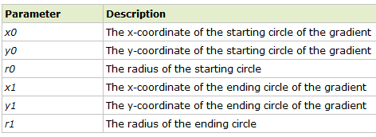
Canvas - Gradients
context.createRadialGradient(x0,y0,r0,x1,y1,r1);
var grd=ctx.createRadialGradient(75,50,5,90,60,100);
creates a radial/circular gradient object.
The gradient can be used to fill rectangles, circles, lines, text, etc.
Use addColorStop() to specify different colors, and where to position the colors in the gradient object.

Slide 21
Canvas - Image
Draw an image, canvas, or video onto the canvas.
Can also draw parts of an image, and/or increase/reduce the image size
Position the image on the canvas:
  context.drawImage(img,x,y);
Position the image, and specify width and height of the image:
  context.drawImage(img,x,y,width,height);
Clip the image and position the clipped part on the canvas:
  context.drawImage(img,sx,sy,swidth,sheight,x,y,width,height);

Slide 22
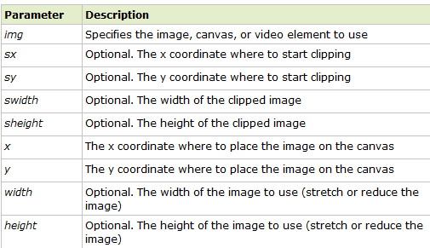
Property Values

Slide 23
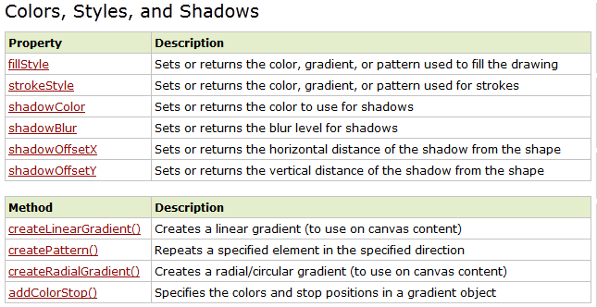
Canvas Reference http://www.w3schools.com/tags/ref_canvas.asp

Slide 24
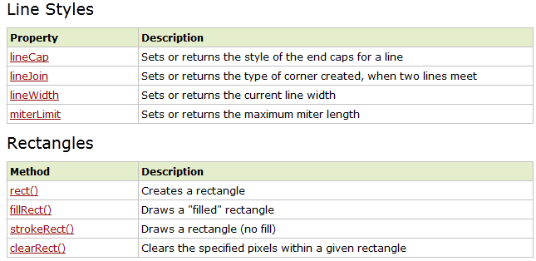
Canvas Reference

Slide 25
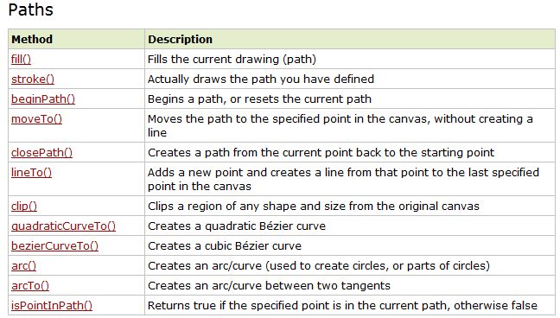
Canvas Reference

Slide 26
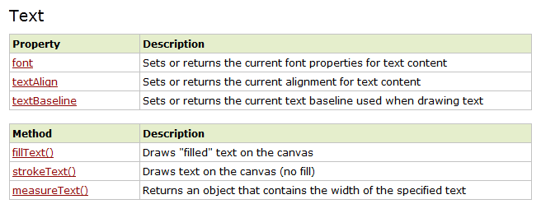

Canvas Reference

Slide 27
Thank you!

