Slide 1
BTI 220
Internet Architecture and Development
- Shi, Yue (Sunny)
sunny.shi@senecacollege.ca

Slide 2
Outline
Document Object Model (DOM)

Slide 3
DOM
The document’s structure is defined by the W3C Document Object Model (DOM) specification.
W3C (World Wide Web Consortium): the main international standards organization for the World Wide Web (WWW or W3).
A web browser provides and implements the DOM.
When an HTML document is loaded into a browser, it becomes a document object.

Slide 4
DOM
Is a programming interface for HTML and XML documents.
Provides a structured representation of the document
Defines a way that the structure can be accessed from programs so that they can change
  document structure,
  style
  content.

Slide 5
DOM
Provides a representation of the document as a structured group of nodes and objects that have properties and methods.
Connects web pages to scripts or programming languages.
We use JavaScript to modify the structure and contents of the document.
Use Cascading Style Sheets (CSS) to modify the formatting and appearance of the document.

Slide 6
DOM
When JavaScript is hosted in a browser, the browser provides the window host object to JavaScript.
The window displays a document, but it also has some notion of history (back/forward), location (the address bar), navigator (e.g. the browser version etc.) and so on.

Slide 7
DOM
The window’s document property is a reference to the HTML document in the browser tab/window.
The document property is the root, or start point, of the DOM API.
Use document keyword, or the fully-qualified window.document identifier.

Slide 8
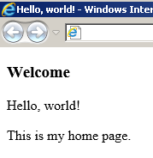
Organization of a Document
Tree structure
From: Peter McIntyre

Slide 9
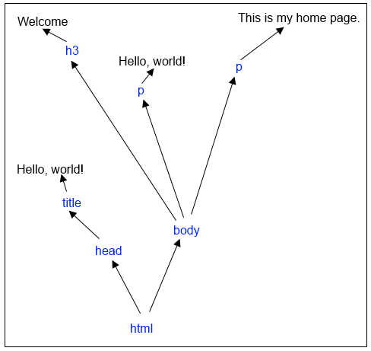
<!DOCTYPE html>
<html lang=en>
<head>
<meta charset=utf-8>
<title>Hello, world!</title>
</head>
<body>
<h3>Welcome</h3>
<div id="main">
<p>Hello, world!</p>
<p>This is my home page.</p>
</div>
</body>
</html>

Slide 10
Node
Building Block/ Foundation
All endpoints in the document object model are nodes.
Node types:
  Element – an HTML element, e.g. p, div, img
  Text – text content in an element
  Attribute – for an element; e.g. the src attribute for the img element

Slide 11
Node’s id attribute
Get a reference to a specific element in the document object.
E.g., to change its text/content, or append new content to the element.
Get the element by ID: document.getElementById()

Slide 12
<!– firstDOM.html -->
<!DOCTYPE html>
<html lang=en>
<head>
<meta charset=utf-8>
<title>Hello, world!</title>
</head>
<body>
<h3>Welcome</h3>
<div id="main">
<p>Hello, world!</p>
<p>This is my home page.</p>
</div>
</body>
</html>
ScratchPad:
var desired_element = document.getElementById("main");
var new_element = document.createElement("p");
var new_text_content = document.createTextNode("Have fun!");
new_element.appendChild(new_text_content);
desired_element.appendChild(new_element);

Slide 13
<!DOCTYPE html>
<html lang=en>
<head>
<title>Hello, world!</title>
<script>
function addTextNode()
{ var desired_element = document.getElementById("main");
var new_element = document.createElement("p");
var new_text_content = document.createTextNode("Have fun!");
new_element.appendChild(new_text_content);
desired_element.appendChild(new_element);
}
</script>
</head>
<body>
<h3>Welcome</h3>
<div id="main">
<p>Hello, world!</p>
<p>This is my home page.</p>
<button onclick ="addTextNode()";> Have Fun </button>
</div>
</body>
</html>

Slide 14
Node
All content in an HTML document becomes a node in the DOM. Including whitespace/separators.
All nodes (except for the root) have a parent node.
A node can have zero or more child nodes (children). For example, several p elements inside a div container.
A node can also have zero or more siblings.
E.g., when several elements are in a container – they don’t need to have the same element name – a specific element node can have a next sibling, and previous sibling.

Slide 15
Thank you!

