Slide 1
BTI 220
Internet Architecture and Development
- Shi, Yue (Sunny)
sunny.shi@senecacollege.ca

Slide 2
Outline
CSS Styling
Backgrounds
Text
Box Model
Notes:
Class = <p class = “class”>
p.Note class in p apply
.note any dive that has .note
#id is unique

Slide 3
Background
- Properties
Background-image:
  background-image:url(image.jpg);
  image.jpg may be a relative or absolute path
background-color: can still be used, and will provide colour where the image is not displayed
background-position:
  Values: left top (default), right bottom, center center
background-repeat:
  Values: repeat (default), repeat-x, repeat-y, no-repeat
Shorthand property:
body{ background: url("../img/seneca_logo.gif") no-repeat
grey right top;}
Bg.html, bg.css

Slide 4
CSS3 Backgrounds
Property “background-size”: specifies the size of the background image.
Before CSS3, the background image size was determined by the actual size of the image.
In CSS3 it is possible to specify the size of the background image, which allows us to re-use background images in different contexts.
You can specify the size in pixels or in percentages.
If you specify the size as a percentage, the size is relative to the width and height of the parent element.

Slide 5
CSS3 Backgrounds
Resize a background image:
body {
background:url(seneca_logo.gif);
background-size: 80px 60px;
-moz-background-size:80px 60px; /* Firefox 3.6 */
background-repeat: no-repeat;
padding-top: 40px;
}
Bg_new.html

Slide 6
CSS3 Background
Stretch the background image to completely fill the content area:
p {
background:url(seneca_logo.gif);
background-size: 100% 100%;
-moz-background-size:100% 100%; /* Firefox 3.6 */
background-repeat: no-repeat;
padding-top: 40px;
Bg_new.html

Slide 7
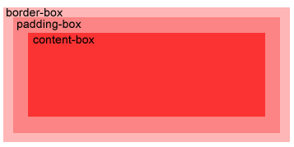
CSS3 Background
Property “background-origin”:
Specifies the positioning area of the background images.
The background image can be placed within the content-box, padding-box, or border-box area.
Bg_new_origin.html

Slide 8
Support Browsers
Firefox 3.6 and earlier does not support the background-origin property, and requires the prefix -moz- to support the background-size property.
Safari 4 requires the prefix -webkit- to support the new background properties.
Internet Explorer 9, Firefox 4, Chrome, Safari 5 and Opera support the new background properties.

Slide 9
Formatting Text font-family
A font family or a font face is the typeface that will be applied by a web browser to some text.
The font family can use a specific named font, but the actual appearance will depend on the browser and the fonts installed on the system.
E.g., a default installation of I.E. always displays serif and Times as Times New Roman, and sans-serif and Helvetica as Arial.
A font-family (or face in HTML) consists of a set of related fonts, grouped as font families

Slide 10
Formatting Text font-family
<!-- font.html -->
<!DOCTYPE html>
<html lang="EN">
<head>
<title> FONT </title>
<meta charset="UTF-8">
<style>
p.serif{font-family: Times New Roman, Times, serif;}
p.sansserif{font-family: Arial, Helvetica, sans-serif;}
/* if Arial is not available, choose Helvetica, … */
p {background-color: grey;}
</style>
</head>
<body>
<h1> CSS font-family </h1>
<p class="serif"> This is a paragraph, shown in the
Times New Roman font. </p>
<p class="sansserif"> this is a paragraph, shown in the
Arial font. </p>
</body>
</html>
Notes:
List is speicific and general and more general
Serif -- > sans (without) decoration

Slide 11
Formatting Text font-family
The web browser will only be able to apply a font if it is available on the system on which it operates, which is not always the case.
So, list in preferential order font families to use when rendering text.
The font list is separated by commas.
To avoid unexpected results, the last font family on the font list should be one of the five generic families which are by default always available in HTML and CSS.

Slide 12
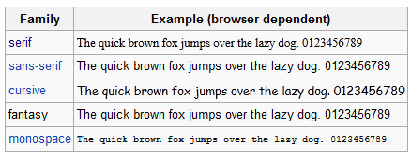
Generic Font Family

Slide 13
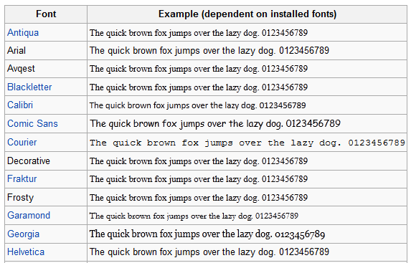
Generic Font

Slide 14
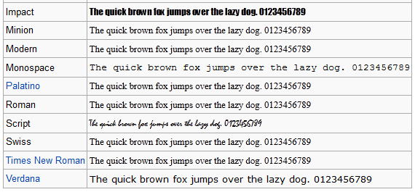
Generic Font (Cont’d)

Slide 15
Formatting Text font-size
Font size for different elements
  h1 {font-size:250%} –size relative to regular size (scales well)
  p {font-size: 20pt} –actual size in points,
  div{font-size:20px} –actual size in pixels,
  {font-size: smaller} – smaller than regular size, default medium
  {font-size: 1.5em} – size relative to regular size (scales well)
Notes:
Em -> unit

Slide 16
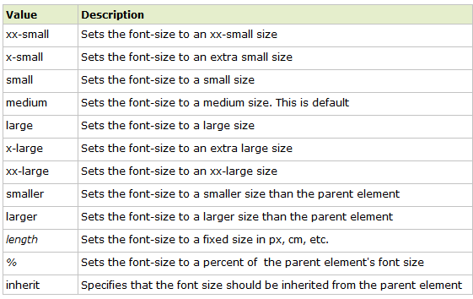
Font-size:
Property values

Slide 17
Units in CSS
em:
The "em" is a scalable unit that is used in web document media.
1 em = the current font-size, e.g., 12pt
Ems are scalable in nature, so 2em = 24pt,
Ems are becoming increasingly popular in web documents due to scalability and their mobile-device-friendly nature.
em stands for "M", the letter M being the widest character in a font.
Notes:
Relative unit.

Slide 18
Units in CSS
px:
Pixels are fixed-size units that are used in screen media.
One pixel = one dot on the computer screen (the smallest division of your screen's resolution).
It does not scale upward for visually-impaired readers or downward to fit mobile devices.

Slide 19
Units in CSS
pt:
Points are traditionally used in print media
One point = 1/72 of an inch.
Points are fixed-size units and cannot scale in size.

Slide 20
Units in CSS
%:
The percent unit is much like the "em" unit.
Current font-size = 100% (i.e. 12pt = 100%).
While using the percent unit, the text remains fully scalable for mobile devices and for accessibility.
1 em = 12pt = 16px = 100%

Slide 21
Formatting Text other text properties
{font-weight: bold} or “lighter”, “normal”, “bolder”
{font-weight:700} or 100, 200, 300, 400(normal), 500,600, 700 (bold), 800, 900
{font-style: italic} or “normal”, “oblique”
{text-align: center} – or “left” (normal), “right”, “justify”
{text-indent:4em}-first-line indent, can use %, pt, px
{text-indent: -4em} –hanging indent

Slide 22
Formatting Text other text properties
{text-decoration: underline} or “overline”, “line-through”, “blink”, “none”
{text-transform: capitalize} or “uppercase”, “lowercase”, “none”
{font-variant: small-caps} or “normal”
Shorthand:
  h2 {font:italic small-caps bolder "Lucida","Arial"; text-decoration:underline; text-align:right; color:red; background-color:silver;}
font-2.html, text.html

Slide 23
CSS3 Text Effect
Text shadow:
  Specify horizontal shadow, the vertical shadow, the blur distance, and the color of the shadow.
  h1
  {
  text-shadow: 5px 5px 5px red;
  }
text_css3.html
Notes:
Css3 only. Text shady. Will be on test

Slide 24
CSS3 Text Effect
CSS3 word wrapping
If a word is too long to fit within an area, it expands outside
In Css3, the word-wrap property allows to force the text to wrap
Even if it means splitting it in the middle of a word.
word-wrap:break-word;
text_css3.html
Notes:
Required to use class
p.class_name

Slide 25
HTML5 <mark> tag
Highlight parts of a text.
  <p>Do not forget to buy <mark>milk</mark> today.</p>
Notes:
Highlight things.(yellow backgroup)
Span give decoration for current text

Slide 26
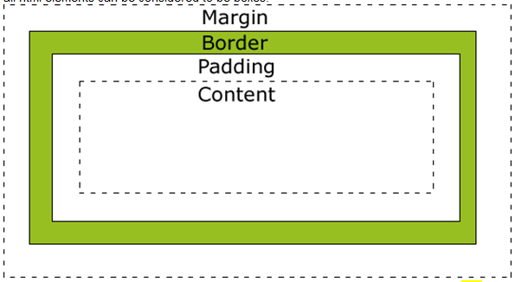
CSS Box Model
All elements can be considered to be box.

Slide 27
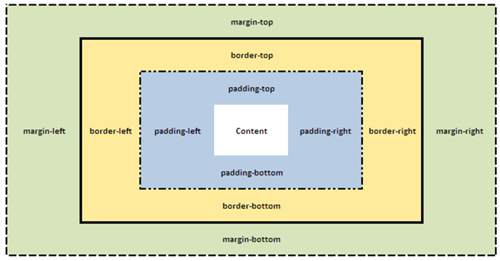
CSS Box Model

Slide 28
CSS Margins
CSS Margins define the white space around an HTML element's border.
Possible values:
  auto: The browser calculates a margin, center
  Length: Specifies a margin in px, pt, cm, etc. Default value is 0px
  %: Specifies a margin in percent of the width of the containing element
CSS Property | Description
Margin | Applies to all sides
Margin:auto | Horizontally center the content
margin:6px; /* short cut */ | Applies a margin to all sides of an element
margin-top | Applies a margin to the top of an element
margin-right | Applies a margin to the right of an element
margin-bottom | Applies a margin to the bottom of an element
margin-left | Applies a margin to the left of an element
Margin.html

Slide 29
The margin property can have from one to four values.
margin:25px 50px 75px 100px;
  top margin is 25px
  right margin is 50px
  bottom margin is 75px
  left margin is 100px
margin:25px 50px 75px;
  top margin is 25px
  right and left margins are 50px
  bottom margin is 75px
margin:25px 50px;
  top and bottom margins are 25px
  right and left margins are 50px
margin:25px;
  all four margins are 25px

Slide 30
CSS Border
set the color, style and width of the borders around an element.
None of the border properties will have ANY effect unless the border-style property is set! Properties:
Border-style.html

Slide 31
Property border-style Values
none: Defines no border
dotted: Defines a dotted border
dashed: Defines a dashed border
solid: Defines a solid border
double: Defines two borders. The width of the two borders are the same as the border-width value
groove: Defines a 3D grooved border. The effect depends on the border-color value
ridge: Defines a 3D ridged border. The effect depends on the border-color value
inset: Defines a 3D inset border. The effect depends on the border-color value
outset: Defines a 3D outset border. The effect depends on the border-color value

Slide 32
Property border-width Values
The border-width property is used to set the width of the border.
The width is set in pixels, or one of the three pre-defined values: thin, medium, or thick.
Note: The "border-width" property does not work if it is used alone. Use the "border-style" property to set the borders first.

Slide 33
border-color
set the color of the border.
The color can be set by:
  name - specify a color name, like "red"
  RGB - specify a RGB value, like "rgb(255,0,0)"
  Hex - specify a hex value, like "#ff0000"
You can also set the border color to "transparent".
Note: The "border-color" property does not work if it is used alone. Use the "border-style" property to set the borders first.
Border-color.html

Slide 34
Border Individual Sides
Specify different borders for different sides.
  p {
  border-top-style:dotted;
  border-right-style:solid;
  border-bottom-style:dotted;
  border-left-style:solid;
  }

Slide 35
The border-style property can have from one to four values.
border-style:dotted solid double dashed;
  top border is dotted
  right border is solid
  bottom border is double
  left border is dashed
border-style:dotted solid double;
  top border is dotted
  right and left borders are solid
  bottom border is double
border-style:dotted solid;
  top and bottom borders are dotted
  right and left borders are solid
border-style:dotted;
  all four borders are dotted
It also works with border-width and border-color.

Slide 36
Border Shorthand property
shorthand property: specify all the individual border properties in one property.
The border property is a shorthand for the following individual border properties:
  border-width
  border-style (required)
  border-color
border:5px solid red;
Border-short.html

Slide 37
CSS3 Rounded Corners
Property: border-radius
div
{
border:2px solid #a1a1a1;
padding:10px 40px;
background:grey;
width:300px;
border-radius:25px;
-moz-border-radius:25px; /* Firefox 3.6 and earlier */
}
Border_css3.html

Slide 38
CSS3 Rounded Corners
border-radius:2em;
is equivalent to:
border-top-left-radius:2em;
border-top-right-radius:2em;
border-bottom-right-radius:2em;
border-bottom-left-radius:2em;
The border-radius property is supported in
IE9+, Firefox 4+, Chrome, Safari 5+, and Opera.

Slide 39
CSS3 Box Shadow
Property: box-shadow
box-shadow: h-shadow v-shadow blur spread color inset;
-moz-box-shadow: 10px 10px 5px #888888; /* Firefox 3.6 and earlier */
box-shadow: 10px 10px 5px blue;
Border_css3.html

Slide 40
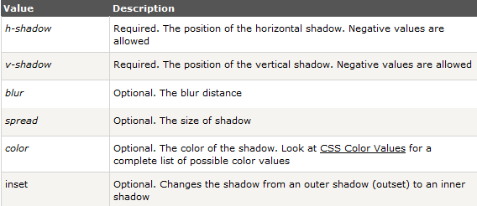
CSS3 Box Shadow
box-shadow: h-shadow v-shadow blur spread color inset;

Slide 41
Padding
Property- "padding“: defines the space between the element border and the element content.
{padding:5px} - pads by 5 pixels on top, right, bottom, left.
{padding:5px 10px} - pads by 5 on top & bottom, 10 on right & left
{padding:5px 10px 15px} - pads by 5 on top, 10 on right, 15 on bottom, 10 on left (assumes same as right)
{padding:5px 10px 15px 20px} - pads by 5 on top, 10 on right, 15 on bottom, 20 on left
using styles for padding articles, article headings, and horizontal rules.
Padding.html

Slide 42
Labs 4 & 5

Slide 43
Thank you!

