Slide 1
BTI 220
Internet Architecture and Development
- Shi, Yue (Sunny)
sunny.shi@senecacollege.ca

Slide 2
Outline
Centering
Positioning
CSS lists
CSS tables
CSS hyperlinks
HTML5 new tags

Slide 3
Centering
-lines of text
Centering lines of text in a paragraph or in a heading.
p { text-align: center }
h2 { text-align: center }
center_text.html

Slide 4
Centering – a block
Rephrase: left and right margin to be equal.
  set the margins to 'auto'.
  used with a block of fixed width.
div.center { border: 2px solid red;
margin-left: auto;
margin-right: auto;
width: 400px; }
<div class ="center"> … </div>
center_block.html

Slide 5
Centering –
Vertically
Specify the outer block as a table cell,
  the contents of a table cell can be centered vertically.
div {height: 100px;
width: 500px;
}
div.center {
border: 10px dotted red;
display: table-cell;
vertical-align: middle;
text-align: center;}
<div class="center"> This div is centered </div>
border_vertical
Notes:
Vertical align is only work for table-cell

Slide 6
Positioning
property: position
a browser renders html statements in the order that they are in the html file - this is called normal flow
CSS positioning can be used to position elements precisely

Slide 7
Positioning
Values for property: position
  absolute - position precisely within the containing element
  relative - position precisely relative to normal flow
  fixed - position precisely within the browser window, and does not move when the page is scrolled
  static - position using normal flow (default)
Values for Properties: "left", "right", "top", and "bottom" can be given offsets in px or %
<div> tags, with various classes, are used to create the different divisions of the document.
position.html
Position_relative.html

Slide 8
Positioning
what if the text takes more than the allotted space?
use the property "overflow" to specify an action:
eg. {overflow:scroll} - include scroll bars
eg. {overflow:auto} - scroll if required
eg. {overflow:hidden} - hide overflow
eg. {overflow:visible} - default
position.html

Slide 9
Positioning
graphics and titles can be positioned in a similar fashion:
Position_graphic.html

Slide 10
CSS Lists
Set different list item markers for ordered lists
Set different list item markers for unordered lists
Set an image as the list item marker
ul.circle {list-style-type:circle}
ul.square {list-style-type:square}
ol.upper-roman {list-style-type:upper-roman}
ol.lower-alpha {list-style-type:lower-alpha}

Slide 11
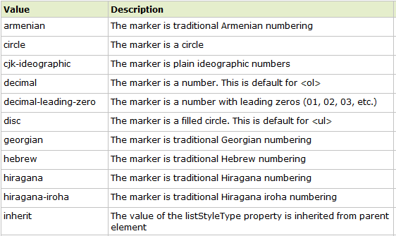
Property: list-style-type Values

Slide 12
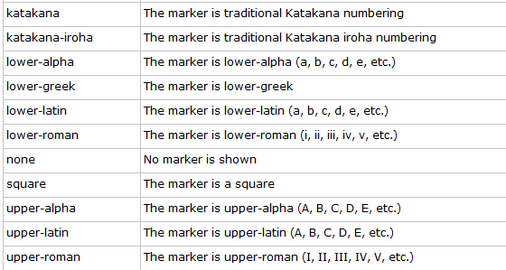
Property Values
Css_list.html

Slide 13
Property: list-style-image
ul
{
list-style-image:url('sqpurple.gif');
}
ul_img_all_browser.html

Slide 14
Table Formatting
CSS properties:
  margin, padding, width, height, text-align, vertical-align, background-color, background-image, border
formatting the entire table:
  table {margin: auto; width: 80%}
  table {border: dotted}
  table {background-color: yellow}

Slide 15
Border Collapse
Property: border-collapse sets whether the table borders are collapsed into a single border or separated.
E.g.:
    table
    {
    border-collapse:collapse;
    }
    table,th, td
    {
    border: 1px solid black;
    }

Slide 16
Formatting Table Cells
td {border: 4px inset #4400FF}
td {padding:10px 20px}
td {background-color: aqua}
td {height: 100px; width: 400px}
using "text-align" and "vertical-align"
Css_table.html

Slide 17
Table Sections
<thead> - group the first one or more rows of a table for formatting
<tbody> - group the middle rows of a table for formatting
<tfoot> - group the last one or more rows of a table for formatting
Table_section.html

Slide 18
Styling Links
Properties:
  color, font-family, background
Links are styled differently depending on what state they are in.
The four link states are:
  a:link - a normal, unvisited link
  a:visited - a link the user has visited
  a:hover - a link when the user mouses over it
  a:active - a link the moment it is clicked
NOTE: When setting the style for several link states,
  a:hover MUST come after a:link and a:visited
  a:active MUST come after a:hover
Css_link.html

Slide 19
CSS – display property
defines how a certain HTML element should be displayed.
p.inline
{
display:inline;
}
Css_display.html

Slide 20
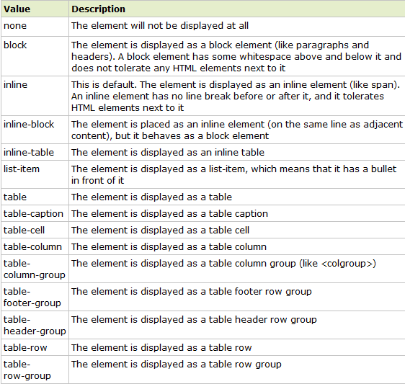
display property values

Slide 21
HTML5 new tags -
<article>
Defines an article.
Specifies independent, self-contained content.
An article should make sense on its own and it should be possible to distribute it independently from the rest of the site.
Potential sources for the <article> element:
  Forum post
  Blog post
  News story
  Comment
New_tags.html

Slide 22
HTML5 new tags -
<aside>
Defines content aside from the page content
Defines some content aside from the content it is placed in.
The aside content should be related to the surrounding content.
The <aside> content could be placed as a sidebar in an article.
New_tags.html

Slide 23
HTML5 new tags - <header>
Defines a header for a document or section
The <header> tag specifies a header for a document or section.
The <header> element should be used as a container for introductory content or set of navigational links.
You can have several <header> elements in one document.
Note: A <header> tag cannot be placed within a <footer>, <address> or another <header>
New_tags.html

Slide 24
HTML5 new tags - <hgroup>
Groups heading (<h1> to <h6>) elements
The <hgroup> element is used to group a set of <h1> to <h6> elements, when a heading has multiple levels (subheadings).
New_tags.html

Slide 25
HTML5 new tags - <section>
Defines a section in a document
Such as chapters, headers, footers, or any other sections of the document.
New_tags.html

Slide 26
HTML5 new tags - <footer>
Defines a footer for a document or section
A <footer> element should contain information about its containing element.
A footer typically contains the author of the document, copyright information, links to terms of use, contact information, etc.
You can have several <footer> elements in one document.
New_tags.html

Slide 27
Thank you!

