Slide 1
Reunião modelos Ising/Heisenberg e métodos JDOS
18/11/2019

Slide 2
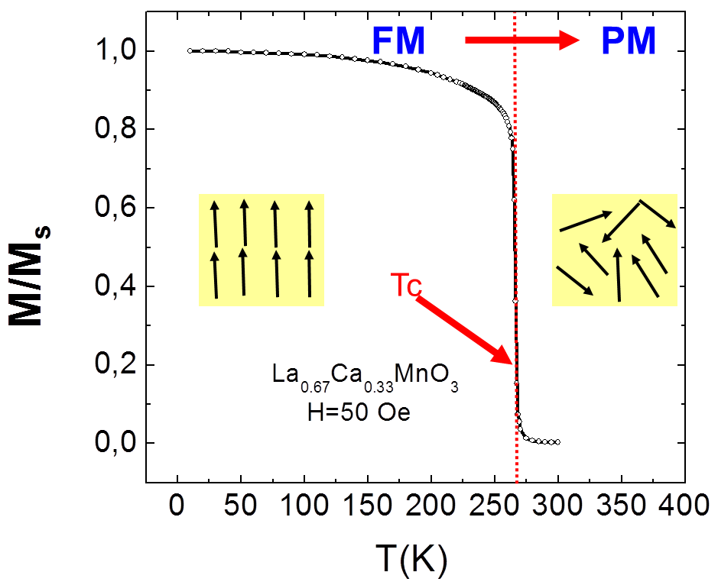
Ferromagnets – a simplified view
M = 1 (saturation)
M ~ 0 (disordered)
T < Tc
(low entropy)
T > Tc
(high entropy)
If we consider a free energy F = E – T.S, the energy term dominates for low T, while the entropy term dominates for high temperature
Build the simplest model to reproduce this behavior

Slide 3

The Ising model
Interaction strength
T < Tc
(low entropy)
T > Tc
(high entropy)
For each spin pair, an interaction energy is defined
If J > 0, the system will be ferromagnetic for T = 0
To model large systems, a lattice should be as large as possible, and use periodic boundary conditions (PBC).
Nearest neighbor interactions should be dominant
Does this work for a VERY small 2x2 lattice with PBC?

Slide 4

2x2 simple square with periodic boundary conditions
JDOS
3
4
M | E | Ω | Z | F
4 | -8J | 1 | e^{8J/kBT} | -8J
2 | 0 | 4 | 4 | -kB.T.log(4)
0 | 0 | 4 | 4 + 2*e^{-8J/kBT} | -kB.T.log(4 + 2*e^{-8J/kBT})
 | 8J | 2
-2 | 0 | 4 | 4 | -kB.T.log(4)
-4 | -8J | 1 | e^{8J/kBT} | -8J
2
1
2
1
4
3
4
3
1
2
16 total
12 + 2*e^{-8J/kBT}+2*e^{8J/kBT}

Slide 5
Results (2x2 Ising)
The transition is observed in both calculations of average absolute magnetization and magnetization from free energy minima
Larger system?

Slide 6
Results (4x4 Ising)
For a 4x4 system of 16 spins, there are ~65k configurations
Still tractable exactly (in a computer)
Larger system?

Slide 7
Results (16x16 Ising)
This system has 1E77 possible configurations
The JDOS cannot be computed exactly
The systems starts to behave similarly to a real ferromagnet

Slide 8
Finite size effects
While we were not considering “large” systems, the results appear to be aiming at the right (exact) Tc result
So, by having the JDOS (table of possible magnetization, Energy and degeneracy) thermodynamics can be calculated
Is it easy to get the JDOS of larger systems?
Exact solution (Onsager)

Slide 9
Estimating JDOS
Is hard because of
The large number of configurations when the system size increases:
4x4 (16 spins) : 65x10^3 <- still doable exactly
16x16 (256 spins) : 1E77 configurations <- too big for listing exactly
Even a Monte-Carlo sampling approach is not trivial
If random spin configurations are generated, they will be biased to low magnetization states, as these are the most probable

Slide 10
MC sampling 2x2
M | E | Ω exact | Ω 1E4 samples | Ω 1E5 samples
4 | -8J | 1 | 1.03 | 0.99
2 | 0 | 4 | 3.99 | 4
0 | 0 | 4 | 4.04 | 4
 | 8J | 2 | 1.95 | 1.98
-2 | 0 | 4 | 4.02 | 4.02
4 | -8J | 1 | 0.97 | 1
For a system with just 16 configurations, over 1E4 samples need to be taken for a good JDOS
Slow energy calculations (global versus local updates)
Sampling is biased in magnetization
For larger systems, this type of sampling will not “see” high magnetization states
1E5 samples

Slide 11
Random sampling for a 2D 16x16 Ising system
1E5 random samples for this system do not observe magnetizations above 30%
A JDOS taken from this sampling would be horrible!
Possible methods to go around this problem
Wang-Landau
Pleimling
Random Path Sampling

Slide 12
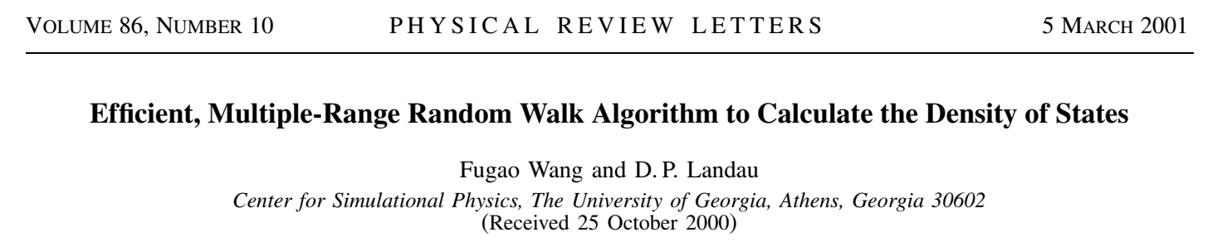
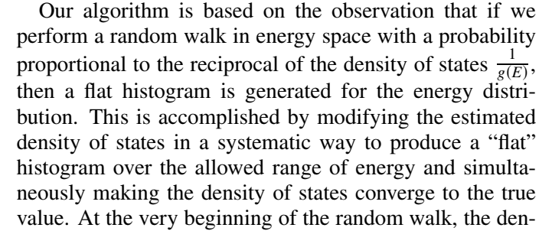
Wang-Landau method

Slide 13
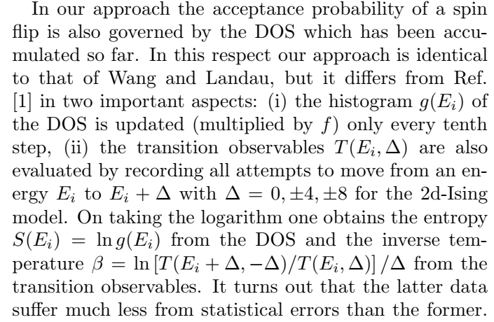
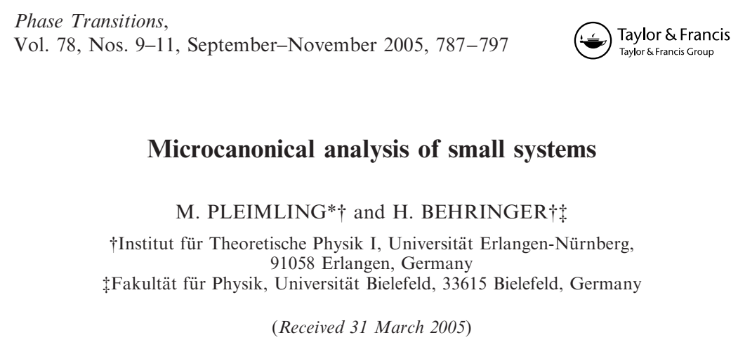
Pleimling

Slide 14
Random Path Sampling
The method [1] forces a flat-magnetization sampling histogram by sweeping magnetization states from total +1 to -1
Energy calculations are local (fast)
Embarrassingly parallel (each sweep is independent) – not a random walk!
Not as fast as Wang-Landau, but much easier implementation, generalization and parallelization
One full RPS sweep (Ising model)
Flip one random spin:
Local energy update
Flip one random spin (no repetition):
Local energy update
repeat
E = -1/2*J*NN*N_spin
E = -1/2*J*NN*N_spin
[1] J. S. Amaral et al., IEEE Trans. Magn. 50 1002204 (2014)

Slide 15
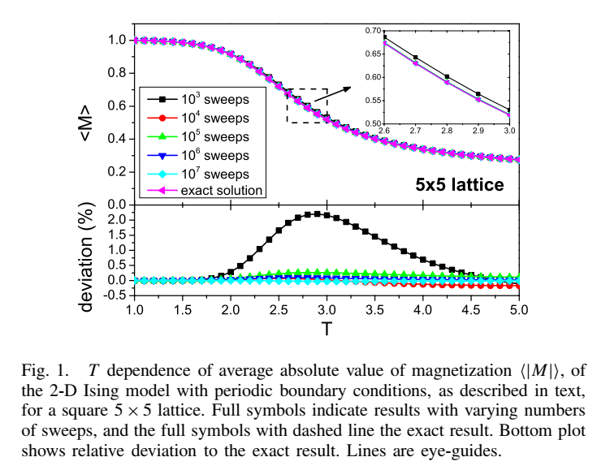
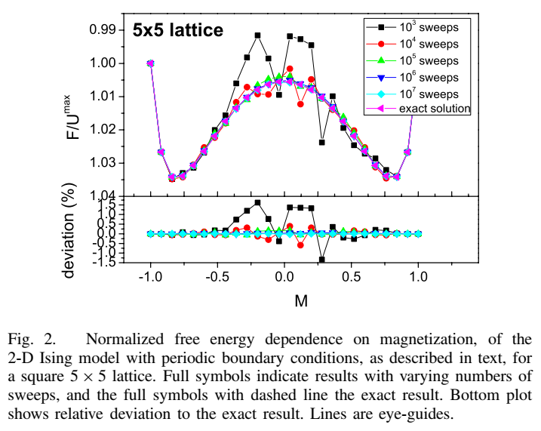
Random Path Sampling: Validation [1]
[1] J. S. Amaral et al., IEEE Trans. Magn. 50 1002204 (2014)

Slide 16
Open questions / ongoing work
JDOS for Heisenberg model
Improve the convergence speed of the RPS method
Expand JDOS estimates to several lattice types
Beyond nearest-neighbor interactions
Application to real materials
DFT -> J values
MC -> thermodynamic properties

Slide 17


Notes:
H = - \sum_{i \ne j}\frac{1}{2}J\hat{S}_i \cdot \hat{S}_j
Z = \sum_{\eta}e^{-\frac{E_{\eta}}{k_B T}}
<M> = \frac{\sum_{\eta} M_\eta e^{-\frac{E_{\eta}}{k_B T}}}{Z}
F(M,T) = -k_B T logZ(M,T)

