Slide 1
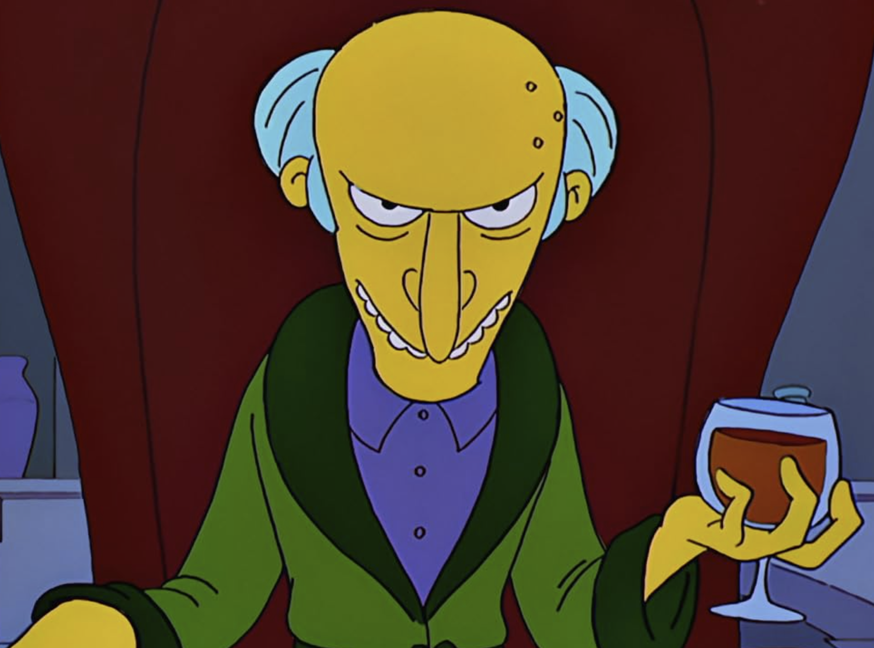
Important Guy
Background
1
Skills

