Slide 1

DSR ToolBox Instructions
DSR ToolBox is a collection of scripts that can be used to obtain information from and perform tasks on client machines. This presentation will give you a general overview of the application.

Slide 2
Table of Contents
Overview
Layout
What happens every time it is launched?
Get Your Questions for Each Specific Section Answered
Launcher Buttons
Buttons at the Very Bottom
In Summary

Slide 3
Overview
This is a collection of various types of scripts I’ve been using for a long time now to obtain information and perform tasks. I developed a GUI to make the usage of these scripts simpler so everyone can use them. From this GUI interface you can do anything from seeing who is logged into a machine to repairing WMI issues and anything in between.

Slide 4
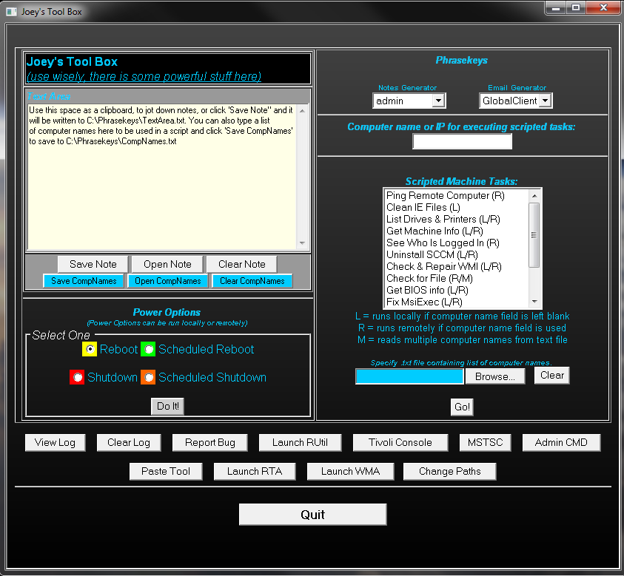
Layout
Back to Table of Contents
Text Area
Phrasekeys
Tasks List
Power Options
Launcher Buttons

Slide 5
What happens every time it is launched?
Upon launching ToolBox.hta, there are several things that happen:
The application pings the Alma_Info share. If a reply is received then it copies down any newly added phrases or email templates for the “Phrasekeys” section of the application.
The application then creates dynamic drop down lists for the “Phrasekeys” section to make sure any new phrases and emails are added.
Finally, the application will check “HTA.ini”. The screen coordinates of where you moved the application window upon last use will be written there. When the GUI is drawn, it will automatically move to those coordinates.
Back to Table of Contents

Slide 6
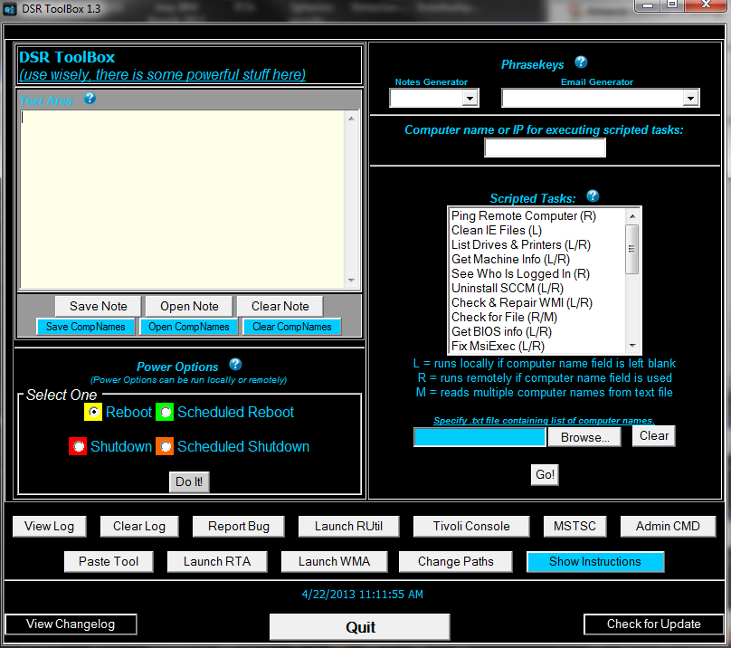
Get Your Questions for Each Specific Section Answered
Since each individual section is capable of so many things, there is a presentation that can be viewed for each specific section now. To access the presentations from the application, simply click the “?” icon beside the title of the section to view the instructions for that section.
Alternately, you can view each presentation here:
Text Area
Phrasekeys
Power Options
Scripted Tasks
Back to Table of Contents

Slide 7
Launcher Buttons
This area give you quick access to several handy things. Simply click on the button of your choice to launch the corresponding action/application.
There are a few special buttons in this section. The “View Log” and “Clear Log” buttons allow you to view or clear the log file I created for error reporting. The “Report Bug” button will compose and email to me with you log file attached. Please include any screenshots or info you have available when reporting bugs.
The “Change Paths” button is for those of you who don’t install things to their default directories. This button can change the paths for the Rutil, Tivoli, Paste Tool, RTA, and WMA buttons in the event that you’ve opted to install these in other directories.
The “MSTSC” will launch Microsoft’s remote desktop tool and “Admin CMD” will open a command prompt that already has administrative privelidges.
Back to Table of Contents

Slide 8
Buttons at the Very Bottom
There are 3 buttons at the bottom of the app window now. They are:
View Changelog – Displays the changelog text file so you can see the changes that have been made.
Quit – Exits the application.
Check for Update – This checks the Alma share for a newer version. If a newer version is found then you will be notified and it will download to your c:\temp directory. I have also included a way to check and see if an uninstall of the older version is needed first. If this is the case, you will be alerted of that as well. If you are not told to uninstall first then you will be presented with the option to install the new update automatically once it has been downloaded. Once installed, simply exit out the the DSR ToolBox and when you launch it once again you will be running the latest and greatest build.
Back to Table of Contents

Slide 9
In Summary
The DSR ToolBox will make your job easier and make you more productive. Updates will be released as often as possible to add new features and fix any bugs that are reported.
In case you were wondering, black background and blue text were chosen because it is easy on the eyes. Staring at a computer screen all day is bad enough for our eyes, but whites and brighter colors are even worse for eye strain.
If you have a suggestion for a new feature or a bug to report, either use the “Report Bug” button in the application or email the developer at pg8077@att.com .

